Slide 1
Project 1: Guilford County Financial
By: Gregory Purvine (gnpurvin), Evan Crabtree (crabtr), Cody Cothern (Mask487), Rohit Gulia (rohit-gulia), Shiyang Xiao (MrVinegar)

Slide 2
Task 1: Data Cleaning

Slide 3
Data Cleaning
Filling the missing values in “Amount” with 0.
Dropping the column “ExpSort” from dataset.
Removing observations where “Fund #” is greater than or equal to 400.
Split dataset into two categories “Expense” and “Revenue” based on their Type.

Slide 4
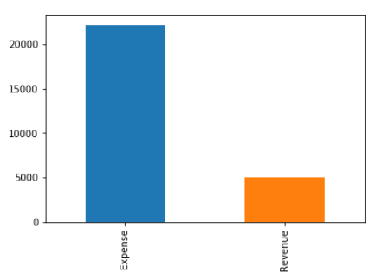
Revenue vs Expense Counts

Slide 5
Task 2: Expense Data

Slide 6
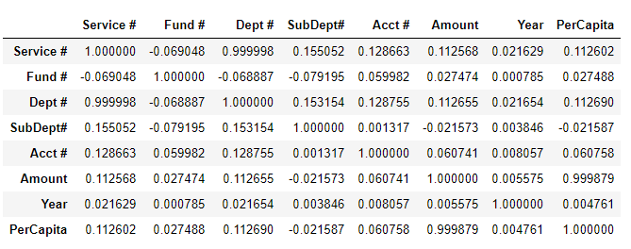
Simple Data Statistics Correlation -

Slide 7
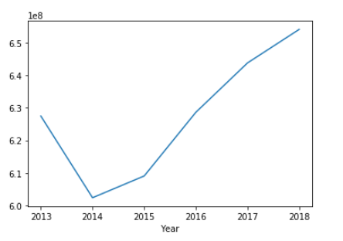
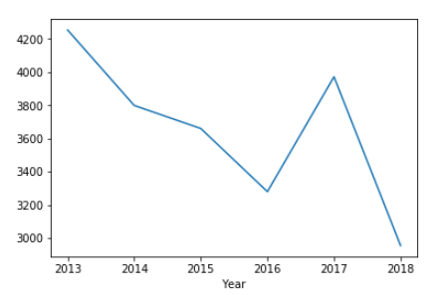
Expense Data
Expenses budgeted increased,
while the number of expense entities decreased

Slide 8
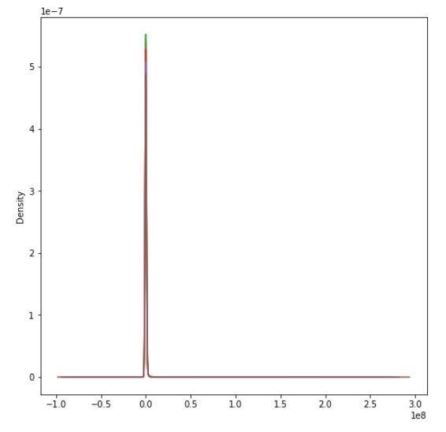
Density Graph for Amount

Slide 9
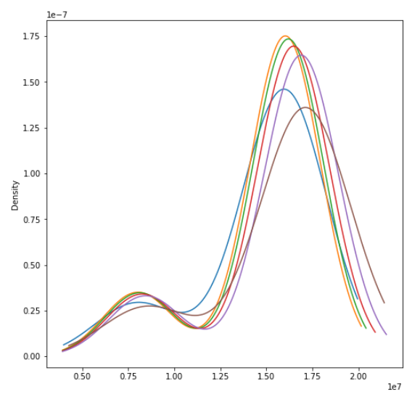
Expenses per month per year

Slide 10
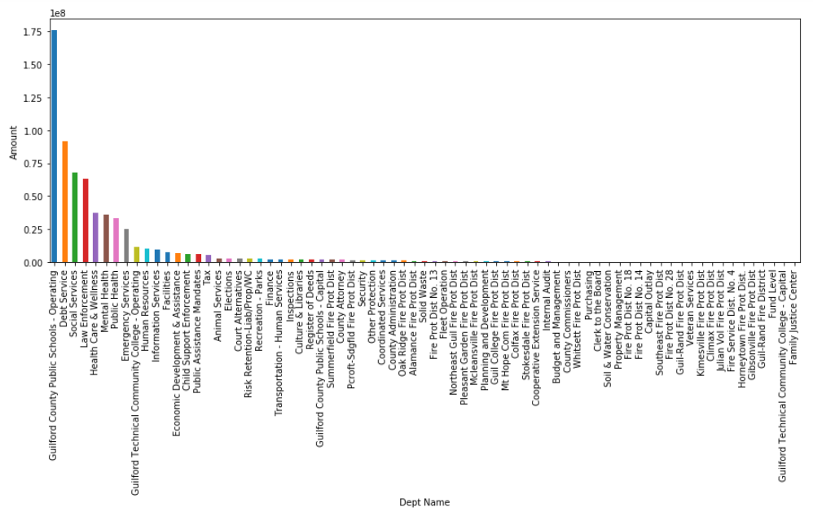
Expenses By Department (2013)

Slide 11
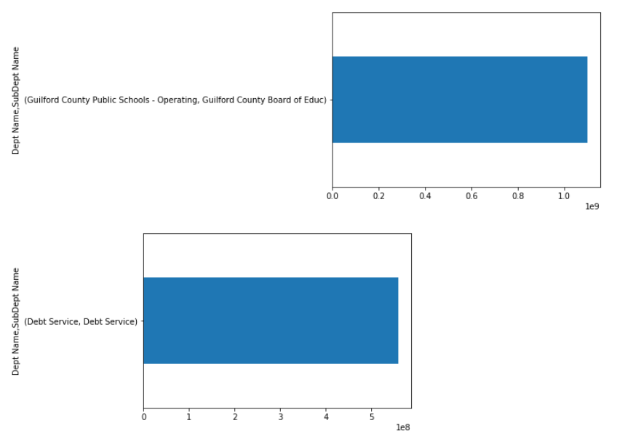
Top Expenses by sub-departments
Notes:
GCS and debt services only have one sub-department

Slide 12
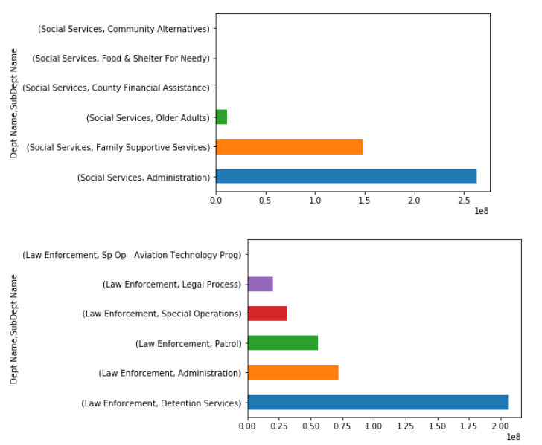

Slide 13
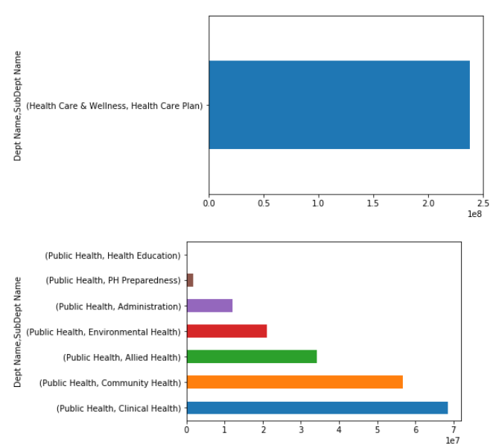

Slide 14
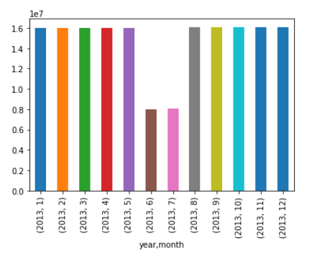
Expenses by month by Guilford County Public Schools

Slide 15
Task 3: Revenue Data

Slide 16
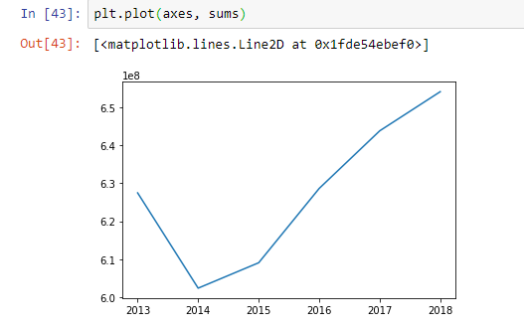
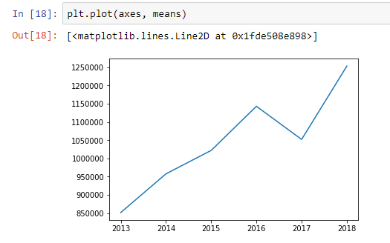
Revenue Data

Slide 17
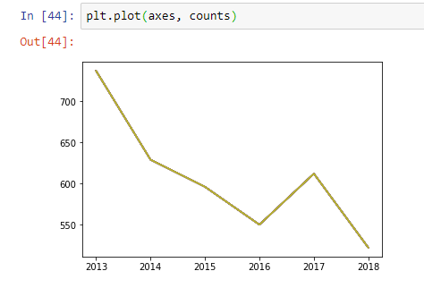
Revenue Data
Amount of revenue budgeted went up over the 6 year period,
but number of entity pairs receiving budgets went down

Slide 18
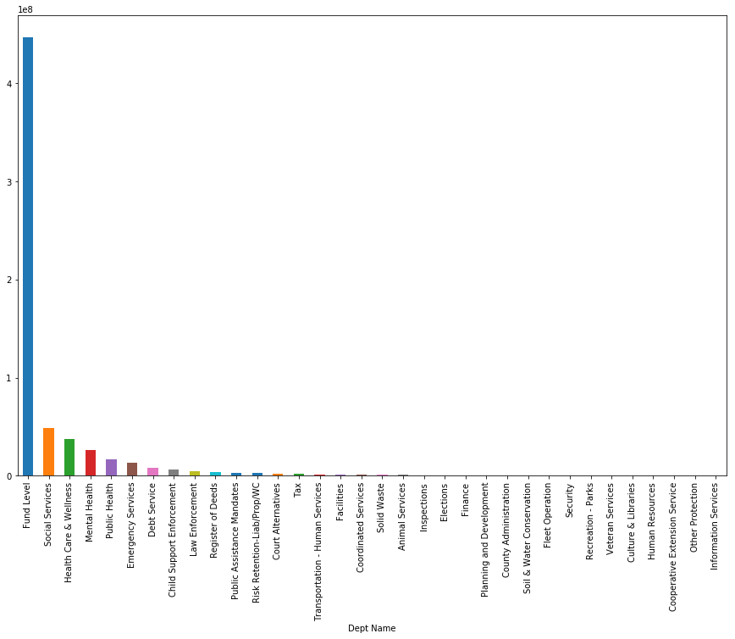
Revenue By Department (2013)

Slide 19
Task 4: Anomaly Detection Research

Slide 20
Detection of Outliers
Future Plans:
Per Department, Per Year
Finding Departments with Greatest Number of Anomalies
Finding Greatest Number of Anomalies per Year
Revenue and Expense

Slide 21
Anomaly Detection Methods

Slide 22
Autoregression Models
Uses preceding data values to predict present value
Different models available
Link

Slide 23
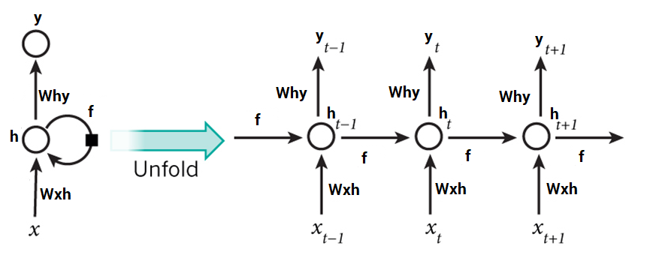
Recurrent Neural Networks
Example:
Using 15,000 Reddit posts and comments to train network to generate new realistic comments
Uses Numpy and Theano
Link

Slide 24
Sigma 3
Simple and easy to implement
X is an anomaly if
(X - data mean) is greater than 3 standard deviations

Slide 25
Thank you!
Questions?

