Slide 1
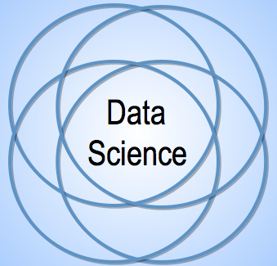
Project 1:
Guilford County Financial
Cody Cothern
Gregory Purvine
Evan Crabtree
Vincent Xiao
Rohit Gulia

Slide 2
Project Overview
What is our dataset?
Financial Data including adopted/amended budget data and historical transaction data for the Guilford County.
What is our idea?
Guilford County Financial Modeling based on data for approved budget from 2013 - 2018 and transactions from 2007 - 2018.
What can we do with that idea?
To help the Financial and Budget Department of Guilford County in maintaining their expected spending and transactions.
Criteria For Success?
Effective communication/Weekly meetings and each team members being responsible and reliable for individual task(s).
Potential Risks and Obstacles?
Finding the root cause of the missing transactions.

Slide 3
Goals
Primary goal: Anomaly detection as the year progresses
Applies to individual transactions and total actual spending
Secondary goal: Reliable projection model
Find trends in spending
How much is each given entity going to require?
What are the general categories for spending?
When and where will these purchases be made?

Slide 4
Data Description
Approved Budgets
2013-2018
Departments have sub-departments
sub departments perform services
expenses are paid from and revenue is paid into funds
expenses & revenue come from accounts
account represents a specific revenue/expense source
Transactions
2007-2018
transaction occurs between an entity and an account
entity - fund & service within government
account - expense/revenue source
has associated amount, description, and date

Slide 5
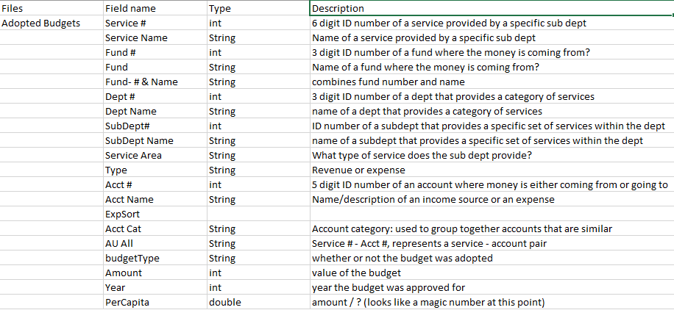
Data Dictionary

Slide 6

Data Dictionary

Slide 7
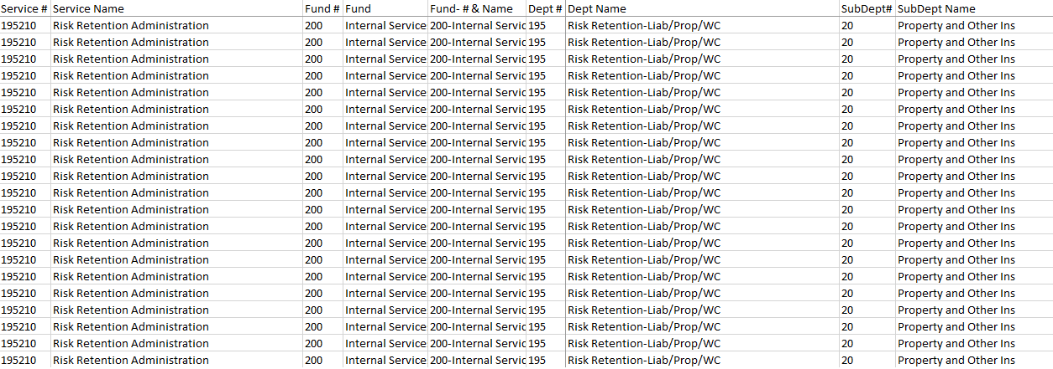
Approved Budgets Data

Slide 8
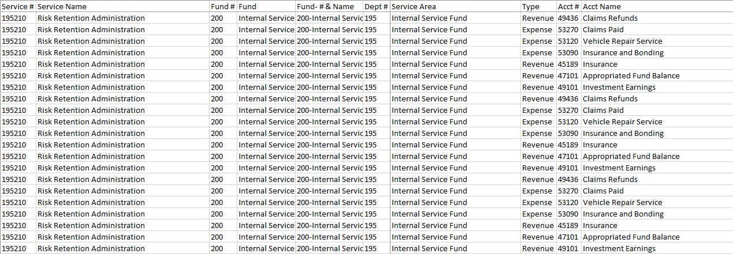
Adopted Budgets Data

Slide 9
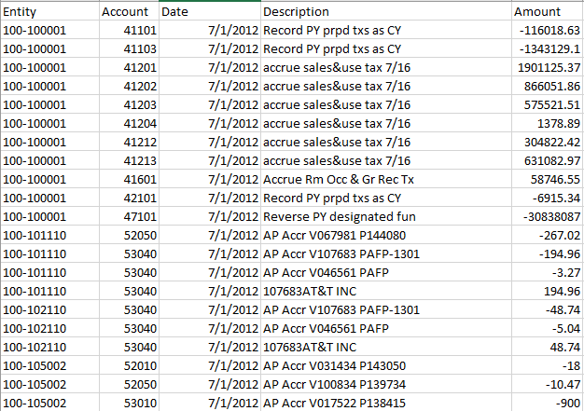
Transaction Data

Slide 10
Related Works

Slide 11
Statsmodels: Econometric and Statistical Modeling with Python
By: Skipper Seabold, Josef Perktold
Link: file:///C:/Users/cothe/Downloads/Statsmodels_Econometric_and_Statistical_Modeling_w.pdf
Paper overviewing statsmodel
statsmodel: a python library used to model statistical data

Slide 12
Data Structures for Statistical Computing in Python
By: Wes McKinney
Link: https://pdfs.semanticscholar.org/f6da/c1c52d3b07c993fe52513b8964f86e8fe381.pdf
Paper detailing working with financial data sets.
Includes use of pandas

Slide 13
Financial Modelling in Python
By: S. Fletcher & C. Gardner
Link: https://leseprobe.buch.de/images-adb/4c/62/4c6218a0-1d7c-48b7-becf-dc7ddd1b6fa3.pdf
Book explaining and showing how to use python to model financial data

Slide 14
Building a Financial Model with Pandas
By: Chris Moffit
Link: http://pbpython.com/amortization-model.html
Article/blog detailing how to use Pandas to financial models
Much more detailed than needed, but touches on some really valuable topics

Slide 15
Quora discussion on detecting anomalies in financial data
By: Various
Link: https://www.quora.com/What-are-the-best-statistical-methods-for-detecting-anomaly-in-financial-time-series-data
A very insightful discussion on the various methods for detecting anomalies in financial time series data

Slide 16
Introduction to Anomaly Detection
By: Pramit Choudhary
Link: https://www.datascience.com/blog/python-anomaly-detection
A cursory overview of using Python to detect anomalies in financial time series data and the methodologies used
Also briefly touches on using machine learning for this task

Slide 17
Tasks
Maintaining Data Dictionary and documentation. → Greg
Finding the patterns in data. → Rohit
Which department spends the most and where? → Rohit
Finding the relationships in the data. → Evan

Slide 18
Tasks
Find more related works. → Evan
How the spending trends change with time. → Vincent
Finding the anomalies in the data. → Cody

Slide 19
Thank you

