Slide 1
Open Source Vulnerability Metrics
Dr. Tate
Seth Goodwin, Michael Follari, Jaron Dunham, Gabe Wilmoth, Rohit Gade

Slide 2
Predict Release Count
Goal:
Predict count of Releases from count of Revisions and Date of Revisions
Question Asked:
Looking at the amount of Revisions per week, can we accurately predict the amount of Releases in the following week to come?

Slide 3
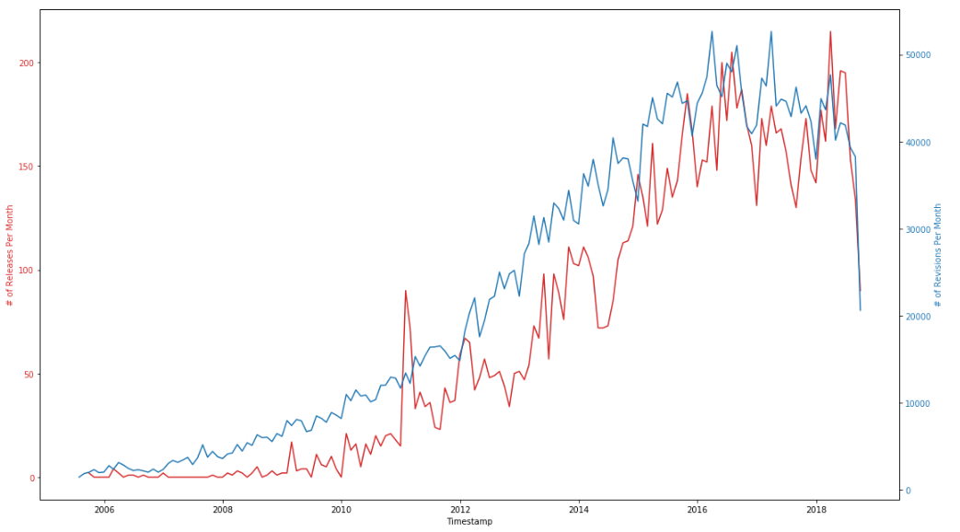

Slide 4
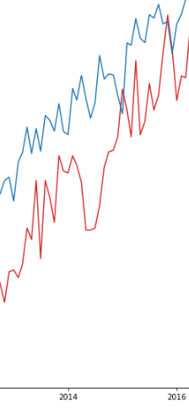
Relation Between Releases
and Revisions
Specifically looking at this gap of time we can
see a correlation between the amount of
releases to the amount of revisions
X → Y
X = Revisions Count & Revisions Date
Y = Releases Count

Slide 5
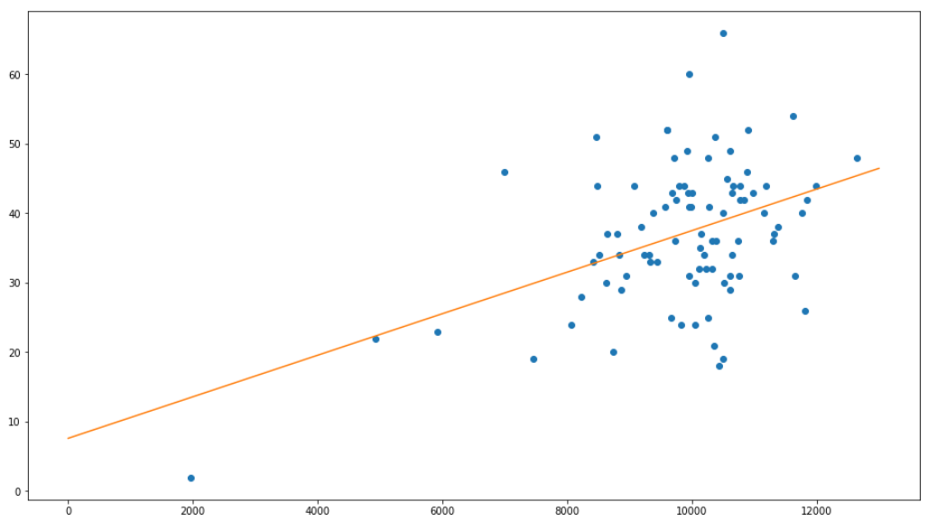
Linear Regression Model

Slide 6
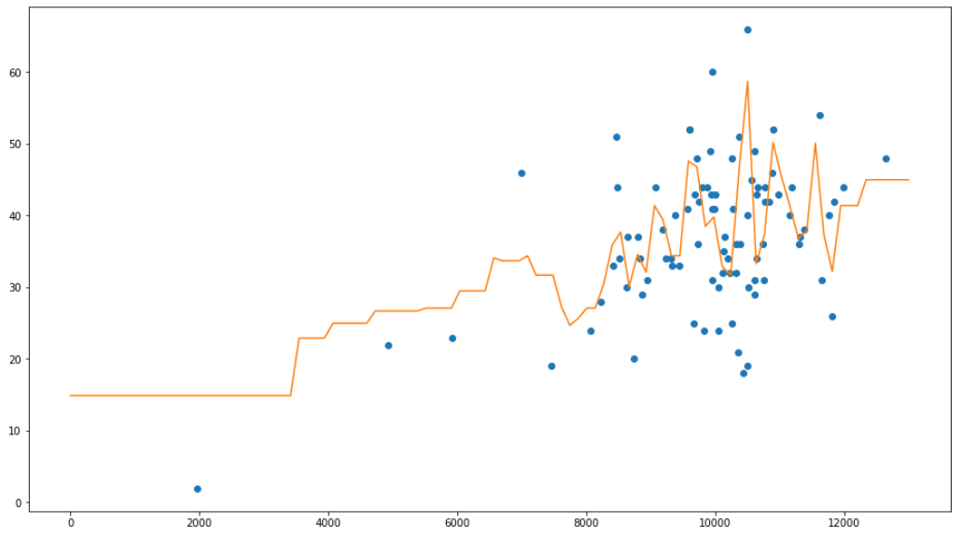
Random Forest Model

Slide 7
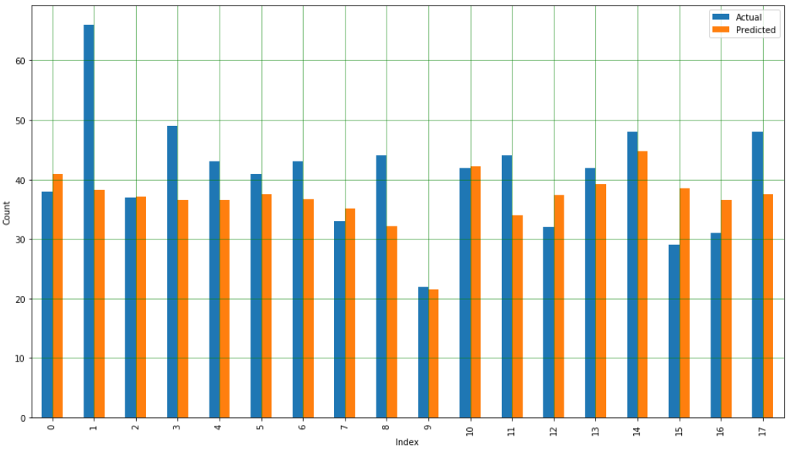
Outcome
Mean Squared Error: 86.19

Slide 8
Commit Message Classification
Task
Explore, analyze, model commit messages.
Goal
Noticable difference in commit messages?
Can a release/revision be distinguished by observing commit message?
Learn about the differences in these kinds of messages.
What words are used most often?
Any single word that largely indicates type?
“Release”, “version”, “fix”, “update”

Slide 9
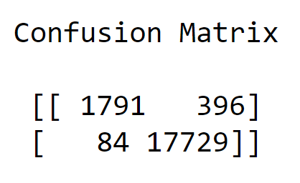
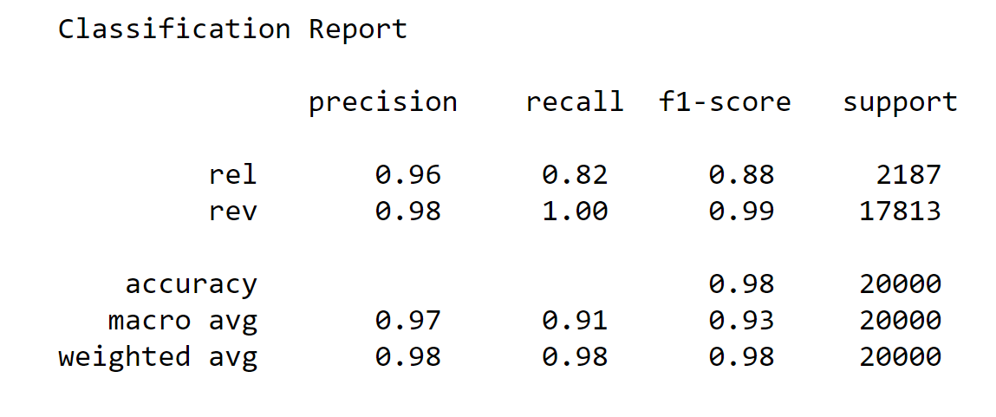
Classification Method / Outcome
Method
Label messages
Vectorize messages
Train with RandomForestClassifier
Outcome
Conf. Matrix
Release not super strong
Report
precision
recall
f1-score
Good Matrix!
Nice Report!!
release
revision
release
revision

Slide 10
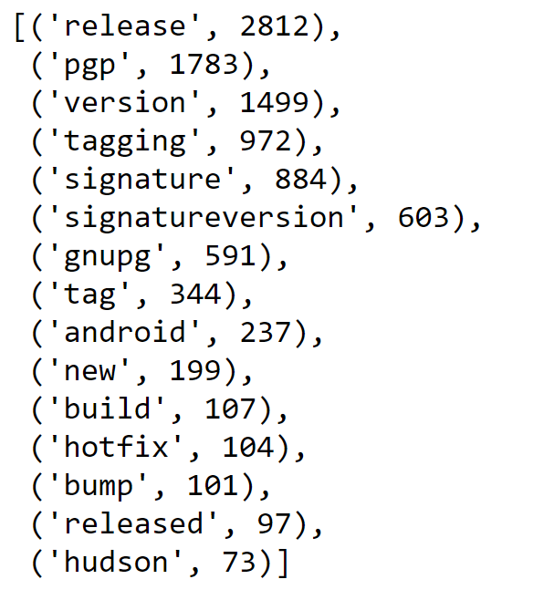
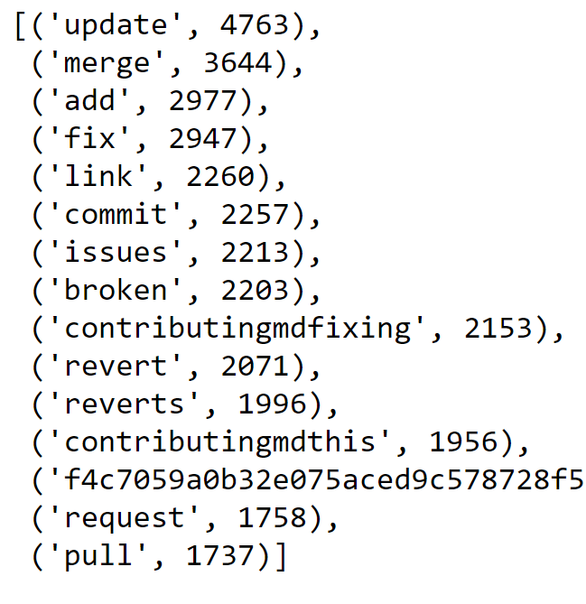
Classification Analytics
Release
Top 15 most common / impactful tokens
Distinct, intuitive difference in word banks
Most impactful words are release and update
Revision

Slide 11
Predicting NVD Base Score
Task
Using cvssV2 variables, attempt to predict Base Score
Goal
See how accurately the predicted Base Score would be
Method
The Machine Learning Algorithm that was used is called Support Vector Machine (SVM), and since our output Base Score is an integer value, it will be the regression form

Slide 12
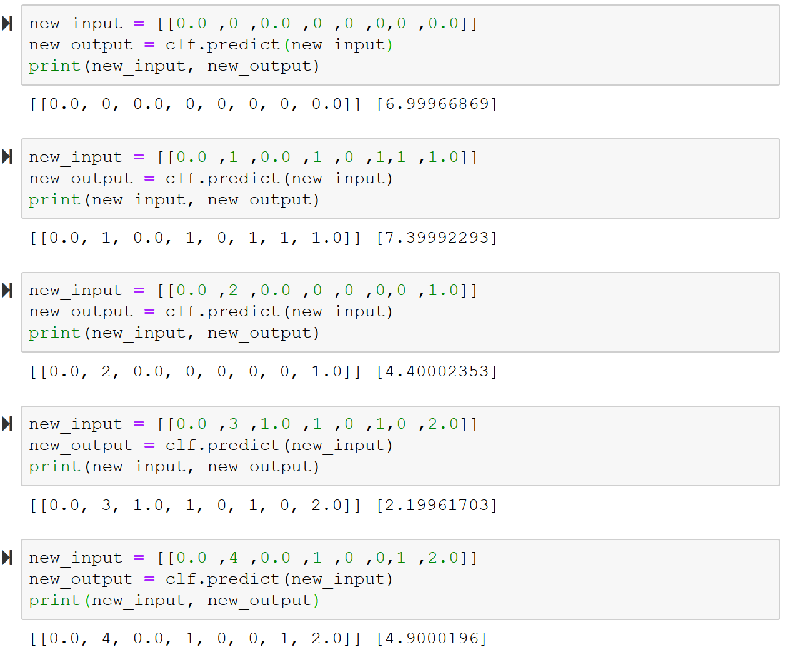
Predicting NVD Base Score Outcome
The inputs were taken from rows within the data used
Comparing these predicted outputs to what we expected
The predicted value was at most ~1 away from its expected value
Predicted (Rounded) | Expected
7.0 | 7.1
7.4 | 7.5
4.4 | 4.3
2.2 | 2.1
4.9 | 5.0

Slide 13
Predicting Van. Fix Duration.
Task : Develop a model to predict the duration between a vulnerability published and its fix.
Question : Given No. of contributors for a project predict, No. of days required to fix a vulnerability in that project

Slide 14
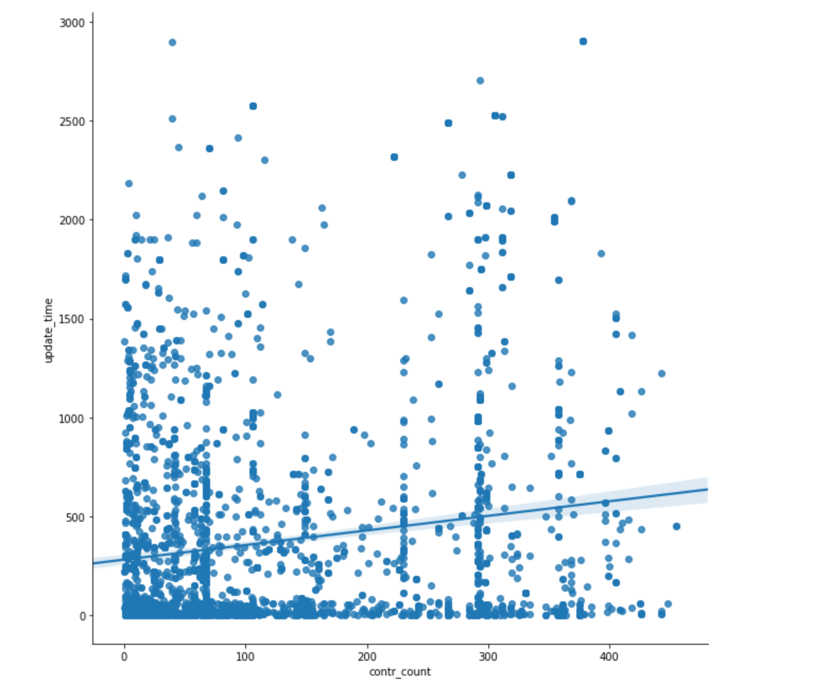
Predicting Van. Fix Duration.
Initial
Independent Variables :
No of. contributors.
And Dependent variable :
Fix Duration (Update_time)

Slide 15
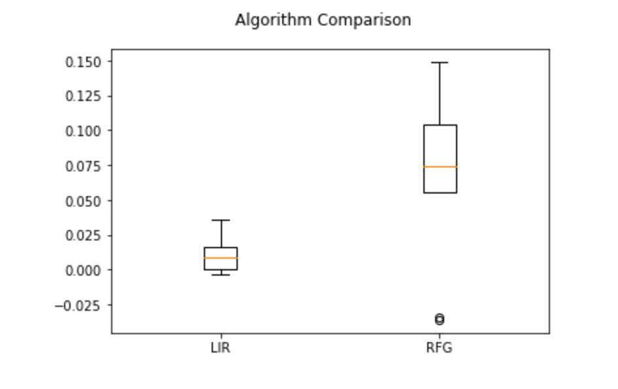
Predicting Van. Fix Duration.
Model Selection Process:
K-fold Cross Validation
between Linear Regression and
Random Forest Regression.

Slide 16
Predicting Van. Fix Duration.
Model : Random Forest Model
Results :
R-Squared : 11.0
RMS : 617.
The model performance was poor in both the test and trained dataset. possible occurrence of underfit. (both the Rms for test and train ware similar.)

Slide 17
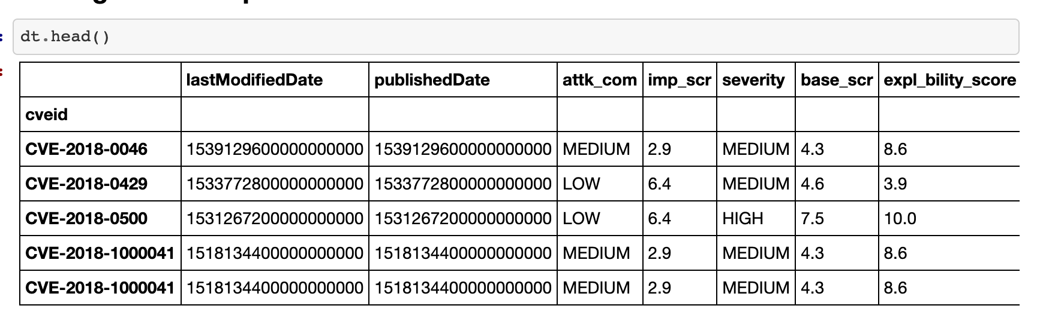
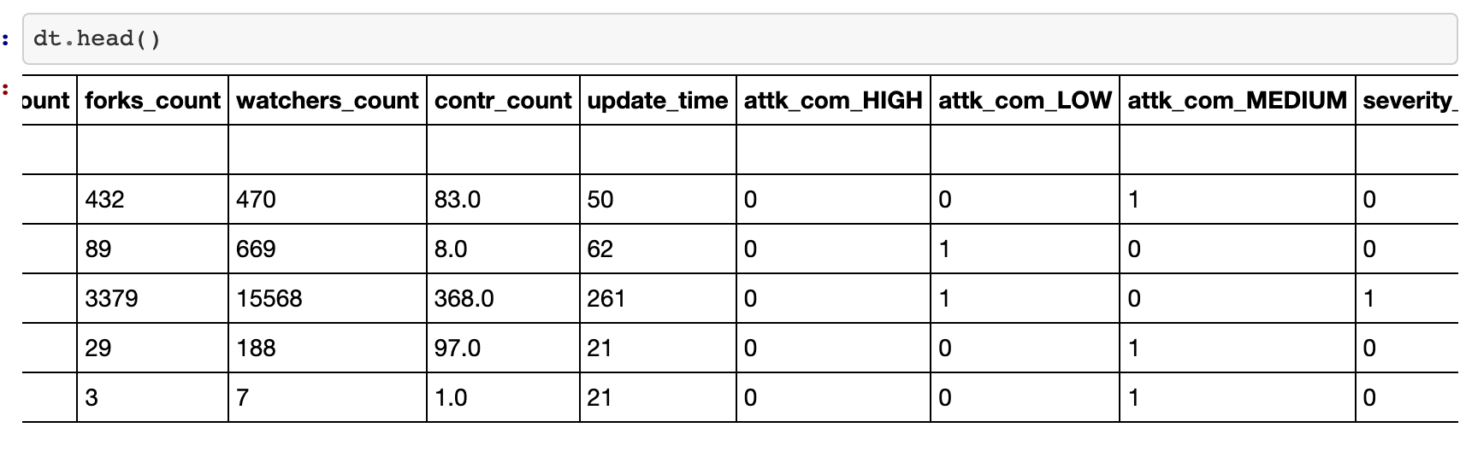
Predicting Van. Fix Duration.
To solve underfitting,
added more features
to the dataset.
And Converted
categorical values.

Slide 18
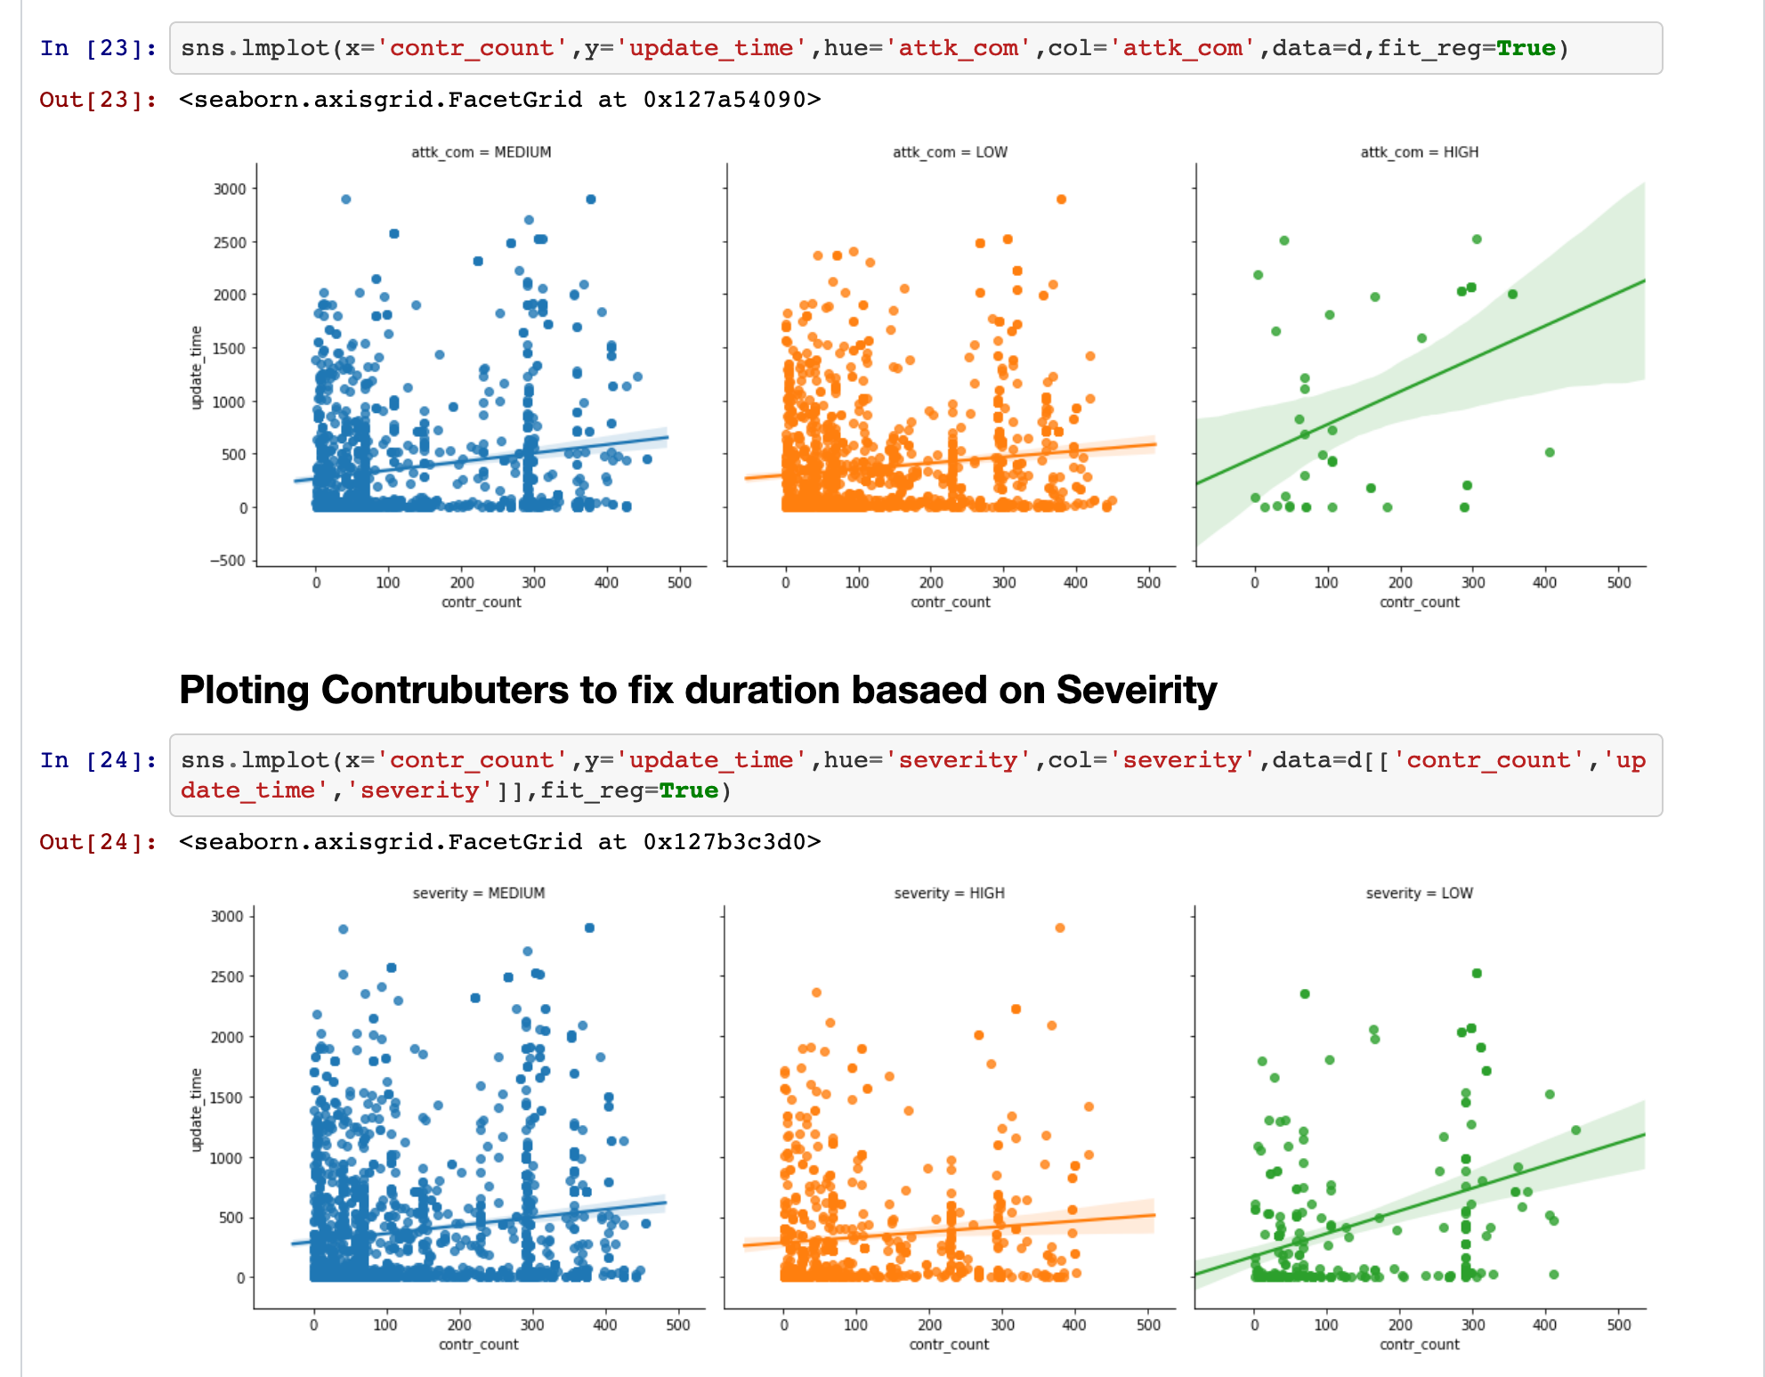
Predicting Van. Fix Duration.
Graph :
Representing fix duration,
when there severity is
HIGH,LOW,MEDIUM.

Slide 19
Predicting Van. Fix Duration.
Final Results:
Model : Random Forest
R-2 Value: 57.19
RMS-Value : 379.46

Slide 20
Predicting Vulnerability Base Score with CVSS v3 Metrics
Task
Using CVSS v3 Metrics, try to predict vulnerability base score
Question
How accurately can we predict vulnerability base scores, given the CVSS v3 metrics?

Slide 21
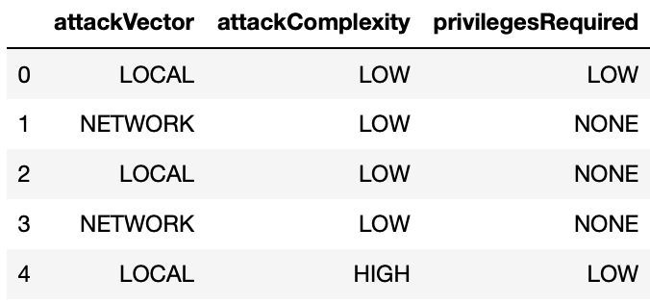
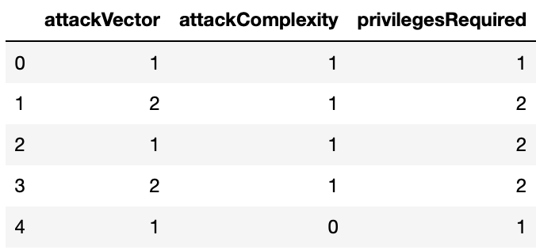
Predicting Vulnerability Base Score with CVSS v3 Metrics
Method
Encode data: 115818 observations, 11 features
Split the data: 70% training, 30% testing
Fit a multiple linear regression estimator
Evaluate model accuracy
root mean squared error
measures the avg distance between predicted values and actual values
r-squared value
measures strength of relationship between model and dependent variable
Used model to make predictions

Slide 22
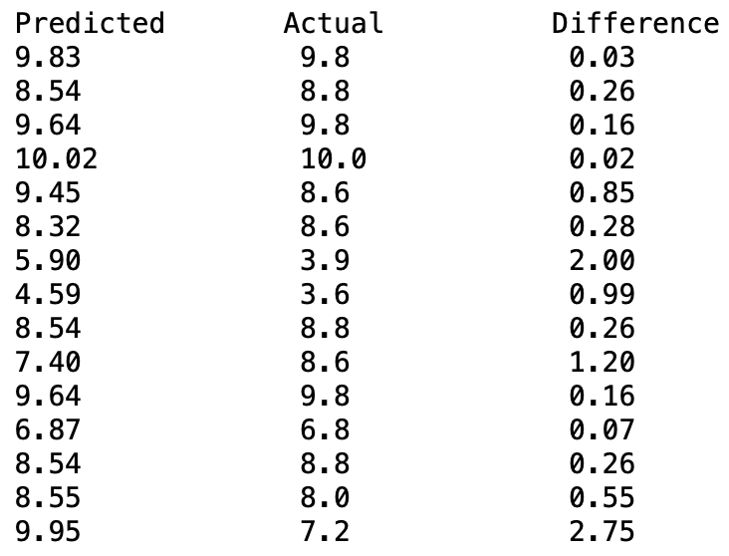
Predicting Vulnerability Base Score with CVSS v3 Metrics
Results
root mean squared error = 1.1268934132918227
On average, the predicted value will be no more than ~1.13 units above/below the actual value
r-squared = 0.7039903174473343
About 70.4% of the data fits the regression model
Insignificant features?
15 random predictions paired with actual values

Slide 23
Questions?

