Slide 1
Open Source Vulnerability Metrics
Dr. Tate
Seth Goodwin, Michael Follari, Jaron Dunham, Gabe Wilmoth, Rohit Gade

Slide 2
Project Description
Software Heritage Graph Dataset (SHGD):
Largest existing public archive of software source code and history
National Vulnerability Database (NVD):
Information on over 120,000 security vulnerabilities
Motivation
Gain insight into how open source software vulnerabilities arise, how we may be able to predict or prevent vulnerabilities, and general insight into open source software as a whole.
Notes:
T1 Description of the project (Team effort)

Slide 3
Project Goals
Cross-reference known software vulnerabilities found on the National Vulnerability Database with commits found in the Software Heritage Graph Dataset.
Time delay between when a software vulnerability is discovered and when it is patched?
Time delay between a fix and new software release?
Relationship between project activity and vulnerability severity?
Relationship between project activity and response to vulnerabilities?
Notes:
T2 Overall goal of the project (30 pts)
T2.1 Describe the questions posed (10 pts)
T2.3 Highlight the research objectives (10 pts)

Slide 4
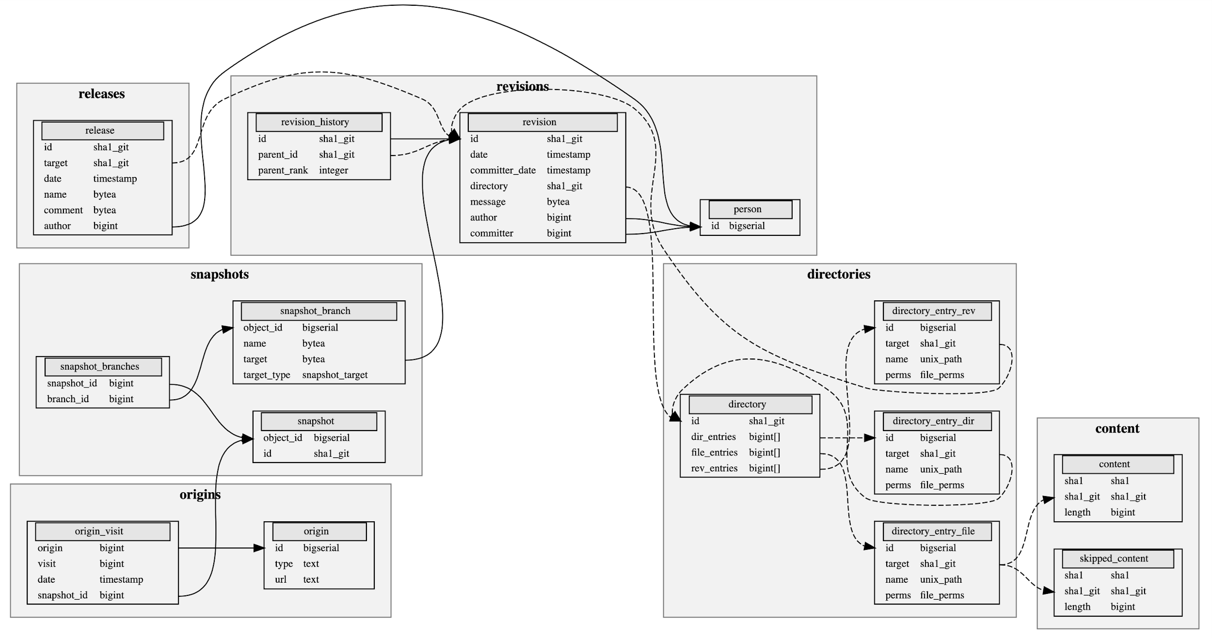
Data (SHGD)
Notes:
T3 Discuss the data (10 pts)

Slide 5
Data (NVD)
id (String): unique identifier for each reported vulnerability marked by year and numeric increment (CVE-yyyy-iiiii)
reference (string): hyperlink reference to vulnerability and/or patch
severity:
confidentiality (string): marker scoring how vulnerable said vulnerability left the software to unauthorized disclosure of information
integrity (string): marker scoring how vulnerable said vulnerability left the software to unauthorized modification of information
availability (string): marker scoring how vulnerable said vulnerability left the software to being maliciously take down
marker values: (none, low, partial, high)
Notes:
T3 Discuss the data (10 pts)

Slide 6
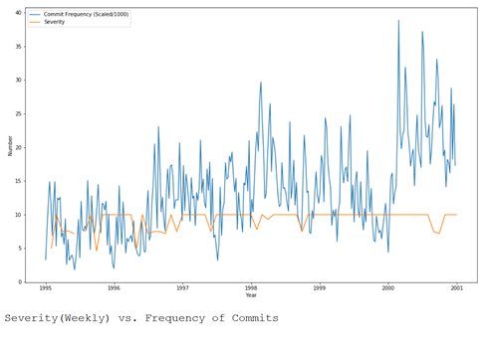
Jaron’s Tasks
Parsing NVD JSON to CSV
Results: Created program to convert NVD Json files into CSV files
Frequency of Commits vs. Severity
Compared the Base Score (Severity) of NVD to the frequency of commits
Results: No correlation was found at that time

Slide 7
Jaron’s Tasks
Predict NVD Base Score
Attempted to see if the Base Score could be predicted using variables within cvssV2
Results: Predicted results were found to be within ~1.5 of expected value
Predicted (Rounded) | Expected
7.0 | 7.1
7.4 | 7.5
4.4 | 4.3
2.2 | 2.1
4.9 | 5.0

Slide 8
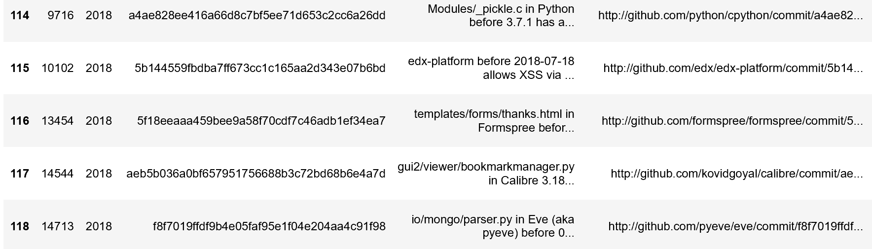
Gabe’s Tasks
Connecting NVD and SHGD:
Are hashes a viable way to link the two datasets?
4,695 parsed hashes from NVD
2.5% of NVD data has been matched to SHGD teaser
Result: 119 Total rows in common between NVD teaser and SHGD

Slide 9
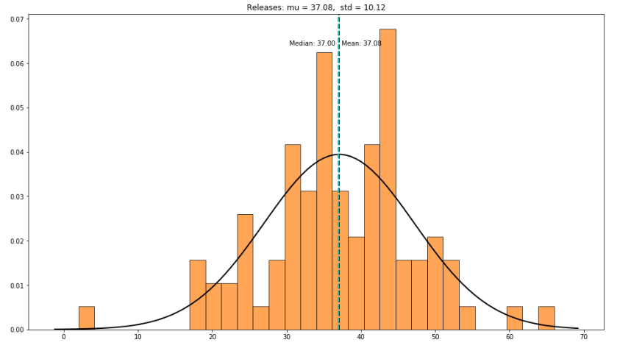
Gabe’s Tasks
Look into Relationship between Releases and New Vulnerabilities:
Mean: 37.08
Median: 37.00
Std: 10.12
Variance: 125.13

Slide 10
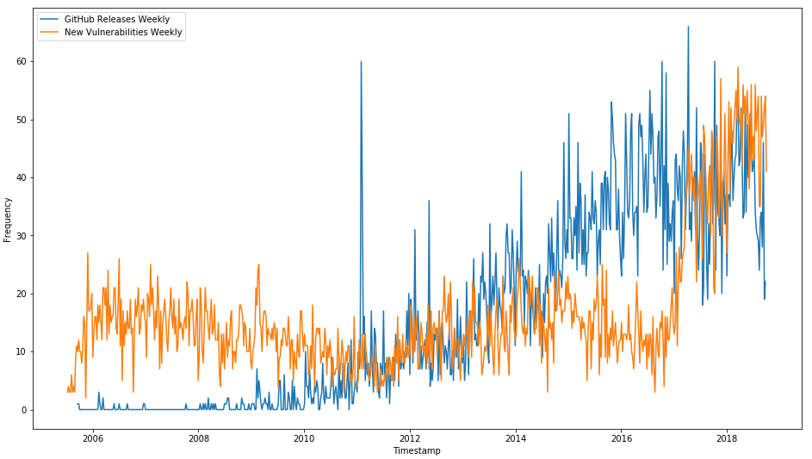
Gabe’s Tasks
Look into Relationship between Releases and New Vulnerabilities:
Specifically Vulnerabilities per week
Result: Weak correlation between the two datasets
Overlay of Vulnerabilities and Releases Per Week
Correlation: 0.46

Slide 11
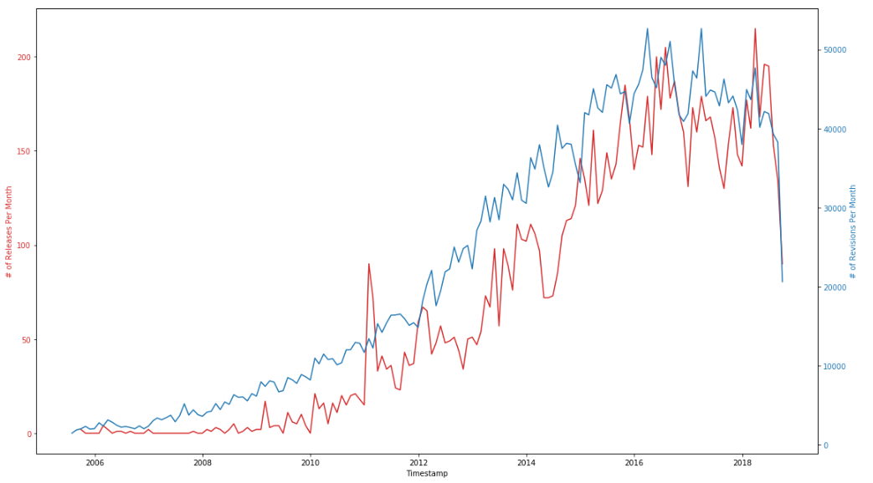
Gabe’s Tasks
Predict count of Releases from count of Revisions and Date of Revisions
Looking at the amount of Revisions per week, can we accurately predict the amount of Releases in the following week(s) to come?

Slide 12
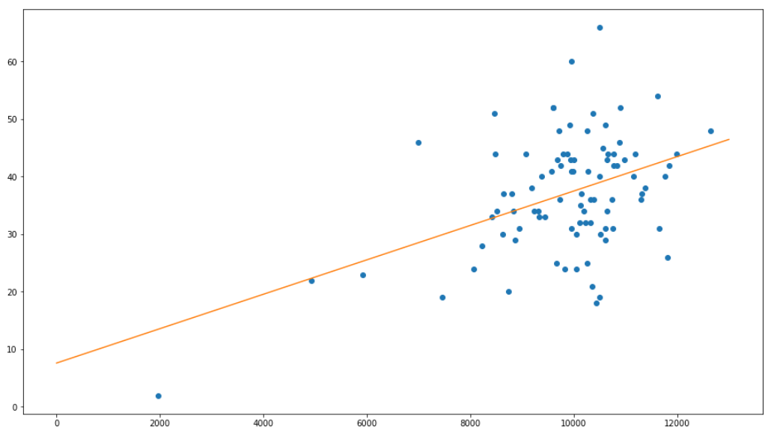
Gabe’s Tasks
Predict count of Releases from count of Revisions and Date of Revisions
Looking at the amount of Revisions per week, can we accurately predict the amount of Releases in the following week to come?

Slide 13
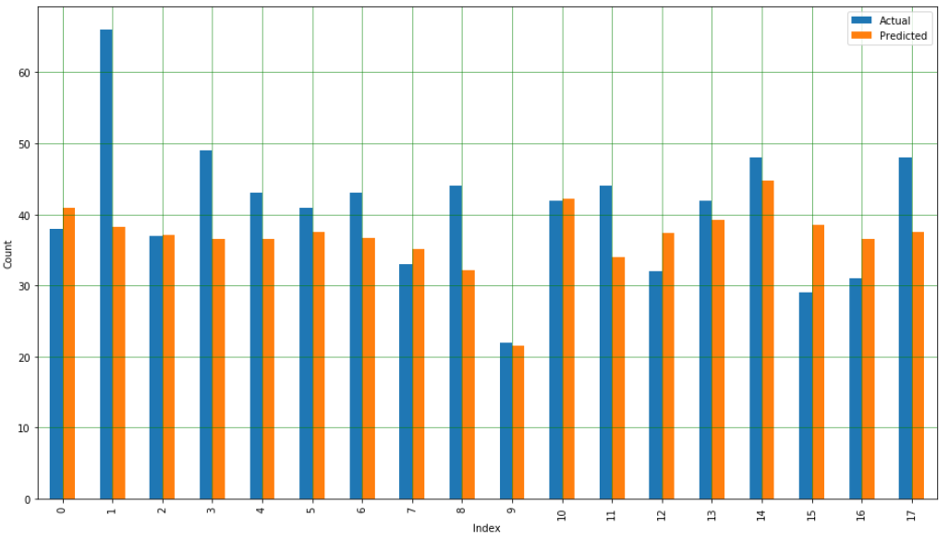
Gabe’s Tasks
Predict count of Releases from count of Revisions and Date of Revisions
Looking at the amount of Revisions per week, can we accurately predict the amount of Releases in the following week to come?
Result: Linear Regression, with mean squared error of 86

Slide 14
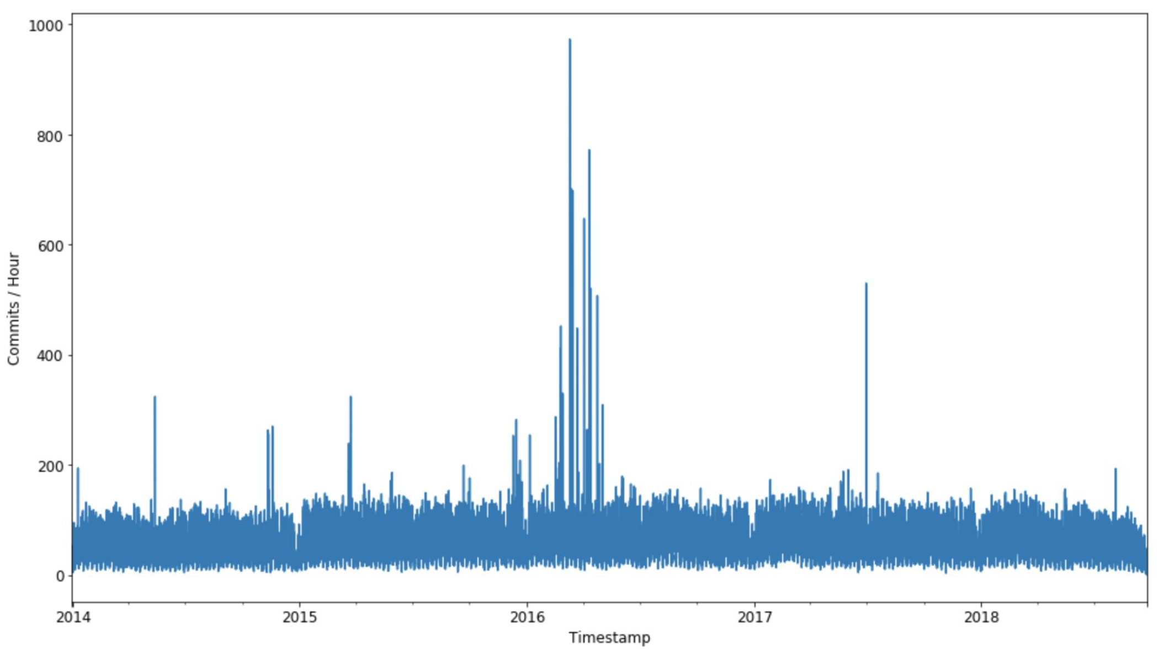
Looking into revision.csv
Method
Aggregation to count commits per year, month, and hour
Results
GitHub activity over the past 5 years
~ 170 commits / hr on average
Early 2016...?

Slide 15
Vulnerability Publish Date vs. Commit Patch Date
Tasks
Determine how long it takes, on average, for a software vulnerability to be patched
How responsive is the NVD?
Method
More data wrangling
Software vulnerabilities that have been patched specifically by a GitHub commit
Statistics of revisions and software vulnerabilities
Distribution modeling
Hypothesis testing

Slide 16
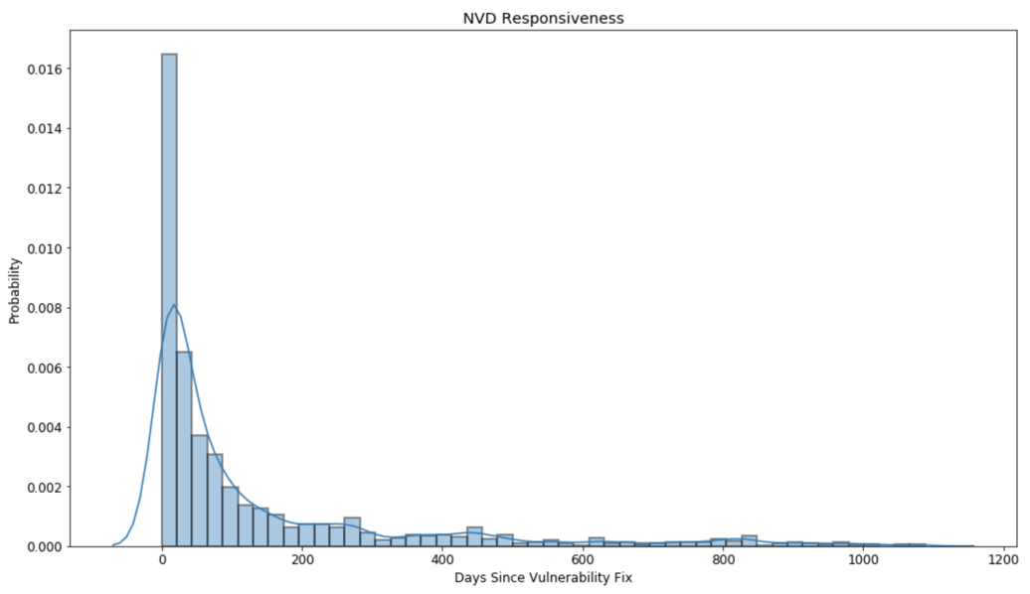
Vulnerability Publish Date vs. Commit Patch Date
Results
NVD publishes vulnerability info, on average, 136 days (~ 4.5 months) after there was a GitHub commit that patches the vulnerability
Opposite relationship
expect vuln to be patched after NVD publishes info
μ = 135.83

Slide 17
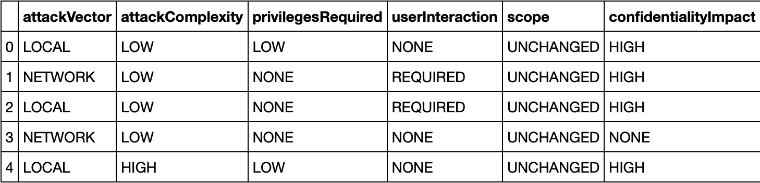
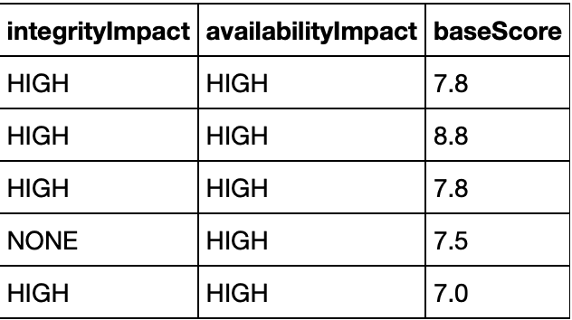
Predicting Vulnerability Base Score with CVSS v3 Metrics
Task
Using CVSS v3 Metrics, try to predict vulnerability base score (0.0 - 10.0)
Attack Vector (Network, Adjacent Network, Local, Physical)
Attack Complexity (Low, High)
Privileges Required (None, Low, High)
User Interaction (None, Required)
Scope (Unchanged, Changed)
Confidentiality Impact, Integrity Impact, Availability Impact (None, Low, High)

Slide 18
Predicting Vulnerability Base Score with CVSS v3 Metrics
Method
Encode data: 38480 rows/observations, 8 columns/features
Split the data: 70% training, 30% testing
Fit a multiple linear regression estimator and train the model
Evaluate model accuracy
root mean squared error
measures the avg distance between predicted values and actual values
r-squared value
measures strength of relationship between model and dependent variable
Use model to make predictions

Slide 19
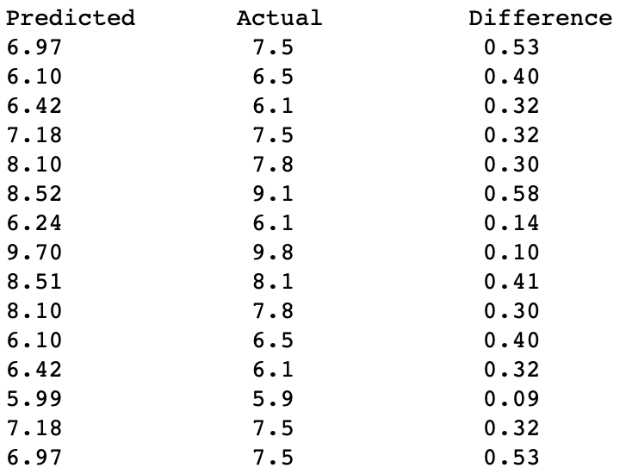
Predicting Vulnerability Base Score with CVSS v3 Metrics
Results
root mean squared error = 0.53
On average, the predicted value will be no more than ~0.53 units above/below the actual value
r-squared = 0.892
About 89.2% of the data fits the regression model
15 random predictions paired with actual values

Slide 20
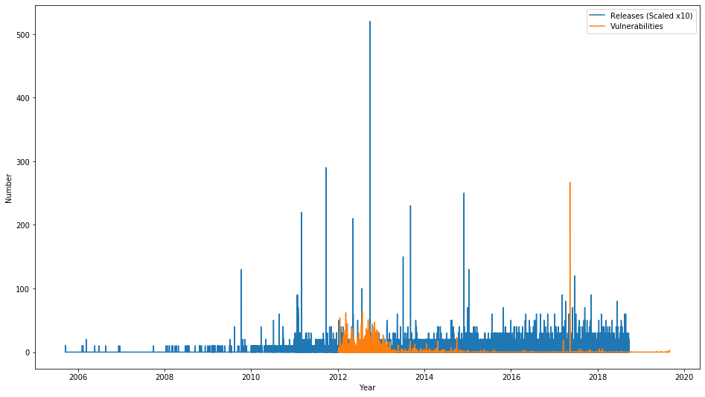
Vulnerabilities vs. Software Releases
Are number of vulnerabilities related to software releases?
Method?
Time Correlation
Hypothesis Test
Are commit messages between release/revisions discernable.
Restrictions
python-3k
Releases (Blue), Vulnerabilities (Orange) vs. Time

Slide 21
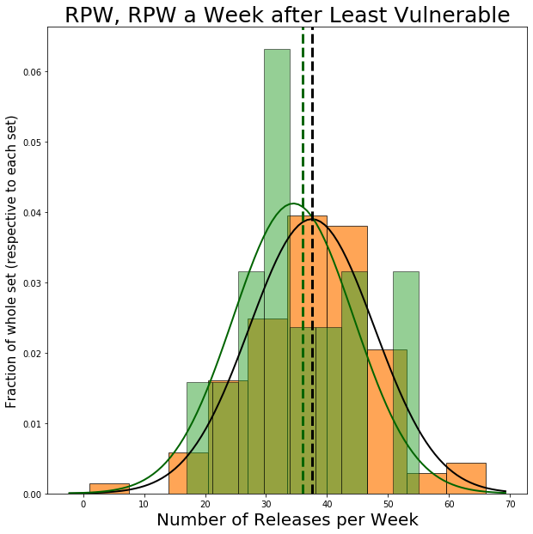
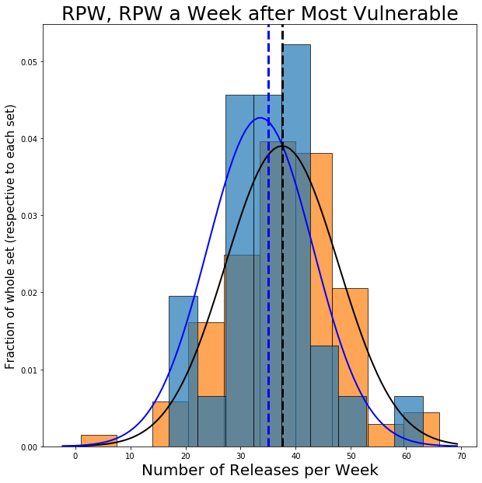
Hypothesis Testing
H0: Weeks after a period of high/low # of vulnerabilities will have the same # of releases as any other week.
Fail to reject H0
2 Sample T-Test
high: 0.244 (p-val)
low: 0.46 (p-val)

Slide 22
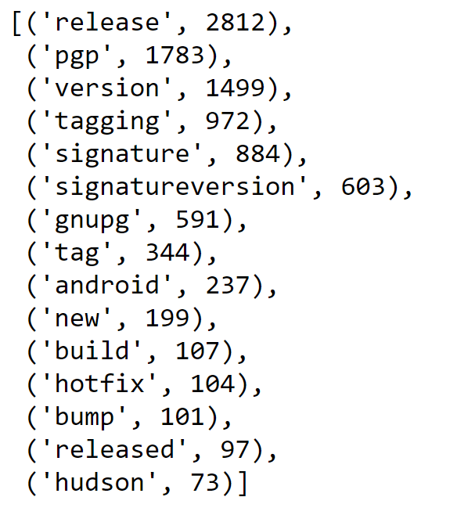
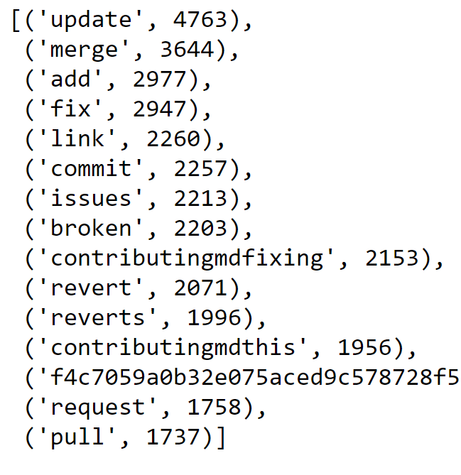
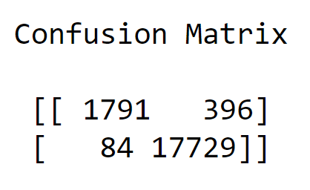
Commit Messages
Release
Method
Label, Vectorize, Train with RandomForestClassifier
Good confusion matrix result
Most impactful words are release and update
Revision
release
revision
release
revision

Slide 23
Rohit Task’s
To find any correlation between contributors and the path durations and develop a model that predicts it.
Extraction of metrics and timestamps of Vulnerabilities form NVD dataset
Parsing the SHD to count the number of contributors in the project
create a dataset using above both and perform Analysis on it

Slide 24
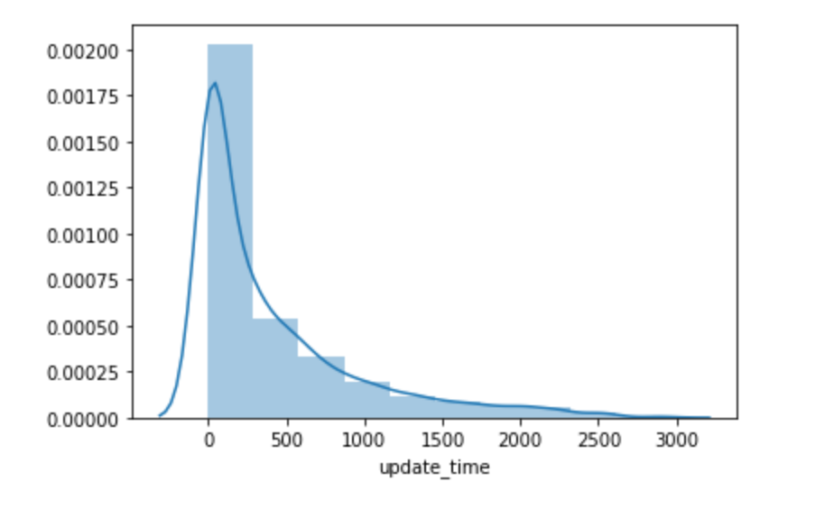
Rohit Task’s
Distribution of
Path Duration.
Distribution: Geometric
Estimator : KDE
Mean : 409
St Dev : 547

Slide 25
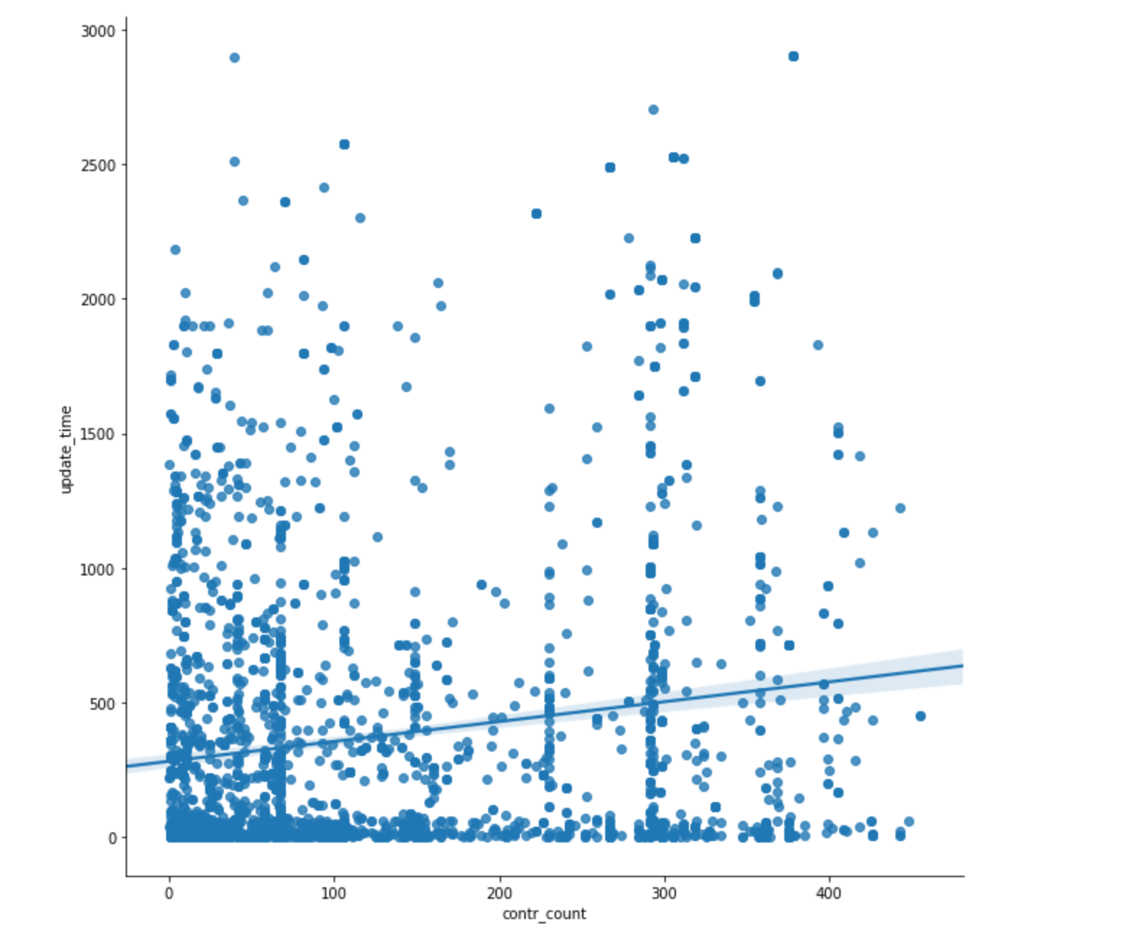
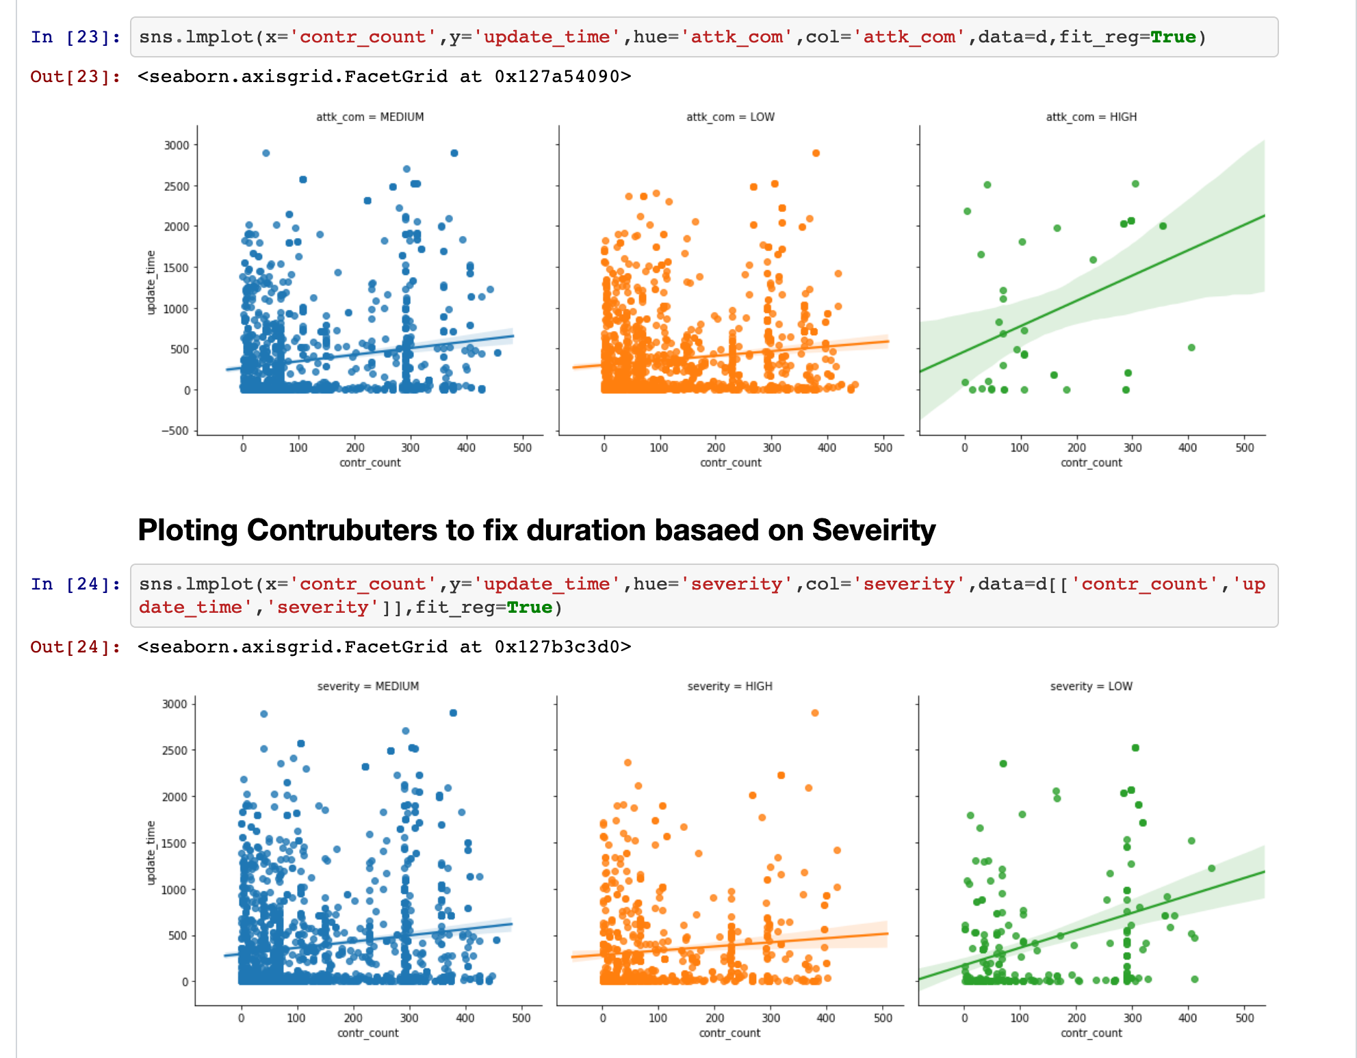
Rohit Task’s
Correlation Between contributors to the project and the path duration

Slide 26
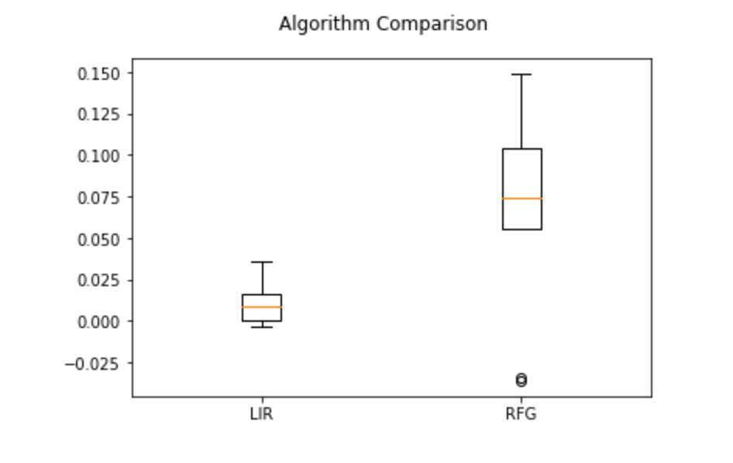
Rohit Task’s
Model Selection: K-Fold Cross Validation
Model : Random Forest Regression
Results :
R-Square Value: 57.50
RMS Value : 384

Slide 27
Questions?

