Slide 1

PodKnow
Chris Edgecombe Harini Booravalli Jamie Weathers Jeremy Hudson Vincent Yang

Slide 2
Phase 1 : Understanding project and acquiring data
Understand the project and requirements :-
Meeting with professor Aaron Beveridge for understanding of requirements and project.
2. Acquired data :-
Each of us were given list of podcasts to download.
6. Automation of whole process

Slide 3
Phase 2 :Conversion and Formatting of Data
1. Converting data from audio format to transcripts
2. Removal of stop words from transcripts
3. Converting the transcripts into data frame for preprocessing of data.
4. Uploading the data back to google cloud.

Slide 4
Phase 3 :Automation
1. In this phase all the tasks performed in phase 1 and phase 2 was converted into python scripts to automate the whole process.
Automation has been a part of both phase 1 and phase 2

Slide 5
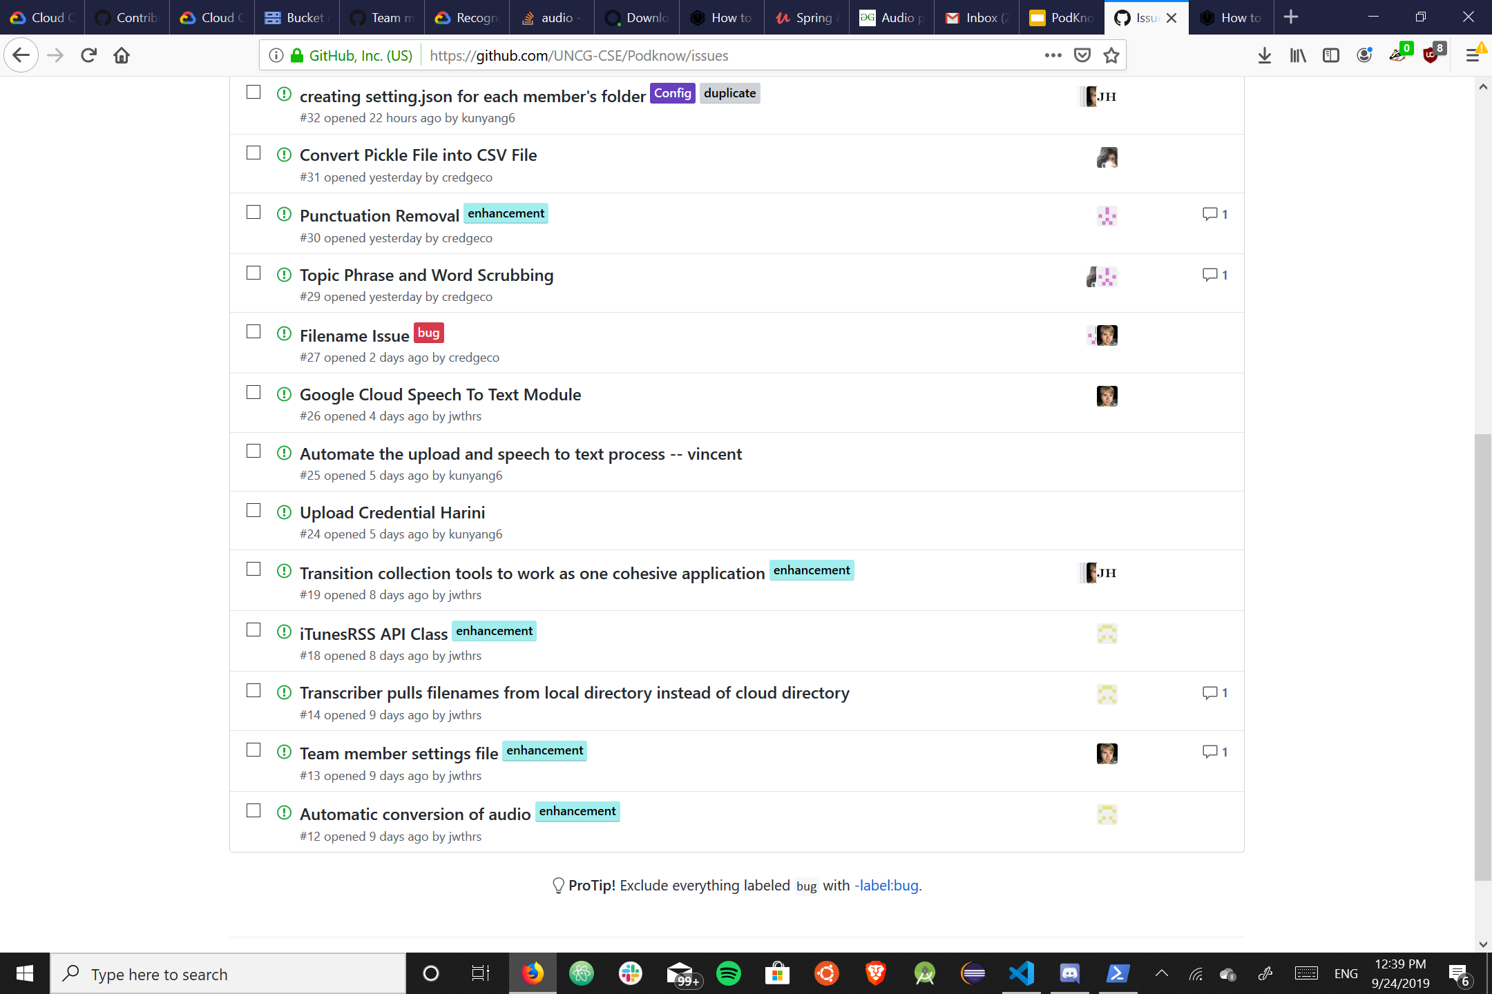
Github Issues
Utilized Github issues to keep our
project up to date.
It is efficiently keeping track of each
commits from our members.

Slide 6
Vincent Yang
Interacted with itunes’ rss api to get the current top 200 podcasts.
.mp3 files to .flac files translator.
Google cloud uploader.
Utilized other teammate’s tools to collect data from speech to text.

Slide 7
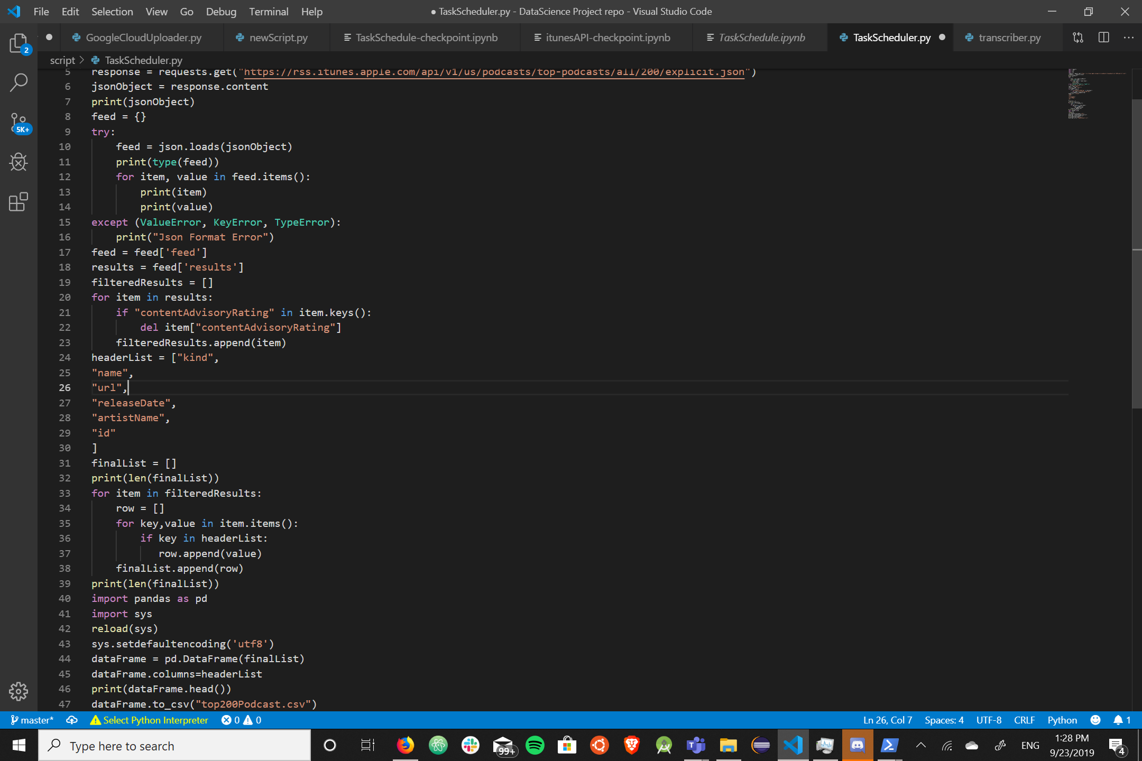
Itunes’ Top 200 podcast: Vincent Yang
Turned itune json list into a
comprehensive pandas dataframe.
Assigned each members with 30
podcasts.
Then write it out as csv file named
top200Podcast.csv

Slide 8
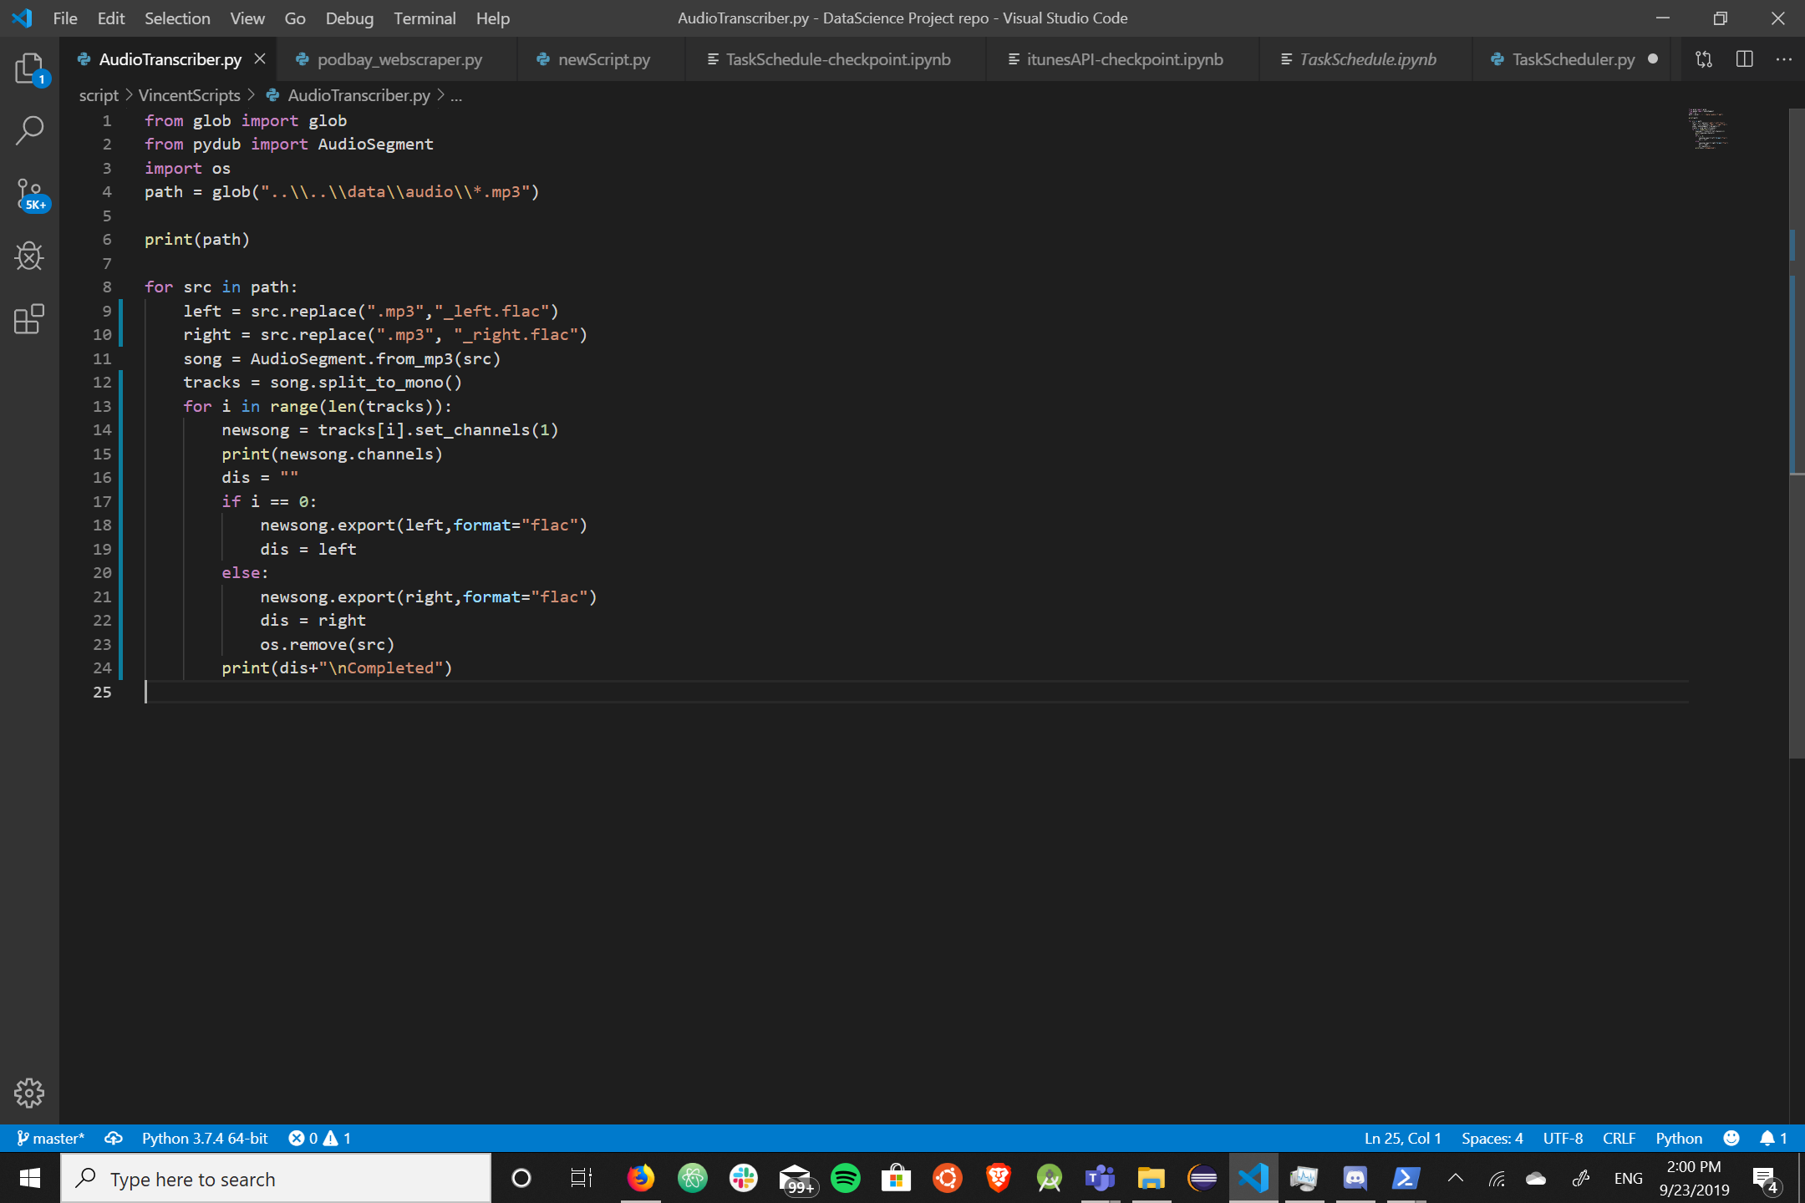
Audio Converter: Vincent Yang
Utilized Pydub to split the .mp3
audio into two tracks, left and right.
Then set each tracks into a mono
.flac file.
Then write it back out to data folder.
Delete the origin .mp3 file on finish.

Slide 9
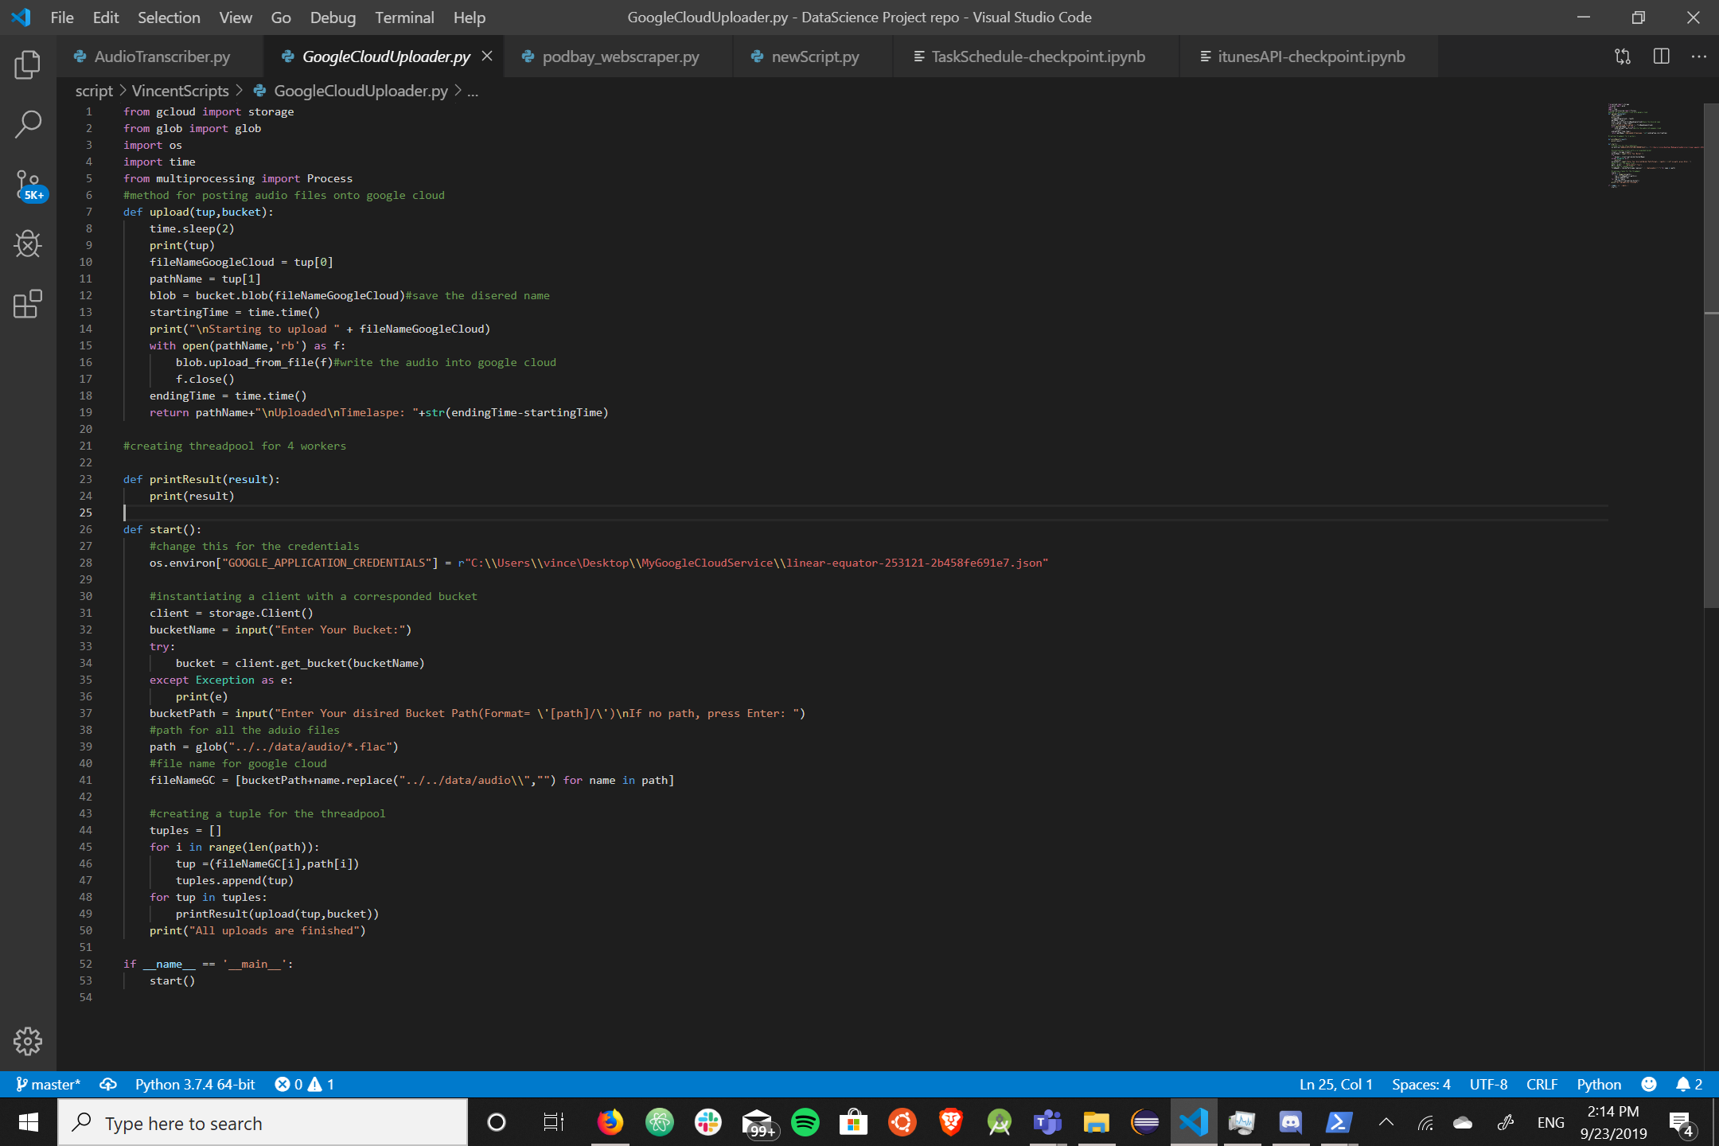
Google Cloud Uploader: Vincent Yang

Slide 10
My Next Step: Vincent Yang
Trying to piece my tools together, so the process between download podcasts and upload podcasts onto google bucket can be automated.

Slide 11
Jamie Weathers
Tasks
Web scraping for audio files
Optimizing transcription process
Misc: Collect data, help set up & organizing Github: directory hierarchy, readme, issues, and project tracker

Slide 12
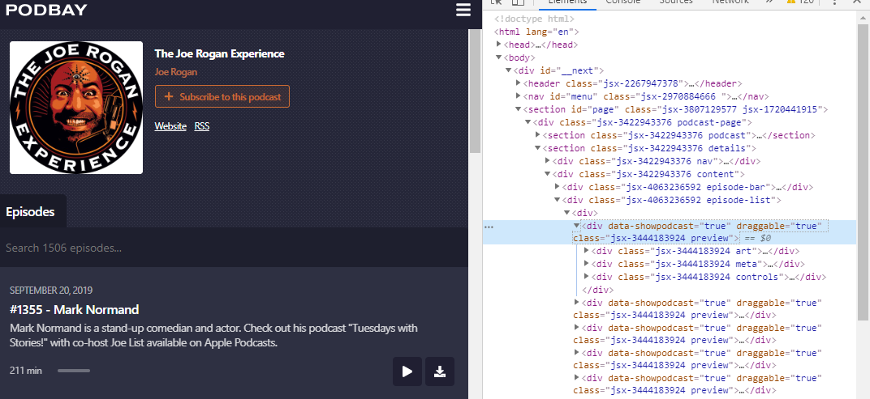
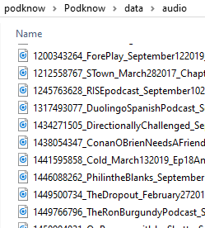
Web Scraping: Jamie Weathers
Each iTunes ID acquired by Vincent's data for podcasts are the same ids on podbay.fm
I programmed a web scraper tool that automatically downloads the latest episode audio from podbay.fm.

Slide 13
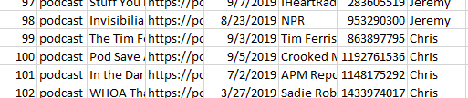
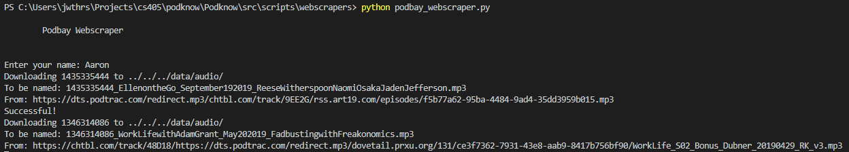
Web Scraping: Jamie Weathers
Enter name for associated portion of the data collection.
Sequentially downloads audio to data/audio/ folder.

Slide 14
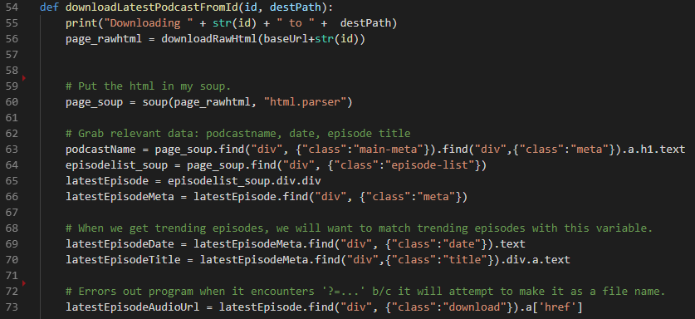
Web Scraping: Jamie Weathers
Web scraping is easily done using BeautifulSoup, which lets you iterate through HTML elements as nodes (similar to using XQuery)
Finding those nodes by hand is still tedious, though.

Slide 15
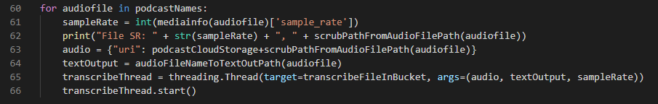
Transcription Optimized: Jamie Weathers
Upgraded Jeremy's program to transcribe all podcasts simultaneously.
Should note that audio files had to be hosted on Google Cloud first for the transcription of large files.
Also resolved a small issue where Google would receive a mismatched sample rate.
Parsing the file first for its information first using pydub solved the issue.

Slide 16
Jeremy Hudson
Needed to find a way to reliably convert audio into text for analysis, since not all Podcasts have accompanying transcripts
Tried several methods to gather initial dataset: Official transcripts, Google Docs Voice Recognition, YouTube Transcripts
Found a reliable long term solution: the Google Speech to Text API
Pros of this API include: implementable in Python, able to be implemented as part of a fully automated system, easy to use once set up, accuracy of transcription

Slide 17
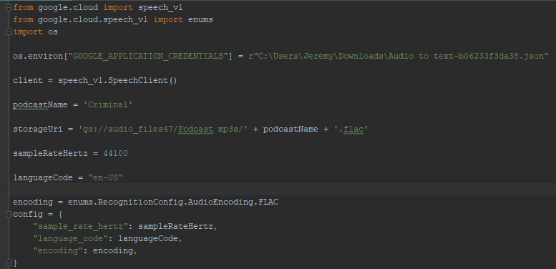
Jeremy Hudson
Imports relevant Google modules, verifies authentication and settings for files and accesses Google Cloud Storage to access files after they’ve been uploaded

Slide 18
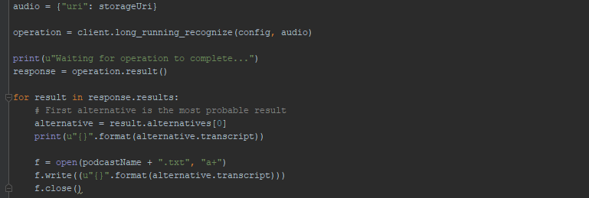
Jeremy Hudson
Contacts Google API and prints the resulting transcript in a .txt file with the same name as the podcast

Slide 19
Jeremy Hudson
After my teammates and I got the Speech to Text API set up we successfully used it to transcribe the bulk of the 200 podcasts assigned to us for our initial dataset
Although the Google Speech to Text API has many advantages, it would also cost money so I have been exploring free alternatives to it
One of these includes a fully offline speech recognition engine called PocketSphinx, although it is not as accurate as Google Speech to Text
Another possible alternative would be Mozilla DeepSpeech, another free linux-based engine

Slide 20
Jeremy Hudson
It would also be possible to switch between APIs using proper software engineering etiquette

Slide 21
Natural Language Toolkit (Chris)
Natural Language Toolkit Implementation
Analyze the speech-to-text data
Create output files
Current Code
Reads raw .txt files from local directory
Runs NLTK stopping word removal on these files
Outputs a “pickle” files that can be opened as a Python array by default
Helps to streamline file reading within Python
Stop word removal is used as a proof of concept to show how the data will flow through the program.
Future Code
Google Cloud Integration
More advanced text analysis (Topic, Word, and Bigram Analysis)

Slide 22
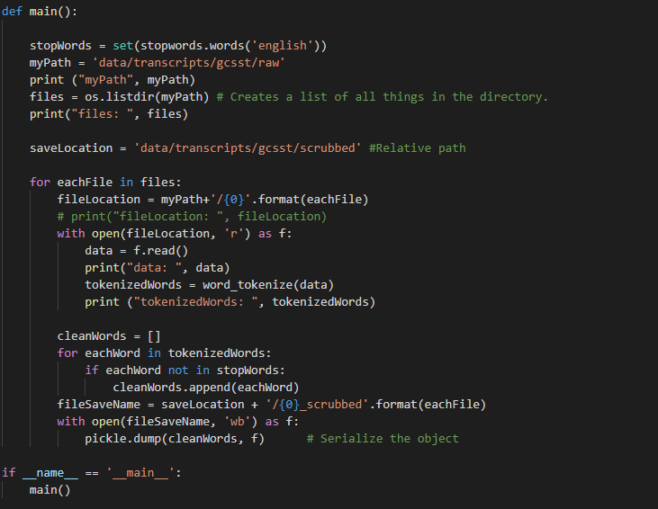



Slide 23
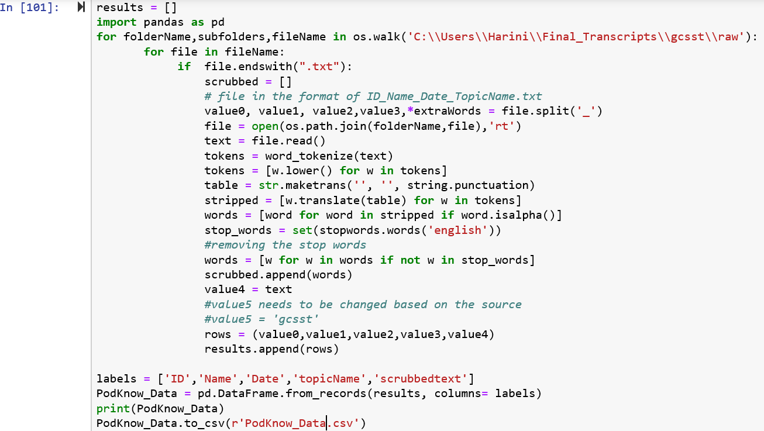
Harini
Program to convert the scrubbed files in txt format into excel readable format.
Program to upload file from local folder into Google cloud.

Slide 24
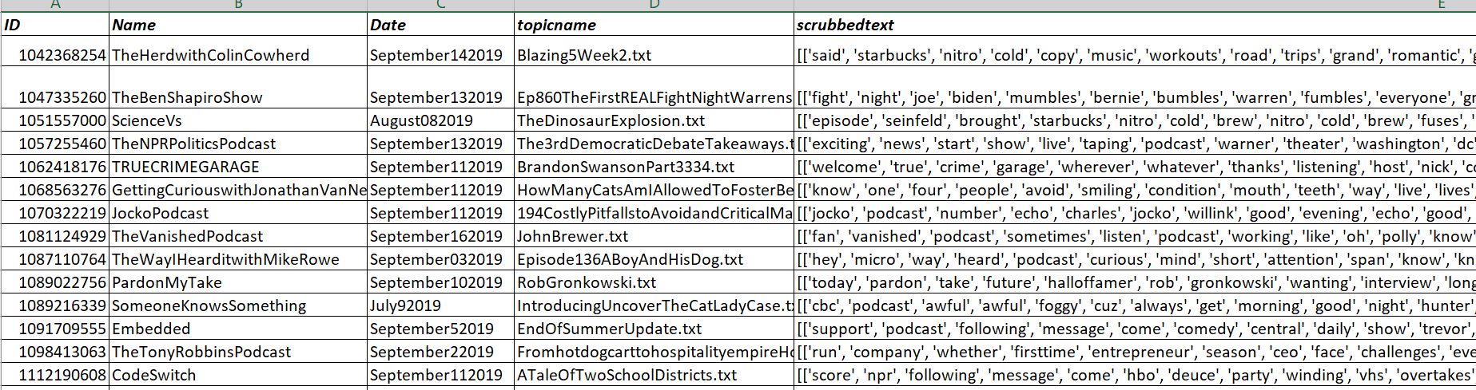
Data in excel sheet:-
Stop Words Example:-
They said at Starbucks Nitro does for cold copy what music does for workouts road trips and Grand romantic gesture sound too good to be true guess you'll have to try it yourself Starbucks Nitro cold brew it's called copy that subtly sweet Lush and velvety smooth only at Starbucks.
words count = 50
['said', 'starbucks', 'nitro', 'cold', 'copy', 'music', 'workouts', 'road', 'trips', 'grand', 'romantic', 'gesture', 'sound', 'good', 'true', 'guess', 'try', 'starbucks', 'nitro', 'cold', 'brew', 'called', 'copy', 'subtly', 'sweet', 'lush', 'velvety', 'smooth', 'starbucks']
words count = 29

Slide 25
Next Steps:
Integrating the code with Chris code and getting the final data in csv format
Pre processing csv data.
Apply text mining model to find the trending podcast for the week .

Slide 26
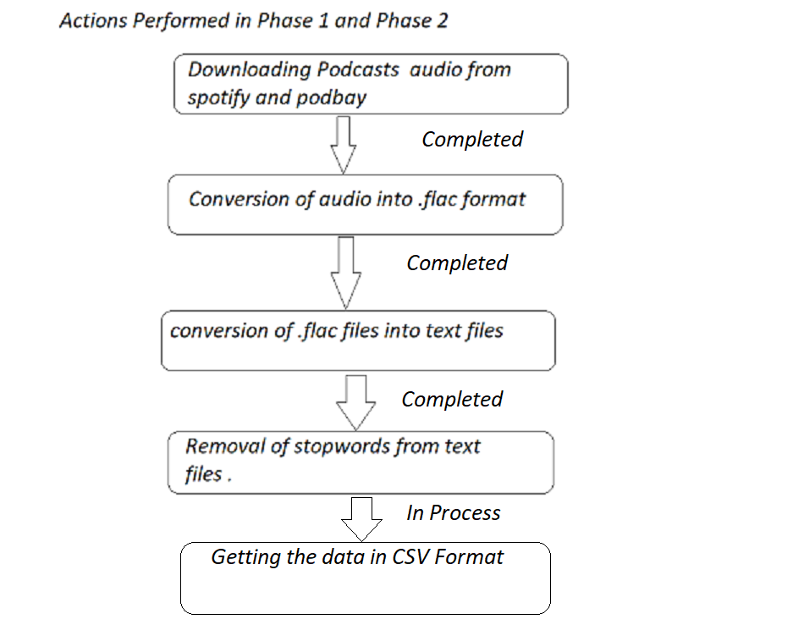
Summary Of Presentation 1

