Slide 1




TOXIC CRUSADERS
CSC 495 Project - Fall 2017
Aaron Denton Jacob Durham Swetha Polisetty Melvin Watlington

Slide 2
Project Goals
Explore Toxics Release Inventory (TRI) and Zillow Home Value Index (ZHVI) data.
Find trends in these data that reveal the impact that industrial production has on communities.
Visualize changes over the last 20-30 years in both industrial chemical emission and house values.
Compare the benefits and disadvantages of industrial production facilities near populated areas.

Slide 3
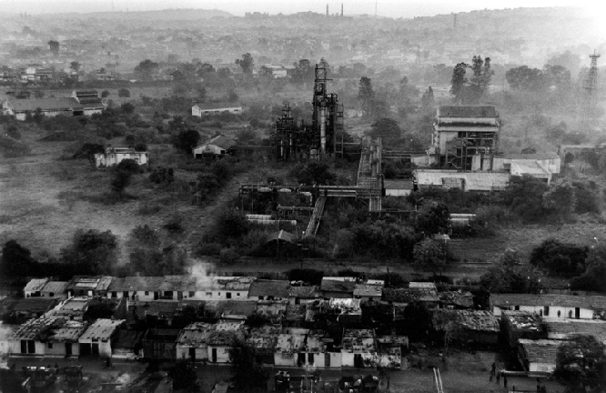
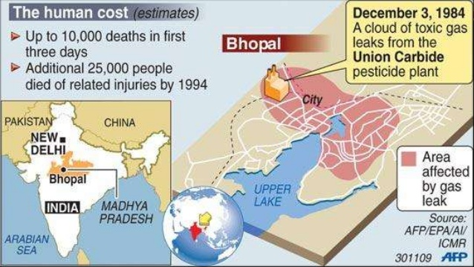
Toxics Release Inventory
History
From the EPA:
“On December 4, 1984, a cloud of extremely toxic methyl isocyanate gas escaped from a Union Carbide Chemical plant in Bhopal, India. Thousands of people died that night… considered to be the worst industrial disaster in history. Thousands more died later… survivors continue to suffer with permanent disabilities. In 1985, a serious chemical release occurred at a similar plant in West Virginia.
In 1986, Congress passed the Emergency Planning and Community Right-to-Know Act (EPCRA) to support and promote emergency planning and to provide the public with information about releases of toxic chemicals in their community. Section 313 of EPCRA established the Toxics Release Inventory.”

Slide 4
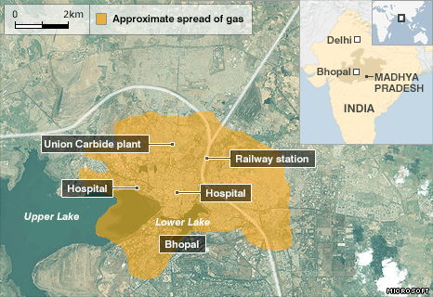
Toxics Release Inventory
History
From the EPA:
“On December 4, 1984, a cloud of extremely toxic methyl isocyanate gas escaped from a Union Carbide Chemical plant in Bhopal, India. Thousands of people died that night… considered to be the worst industrial disaster in history. Thousands more died later… survivors continue to suffer with permanent disabilities. In 1985, a serious chemical release occurred at a similar plant in West Virginia.
In 1986, Congress passed the Emergency Planning and Community Right-to-Know Act (EPCRA) to support and promote emergency planning and to provide the public with information about releases of toxic chemicals in their community. Section 313 of EPCRA established the Toxics Release Inventory.”

Slide 5




Toxics Release Inventory
Cultural Influence
Interesting side-note:
Public concern over events like the Bhopal Tragedy motivated not only the creation of the EPCRA, but also created a generation of cartoon mutants to make kids aware of these issues (and to sell action figures!).

Slide 6
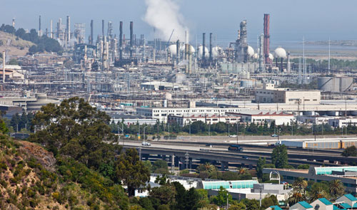
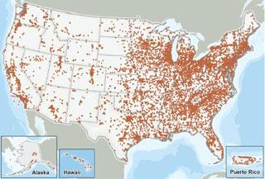
Toxics Release Inventory
Data Sets
The EPA provides data sets containing TRI data for the years 1987 through 2016.
Facilities across many different industrial sectors must submit annual reports of chemicals released to the environment and/or managed through recycling, energy recovery, and treatment.
In this context, “release” of a chemical means that it is emitted to the air or water, or placed in some type of land disposal.

Slide 7
Toxics Release Inventory
Data Sets
The EPA site states that the purpose of this data is “for citizens to better understand possible sources of pollution in their communities.”
Our goal in exploring this data, then, is to extract relevant relations and trends that will shed light on understanding how these toxic releases affect the surrounding communities.
We will accomplish this by comparing the trends in these data to those that we find in the Zillow House Value Index data, and the relations between the two.

Slide 8
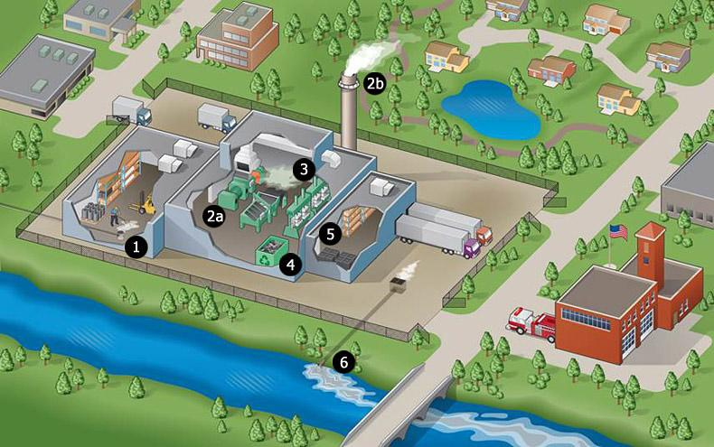
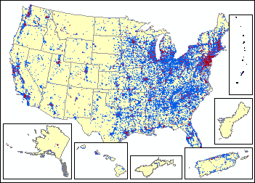
Toxics Release Inventory
Data Sets
We are using the ‘National’ data files, which contain yearly TRI for all 50 U.S. states and the six districts and territories, and ‘State’ data files, which contain yearly TRI data for each state individually.
Each data file (in CSV format) contains 108 attributes, which fall into six categories…

Slide 9
Toxics Release Inventory
Data Sets
Facility Information
Facility Name
Address
Latitude & Longitude Coordinates
SIC codes (4-digit industrial classification)
NAICS codes (6-digit industrial classification)
Industry Sector Codes
(2) Chemical Identification and Classification Information
(3) On-site Release Quantities
(4) Publicly Owned Treatment Works (POTW) Transfer Quantities
(5) Off-Site Transfer Quantities for Release/Disposal and Further Waste Management
(6) Summary Pollution Prevention Quantities

Slide 10
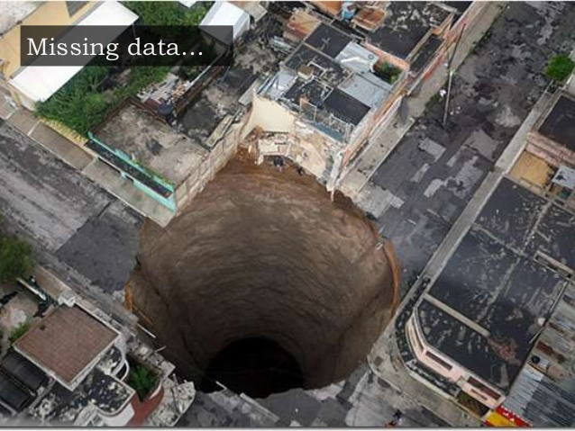

Toxics Release Inventory
Data Sets
Zeroes in the TRI Data Sets
Numeric data fields may contain zero (0) for three reasons:
Release of chemical below threshold for reporting
Chemical reported as “NA” for that particular industry
Left blank in hand-written submission of reporting form

Slide 11


Zillow Home Value Index
Background
Zillow is an online real estate database company, founded in 2006.
They provide many real estate related services, including real estate loan quotes, neighborhood boundary mapping, and home value estimates.
Their home value estimates, called Zestimates, are based on a proprietary algorithm, and serve as the basis of the Zillow data set that we are leveraging for this project.

Slide 12
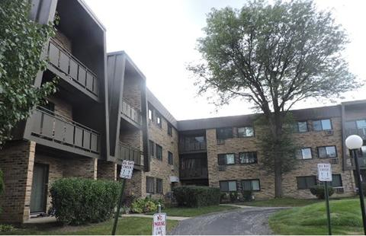
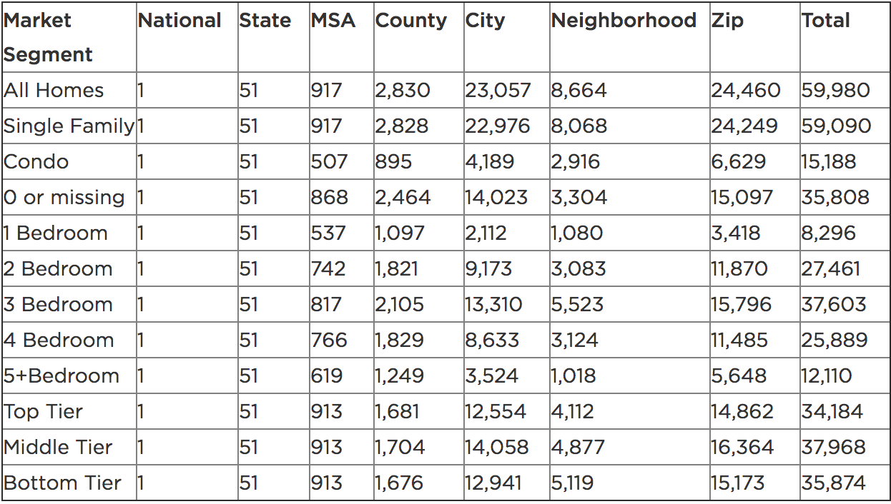
Zillow Home Value Index
Data Sets
Zillow Home Value Index (ZHVI) is a collection of Zestimates, split into 12 market segments.
All Homes
Single Family
Condo
0 or “missing” Bedrooms
1/2/3/4/5+ Bedrooms
Top Tier (among homes in same metro area)
Middle Tier
Bottom Tier

Slide 13

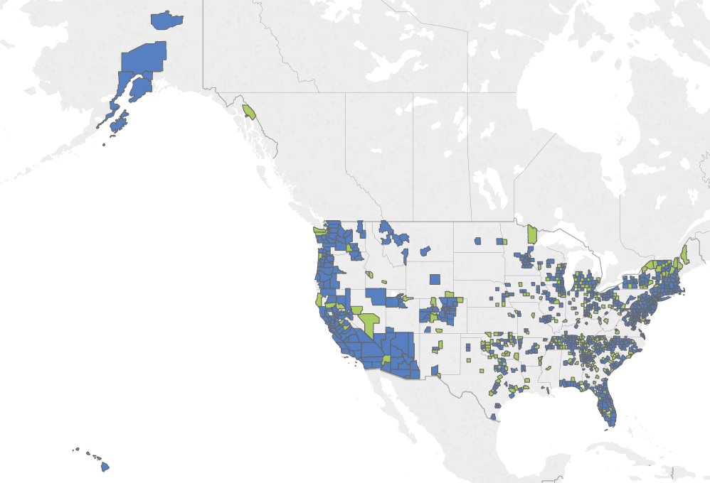
Zillow Home Value Index
Data Sets
Using the Zestimates for residential homes, the ZHVI data is created in a 5 step process:
Calculate Raw Median Zestimates
Adjust for Residual Systematic Error
Apply Henderson Moving Average Filter
Apply Seasonal Adjustment
Final Quality Control
Zillow provides data sets for each market segment, ranging from 1996-2016 (although this data contains lots of gaps for the first few years)

Slide 14
Combining The Data
TRI + ZHVI
Between the TRI and ZHVI data sets, there is a tremendous amount of information to explore.
By comparing ZHVI trends to temporal changes in TRI data, we hope to gain insight on the affect that industrial chemical release might have on home values.
In addition to this combined purpose, there are many interesting questions that we can ask about each data set individually.

Slide 15
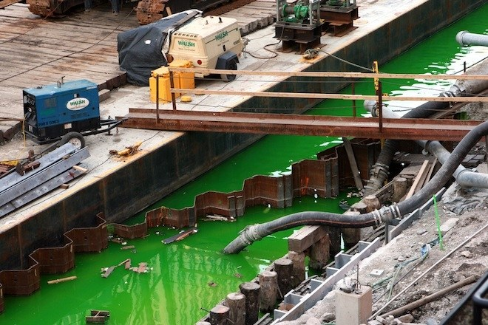

Combining The Data
Primary Questions
As of now, the main observations about these data that we are interested in include:
Observation of ZHVI variation in different categories of housing (1 bedroom, middle tier, condo, etc…)
ZHVI that is most varied:
In terms of depreciation by industry sector
In terms of appreciation by industry sector
ZHVI changes depending on:
On-site releases
Off-site transfers and POTWs
Other waste management

Slide 16
Combining The Data
Game Plan!
To start, we will study trends and relationships between the data in a single state, and then expand to the national data by regions, possibly splitting U.S. regions among all team members.
As we continue, we will identify interesting features of the data, and find ways to visualize our research that will highlight the impact that industrial production has on surrounding communities.
Another Zillow data set, the Zillow Rental Index (ZRI), might be interesting to explore, as the ratio of rentals versus home purchases is on the rise in recent years, even among families.

Slide 17
To Be Continued…
TOXIC CRUSADERS
CSC 495 Project - Fall 2017
Aaron Denton Jacob Durham Swetha Polisetty Melvin Watlington

Slide 18
TOXIC CRUSADERS
CSC 495 Project - Fall 2017 - Report 2
Aaron Denton Jacob Durham Swetha Polisetty Melvin Watlington

Slide 19
Revised Goals
Explore Toxics Release Inventory (TRI) data.
Find trends and relations in these data to characterize facilities, parent companies, and industrial sectors in terms of toxic release and recycling.
Visualize changes over the last 20-30 years in industrial chemical emissions on national and state levels.

Slide 20
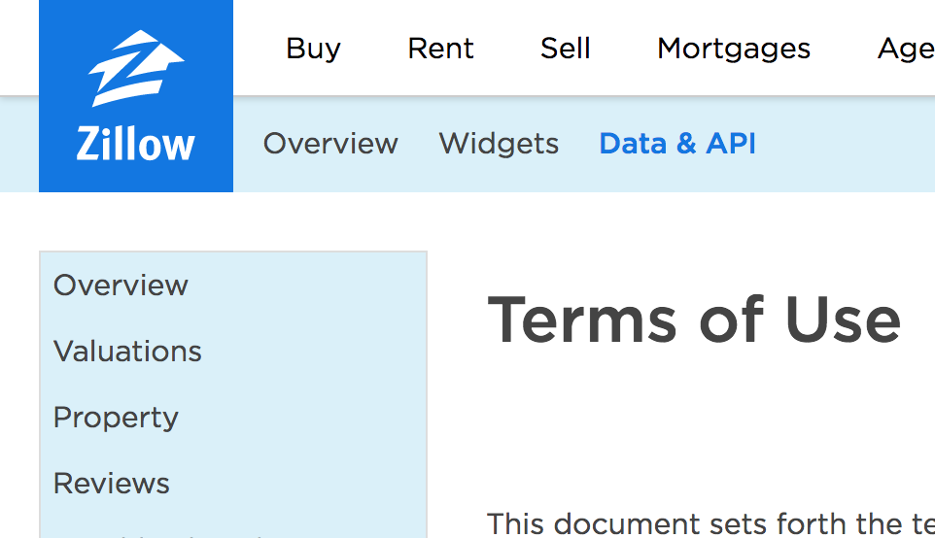
ZHVI Issues
ZHVI data include ZIP codes and Region IDs, no latitude and longitude data
Public ZHVI web API has Regions and Subregions, but are scattered and time consuming to match
Public API also has limited calls
Neighborhoods are non-standard sizes

Slide 21
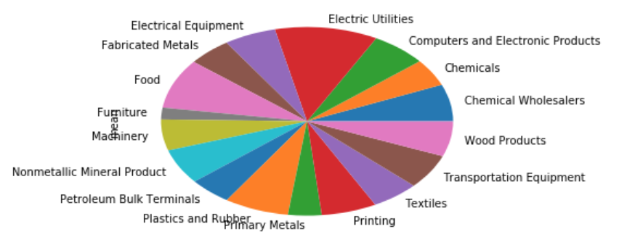
ZHVI Issues
Potentially use ZIP code centroids, but that has problems
ZIP code geographic sizes greatly vary, makes it difficult to compare impact of TRI facilities
Using ZIP code centroids, initial analysis revealed nearly zero impact on home values from close-by facilities

Slide 22
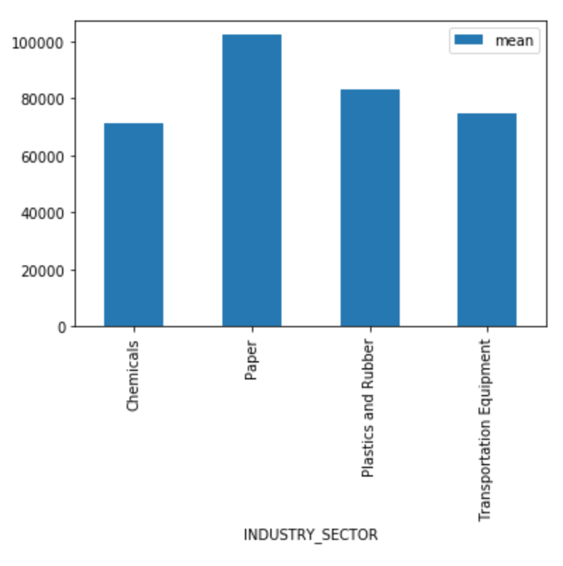
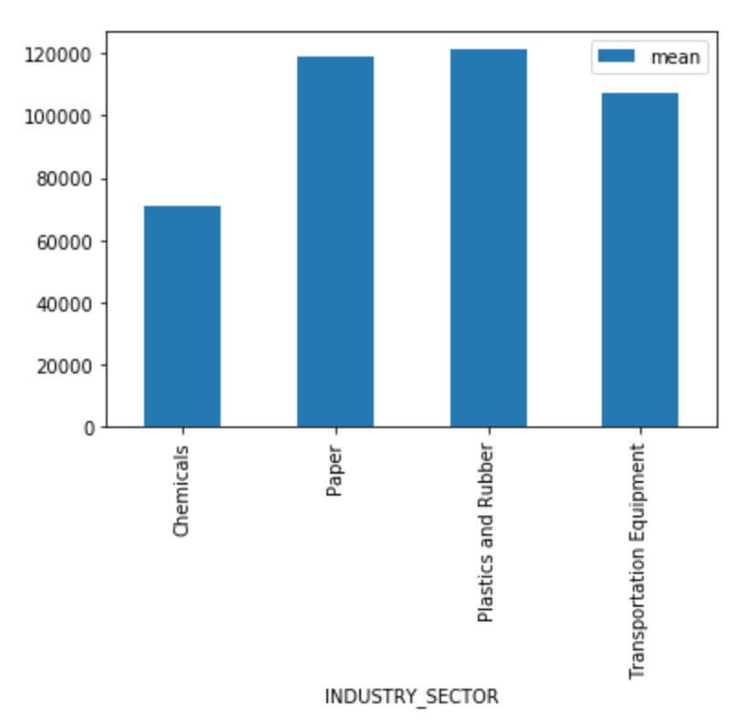
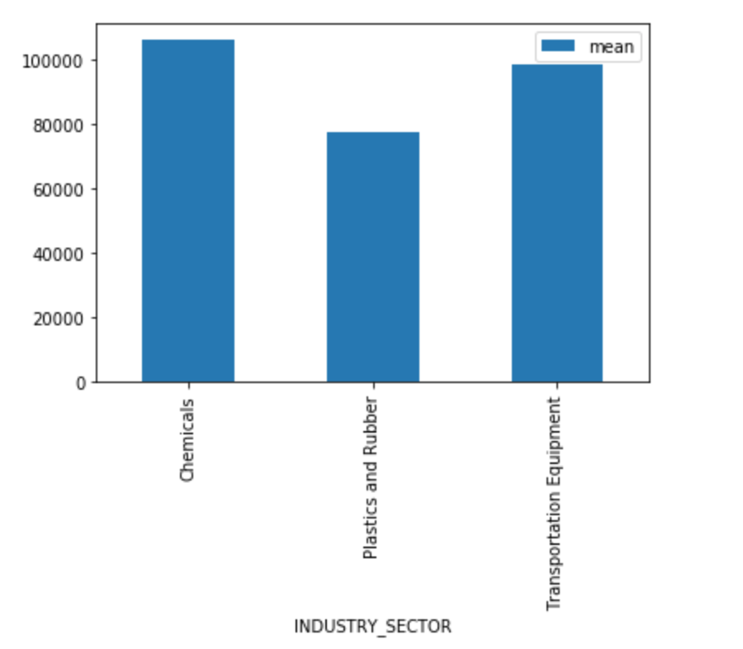
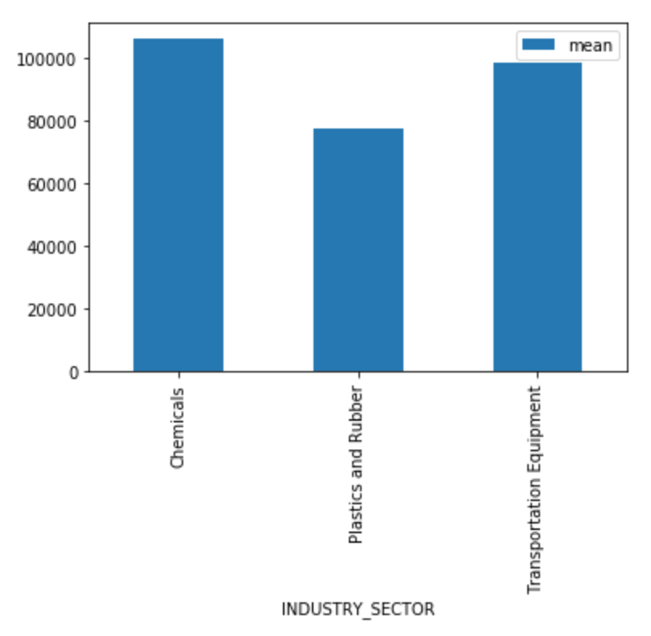
ZHVI: Going Forward
Although, a certain pattern was observed with the average price of homes(considering the centroid) with respect to their distances from the TRI industries.
For the Chemical Industry Sector, it was noticed that the average home prices(1-,2-,3-,4- bedrooms,condos) increase as their distance from the industry facility increases.
Continue to look into these trends going forward, perhaps secondary goal now

Slide 23
New Goal: Explore TRI Data
To make the best use of our remaining time, we have chosen to focus on the TRI data sets
~30 years of data, over 100 columns
Many interesting questions to be explored on national and state levels

Slide 24
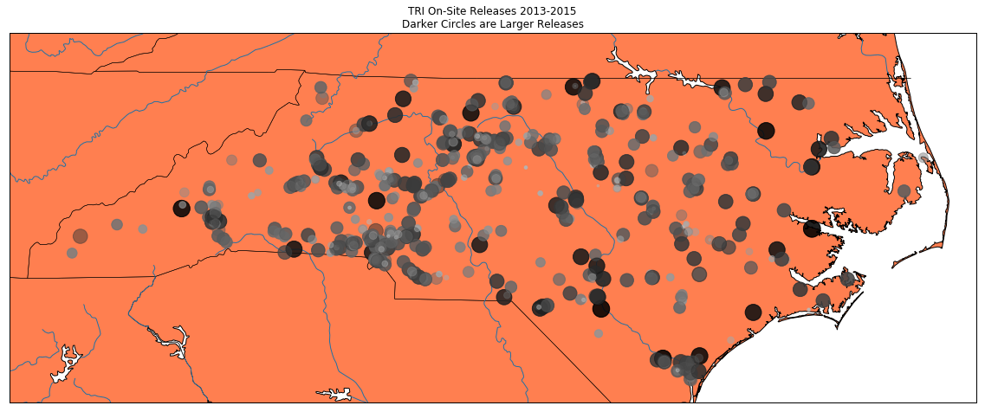
Initial Exploration and Visualization

Slide 25
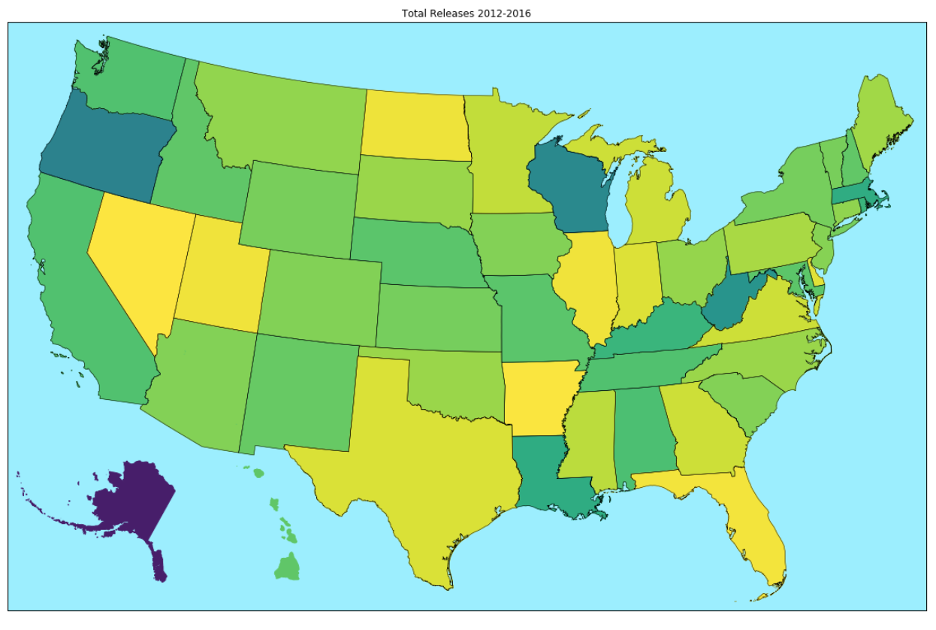
Initial Exploration and Visualization

Slide 26
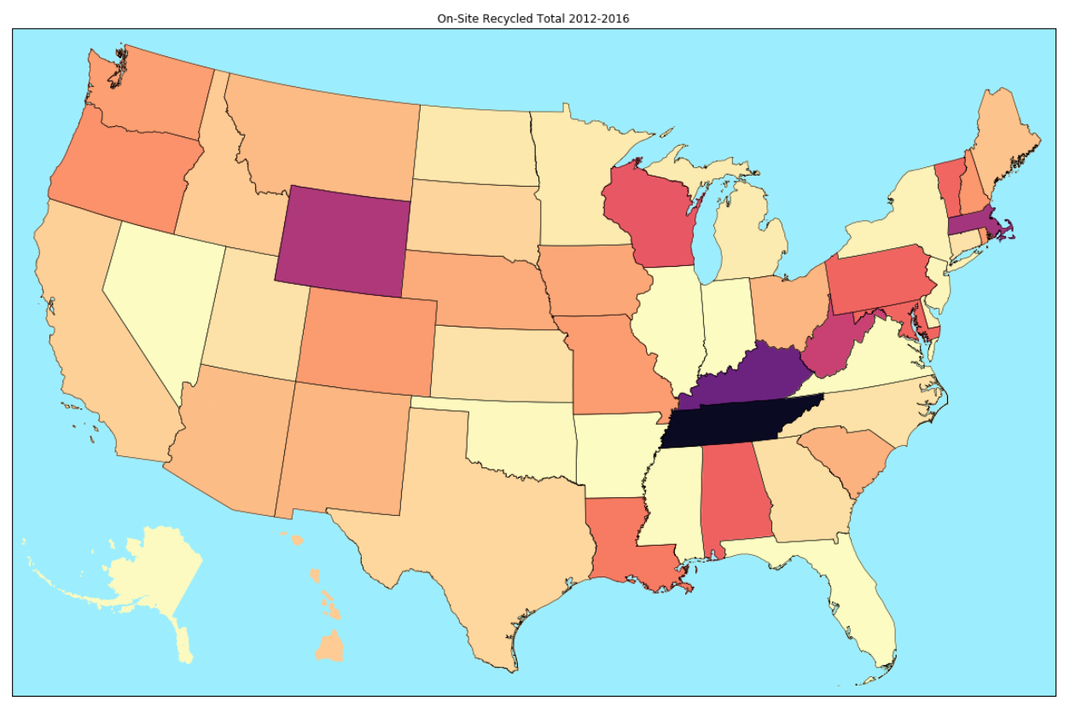
Initial Exploration and Visualization

Slide 27
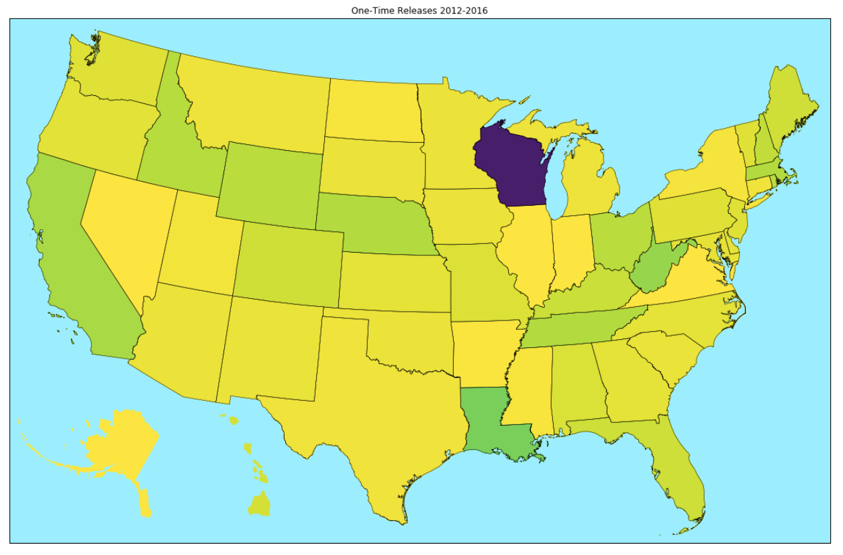
Initial Exploration and Visualization

Slide 28
Standardizing Project Data: What Do We Need?
Over 100 columns on attributes, lots of them are irrelevant for our purposes
This includes unwanted Government codes, industry compliance codes, etc
We want location information, chemical information, and release and recycling information
We identified 21 categories, common to US and State data sets, to use
YEAR
FACILITY_NAME
FEDERAL_FACILITY
PARENT_COMPANY_NAME
INDUSTRY_SECTOR
ZIP
STATE
CITY
COUNTY
LATITUDE
LONGITUDE
CHEMICAL
UNIT_OF_MEASURE
CARCINOGEN
CAA_CHEMICAL
TOTAL_RELEASES
ON_SITE_RELEASE_TOTAL
OFF_SITE_RELEASE_TOTAL
ON_SITE_RECYCLED_TOTAL
OFF_SITE_RECYCLED TOTAL
ONE_TIME_RELEASES

Slide 29
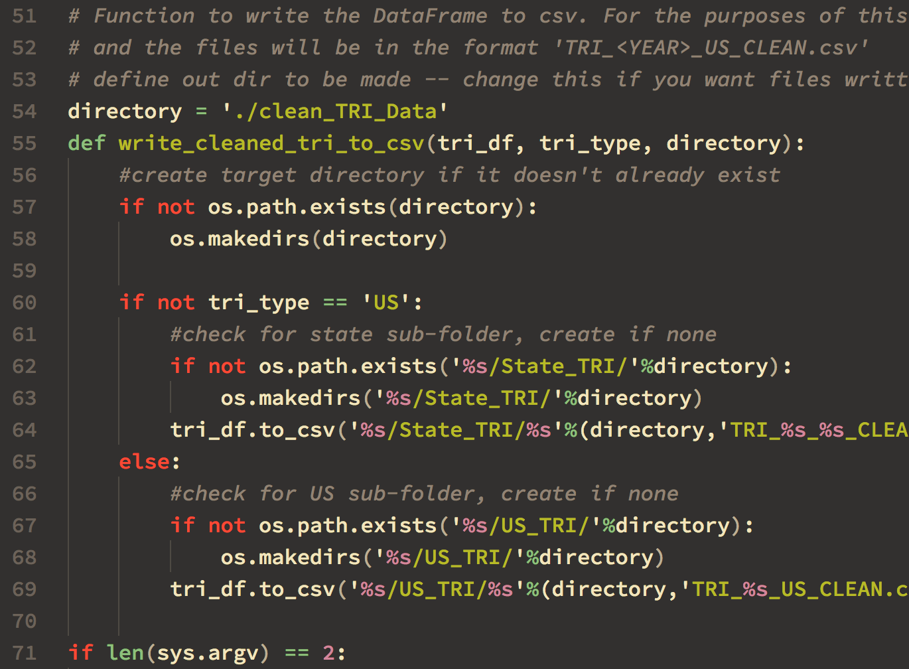
Standardizing Project Data: Cleaning CSV Files
Created Python script to process US and State CSV files
Trims unwanted attributes
Renames columns for standard access
Handles NaN values in numerical columns
Reduces CSV size by ~75%
Run script on downloaded CSV files to pre-clean for use in ipynb

Slide 30
Next Steps
Apply graphing, mapping, and statistical functions to US and State TRI data sets, focusing on:
Nationwide relations and trends
Regional relations and trends
Facilities and parent companies’ releases
Industry sector releases

Slide 31
To Be Continued…
TOXIC CRUSADERS
CSC 495 Project - Fall 2017 - Report 2
Aaron Denton Jacob Durham Swetha Polisetty Melvin Watlington

