Slide 1
Uni-X
Descriptive Analysis to College Scorecard Data
Oct. 30th 2017
Group members: Ahlam Hakami
Bin Luo
Qi Zhang

Slide 2
Goals:
What variables can affect repayment rates?
Estimate repayment rates based on other variables.
Predict repayment rates in coming years.

Slide 3
What we have done so far:
Selected the valid explanatory variable and response variable.
Explored valid observation for different types of repayment rates.
Merged and cleaned data and exported to .csv file.
Developed sharable function for the whole data management process
Started descriptive analysis on repayment rate.
Found highly correlated explanatory variables.

Slide 4
Data Description
Analyzing a repayment rate for college score data from (2007 - 2014)
Repayment rate in first year
Repayment rate in 3 years
Repayment rate in 5 years
Repayment rate in 7 years

Slide 5
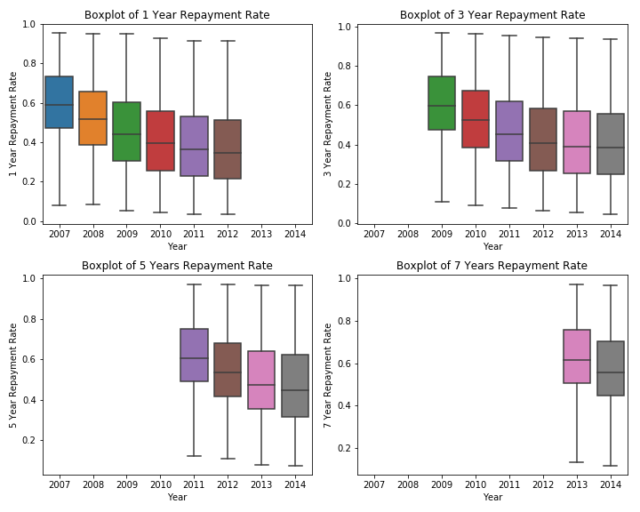
Repayment Rate

Slide 6
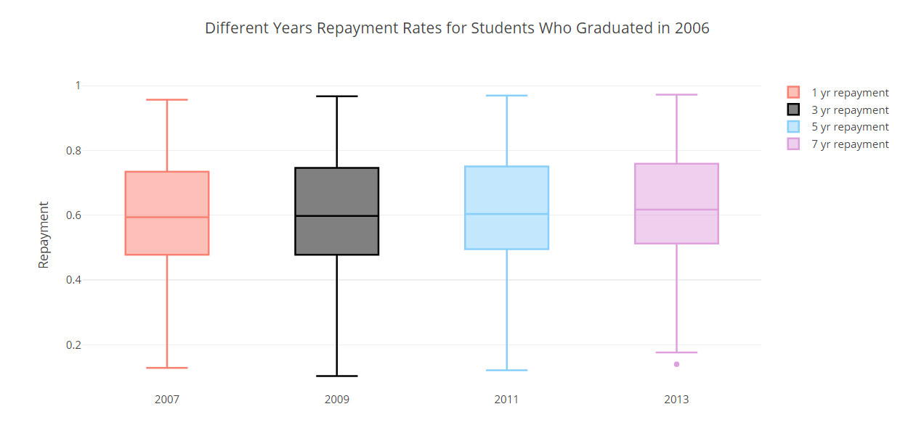
Repayment Rate

Slide 7
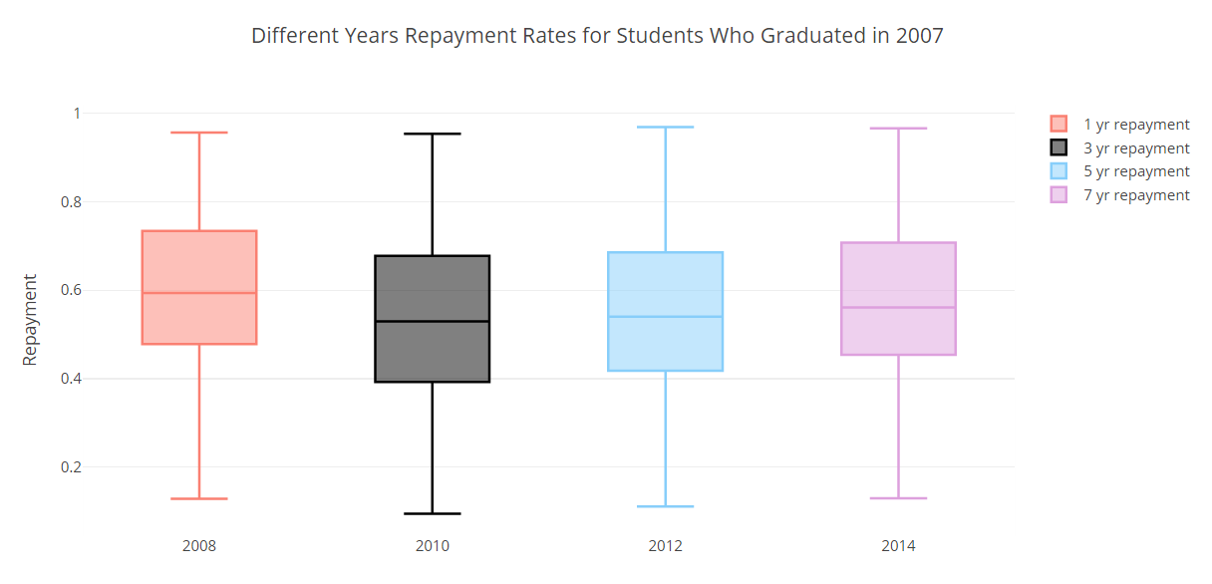
Repayment Rate

Slide 8
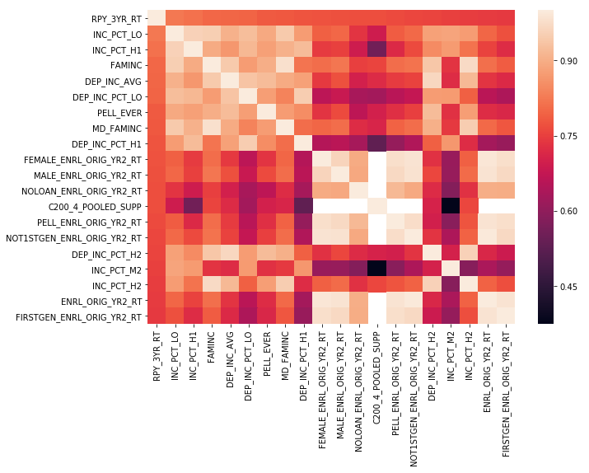
Correlation
Correlation between 3rd year repayment rate and top 20 explanatory variables

Slide 9
Next:
What variables can affect repayment rates?
Estimate repayment rates based on other variables.
Predict repayment rates in coming years.

Slide 10
Questions?

