Slide 1
CISC7204 · DATA SCIENCE AND DATA VISUALIZATION
The Power-Hungry
World
218
countries and territories
in the analysis table
33
years compared
1990 – 2022
Comparing global electricity consumption across countries,
regions and end-use sectors, 1990–2022
8
figure outputs
+ 2-page dashboard
SEMESTER PROJECT PRESENTATION
Class G - Team 03
2026/2027, Semester 1 · University of Macau
Department of Computer and Information Science
10 November 2026
github.com/UNCHIKIT
/CISC7204-GroupG-SemesterProject-Team03

Slide 2
00 · OUTLINE
What this deck covers
The structure follows the required items of the brief, with three results slides in the middle.
01
The team, names and student IDs
03
10
Findings - countries and shares
12
02
Project Title and Research Question
04
11
Findings - sectors and geography
13
03
Project context - frontend + backend
05
12
Project challenges
14
04
Project goals
06
13
Criteria of success and evaluation
15
05
Project services and data requirements
07
14
Project deliverables
16
06
Project tasks
08
15
Division of work
17
07
Backend - the data pipeline
09
16
Contributions of team members
18
08
Frontend - the dashboard
10
17
Project learning - individual + team
19
09
Findings - growth, 1990 - 2022
11
18
Work in progress and next steps
20
Fifteen minutes of content, questions at the end. Every number on every slide is reproducible from the repository.
The Power-Hungry World · CISC7204 Class G - Team 03
02 / 20

Slide 3
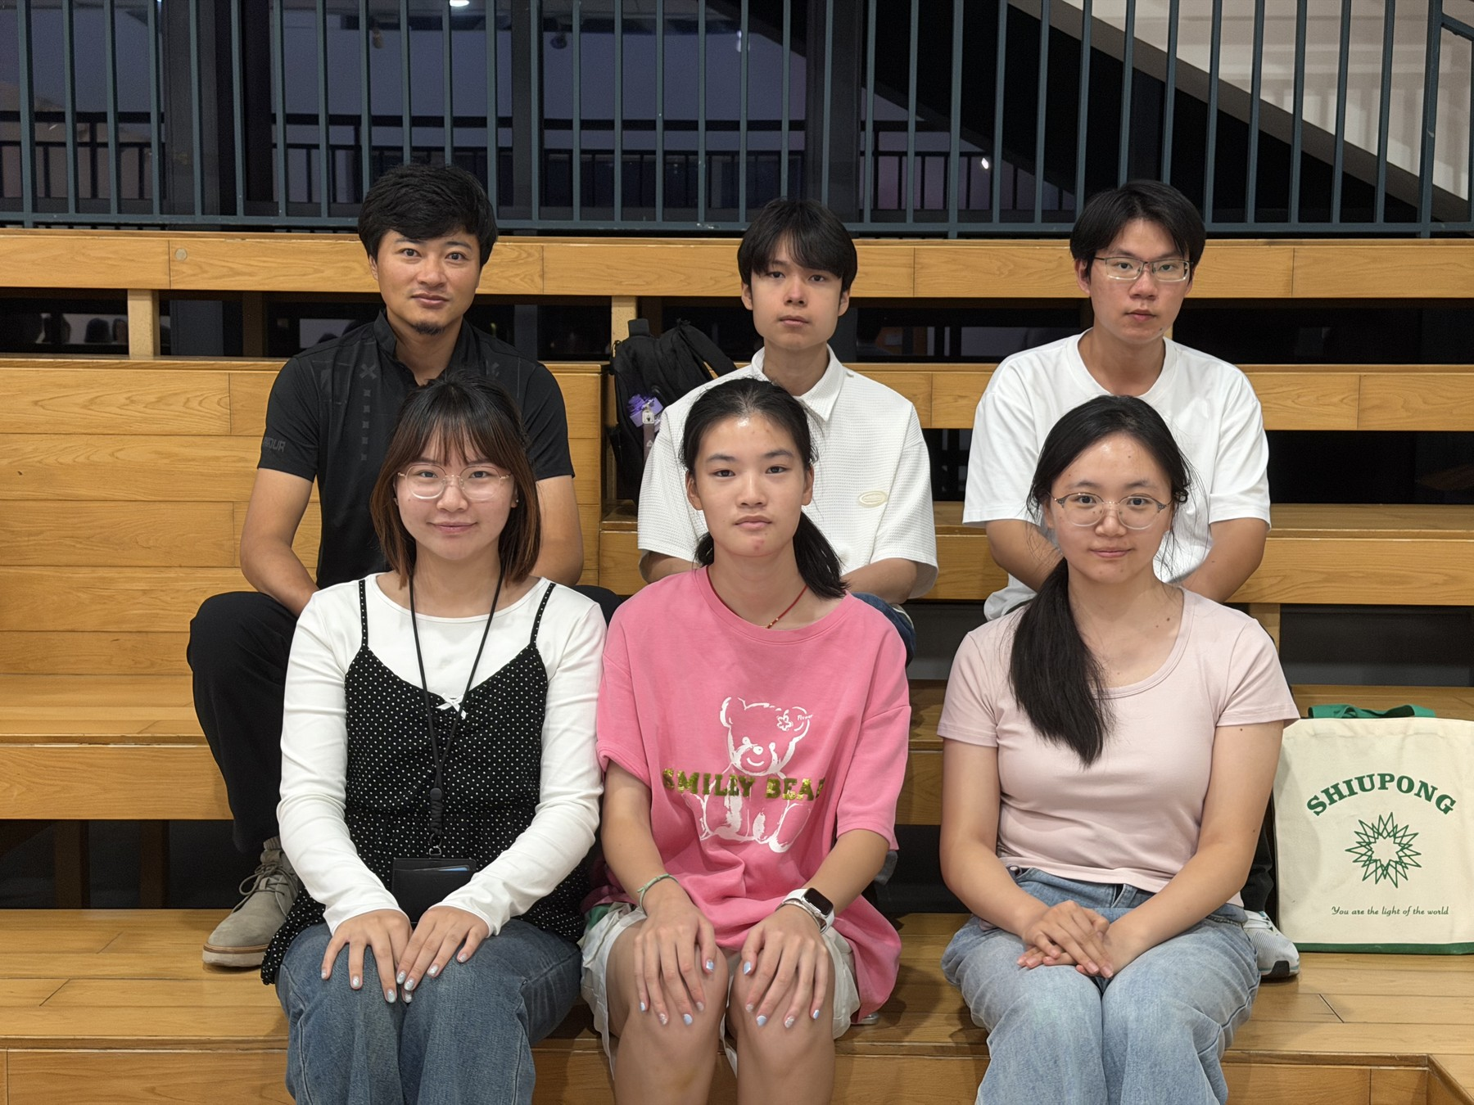
01 · THE TEAM
Class G - Team 03
Six members, one owner per role, one repository. Names and student IDs as registered.
UN CHI KIT
MC653081
Team coordinator · project tracker
KELDEN JAMTSHO
MC664183
Project analyst · quality reviewer
GAN RUIYAN
MC664801
Lead project developer
HE YIFEI
MC664916
Team reporter · team liaison
SHENG TIAN
MC664961
Second project developer
TANG JING
MC666256
Second project analyst · team scribe
The team, 2026/2027 Semester 1 · University of Macau
Roles as recorded in the proposal (§6). Every required role - coordinator, analyst, developer, reporter, scribe, liaison - has exactly one owner.
The Power-Hungry World · CISC7204 Class G - Team 03
03 / 20

Slide 4
02 · PROJECT PARTICULARS
Project Title and Research Question
PROJECT TITLE
The Power-Hungry World:
Comparing Global Electricity Consumption Across Sectors
SCOPE, FIXED BEFORE ANALYSIS
WINDOW
1990 – 2022 (33 years)
MEASURE
Final consumption, not generation
How has final electricity consumption changed across countries
and regions between 1990 and 2022, and which countries and end-use
sectors account for the largest shares of that consumption?
UNIT
TWh · 1 TWh = 3.6 PJ = 3,600 TJ
SECTORS
Industry, transport,
residential, services/other
GEOGRAPHY
218 UN areas, country level
The data are observational. We describe patterns and associations; we do not claim that any factor caused a change in consumption.
01
02
03
04
Change over time
Country shares
Sector composition
Geography
Global and regional trends; absolute change, compound annual growth and an index set to 1990 = 100.
Who holds the world total, how the top ten moved, and how concentrated consumption is.
Industry, transport, residential and services/other - shares and percentage-point change.
Where consumption sits in 1990 and 2022: two world maps on one colour scale, unmatched areas disclosed.
The Power-Hungry World · CISC7204 Class G - Team 03
04 / 20

Slide 5
03 · PROJECT CONTEXT
A data-science investigation in two halves
A descriptive, geospatial and time-series investigation - built as a reproducible backend and an explorable frontend.
01 · SOURCES
02 · BACKEND
03 · TABLES
04 · FRONTEND
Public and national sources
Python, seven scripts
Two analysis tables
Self-contained web
· UN SDMX energy balance (B07_EL)
· download → parse → map
· country × year - 6,932 rows
· dashboard - eight outputs
· Our World in Data - demand, generation
→
· three documented data decisions
→
· region × year - 198 rows
→
· world-map slider 1990–2022
· World Bank population
· validation, four layers
· TWh, four sectors + total
· method + data dictionary
· Natural Earth 50m polygons
· figures + dashboard build
· three quality flags kept
· PNG / CSV per figure
· National statistics - AGEB, SBP, ESDM, GASTAT, SDES
· 1,621 lines, no manual edits
BACKEND OWNS THE TRUTH
FRONTEND OWNS ACCESS
Deterministic and cached: one SDMX request, a date-stamped manifest, no value typed by hand. Missing rows are never treated as zero, parent aggregates are never added to their own children.
Two self-contained HTML pages, no server and no CDN. Every card carries its own caveat and a CSV/PNG download, so a reader can check the chart against the table behind it.
One direction only: the frontend never edits data. Every figure is regenerated from the tables by make_figures.py.
The Power-Hungry World · CISC7204 Class G - Team 03
05 / 20

Slide 6
04 · PROJECT GOALS
What the project set out to do
One aim - replace a single global number with a decomposition - and four goals that make it usable.
G1
Decompose, don't repeat
Break the 2022 world total into regions, countries and end-use sectors, and show how each moved since 1990.
EXPECTED LEARNING OUTCOMES
·
Apply a reproducible data-science workflow to several public datasets.
G2
Be reproducible from a clean clone
·
Evaluate differences in coverage, definitions, units and reporting practice.
One documented Python environment, seven scripts, cached downloads, and a table contract the notebook still respects.
·
Run EDA as a stage: structure, distributions, missingness, outliers.
G3
Make uncertainty visible
·
Compute and interpret absolute change, CAGR, indices and shares.
Coverage gaps, estimated values and cross-source disagreement are disclosed on the figure, not buried in an appendix.
·
Prepare geospatial data - country-code matching, choropleth mapping.
G4
Deliver something explorable
·
Assess uncertainty from estimates, missing observations and source disagreement.
A dashboard with per-figure downloads, not a static report with pictures of charts.
From the proposal, §2
The Power-Hungry World · CISC7204 Class G - Team 03
06 / 20

Slide 7
05 · SERVICES & DATA REQUIREMENTS
What we deliver, and what it takes to run
Four services for a reader, five data sources behind them - with the access condition that governs each.
SERVICES
DATA REQUIREMENTS
S1
Analysis tables
SOURCE
GRANULARITY
UNIT
ACCESS
Country × year (6,932) and region × year (198), in TWh, with three quality flags.
UN SDMX B07_EL
218 areas × 33 yr × 7 codes
TJ
public API, cached
S2
Interactive dashboard
OWID electricity
≈213 countries, totals only
TWh
one CSV request
Two pages: eight outputs with captions and PNG/CSV download, plus the 1990–2022 map slider.
World Bank SP.POP.TOTL
country × year
persons
public API
Natural Earth 50m
country polygons
UN_A3
public GeoJSON
S3
Figure pack
Eight static figures at 250 dpi and one animated HTML map, all regenerated by script.
National statistics
gap years: DE, PK, ID, SA, FR
PJ / GWh
official sites, cited
S4
Reproduction kit
Seven pipeline scripts, the method document, and the file manifest with row counts.
FIXED BEFORE THE FIRST FIGURE WAS DRAWN
Window 1990–2022 · unit TWh (1 TWh = 3.6 PJ) · four sector groups · missing ≠ zero · parent aggregate B47_123 never added
IEA World Energy Balances was dropped: its licence does not permit our public outputs, so UNdata is the primary source.
The Power-Hungry World · CISC7204 Class G - Team 03
07 / 20

Slide 8
06 · PROJECT TASKS
Seven tasks in four weeks, with no unowned work
The proposal's seven stages, with the Work Plan 02 steps (S1–S8) as sub-tasks. S7 spans tasks 4–6.
#
PROJECT TASK
SUB-TASK (WORK PLAN 02)
LEAD / SUPPORT
WEEK
1
Data acquisition
S1 Source and licence research
Kelden / Un; He, Tang
W1 · Current progress
2
Data preparation
S2 Finish source and preprocessing review
Kelden / Un
W2 · Review target
3
Exploratory data analysis
S3 Review flags, sensitivity, calculations
Un / Kelden
W2 · Review target
4
Time trends and regions
S7 Refine trend and regional outputs
Un / Kelden
W3
5
Countries and geospatial
S7 Refine rankings, figures and maps
Un / Kelden
W3
6
Sector composition
S7 Refine sector outputs and dashboard
Un / Kelden
W3
7
Validation, dashboard, communication
S4 Prepare the presentation package
Gan/Sheng; He/Tang
W2 (W3 if needed)
S5 Rehearse and upload to the Public Forum
All (He, Tang)
W2 (W3 if needed)
S6 Present in the assigned session
All members
W2 or W3
S8 Finalise and submit the project
He, Tang; all review
W4 · Proposal target
PLAN
TODAY · 10 NOV
W1
5–11 Nov
W2
12–18 Nov
W3
19–25 Nov
W4
26 Nov–3 Dec
sources, pipeline, figures, site
review targets, WIP PPT, session 18 Nov
refine outputs; session 25 Nov
report, checks, submit by 3 Dec
Online team meetings on Wednesdays, 16:00–16:30 (11, 18 and 25 Nov; 2 Dec if required), with minutes by Tang Jing. The presentation is in the instructor-assigned session on 18 or 25 November.
The Power-Hungry World · CISC7204 Class G - Team 03
08 / 20

Slide 9
07 · BACKEND
Seven scripts, one request, two analysis tables
Python 3, pandas and plotly. Nothing in the pipeline is typed by hand; re-running it reproduces every number in this deck.
1
download_undata.py
one UN SDMX request → un_all.xml, 2.8 MB; CL_AREA code list
THE TWO RULES THAT MATTER
TWh = OBS_VALUE / 3600
UNIT says HSO, the value is TJ
Services = B48 + B49 + B51
B47_123 is never added
2
build_energy_dataset.py
XML → long CSV, 36,247 rows; parent B47_123 never added
3
build_mappings.py
CL_AREA + Natural Earth → country → continent and polygon
4
build_analysis_tables.py
TJ ÷ 3,600 → TWh; 6,932 country-years; three decisions applied
1,621
lines of Python
across seven scripts
5
validate_dataset.py
four layers → validation_jumps.csv, validation_crosscheck.csv
36,247
raw observations
6
make_figures.py
eight figures + the animated 1990–2022 map
→ 6,932 country-years
7
make_dashboard.py
two self-contained HTML pages, plotly.js inlined once
0
external CDNs
the dashboard opens offline
Three documented decisions, each flagged in the table: Germany 1990 sector split linked from AGEB (an estimate; industry 229.9 TWh); Pakistan 1990–92 FEC recomputed to 28.75 / 31.50 / 33.89 TWh; Pakistan 2017–19 transport reported nil, set to 0 (2020–22 has no source and is being reset to missing).
The Power-Hungry World · CISC7204 Class G - Team 03
09 / 20

Slide 10
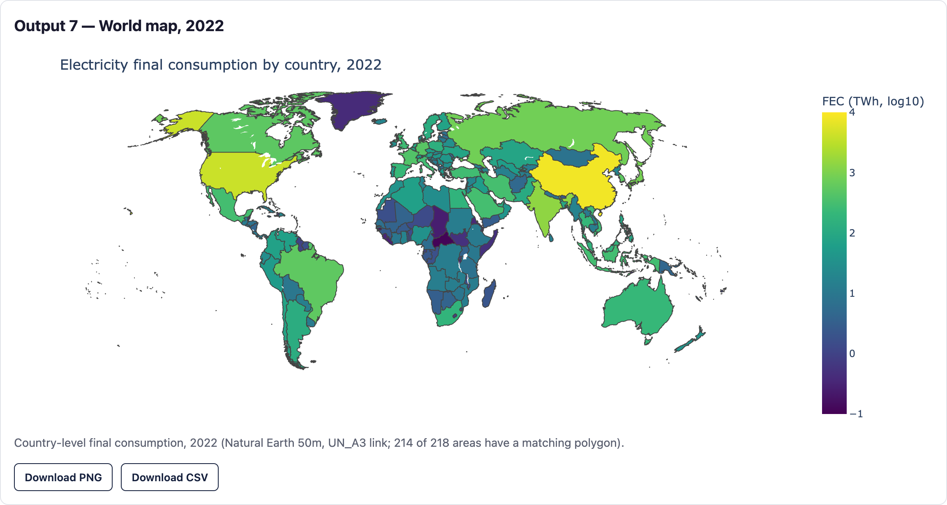
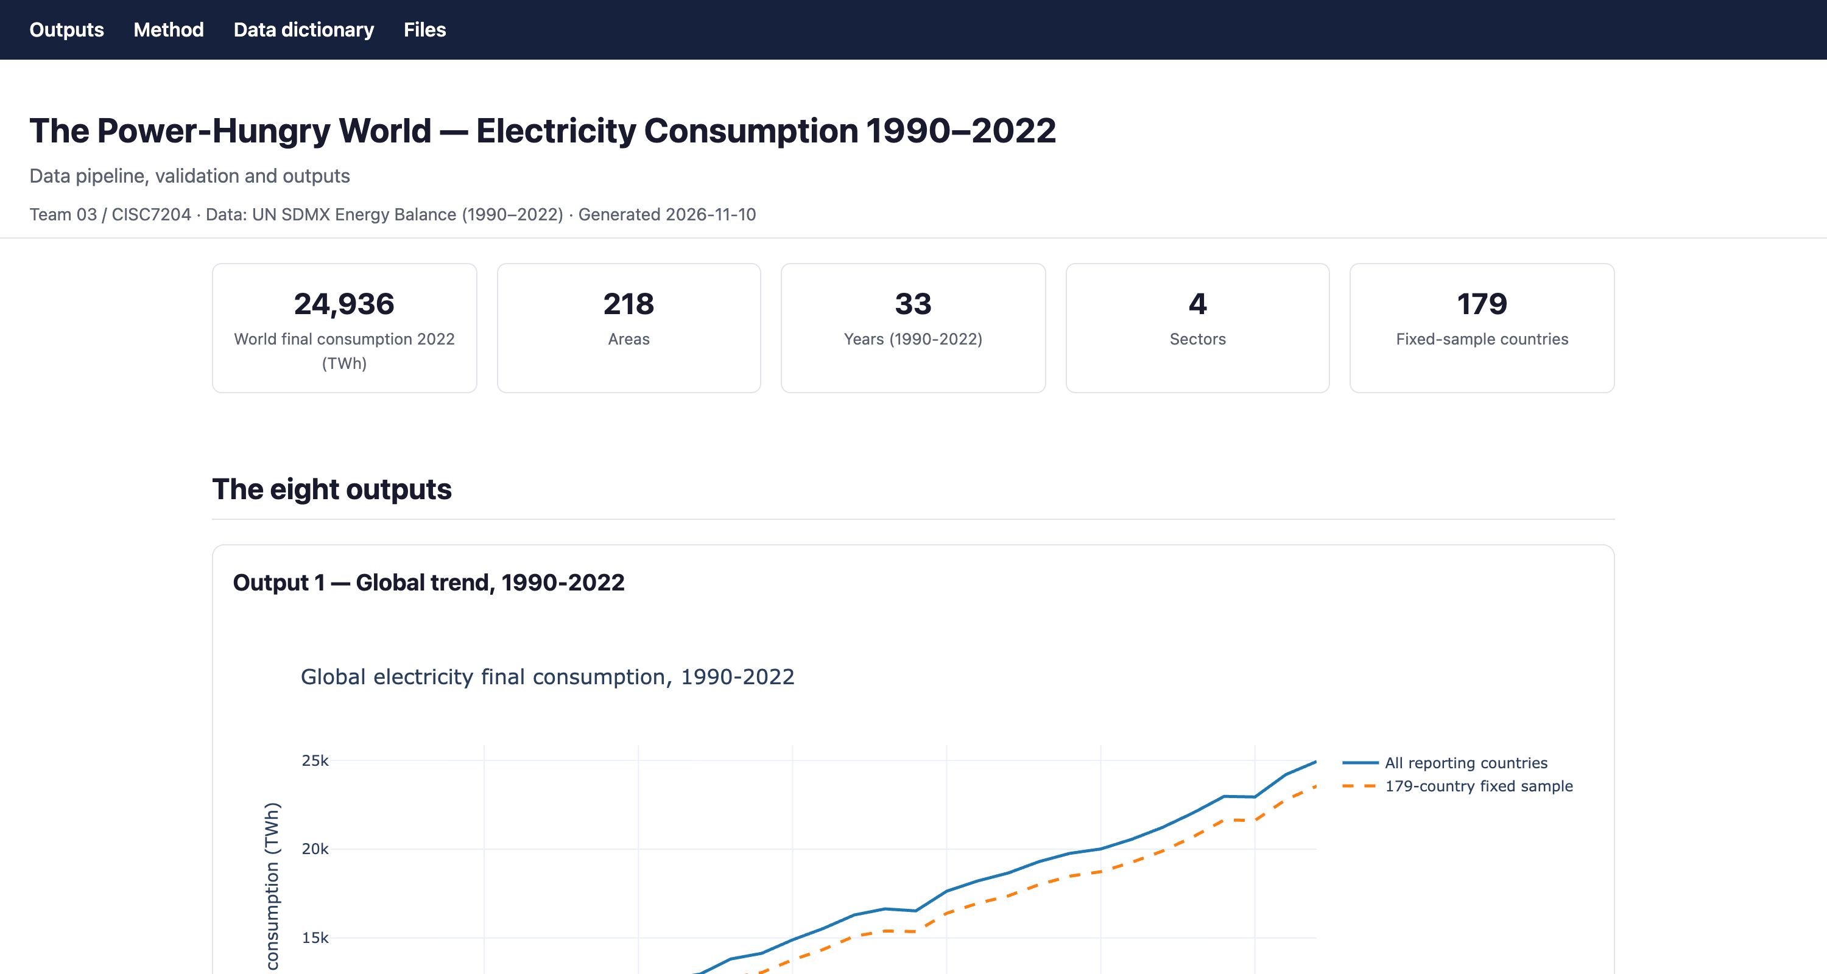
08 · FRONTEND
A self-contained dashboard anyone can open offline
web/index.html and web/method.html - generated by script, no server, no CDN, no external fonts.
team03.local/index.html
Output 7 - the 2022 choropleth, 214 of 218 areas matched to a polygon.
2 pages
outputs + method
18.5 MB
one self-contained file
Outputs page: five headline figures, nine chart cards, and a PNG/CSV download for every card.
9
chart cards, PNG + CSV each
method.html documents the ten steps from raw XML to the chart, the data dictionary for analysis_country_year.csv, and the file manifest - so a marker can audit the dashboard without running it.
The Power-Hungry World · CISC7204 Class G - Team 03
10 / 20

Slide 11
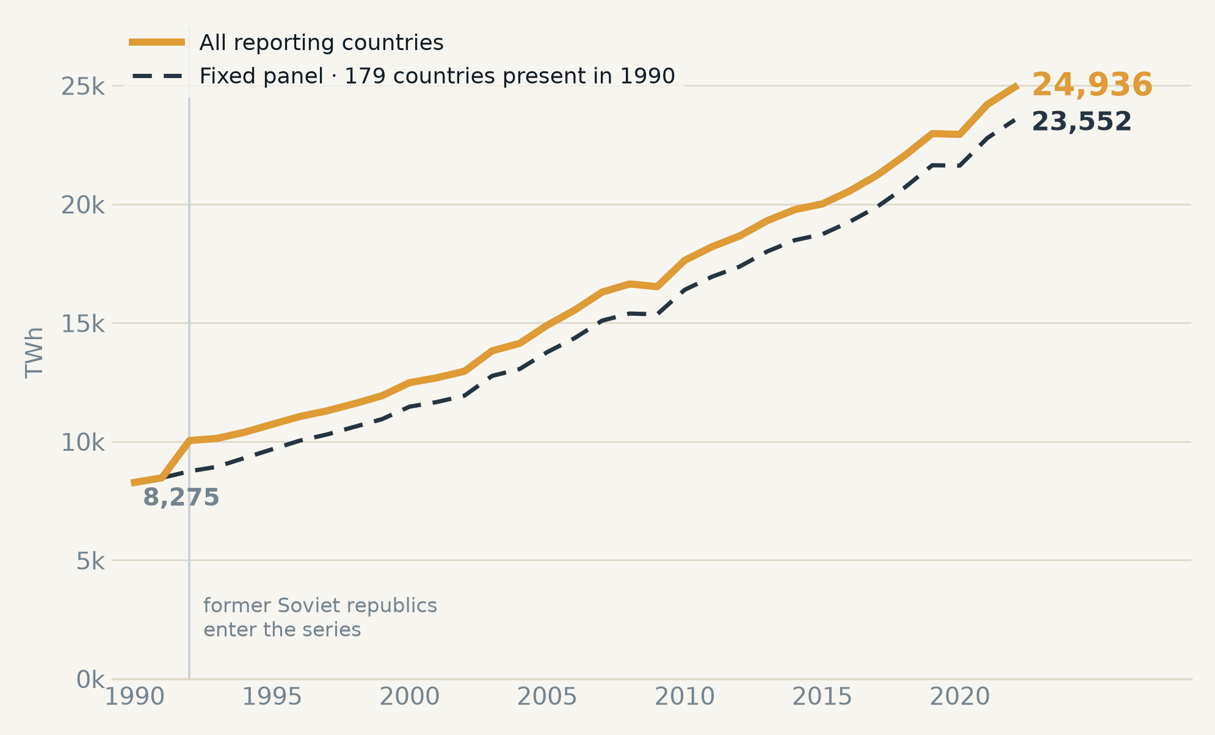
09 · FINDINGS
Final consumption roughly tripled - and most of it is real
World final electricity consumption, 1990–2022, with a fixed panel as the coverage control.
2022 WORLD TOTAL
24,936 TWh
from 8,275 TWh in 1990 · ×3.01
+201%
total growth
3.5% a year
+185%
same 179 countries
2.8× on a fixed panel
So growth is not an artefact of new reporters. The 39 areas that appear after 1990 add 1,384 TWh - 5.5% of the 2022 total - and the panel still nearly triples.
Source: UN SDMX energy balance B07_EL, final consumption (B25_FEC). All reporting areas vs. the 179 areas present in both years.
The Power-Hungry World · CISC7204 Class G - Team 03
11 / 20

Slide 12
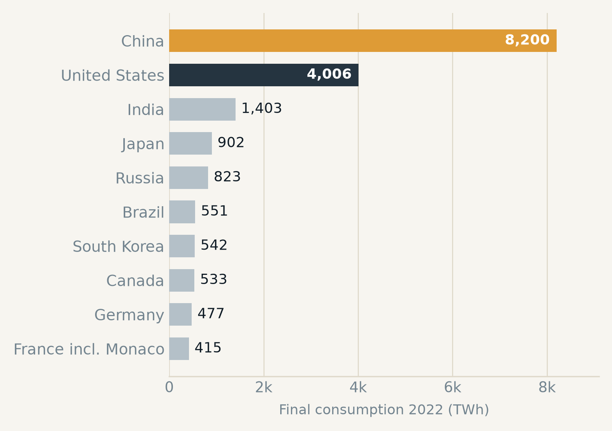
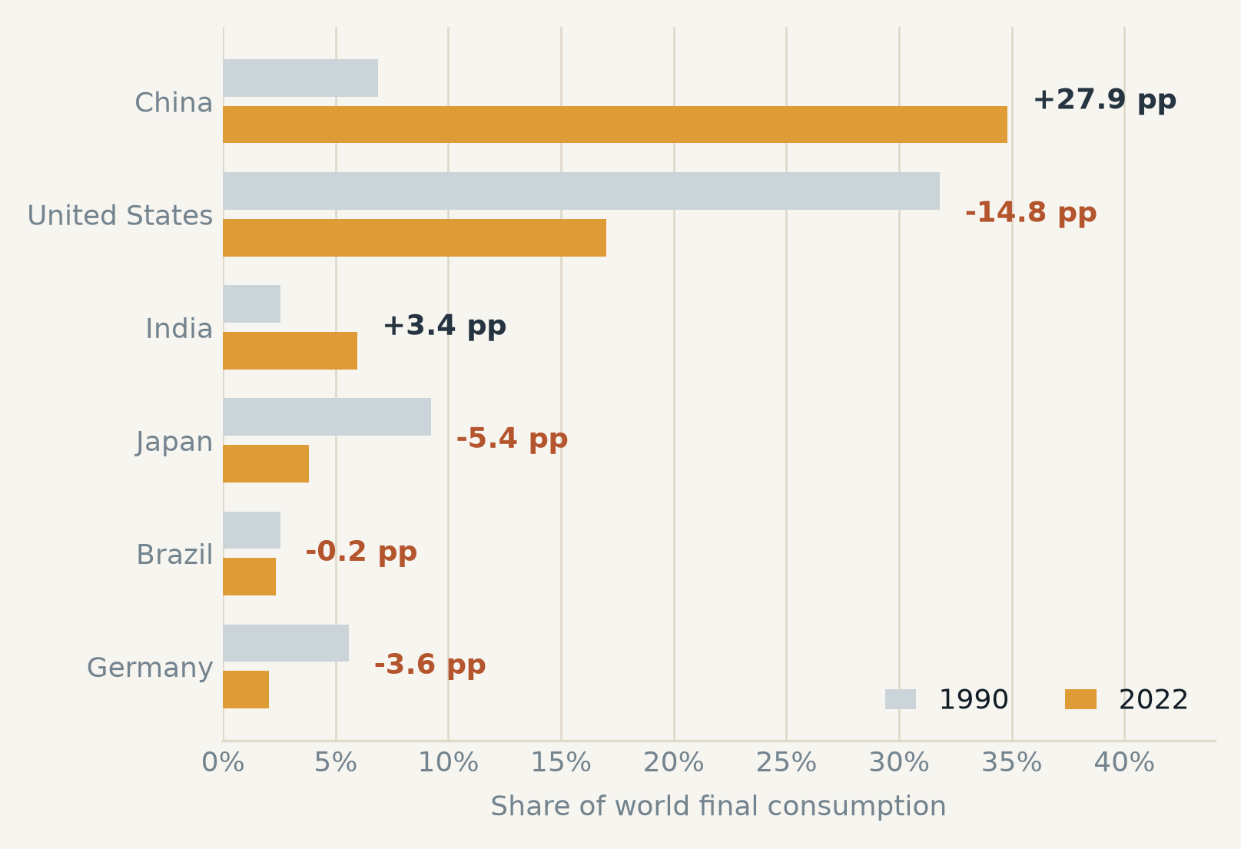
10 · FINDINGS
Ten countries hold 72% of world consumption
The top two swapped places. Ranking by final consumption in 2022, and share change on a like-for-like panel of 179 countries.
Output 2 - top ten consumers, 2022 (all 218 areas)
Output 5 - share change, same 179 countries in both years
×14.4
China, 569 → 8,200 TWh
−14.8 pp
United States share, 31.8 → 17.0%
88.6%
top 30 countries, 2022
The Power-Hungry World · CISC7204 Class G - Team 03
12 / 20

Slide 13
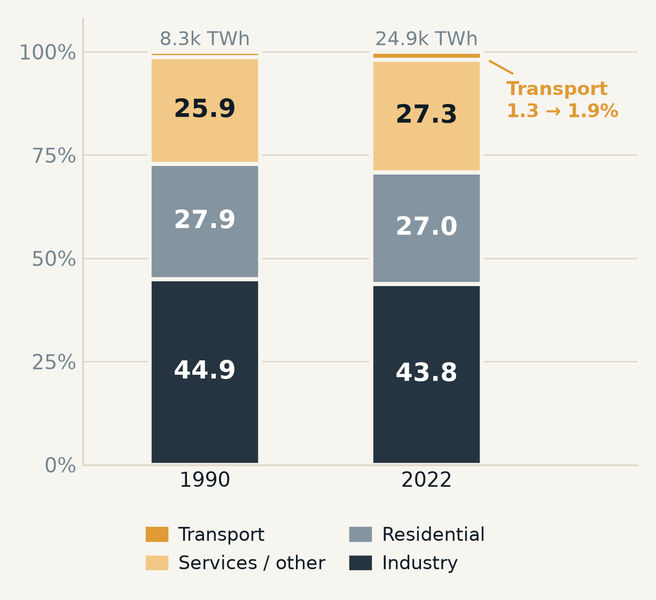
11 · FINDINGS
The sector mix barely moved - the map did
World composition in 1990 and 2022, and the same measure redrawn as comparable choropleths.
Output 4 - world sector shares
Industry 44.9 → 43.8%
Residential 27.9 → 27.0%
Transport 1.3 → 1.9%
+7,199 TWh in absolute terms - the largest single block of growth.
Flat share, but +4,413 TWh: households grew with the total.
Only 98 of 218 areas report it in 2022; treat the trend as indicative.
The Power-Hungry World · CISC7204 Class G - Team 03
13 / 20

Slide 14
12 · PROJECT CHALLENGES
Five things that could have broken the analysis
Each with the evidence we found, and what the pipeline does about it.
CHALLENGE
WHAT WE FOUND
RESPONSE
Sources disagree on the same country
UN vs OWID 2022: 125 of 201 outside 0.85–0.95; France SDES within
± 2.5%
Report both, reconcile explicitly, never merge silently
Sector reporting is uneven
Transport reported for 98 of 218 areas in 2022 - 41 areas in all 33 years
Balanced-panel check; the transport trend is labelled indicative
Later years carry more estimates
16.4% of 2022 values flagged ESTIMATE=Y, against 12.4% in 2012
Flags kept in the table; sensitivity re-run still to do
A licence blocked our first source
IEA confirmed (5–9 Nov) its licence does not permit our public outputs
IEA dropped; UNdata primary, national statistics fill documented gaps
Names and blank rows lie
China / Korea / Czechia spelled differently; nil vs missing
Explicit mapping table; a missing row is never a zero
THREE DECISIONS WE HAD TO MAKE, AND RECORD
Germany 1990 - no UN row exists, so the sector split is linked from AGEB (an estimate; industry 229.9 TWh).
Pakistan 1990–92 - industry missing and the published total omitted it; FEC recomputed to 28.75 / 31.50 / 33.89 TWh.
Pakistan 2017–22 - nil reported for 2017–19, set to 0; 2020–22 has no source and is being reset to missing.
The Power-Hungry World · CISC7204 Class G - Team 03
14 / 20

Slide 15
13 · CRITERIA OF SUCCESS AND EVALUATION
Nine checks, run before submission
Seven met, one partial, one open - with the evidence that decides each one.
CRITERION
EVIDENCE TODAY
STATUS
Data quality and coverage
6,932 country-years; 10 flagged rows; limitations list published
MET
Calculation correctness
Sector sum equals FEC within 1% in 6,932 of 6,932 country-years
MET
Reproducibility and traceability
7 scripts + manifest; every figure regenerated from the tables
MET
Comparability
one mapping table; four sector groups; parent aggregate never added
MET
Geospatial accuracy
214 of 218 areas matched to a Natural Earth polygon; 4 disclosed
MET
Visual communication
one palette; units, years and source on every figure
MET
Interactive dashboard
8 outputs + slider + downloads - static HTML, not the planned Dash app
PARTIAL
Robustness and sensitivity
41 year-on-year jumps over 50% reviewed; panel re-run still pending
OPEN
Citations and licences
UN, OWID, World Bank, Natural Earth and national sources cited; licences checked 9 Nov; IEA dropped
MET
Cross-source evaluation: of 201 countries checked against OWID demand in 2022, 76 fall inside the expected 0.85–0.95 ratio band and 125 do not. Every outlier is recorded with a reason - the open question is the band, not the data.
The Power-Hungry World · CISC7204 Class G - Team 03
15 / 20

Slide 16
14 · PROJECT DELIVERABLES
What exists today
Eight deliverables, all committed to one repository and all regenerable from the scripts.
2 CSV
8 PNG
1 HTML
2 PAGES
Analysis tables
Eight figures
Animated map
Dashboard
6,932 country-years and 198 region-years in TWh, with three quality flags.
Trends, rankings, composition, share change and two choropleths, at 250 dpi.
1990–2022 slider, self-contained, opens without a network.
Outputs and method, each chart with a caption and a CSV/PNG download.
7 SCRIPTS
315 LINES
2 CSV
4 FILES
Pipeline
Method document
Validation records
Report, proposal, video
1,621 lines from the SDMX request to the finished dashboard.
DATA_PIPELINE.md: sources, decisions, validation, limitations, manifest.
41 year-on-year jumps and 201 cross-source ratios, each with a reason.
Proposal, meeting minutes, five-minute introduction, written report.
github.com/UNCHIKIT/CISC7204-GroupG-SemesterProject-Team03 · branch main · 18 commits, 3–10 November 2026
The repository holds code, instructions and permitted derived outputs - no IEA data, which was dropped for licence reasons.
The Power-Hungry World · CISC7204 Class G - Team 03
16 / 20

Slide 17
15 · DIVISION OF WORK
One owner per role, one backup per task
Roles as proposed; current responsibilities as approved in Work Plan 02 (10 Nov). Effort shares were agreed in week 1.
UN CHI KIT
18%
KELDEN JAMTSHO
20%
UC
MC653081
KJ
MC664183
Coordinator · tracker
of effort
Analyst · quality reviewer
of effort
Technical development: pipeline, analysis tables, figures, dashboard
Data collection and preprocessing: sources, supplements, licences
GAN RUIYAN
22%
HE YIFEI
15%
GR
MC664801
HY
MC664916
Lead developer
of effort
Reporter · liaison
of effort
Presentation PPT: content structure and storyline
Progress documentation, report integration, instructor contact
SHENG TIAN
15%
TANG JING
10%
ST
MC664961
TJ
MC666256
Second developer
of effort
Second analyst · scribe
of effort
Presentation PPT: slide design, chart layouts, readability
Meeting minutes, progress records, document checks
Decisions are collective; delivery is not. Each artefact has one named owner, and the reviewer signs it off before submission.
The Power-Hungry World · CISC7204 Class G - Team 03
17 / 20

Slide 18
16 · CONTRIBUTIONS
What each member actually produced
A filled marker is a primary contribution, an open marker a supporting one - plus the deliverable that carries the member's name.
MEMBER
PIPELINE
ANALYSIS
FIGURES
DASHBOARD
REPORT / VIDEO
ADMIN
SIGNATURE DELIVERABLE
UN CHI KIT
Data pipeline, analysis tables, figures and the two-page dashboard
KELDEN JAMTSHO
Source evaluation, IEA correspondence, supplementary national sources
GAN RUIYAN
Presentation PPT content and storyline
HE YIFEI
Report integration and the introductory video presentation
SHENG TIAN
Presentation PPT design and chart layouts
TANG JING
Meeting minutes, progress records and document checks
HOW THIS WAS VERIFIED
Responsibilities follow Work Plan 02, approved by all six members on 10 November; the commit log (18 commits, 3–10 November) records the data and pipeline work.
The Power-Hungry World · CISC7204 Class G - Team 03
18 / 20

Slide 19
17 · PROJECT LEARNING
What we learned - individually and together
One line each, chosen by the member it belongs to.
UN CHI KIT
KELDEN JAMTSHO
A schedule is a data structure: the tracker only works if every task has a date and a name.
A number is not a finding. The ratio between two sources told us more than either source did.
GAN RUIYAN
HE YIFEI
Reproducibility is a design constraint, not a final check - it decides how the files are shaped.
Writing the method before the results kept the narrative honest and made the video script easy.
SHENG TIAN
TANG JING
A chart is an argument. Two maps only compare if they share one colour scale and one classification.
Minutes are cheap insurance: three decisions we later defended were recorded before we made them.
AS A TEAM
- Scope discipline beats scope: the three decisions that change every number - window, unit, sector grouping - were fixed first.
- The hardest work was not analysis - it was deciding what a missing value means.
- Two sources that disagree are more useful than one source that is trusted.
- Every hour spent on the method document saved an hour of explaining a number later.
The Power-Hungry World · CISC7204 Class G - Team 03
19 / 20

Slide 20
18 · WORK IN PROGRESS
What is finished, what is not, and what comes next
Stated plainly: a project that hides its gaps cannot be evaluated fairly.
FINISHED
PARTIAL
OPEN
· Eight outputs and both dashboard pages
· Dashboard is static HTML, not the planned Dash app
· Balanced-panel sensitivity for sector trends
· Four validation layers, all passing
· Cross-source band 0.85–0.95 flags 125 of 201
· Malaysia source pending; Bangladesh unchecked
· Three data decisions documented and flagged
· Notebook still reads a cached CSV
· Saudi transport not reported; Indonesia supplements not yet integrated
· Pipeline runs from one command chain
· GeoplotLib replaced by Plotly
· No unit tests; validation is a script
NEXT, BEFORE 3 DECEMBER
Re-run the sector trends on a balanced panel and report both versions · rebuild the notebook against the new pipeline · calibrate or defend the cross-source band · write the report · rehearse and submit by 3 December.
Thank you - questions welcome.
github.com/UNCHIKIT/CISC7204-GroupG-SemesterProject-Team03
Class G - Team 03 · CISC7204
The Power-Hungry World · CISC7204 Class G - Team 03
20 / 20

