Slide 1
CISC 7204 · DATA SCIENCE AND DATA VISUALIZATION
The Power-Hungry
World
Comparing global electricity consumption across sectors
TEAM PROJECT · INTRODUCTORY VIDEO · 5 NOVEMBER 2026
Presented by HE YIFEI (Zephyr) · MC664916
Class G — Team 03 · 2026/2027, Semester 1 · Six members
University of Macau · Department of Computer and Information Science
Notes:
00:00-00:15 | Hi, I am Zephyr - He Yifei - from Class G, Team 03. For the next five minutes I will introduce the project we are building this semester: The Power-Hungry World, comparing global electricity consumption across sectors.

Slide 2
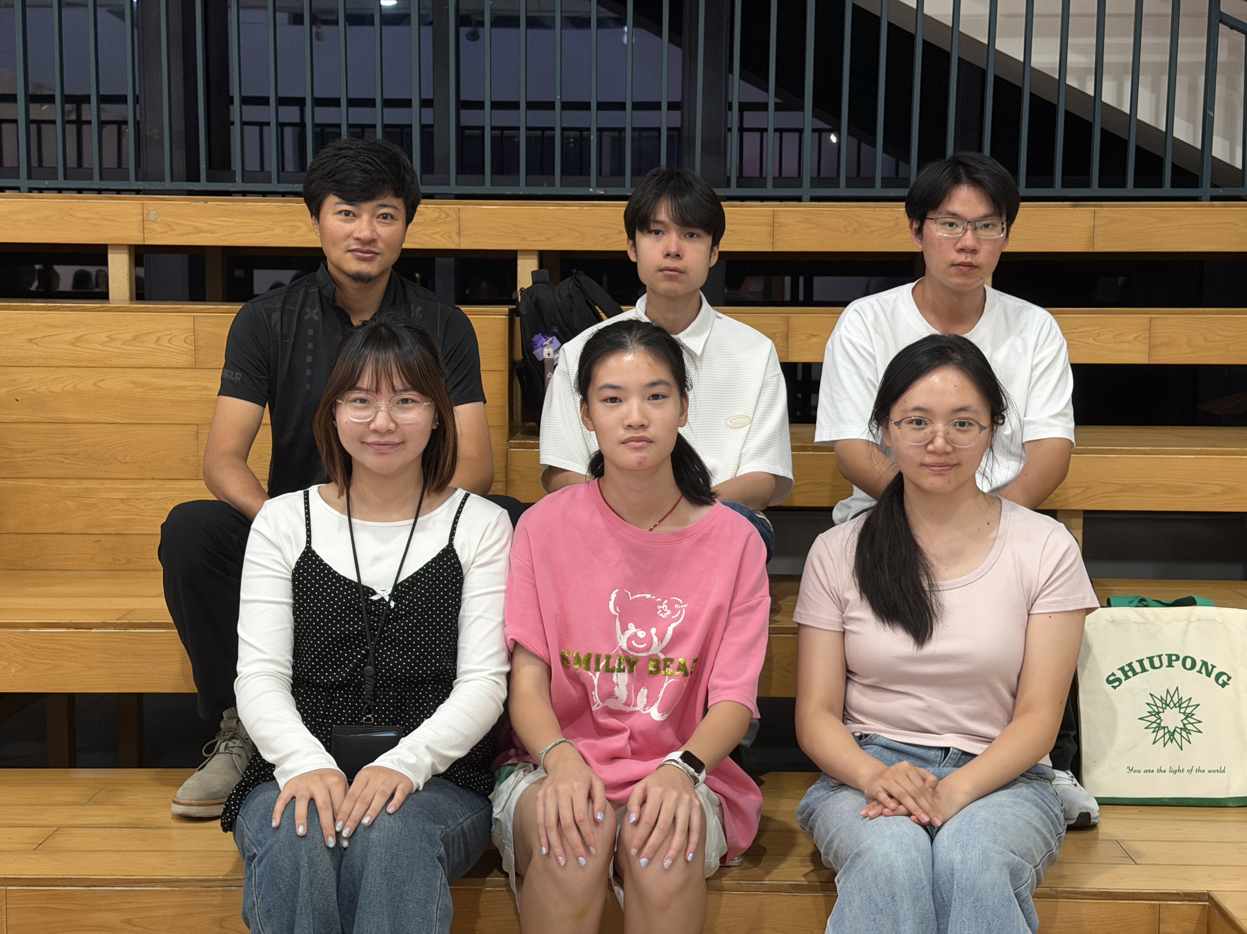
THE TEAM
Six members, six roles, one table
UN CHI KIT
MC653081
Team coordinator · project tracker
KELDEN JAMTSHO
MC664183
Project analyst · quality reviewer
GAN RUIYAN
MC664801
Lead project developer
HE YIFEI
MC664916
Team reporter · team liaison
SHENG TIAN
MC664961
Second project developer
TANG JING
MC666256
Second project analyst · team scribe
CISC7204 Data Science and Data Visualization · Class G — Team 03 · 2026/2027, Semester 1
The Power-Hungry World: Comparing Global Electricity Consumption Across Sectors
The Power-Hungry World · CISC7204 Class G · Team 03
02 / 12
Notes:
00:15-00:35 | We are six members of Class G, Team 03 - Un Chi Kit, Kelden Jamtsho, Gan Ruiyan, me, Sheng Tian and Tang Jing. Every role in this project has one owner: coordination, analysis, development, reporting and the minutes.

Slide 3
WHY THIS PROJECT
One number is true. It explains almost nothing.
24,700 TWh
The public conversation about electricity usually cites a single global total. It is accurate — and it hides the only part worth arguing about: which regions, which countries and which sectors moved, and by how much.
World final electricity consumption, 2022 · IEA: 88,859 PJ ÷ 3.6
218
4
1990
countries and
territories
sector groups
compared
start of the
comparison window
The Power-Hungry World · CISC7204 Class G · Team 03
03 / 12
Notes:
00:35-01:05 | Here is the number everyone quotes. In 2022 the world consumed about 24,700 terawatt-hours of electricity. It is correct, and on its own it is useless: it cannot tell us who used that power, where the growth happened, or whether industry or households drove it. Our project replaces the total with a decomposition.

Slide 4
RESEARCH QUESTION
How has electricity consumption changed across the world’s countries and regions between 1990 and 2022, and which countries and sectors account for the largest shares of that consumption?
THREE SUB-QUESTIONS, ONE HARMONISED TABLE
01
02
03
Change over time
Country shares
Sector shares
Growth by region and by the largest countries: absolute change, compound annual growth, index 1990 = 100, and growth by decade.
Each country’s share of world consumption in 1990, 2000, 2010 and 2022; the top ten and how their ranks moved.
How consumption splits between industry, transport, residential and services — worldwide and by region, 1990 against 2022.
Answerable with descriptive statistics and a small number of tests — the data is observational, so we describe patterns and do not claim causes.
The Power-Hungry World · CISC7204 Class G · Team 03
04 / 12
Notes:
01:05-01:35 | The question has three parts, and they all come from the same table. First, how consumption changed over time, by region and for the largest countries. Second, which countries hold the shares, and whether that changed. Third, how the split between industry, transport, residential and services moved. Descriptive statistics answer this; the data cannot support causal claims, and we do not make them.

Slide 5
DATA
Three public sources, one comparable table
PRIMARY · SECTORS AND REGIONAL TOTALS
PRIMARY · COUNTRY TOTALS AND RANKS
CONTEXT · GENERATION MIX · ANCHOR
IEA World Energy
Balances Highlights, 2026
UN Statistics Division
Energy Balance dataflow
Our World in Data
Energy (Ember, Energy Institute)
COVERAGE
COVERAGE
COVERAGE
54 countries, 10 aggregates
218 countries and territories
213 countries with demand data
WINDOW · UNIT
WINDOW · UNIT
WINDOW · UNIT
1971–2024 · petajoules
1990–2023 · terajoules
2000–2022 · terawatt-hours
SECTOR DETAIL
SECTOR DETAIL
SECTOR DETAIL
industry, transport, residential, commercial
industry, transport, households, commerce
totals only — no sector split
ACCESS
ACCESS
ACCESS
free account; the raw file must not be redistributed
public API and CSV; free to copy with UNSD cited
free CSV, XLSX, JSON in one request
Each source covers the others’ gaps. Raw files stay untouched — the repository holds code, instructions and a derived extract, never licensed data.
The Power-Hungry World · CISC7204 Class G · Team 03
05 / 12
Notes:
01:35-02:10 | Three sources, each covering the others gaps. The IEA balances give sector detail and regional totals, but the licence forbids redistributing the file. UN energy balances give all 218 countries and territories, with no aggregates. Our World in Data adds generation mix and, because it downloads in one request, it becomes our reproducibility anchor. Everything is converted to one unit: terawatt-hours.

Slide 6
METHOD
Three raw files become one analysis table
01
02
03
04
05
06
Acquire and freeze
Harmonise
Change over time
Country shares
Sector shares
Validate and report
Each file date-stamped in a manifest.
Names, TJ → PJ → TWh, four sector groups, estimate flag kept.
Regional totals, growth rates, index 1990 = 100.
Top-ten shares and concentration across four census years.
Share change in points; contribution to total growth.
Nine checks, four figures, dashboard, notebook.
HELD CONSTANT ACROSS EVERY RESULT
WINDOW
UNIT
SECTORS
RULE
1990–2022
TWh (1 TWh = 3.6 PJ)
industry · transport · residential · services
a missing sector row is not zero
Python 3.14 · pandas · matplotlib · seaborn · pinned environment, notebook re-runs clean
The Power-Hungry World · CISC7204 Class G · Team 03
06 / 12
Notes:
02:10-02:40 | The pipeline has six steps. Freeze the three files. Harmonise them - country spellings, unit conversion, four sector groups, and the estimate flag carried through. Then one analysis per sub-question. Finally validate: nine checks, four figures and a dashboard. The window, the unit and the sector groups are fixed before any figure is drawn.

Slide 7
OUTPUTS
Four figures, one dashboard, one notebook
01
02
03
04
Regional trend
Country share shift
Sector share
Generation mix
Absolute TWh by region and largest country, 1990–2022; index 1990 = 100.
Top-ten countries’ share of world consumption, 1990 against 2022.
Four sector groups as a share of world and regional totals, 1990 vs 2022.
Fuel split, 2000 vs 2022 — generation, not consumption, shown separately.
PLUS
One interactive dashboard for exploring country and sector shares, and one executed notebook that reproduces every number in the report.
The Power-Hungry World · CISC7204 Class G · Team 03
07 / 12
Notes:
02:40-03:00 | Four figures and a dashboard. A regional trend, a country-share shift, a sector-share comparison, and - kept deliberately separate, because generation is not consumption - the fuel mix. Everything is produced by one executed notebook, so any number in the report can be traced back to code.

Slide 8
OPEN PROBLEMS
Five things that could break the analysis
01
The sources disagree on the same country
→
Report both, reconcile explicitly, never merge silently.
UN/IEA total ratios: Indonesia 0.77, China 1.09, India 0.98, Korea 0.95 — unexplained.
02
Sector reporting is uneven
→
Repeat the sector trend on a balanced country panel.
UN transport is reported for 98 of 218 areas in 2022 — 81 in 2012.
03
Late years carry more estimates
→
Re-run key results with estimates excluded.
17.3 % of 2022 UN values are flagged as estimates; 12.9 % in 2012.
04
The IEA licence blocks replication
→
Ship a derived extract; let OWID anchor reproduction.
The raw file may not be redistributed or committed to Git.
05
Names and blank rows lie
→
Explicit mapping table and documented rules.
China, Korea, Turkey and Czechia are spelled differently; a missing row is not a zero.
The Power-Hungry World · CISC7204 Class G · Team 03
08 / 12
Notes:
03:00-03:45 | This is the honest part, and the part we will spend most of our time on. One: the two main sources disagree on the same country - China by nine per cent, Indonesia by twenty-three. We report both and never merge them silently. Two: sector reporting is uneven, so a rising transport series can simply mean more countries reported. Three: later years carry far more estimates. Four: the IEA licence stops anyone re-running our data, so we ship a derived extract and use Our World in Data as the anchor. Five: country names do not join cleanly, and a missing row is not a zero.

Slide 9
SUCCESS CRITERIA
Nine checks, all run before submission
01
02
03
Data quality
Reproducibility
Calculation correctness
Missing values, estimates and coverage gaps stated for every table.
The notebook runs clean from a restart in a fresh environment.
Sector shares sum to 100 %; all unit conversions consistent.
04
05
06
Figure clarity
Citations and licences
Brief compliance
Every figure carries title, units, source and years.
Every source and licence condition covered; IEA cited as required.
Checked line by line against the assignment brief.
07
08
09
Reporting bias
Estimate sensitivity
Traceability
Sector trends repeated using only countries reporting every year.
Key results re-run with estimated values excluded.
Every sentence in the report ties to a number in the outputs.
Each check is observable, and each is run before submission — not asserted afterwards.
The Power-Hungry World · CISC7204 Class G · Team 03
09 / 12
Notes:
03:45-04:05 | Nine checks decide whether the work is good enough, and we run all of them before submitting - data quality, reproducibility, the arithmetic, figure clarity, citations and licences, the brief itself, reporting bias, estimate sensitivity, and traceability from every sentence back to a number.

Slide 10
DIVISION OF WORK
One owner for every task
UC
UN CHI KIT
KJ
KELDEN JAMTSHO
GR
GAN RUIYAN
MC653081
MC664183
MC664801
Coordinator · tracker
Analyst · quality reviewer
Lead developer
Proposal assembly, schedule, submission log
Research question, data, every number checked
Pipeline, notebook, dashboard, repository
HY
HE YIFEI
ST
SHENG TIAN
TJ
TANG JING
MC664916
MC664961
MC666256
Reporter · liaison
Second developer
Second analyst · scribe
Report, video, instructor contact, rehearsal
Visualisations and dashboard components
Minutes, second analysis, figure checks
Decisions are collective. Every number comes from the notebook. The reviewer signs off each deliverable. The coordinator ticks each individual submission by name.
The Power-Hungry World · CISC7204 Class G · Team 03
10 / 12
Notes:
04:05-04:25 | Six people, and every task has one accountable owner. Kelden owns the analysis and checks every number; Gan owns the pipeline; Sheng owns the visualisations; I own the report and this video; Tang keeps the minutes and runs the second analysis; Un Chi Kit coordinates and ticks off each submission by name.

Slide 11
TIMELINE
Four weeks, ending 3 December
W1 · 5–11 NOV
W2 · 12–18 NOV
W3 · 19–25 NOV
W4 · 26 NOV–3 DEC
Sources frozen and harmonised
Sub-question 1 — change over time
Sub-question 2 — country shares
Sub-question 3 — sector shares
Four figures and dashboard
Report, rehearsal, validation
DEADLINES
5 NOV proposal · minutes · video
3 DEC semester project submitted
5 DEC collaboration record posted
The Power-Hungry World · CISC7204 Class G · Team 03
11 / 12
Notes:
04:25-04:50 | The plan runs from the proposal deadline to the third of December. Week one freezes and harmonises the data. Week two runs the time-series and the country shares. Week three adds the sector analysis and the generation mix. Week four is the report, the dashboard, the rehearsal and a final validation pass. The collaboration record follows on the fifth.

Slide 12
THANK YOU
Read it. Run it. Check it.
One repository holds the code, the instructions and the evidence behind every number in this project.
REPOSITORY
github.com/UNCHIKIT/CISC7204-GroupG-SemesterProject-Team03
HE YIFEI (Zephyr) · MC664916
Class G — Team 03 · CISC7204 Data Science and Data Visualization · 2026/2027, Semester 1
Questions welcome — happy to walk through the notebook.
THE POWER-HUNGRY WORLD
Notes:
04:50-05:00 | Everything you have just seen is in one repository: the code, the instructions, and the evidence behind every number. Thank you - we are happy to take questions.

