Slide 1







How do we evaluate scenarios in the context of public health action?
or “What can we learn from evaluating
scenario projections” continued
Justin Lessler and Emily Howerton
with thanks to Cecile Viboud and the SMH Teams . Modelling and inference for pandemic preparedness, Isaac Newton Institute
Notes:
10-12 min presentation, 3-5 for questions
Welcome, SMH large collaborative effort

Slide 2
Clarification: What is a planning scenario?

Slide 3
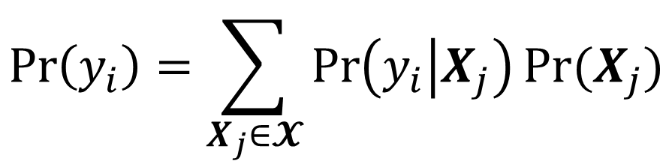

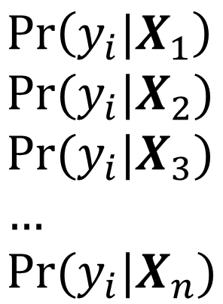
Planning scenarios are conditional forecasts
“Proper”
Forecast
$$\operatorname{Pr}\left(y_{i}\right)=\sum_{X_{j}∈𝓧}{\operatorname{Pr}\left(y_{i} | X_{j}\right)Pr⁡(X_{j})}$$
$$\operatorname{Pr}\left(y_{i}|X_{1}\right) \\ \operatorname{Pr}{(y_{i}|X_{2}}) \\ \operatorname{Pr}{(y_{i}|X_{3}}) \\ … \\ Pr⁡(y_{i}|X_{n})$$
Planning
Scenarios
where
$$<X_{1},X_{2},…,X_{n}>⊆𝓧$$

Slide 4
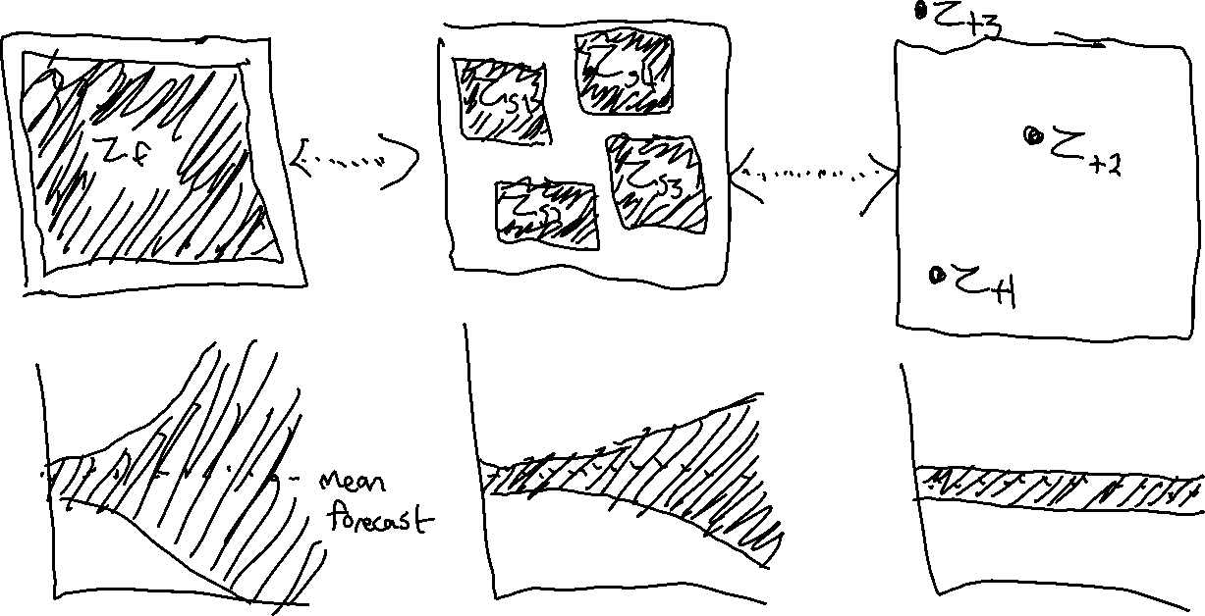
Forecasting
Planning Scenarios
Theoretical

Slide 5
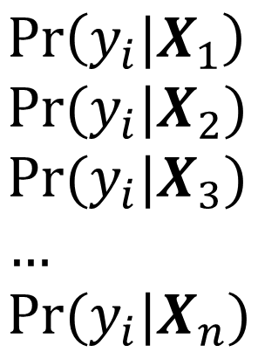
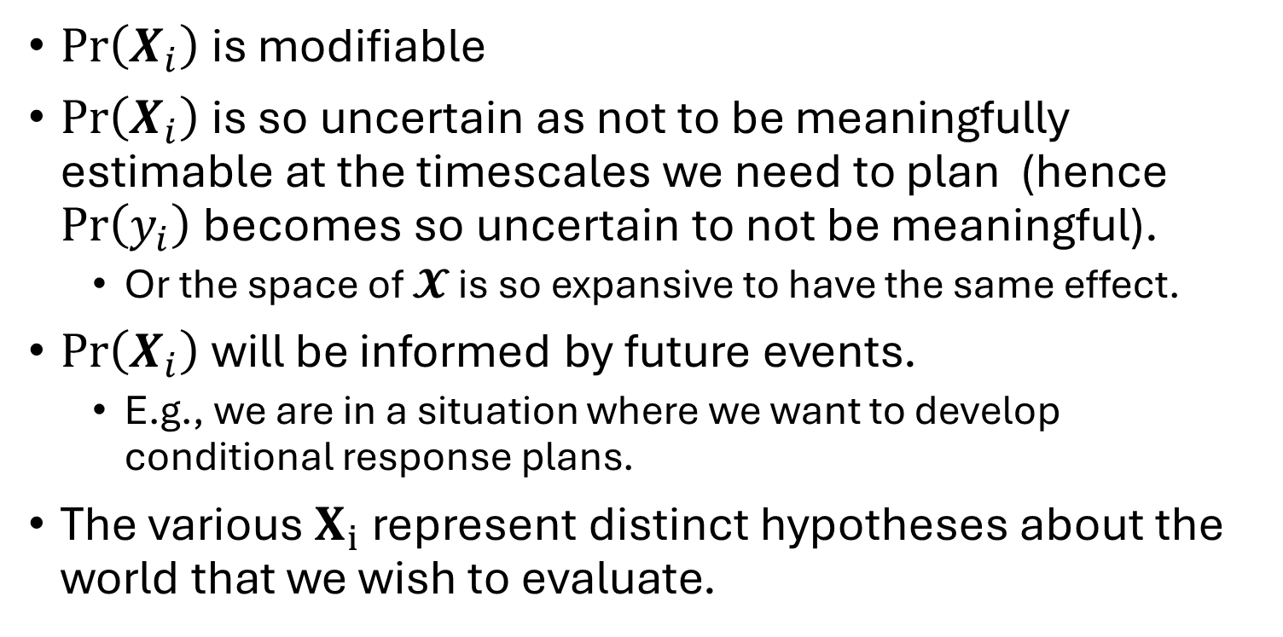
Why would we want to do this?
$Pr\left(X_{i}\right)$ is modifiable
$Pr\left(X_{i}\right)$ is so uncertain as not to be meaningfully estimable at the timescales we need to plan (hence $\operatorname{Pr}\left(y_{i}\right)$ becomes so uncertain to not be meaningful).
Or the space of $𝓧$ is so expansive to have the same effect.
$Pr\left(X_{i}\right)$ will be informed by future events.
E.g., we are in a situation where we want to develop conditional response plans.
The various $X_{i}$ represent distinct hypotheses about the world that we wish to evaluate.
$$\operatorname{Pr}\left(y_{i}|X_{1}\right) \\ \operatorname{Pr}{(y_{i}|X_{2}}) \\ \operatorname{Pr}{(y_{i}|X_{3}}) \\ … \\ Pr⁡(y_{i}|X_{n})$$

Slide 6
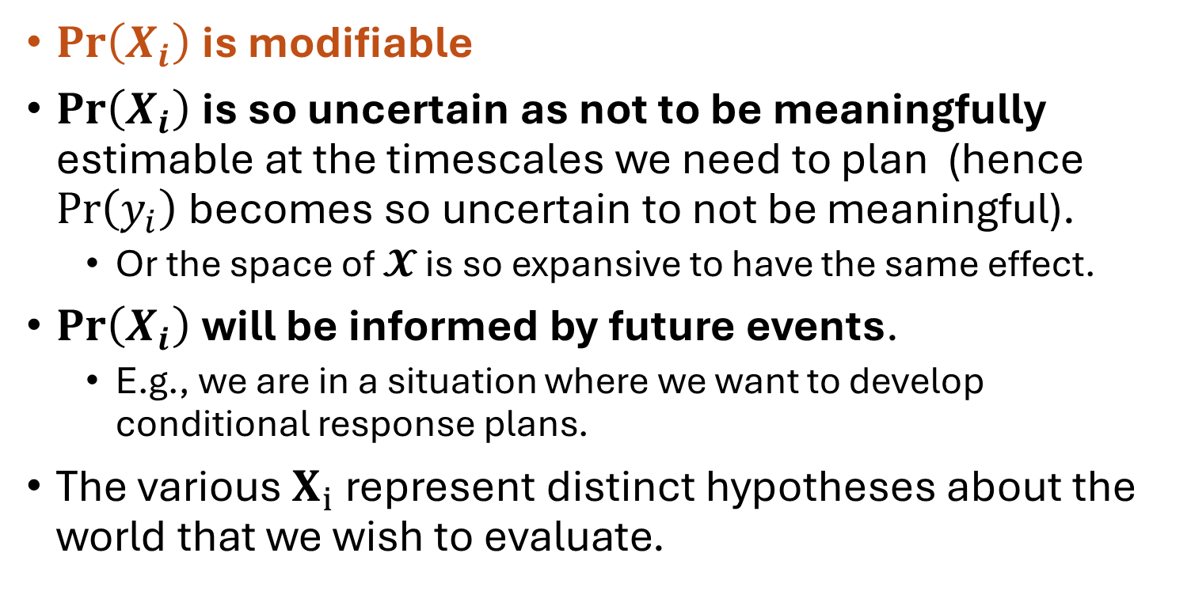
Why would we want to do this?
$Pr\left(X_{i}\right)$ is modifiable
$Pr\left(X_{i}\right)$ is so uncertain as not to be meaningfully estimable at the timescales we need to plan (hence $\operatorname{Pr}\left(y_{i}\right)$ becomes so uncertain to not be meaningful).
Or the space of $𝓧$ is so expansive to have the same effect.
$Pr\left(X_{i}\right)$ will be informed by future events.
E.g., we are in a situation where we want to develop conditional response plans.
The various $X_{i}$ represent distinct hypotheses about the world that we wish to evaluate.
$$\operatorname{Pr}\left(y_{i}|X_{1}\right) \\ \operatorname{Pr}{(y_{i}|X_{2}}) \\ \operatorname{Pr}{(y_{i}|X_{3}}) \\ … \\ Pr⁡(y_{i}|X_{n})$$

Slide 7

Challenge: Planning scenarios are inherently counterfactual, so how do we evaluate them (i.e., hold ourselves accountable).

Slide 8
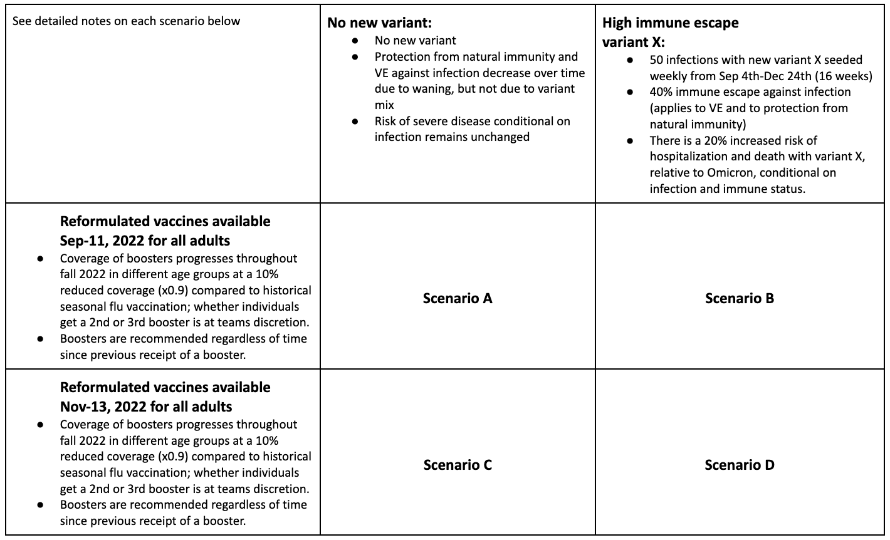


Slide 9
Conjecture: A full set of planning scenarios should be evaluated in relation to how useful it is.

Slide 10
Conjecture: A predictive model is only useful if it helps use respond to future events.
So what does it mean to respond?

Slide 11
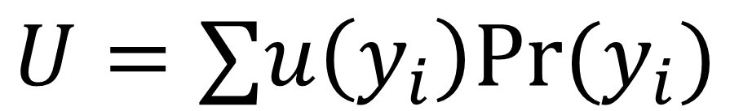
Response is about modifying a utility function.
$$U=∑u\left(y_{i}\right)Pr⁡(y_{i})$$
Notes:
Does this capture different goals and trying to do most of these simultaneously leads to tensions and challenges.

Slide 12
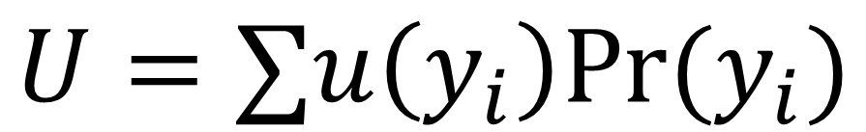
Two types of response
$$U=∑u\left(y_{i}\right)Pr⁡(y_{i})$$
Preparing
Intervening
Taking actions that mitigate the impact of some future event or allow us to best benefit from that event.
E.g., wearing your raincoat, making an investment
Intervening: Taking actions that prevent or lower the probability of some forecast future event
E.g., lockdowns, reducing carbon emissions
Notes:
Does this capture different goals and trying to do most of these simultaneously leads to tensions and challenges.

Slide 13
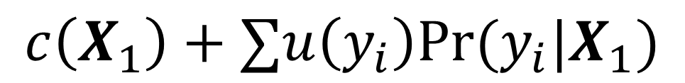
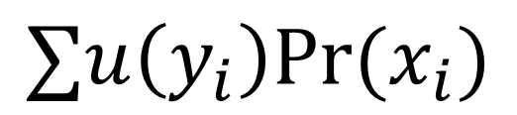
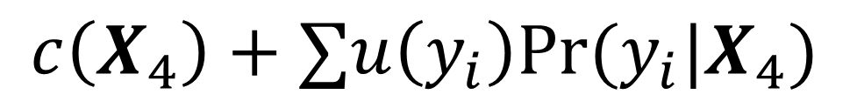
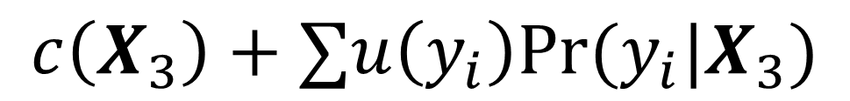
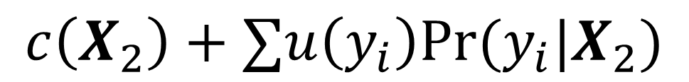
Preparing
Intervening
$$c\left(X_{1}\right)+∑u\left(y_{i}\right)Pr⁡(y_{i}|X_{1})$$
Responder Optimized
$$c\left(X_{2}\right)+∑u\left(y_{i}\right)Pr⁡(y_{i}|X_{2})$$
Responder Optimized
$$∑u\left(y_{i}\right)Pr⁡(x_{i})$$
$$c\left(X_{3}\right)+∑u\left(y_{i}\right)Pr⁡(y_{i}|X_{3})$$
$$c\left(X_{4}\right)+∑u\left(y_{i}\right)Pr⁡(y_{i}|X_{4})$$

Slide 14






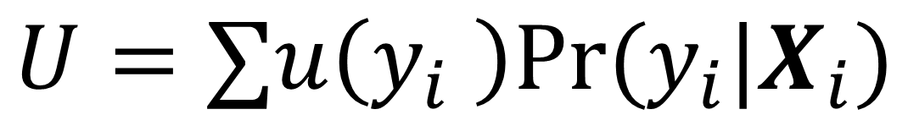
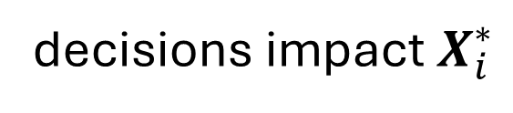
Differing consumers
decisions impact $X_{i}^{∗}$
$$U=∑u\left(y_{i} \right)Pr⁡(y_{i}|X_{i})$$
decisions impact utility

Slide 15
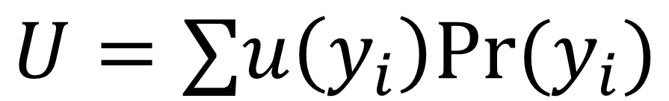
Differing consumers
$$U=∑u\left(y_{i}\right)Pr⁡(y_{i})$$
We want to
evaluate this
But different consumers
have different values of
this.

Slide 16
Argument: Regardless of the complications the full set of scenarios should be evaluated in the context of decision theory and value of information.

Slide 17
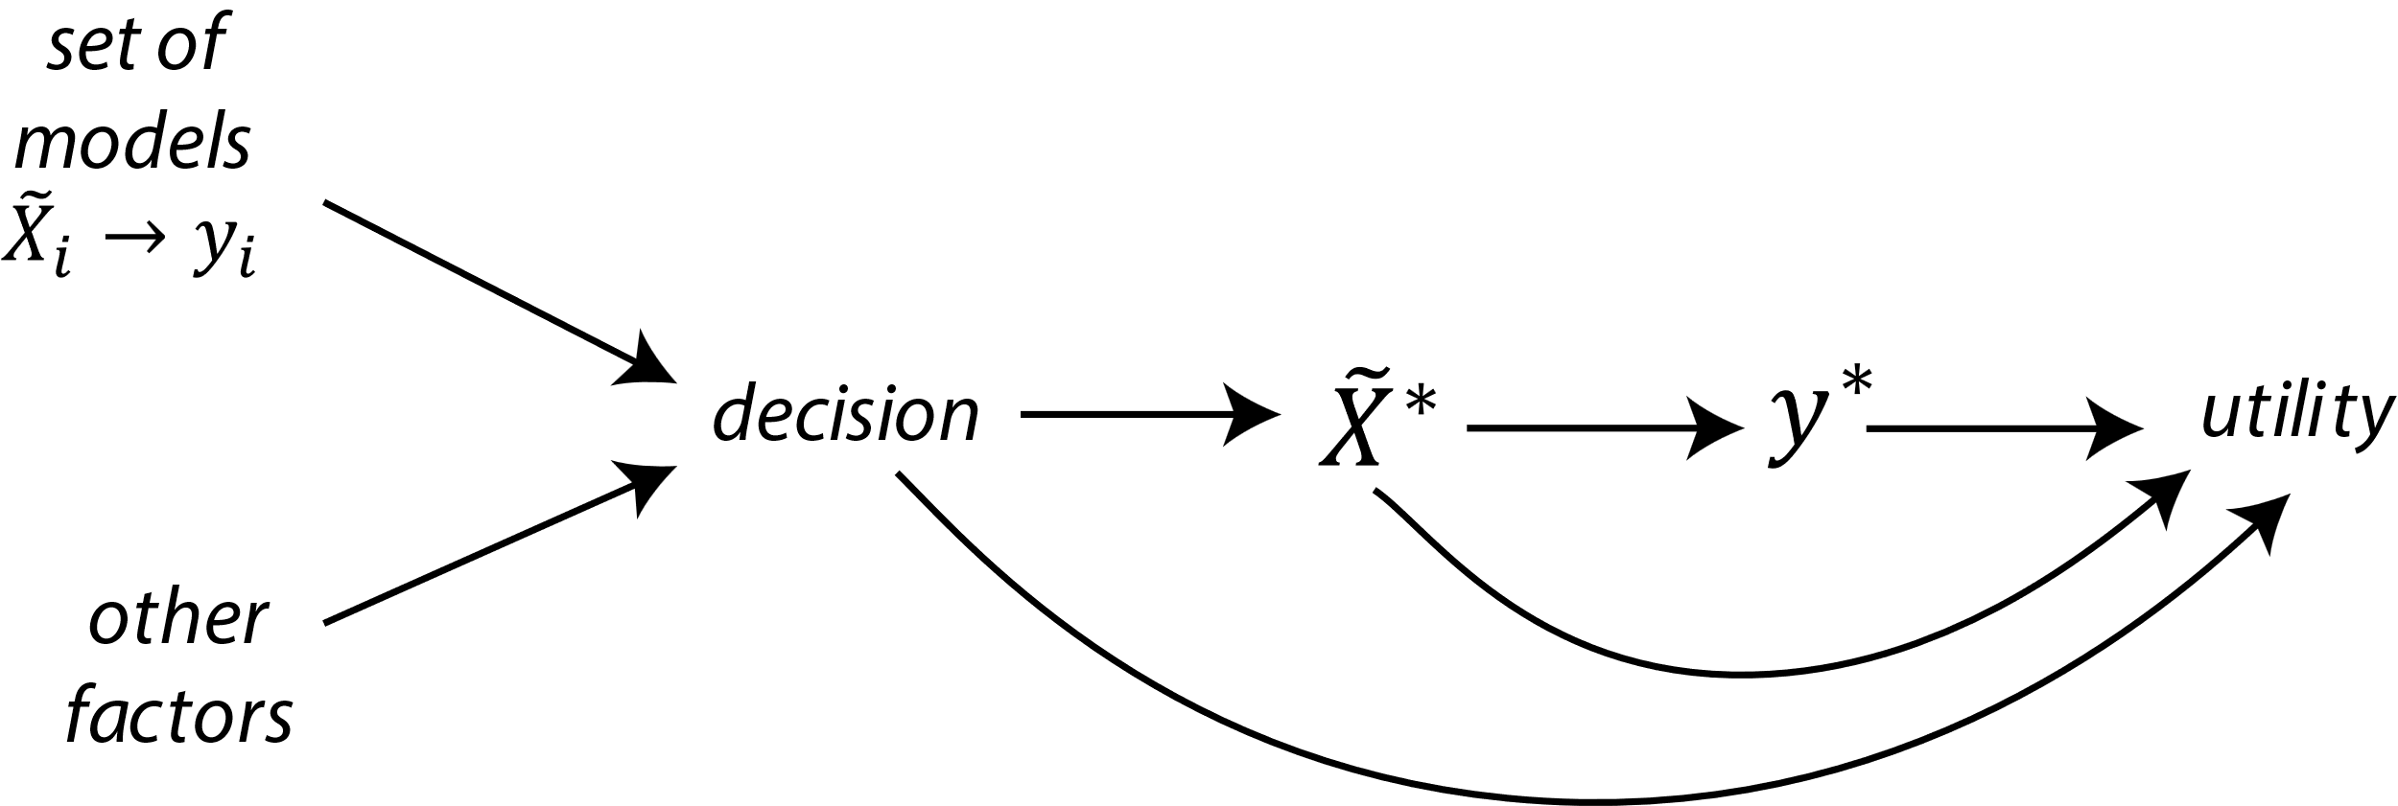

Slide 18
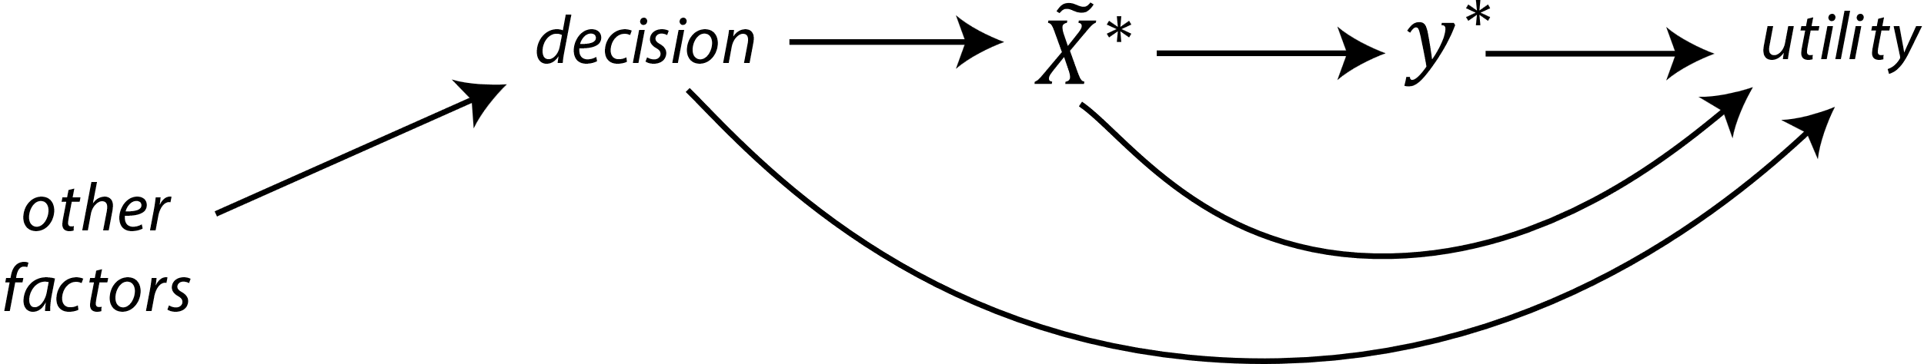

Slide 19
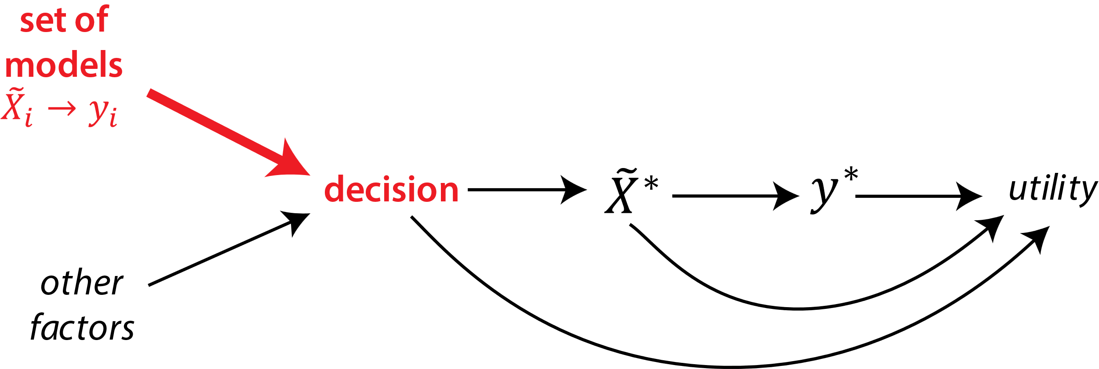
Argument: Wrong projections of the counterfactual scenarios can lead to wrong decisions.

Slide 20
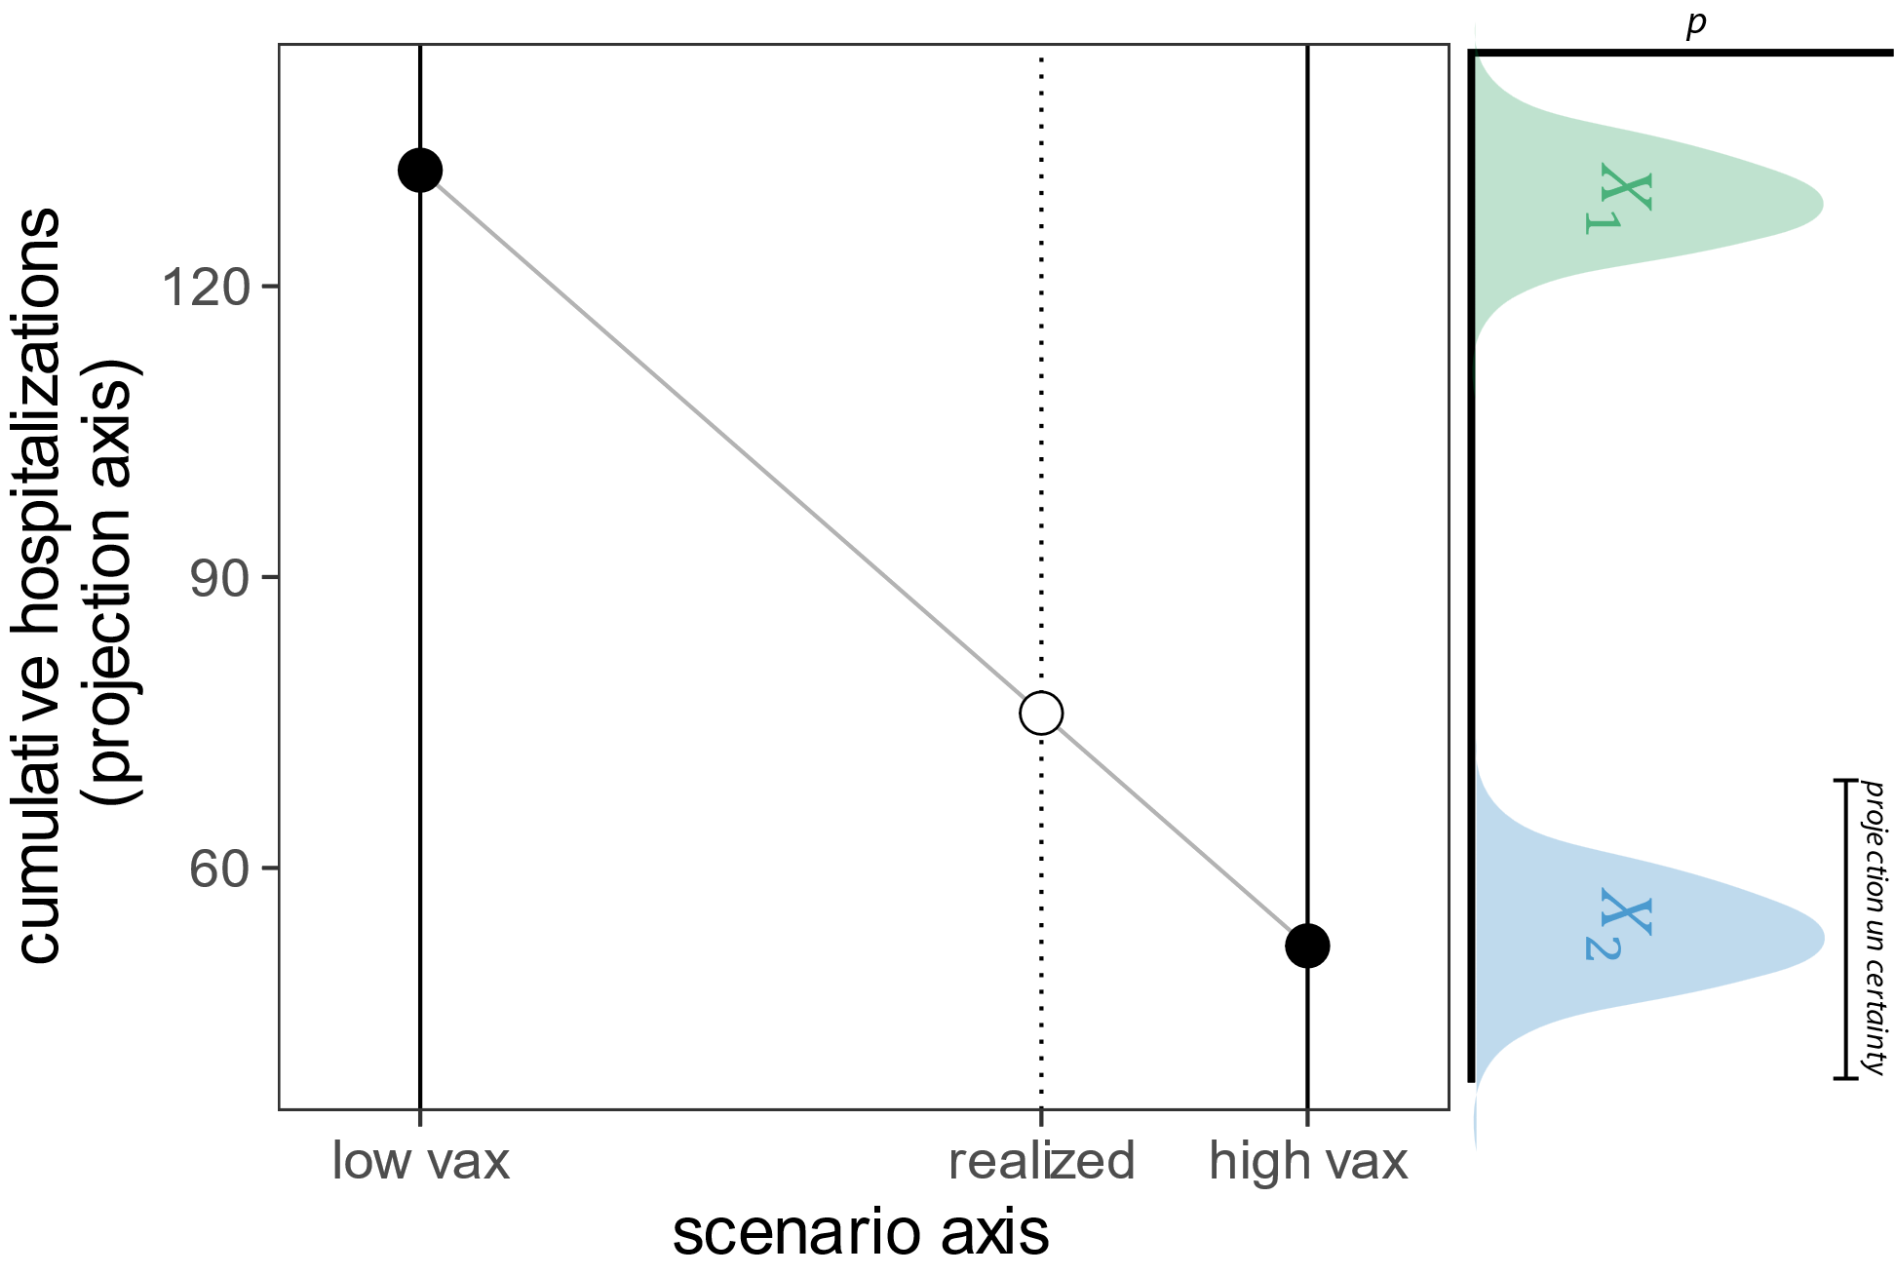

Slide 21
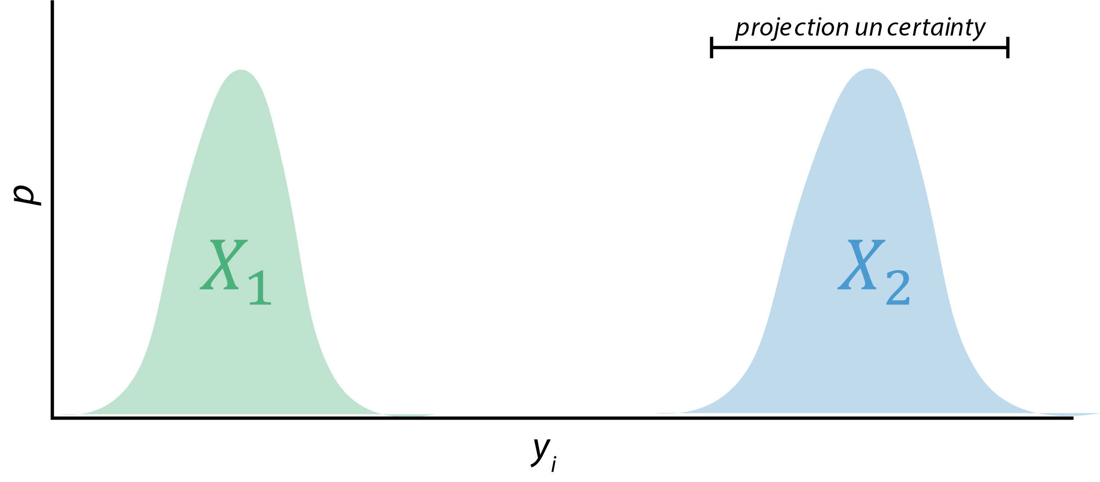

Slide 22
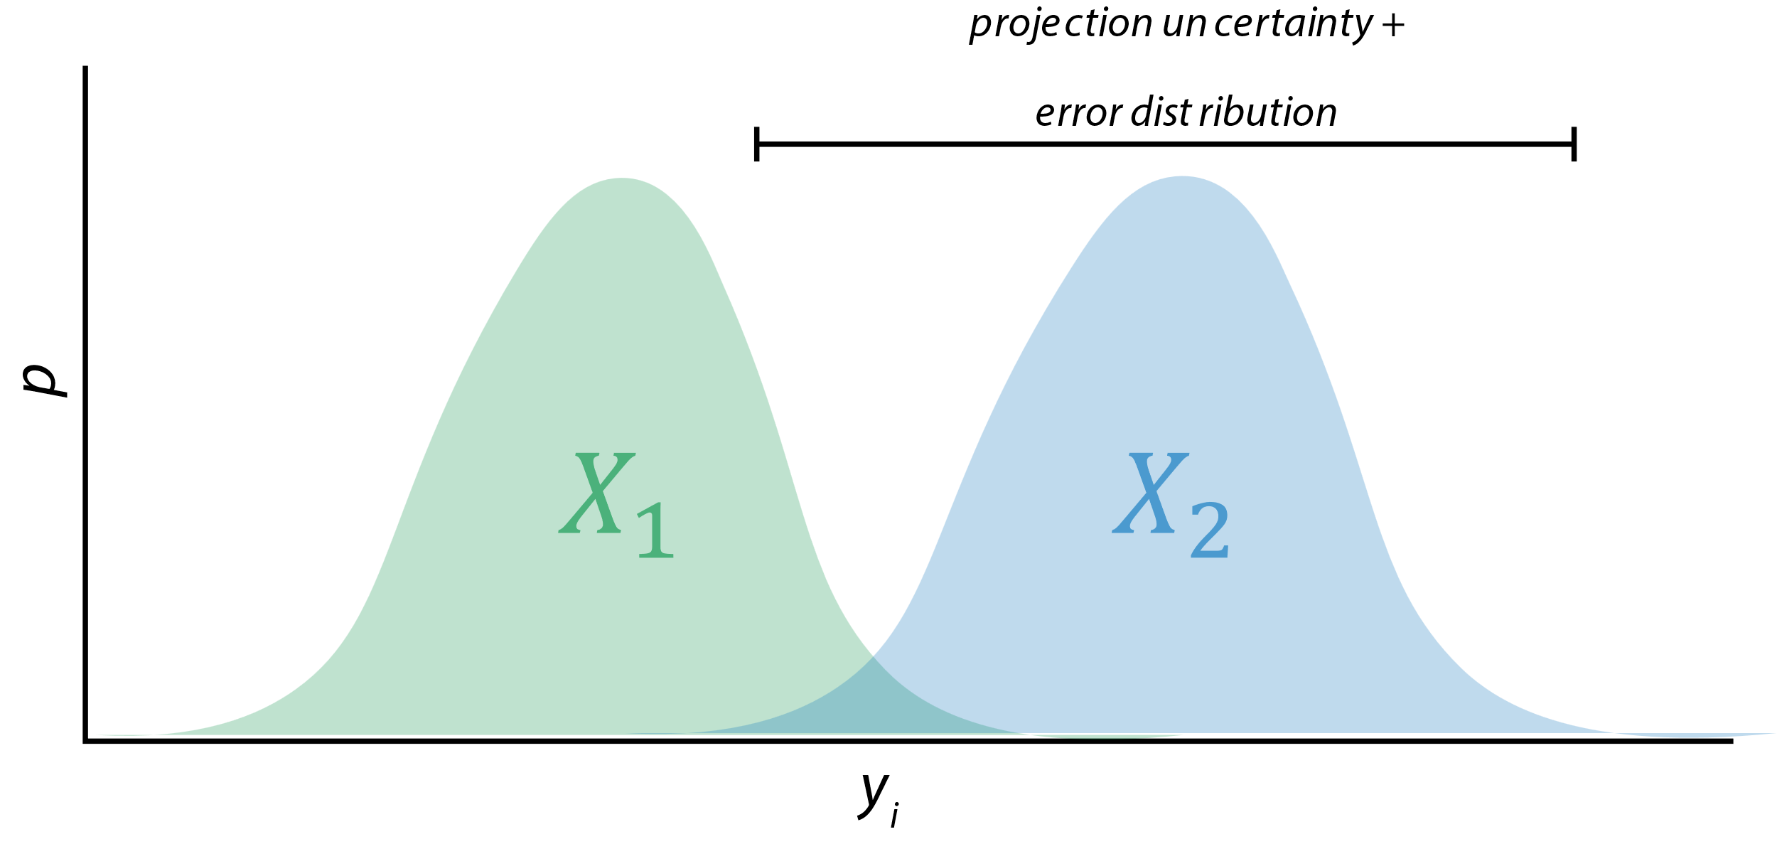

Slide 23
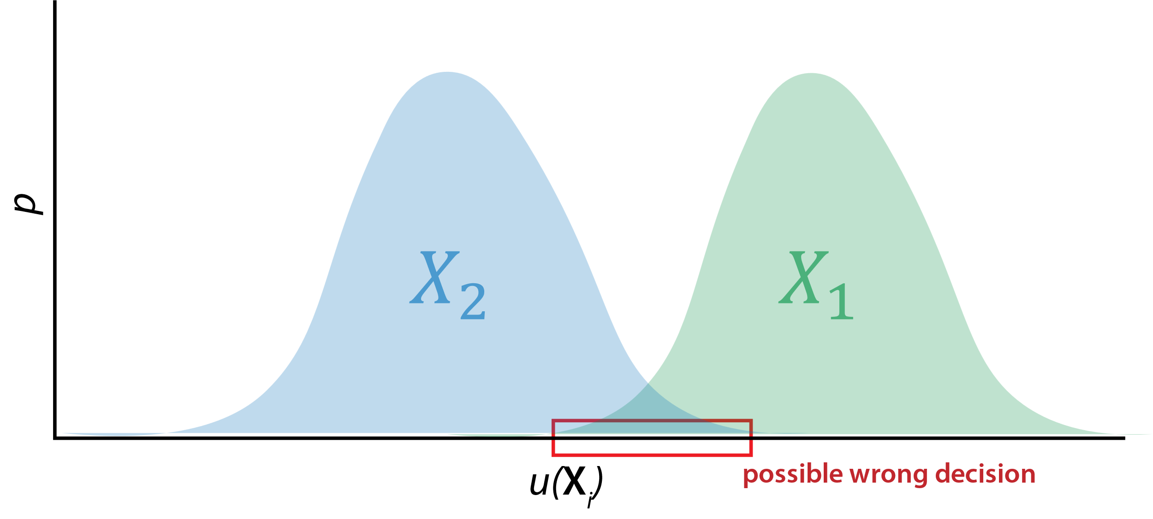

Slide 24
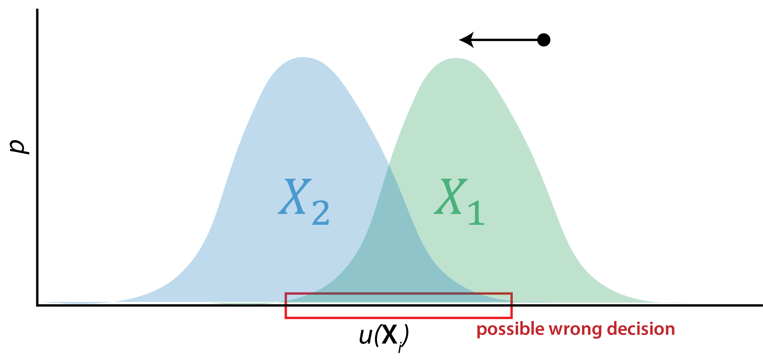
$$c\left(X_{1}\right)$$

Slide 25
Caution: Being optimal isn’t everything.

Slide 26
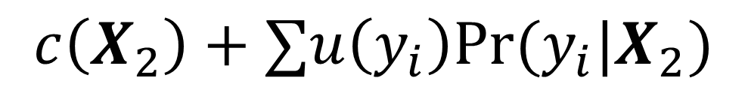
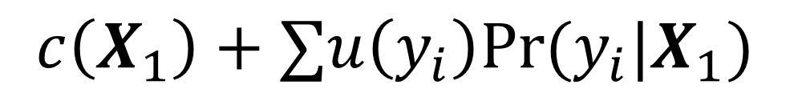
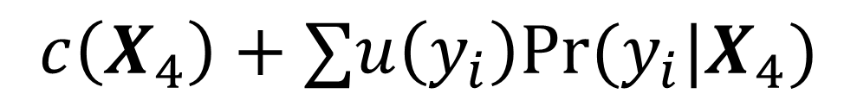
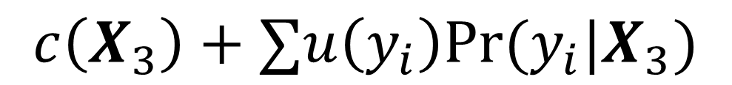
Further complications
$$c\left(X_{1}\right)+∑u\left(y_{i}\right)Pr⁡(y_{i}|X_{1})$$
$$c\left(X_{2}\right)+∑u\left(y_{i}\right)Pr⁡(y_{i}|X_{2})$$
$$c\left(X_{3}\right)+∑u\left(y_{i}\right)Pr⁡(y_{i}|X_{3})$$
$$c\left(X_{4}\right)+∑u\left(y_{i}\right)Pr⁡(y_{i}|X_{4})$$

Slide 27
Further complications
$$c\left(X_{1}\right)+∑u\left(y_{i}\right)Pr⁡(y_{i}|X_{1})$$
$$c\left(X_{2}\right)+∑u\left(y_{i}\right)Pr⁡(y_{i}|X_{2})$$
We may correctly order these.
$$c\left(X_{3}\right)+∑u\left(y_{i}\right)Pr⁡(y_{i}|X_{3})$$
$$c\left(X_{4}\right)+∑u\left(y_{i}\right)Pr⁡(y_{i}|X_{4})$$

Slide 28
Further complications
$$c\left(X_{1}\right)+∑u\left(y_{i}\right)Pr⁡(y_{i}|X_{1})$$
$$c\left(X_{2}\right)+∑u\left(y_{i}\right)Pr⁡(y_{i}|X_{2})$$
$$c\left(X_{3}\right)+∑u\left(y_{i}\right)Pr⁡(y_{i}|X_{3})$$
$$c\left(X_{4}\right)+∑u\left(y_{i}\right)Pr⁡(y_{i}|X_{4})$$
But be ignored and lack
face validity if we miss this.

Slide 29
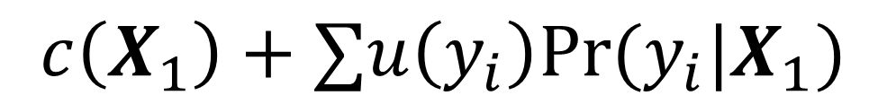
Further complications
$$c\left(X_{1}\right)+∑u\left(y_{i}\right)Pr⁡(y_{i}|X_{1})$$
$$c\left(X_{2}\right)+∑u\left(y_{i}\right)Pr⁡(y_{i}|X_{2})$$
$$c\left(X_{3}\right)+∑u\left(y_{i}\right)Pr⁡(y_{i}|X_{3})$$
$$c\left(X_{4}\right)+∑u\left(y_{i}\right)Pr⁡(y_{i}|X_{4})$$
And policy disagreements
tend focus on this

Slide 30
What next?

Slide 31
Some directions…
Think about aspects of utility functions we need to know, maybe come up with some canonical or reference utility functions.
Focus on working out the math and making some tools for “idealized” situations.
Optimal decision based on modeled scenarios
Assume we want to know how good that decision would have been had we been able to achieve the assumed scenario, given what we actually observed.
Do simulations/math to see when this breaks, sends us the wrong direction
Tie this to VOI analysis, including the space of scenarios considered.

Slide 32



Thank you!
Coordination Team Katriona Shea, Justin Lessler, Cécile Viboud, Rebecca Borchering, Emily Howerton, Shaun Truelove, Claire Smith, Michelle Qin, Nicholas Reich, Michael Runge, Lucie Contamin, John Levander, Jessica Kerr, Harry Hochheiser, Luke Mullany, Sara Loo, Sung-mok Jung, Smantha Bents, Katie Yan
Modeling Groups Contributing COVID-19 Projections
Columbia University – Age-Stratified Model: Marta Galanti, Teresa Yamana, Sen Pei, Jeffrey Shaman
Institute for Health Metrics and Evaluation – IHME COVID
John Hopkins University-APL: Matt Kinsey, Kate Tallaksen, R.F. Obrecht, Laura Asher, Cash Costello, Michael Kelbaugh, Shelby Wilson, Kaitlin Lovett
John Hopkins University-IDD-COVIDSP: Joseph C. Lemaitre, Juan Dent Hulse, Kyra H. Grantz, Joshua Kaminsky, Stephen A. Lauer, Elizabeth C. Lee, Justin Lessler, Hannah R. Meredith, Javier Perez-Saez, Shaun A. Truelove, Claire P. Smith, Lindsay T. Keegan, Kathryn Kaminsky, Sam Shah, Josh Wills, Pierre-Yves Aquilanti, Karthik Raman, Arun Subramaniyan, Greg Thursam, Anh Tran
North Carolina State University-COVSIM: Erik Rosenstrom, Jessica Mele, Julie Swann, Julie Ivy, Maria Mayorga
Northeastern University MOBS GLEAM COVID: Matteo Chinazzi, Jessica T. Davis, Kunpeng Mu, Xinyue Xiong, Ana Pastore y Piontti, Alessandro Vespignani
University of Florida – ABM: Thomas Hladish, Alexandar Pillai, Kok Ben Toh, Ira Longini Jr.
University of North Carolina at Charlotte – UNCC-hierbin: Shi Chen, Rajib Paul, Daniel Janies, Jen-Claude Thill
University of Notre Dame - FRED: Guido Espana, Sean Cavany, Sean Moore, Alex Perkins
University Southern California SlkJalpha: Ajitesh Srivastava, Majd Al Aawar
University of Texas at Austin-ImmunoSEIRS: Anass Bouchnita, Spencer Fox, Michael Lachmann, Lauren Ancel Meyers, UT COVID-19 Modeling Consortium
University of Victoria: Dean Karlen
University of Virginia-adaptive: Przemyslaw Porebski, Srini Venkatramanan, Anniruddha Adiga, Bryan Lewis, Brian Klahn, Joseph Outten, James Schlitt, Patric Corbett, Pyrros Alexander Telionis, Lijing Wang, Akhil Sai Peddireddy, Benjamin Hurt, Jiangzhou Chen, Anil Vullikanti, Madhav Marathe
University of Virginia-EpiHiper: Jiangzhuo Chen, Stefan Hoops, Parantapa Bhattacharya, Dustin Machi, Bryan Lewis, Madhav Marathe
Collaborators Matthew Biggerstaff, Michael Johansson, Rachel Slayton, Jessica Healey (CDC); Nicole Samay (Northeastern University)
jlessler@unc.edu
https://scenariomodelinghub.org

Slide 33
Backup

Slide 34
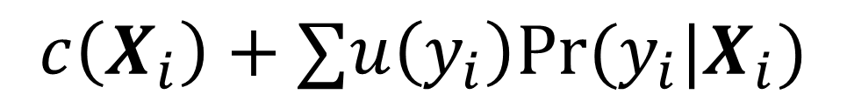
$$u\left(y_{i}\right)$$
$$c\left(X^{∗}\right)$$
$$c\left(X_{i}\right)$$
$$c\left(X_{i}\right)+∑u\left(y_{i}\right)Pr⁡(y_{i}|X_{i})$$

Slide 35
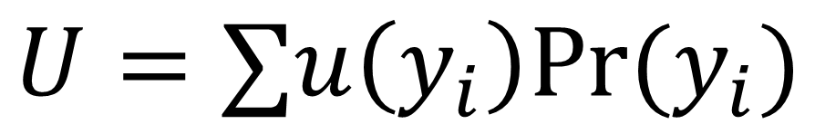
The tension of simultaneous responses
$$U=∑u\left(y_{i}\right)Pr⁡(y_{i})$$
Preparing
Intervening
Notes:
Does this capture different goals and trying to do most of these simultaneously leads to tensions and challenges.

Slide 36
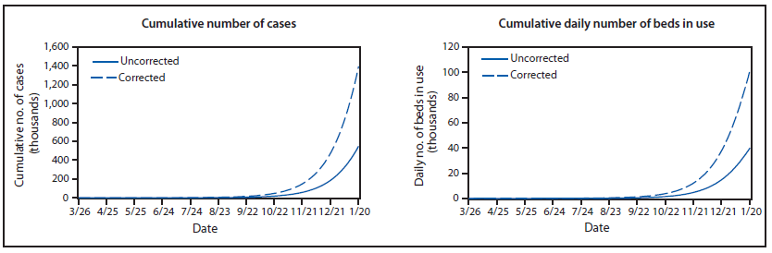
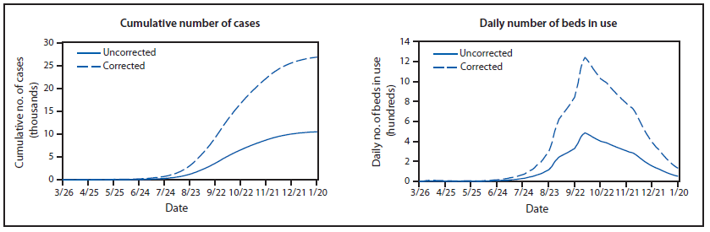
Intervention
axis
preparation axis
Meltzer et al. MMWR 2014

