Slide 1
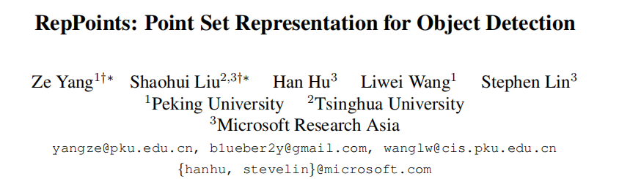

Slide 2
Background
In the object detection pipeline, bounding boxes, which encompass rectangular areas of an image, serve as the basic element for processing.
Though bounding boxes facilitate computation, they provide only a coarse localization of objects that does not conform to an object’s shape and pose.
Deformable RoI pooling is unable to serve as a geometric object representation.

Slide 3
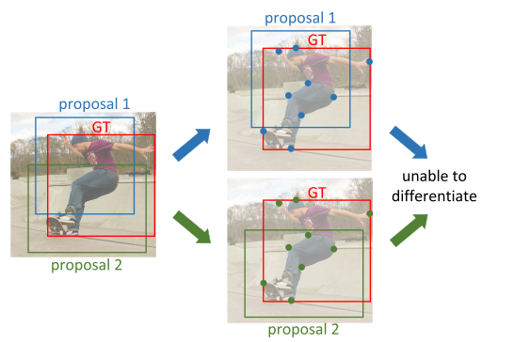
Analysis of Deformable RoI Pooling
The translation sensitivity of the regression step in the context of bounding boxes

Slide 4
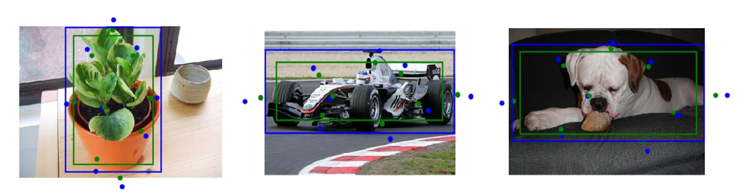

Slide 5
Contribution
In this paper, we propose a new representation, called RepPoints, that provides more fine-grained localization and facilitates classification.
we develop a clean and effective anchor-free object detector.
The proposed object detector not only surpasses all existing anchor-free detectors but also performing on-par with state-of-the-art anchor-based baselines.

Slide 6
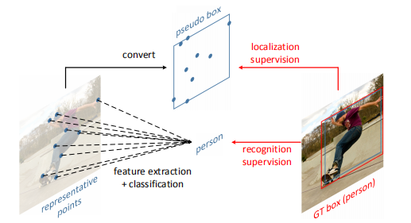
RepPoints is a new representation for object detection that consists of a set of points which indicate the spatial extent of an object and semantically significant local areas. This representation is learned via weak localization supervision from rectangular ground-truth boxes and implicit recognition feedback.

Slide 7
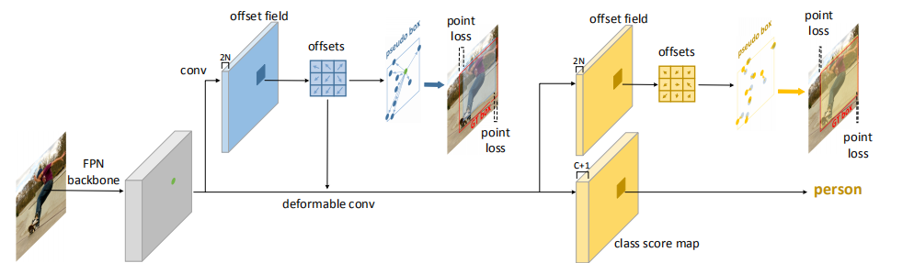

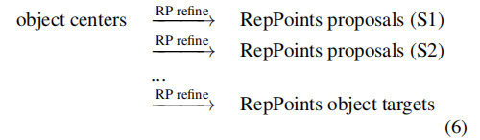

Methods

Slide 8
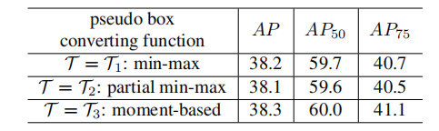
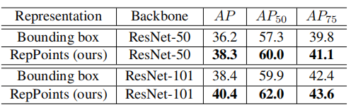
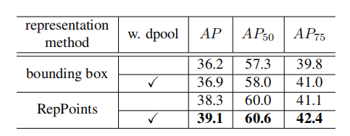
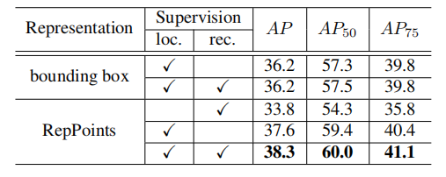
Experiment

Slide 9
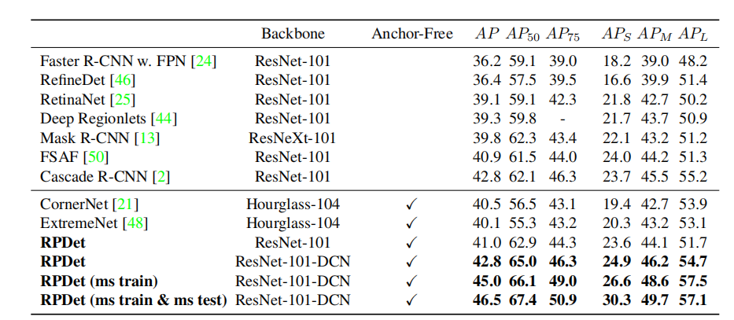

Slide 10
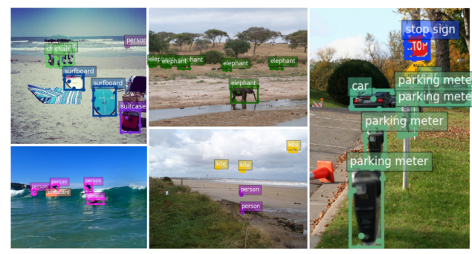

Slide 11
