Slide 1
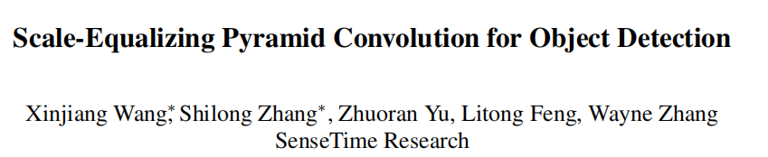

Slide 2
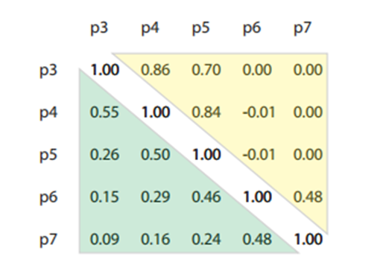
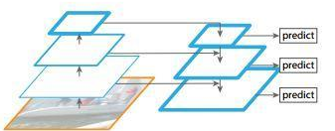
Motivation
The image pyramid method is time-consuming since multiple inputs are necessary.
There exists a semantic gap between each two levels in feature pyramid.
The design of feature fusion is intuitive by directly summing up feature maps after resizing them to the same resolution. Intrinsic properties of the feature pyramid are not explored to let all feature maps contribute equally without distinction.

Slide 3
Contribution
We propose a light-weighted pyramid convolution (PConv) to conduct 3-D convolution inside the feature pyramid to cater for inter-scale correlation.
We also develop a scale-equalizing pyramid convolution (SEPC) to relax the discrepancy between the feature pyramid and the Gaussian pyramid by aligning the shared PConv kernel only at high-level feature maps.
The module boosts the performance (∼ 3.5AP increase on state-of-the-art single stage object detectors) with negligible inference speed compromise.

Slide 4
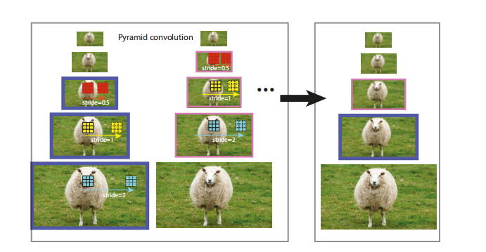
Pyramid convolution

Slide 5
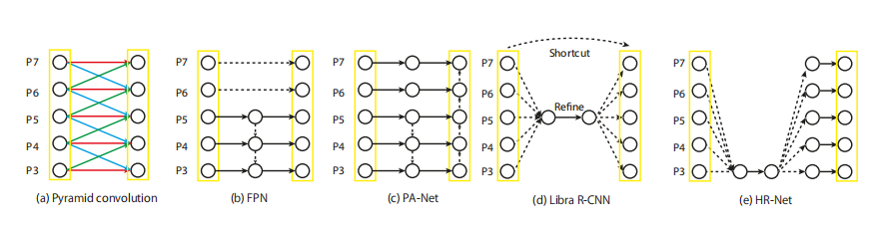
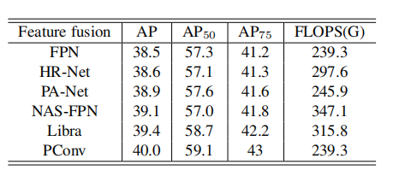
Dotted lines represent interpolation operations, meaning that they can be upsampling, downsampling or shortcut depending on the respective feature map sizes.
Each black solid line is an independent convolution, and colored solid lines of the same color are shared convolution operations.

Slide 6
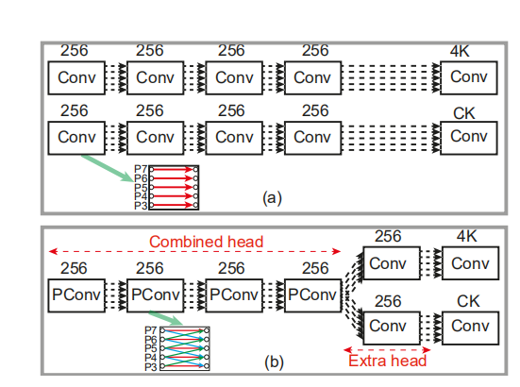
Head design with PConv

Slide 7
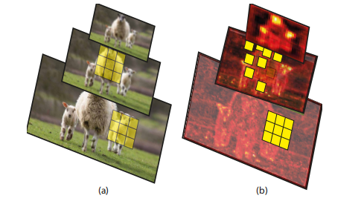
PConv on Gaussian pyramid（a） SEPC on Feature pyramid（b）

Slide 8
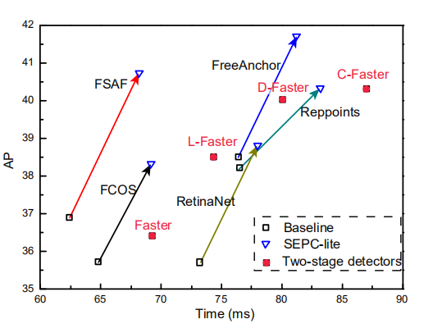
Experiment

Slide 9
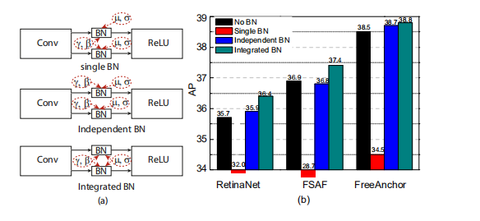

Slide 10
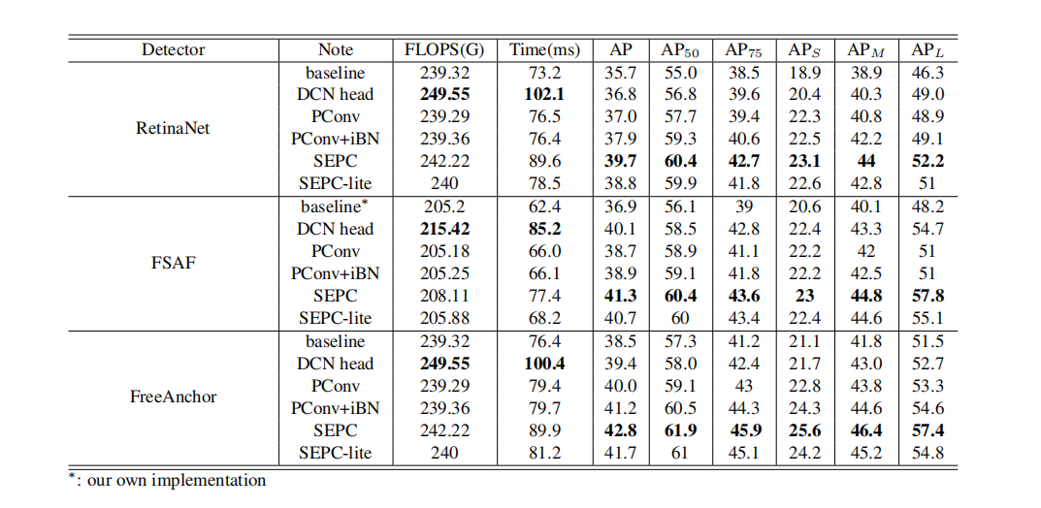

Slide 11
