Slide 1
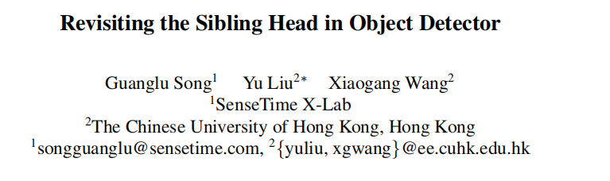

Slide 2

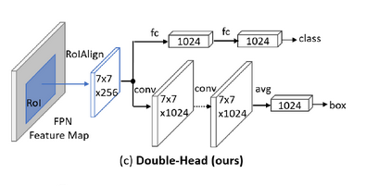
background
the spatial misalignment between the two object functions in the sibling head can considerably hurt the training process
IoU-Net
Double-Head R-CNN

Slide 3
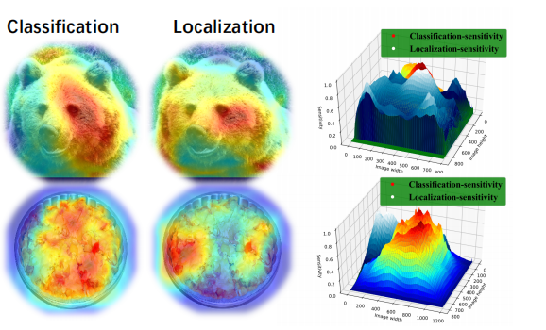

Slide 4
Contributions
1) We delve into the essential barriers behind the tangled tasks in RoI-based detectors and reveal the bottlenecks that limit the upper bound of detection performance.
2) We propose a simple operator called task-aware spatial disentanglement (TSD) to deal with the tangled tasks conflict.
3) We further propose a progressive constraint (PC) to enlarge the performance margin between TSD and the classical sibling head.
4) Our proposed method achieves the mAP of 49.4 using a single model with ResNet-101 backbone and mAP of 51.2 with heavy SENet154.

Slide 5
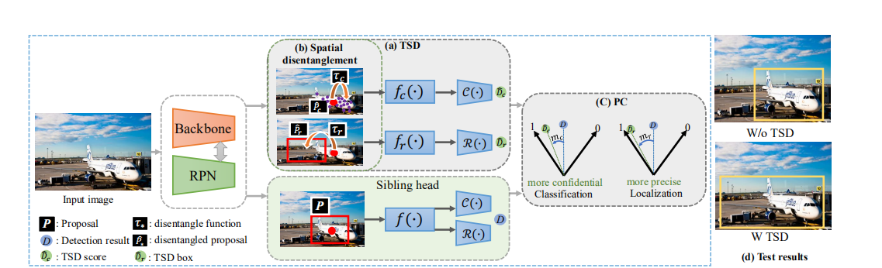
Framework

Slide 6
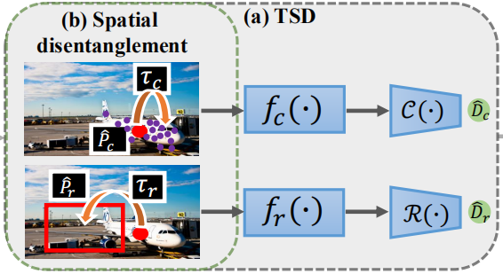




TSD

Slide 7
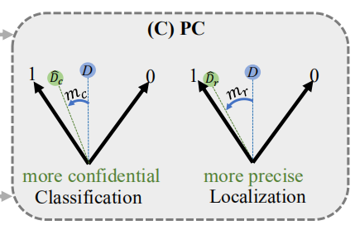
PC

Slide 8

Loss function

Slide 9
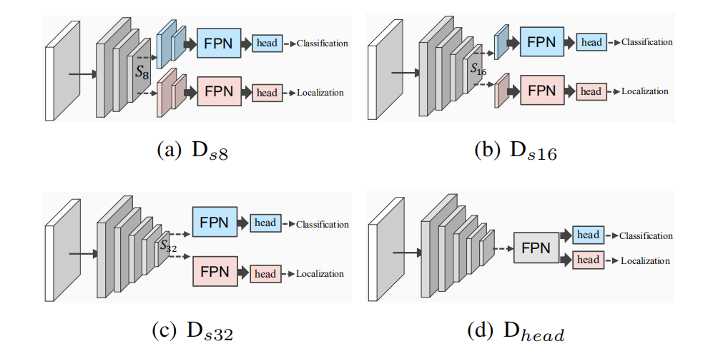
Experiments

Slide 10
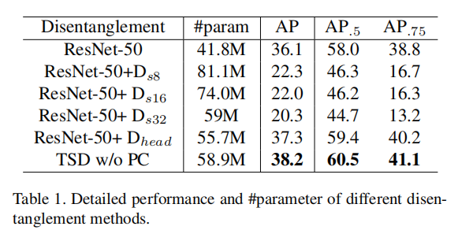

Slide 11
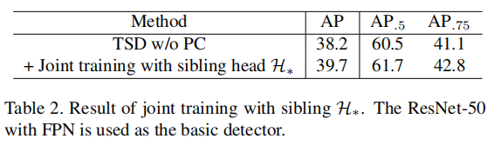
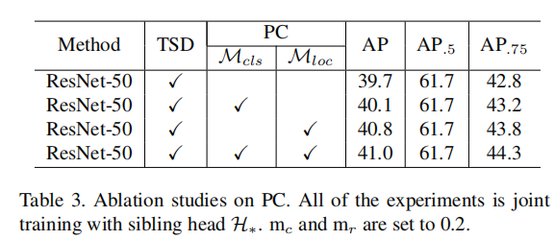

Slide 12
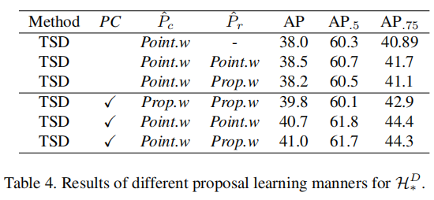
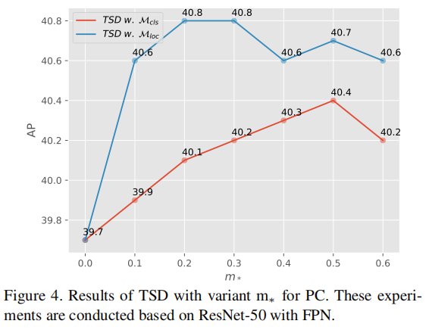

Slide 13
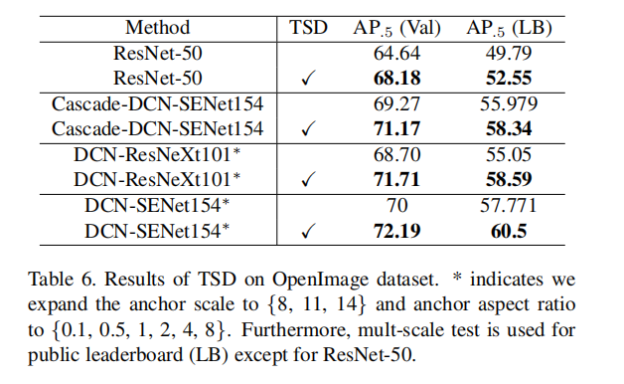
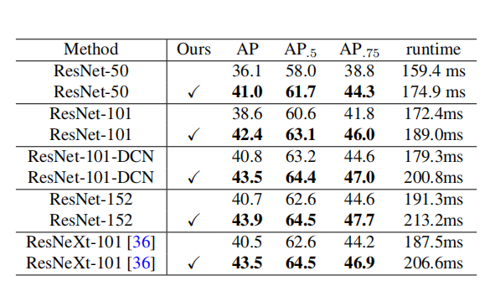

Slide 14
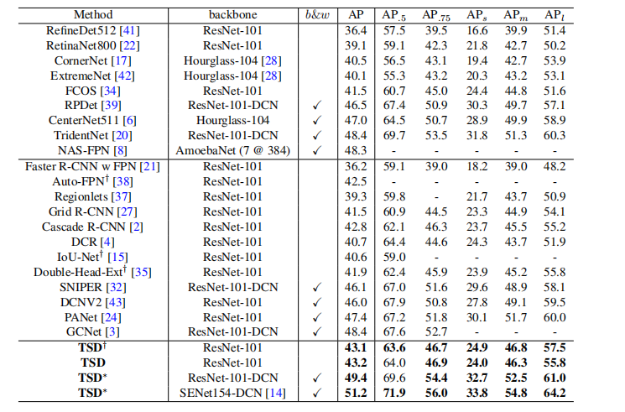

Slide 15
