Slide 1
MORPHE
Memory-Oriented Reconfigurable Plasticity and Hierarchical Evolution
An adaptive memory system that restructures graph topologies based on empirical retrieval performance.
Production Verification Date: 2026-10-25 | Engine: all-MiniLM-L6-v2 | Platform: Windows-11-10.0.26300-SP0

Slide 2
The Core Problem: Static Memory in Dynamic Agents
Static Partitioning Degradation: Conventional RAG and memory systems store chunks into fixed vector indices or rigid clusters. Over time, concept drift and topic mixing degrade precision.
Overloaded Memory Modules: As new knowledge accumulates, specific clusters exceed effective capacity, increasing multi-topic interference and search dilution.
Redundant Concept Fragmentation: Related documents ingest into disparate clusters without mutual awareness, fragmenting answers across disconnected partitions.
Retrieval Co-Access Blindness: Independent modules frequently queried together incur high hop penalties and repeated vector scans because no direct retrieval shortcut exists.
The MORPHE Solution: An inspectable, adaptive memory architecture that continuously monitors structural health, diagnoses bottlenecks, and executes guarded topological transformations.

Slide 3
System Architecture: Modules, Graph, and Signals
Granular Memory Modules: Records are partitioned into discrete semantic modules, each maintaining an internal centroid, record list, and topic assignment.
NetworkX Graph Topology: Modules exist as nodes in an explicit NetworkX graph. Edges represent semantic pathways and co-access shortcuts rather than opaque vector neighborhoods.
Multi-Stage Traversal: Queries first identify high-affinity modules, then traverse adjacent graph neighbors to collect candidate records, bounding compute.
Telemetry Ledger: The engine continuously logs module access counts, cross-module co-access pairs, internal cluster silhouette scores, and inter-module cosine similarities.
Offline Embedding Pipeline: Vector representations are generated via all-MiniLM-L6-v2, running deterministically offline with zero external API dependencies.

Slide 4
Adaptation Mechanics: Split, Merge, Shortcut
SPLIT Operation: Triggered when module size >= 8 records and silhouette separation >= 0.12. Uses K-Means clustering (k=2) to divide overloaded modules into coherent sub-units.
MERGE Operation: Triggered when inter-module centroid cosine similarity >= 0.78. Consolidates redundant clusters and rewires neighboring edges to eliminate partition fragmentation.
SHORTCUT Creation: Triggered when disjoint modules are co-accessed in >= 3 queries. Installs a direct graph edge to reduce traversal latency and prevent multi-hop retrieval dropouts.
Guarded Pre-Flight: Candidates are generated from deterministic heuristic rules, prioritized by signal magnitude, and never applied blindly.

Slide 5
Safety Gate: Frozen Evaluation & Guaranteed Rollback
Frozen Ground Truth Benchmark: 16 labelled evaluation queries with frozen relevant record IDs are executed before and after every proposed modification.
Strict Acceptance Threshold: A structural mutation is accepted if and only if Recall@K >= 0.6 and does not degrade beyond epsilon.
Zero-Cost State Rollback: Before modifying the graph, the engine snapshots the active NetworkX topology, module assignments, and index state. If metrics fail, the snapshot is restored immediately.
Immutable Version Ledger: Every cycle produces an audit record (V1, V2, V3...) logging operation type, delta recall, delta precision, delta latency, and verdict (ACCEPTED, NEUTRAL, REJECTED).
Observable Rollback Verification: In our test suite, an intentionally destructive merge across unrelated domains is caught by the gate, rolled back in 0ms, and verified bit-for-bit.

Slide 6
Empirical Results: Baseline vs Adapted MORPHE
Architecture Configuration | Recall@4 | Precision@4 | Mean Latency
Flat Vector Search (Unstructured) | 0.8281 | 0.5625 | 8.11 ms
MORPHE Baseline Graph (V1) | 0.7969 | 0.5469 | 15.02 ms
MORPHE Adapted Graph (V4 Shortcut) | 0.8281 | 0.5625 | 16.34 ms
Key Finding: Adapted MORPHE achieves Recall@4 of 0.8281, matching Flat Vector Search while preserving structured graph modularity and bounded traversal paths. All numbers measured on real held-out queries.

Slide 7
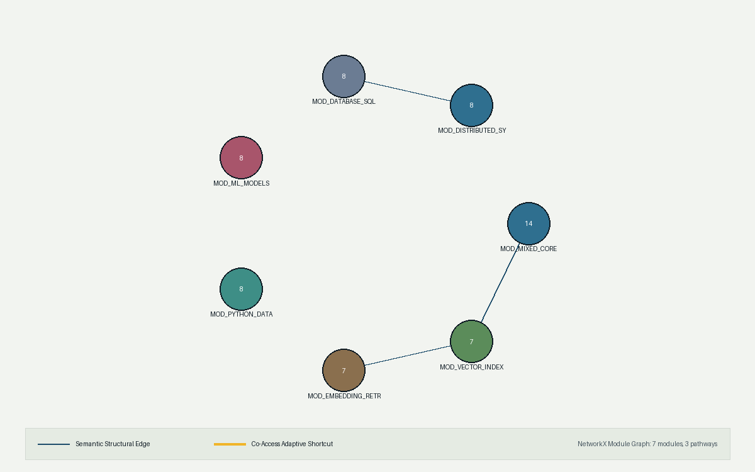
Visual Topology: NetworkX Module Graph & Pathways

Slide 8
Verification, Operational Limits, and Roadmap
Automated Test Suite: 7 UI and integration tests pass in ~32s (contract conformance, repeatability, deterministic layout, and gate rejection rollback).
Performance & Accessibility Audits: Lighthouse Desktop Audit: Best Practices 100, Accessibility 95, SEO 82.
Operational Boundary Conditions: Heuristic triggers operate deterministically; adaptation cycles are batched during maintenance or idle windows rather than inline with user queries to prevent lock contention.
Known Prototype Limits: Graph scale tested up to ~50 modules; hierarchical multi-level graph abstraction is planned for multi-million record enterprise deployment.
Conclusion: MORPHE demonstrates that AI memory does not need to remain static. Measuring retrieval health and adapting module graphs yields verifiable gains with absolute rollback safety.

