Slide 1
Preheat Retreat – Machine Learning Section
Amjad Dabi

Slide 2
Machine Learning
Algorithms that allow computational machines to learn from data on specific tasks:
Prediction
Regression
Classification
Clustering
Dimensionality Reduction
What will the value(s) Y be given specific features (X)?
How does X relate to Y?
Which class does Y belong to given X?
How do values in X cluster in specific groups?
Can we represent X with a smaller set of features?
Natural Language Processing
Generating Synthetic Data
Syntax, translation, sentiment analysis
Generative Adversarial Networks
Diffusion Models (DALL-E, Imogen)

Slide 3
What are we exactly learning?
To minimize or maximize specific metrics, usually iteratively
Prediction
Regression
Classification
Clustering
Dimensionality Reduction
Minimize the error between predicted and true labels
Minimize error around some fitted function
Minimize the error between predicted and true labels
Minimize variance within each cluster and maximize it between clusters
Minimize the distance between recreated (from latent space) and real data
Natural Language Processing
Generating Synthetic Data
Minimize error between predicted translation/sentiment and correct translation/sentiment
Minimize distance between generated and real data
Whatever relationship we are trying to minimize or maximize is called the Objective Function

Slide 4
Supervised vs Unsupervised
In supervised learning our data is labelled (e.g. images are labelled as cat or dog) and we want the model to learn relationships between X and the labels.
In unsupervised learning, our data is not labelled, and the model is learning on features of the data itself (e.g. K-means Clustering learns clusters from the relationships between the data points).

Slide 5
Tidy Data Format
Observations | Feature 1 | Feature 2 | Feature 3 | Feature 4 | Features 5 | Outcome
Obs 1 | … | … | … | … | … | 0
Obs 2 | … | … | … | … | … | 1
Obs 3 | … | … | … | … | … | 1
Obs 4 | … | … | … | … | … | 0
Obs 5 | … | … | … | … | … | 1

Slide 6

Logistic Regression
In normal regression
$$Y=β_{0}+β_{1}x+ε$$
Where $ε\sim N(0, σ^{2})$

Slide 7
Logistic Regression
In normal regression
$$Y=β_{0}+β_{1}x+ε$$
Where $ε\sim N(0, σ^{2})$

Slide 8

Logistic Regression
Binary outcome
$$p\left(x\right)=\frac{1}{1+e^{−\left(β_{0}+β_{1}x\right)}}$$

Slide 9
Logistic Regression
Binary outcome
$$p\left(x\right)=\frac{1}{1+e^{−\left(β_{0}+β_{1}x\right)}}$$

Slide 10
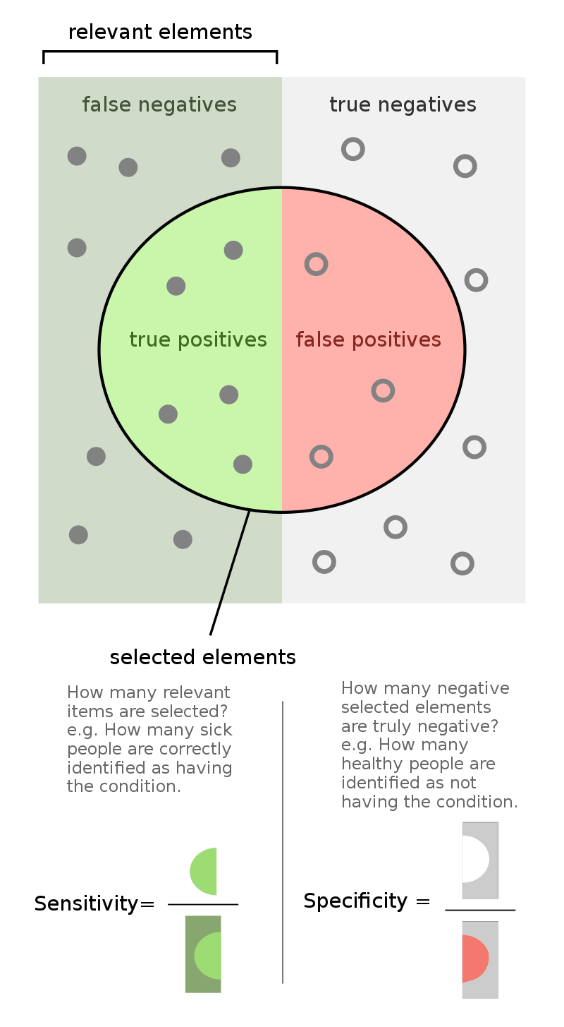
Model Performance
Accuracy (% of correct predictions)
Specificity
Sensitivity
Courtesy of Wikipedia

Slide 11
Validation-Test Split
Often times if our model is overfitting the data, the metrics are not accurate at capturing the robustness of the model.
To ameliorate this, we leave a chunk of the data out of the model fitting, and then test the model against it. We call this the validation set.
Generally, the more of your data you can afford to leave out, the more representative your metrics will be for generalized performance, at the cost of training precision.

Slide 12
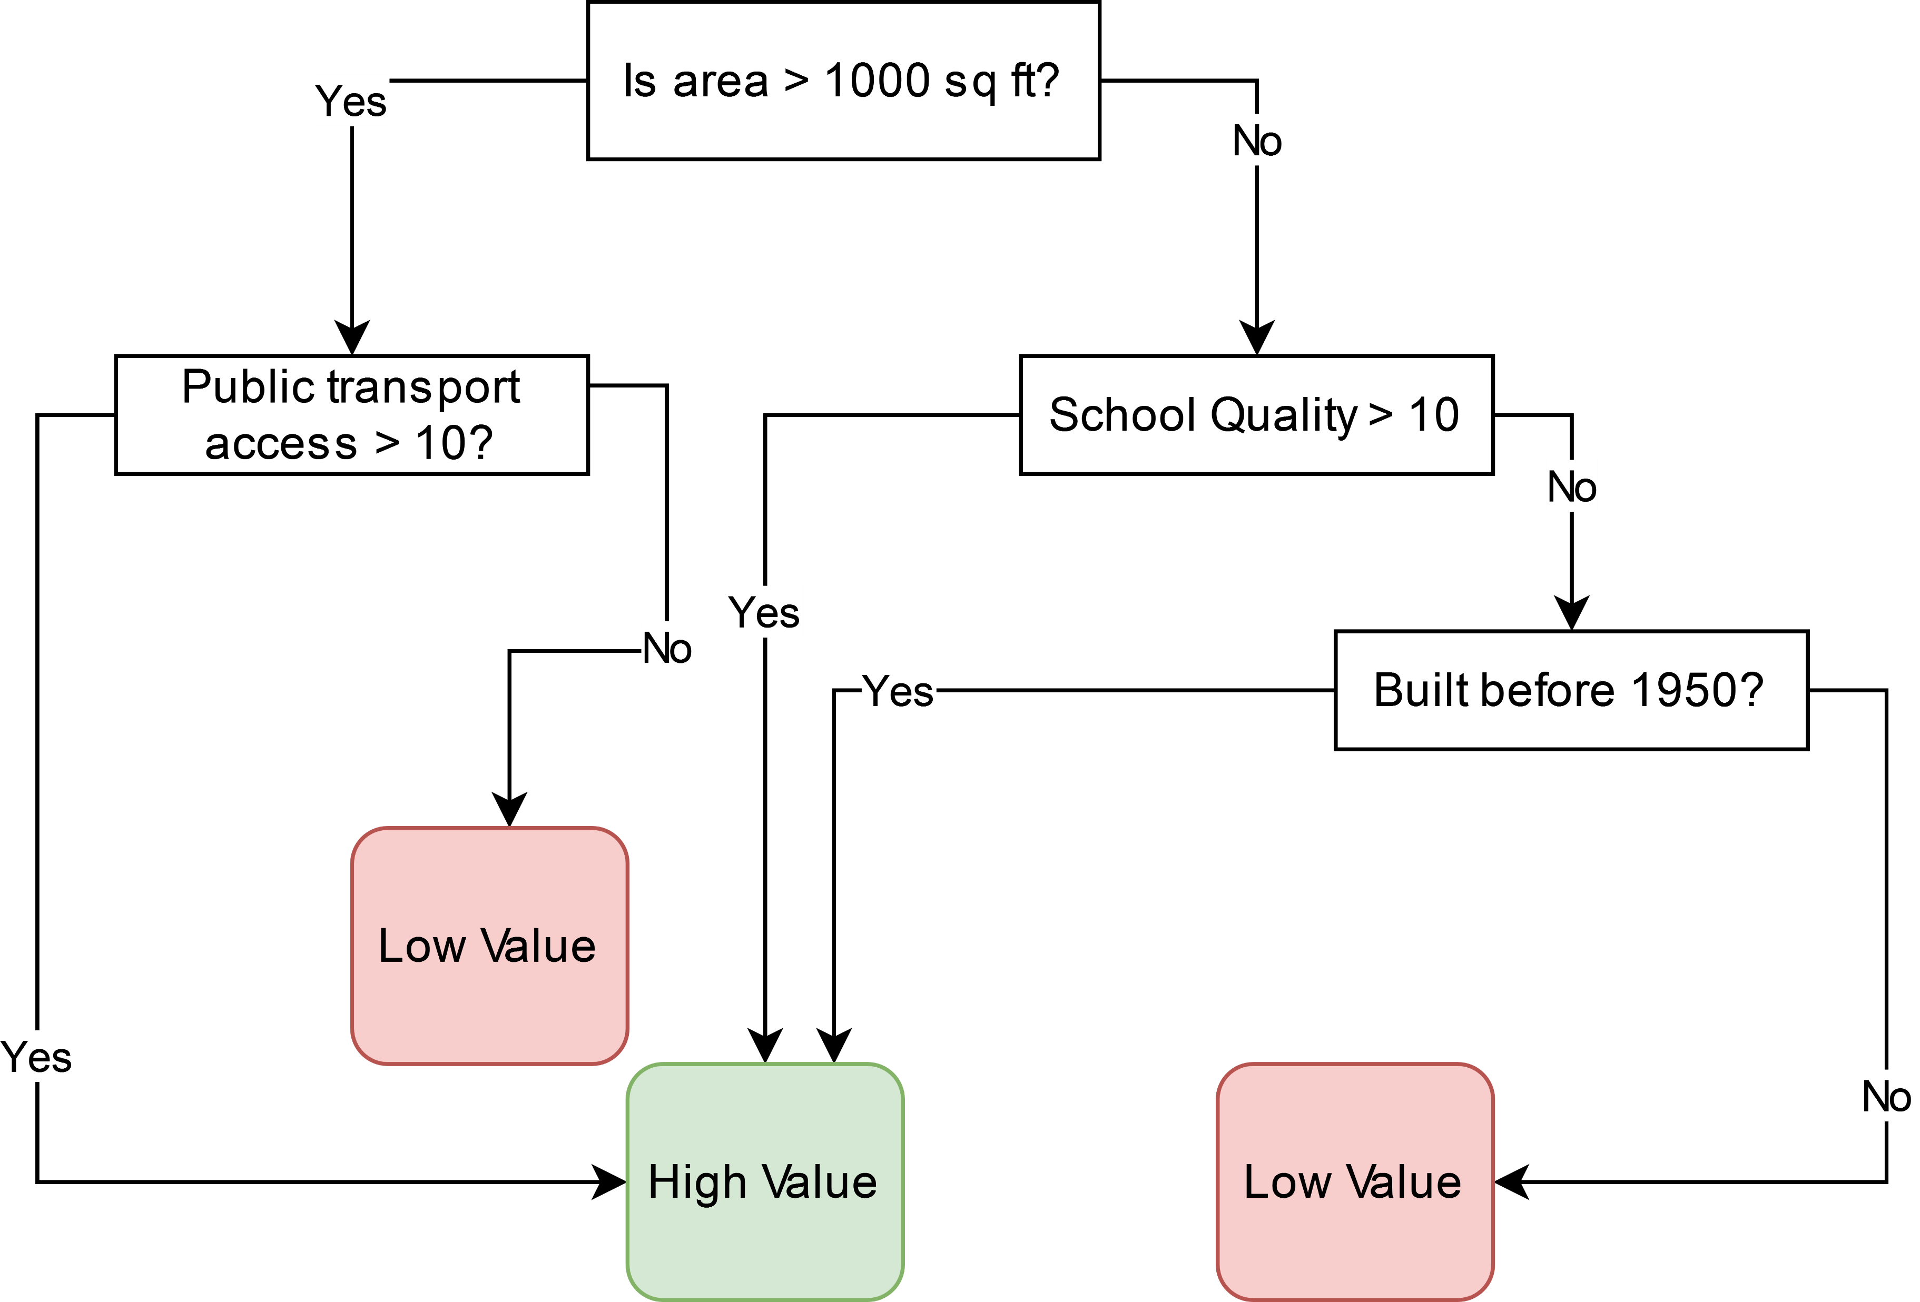
Decision Trees

Slide 13
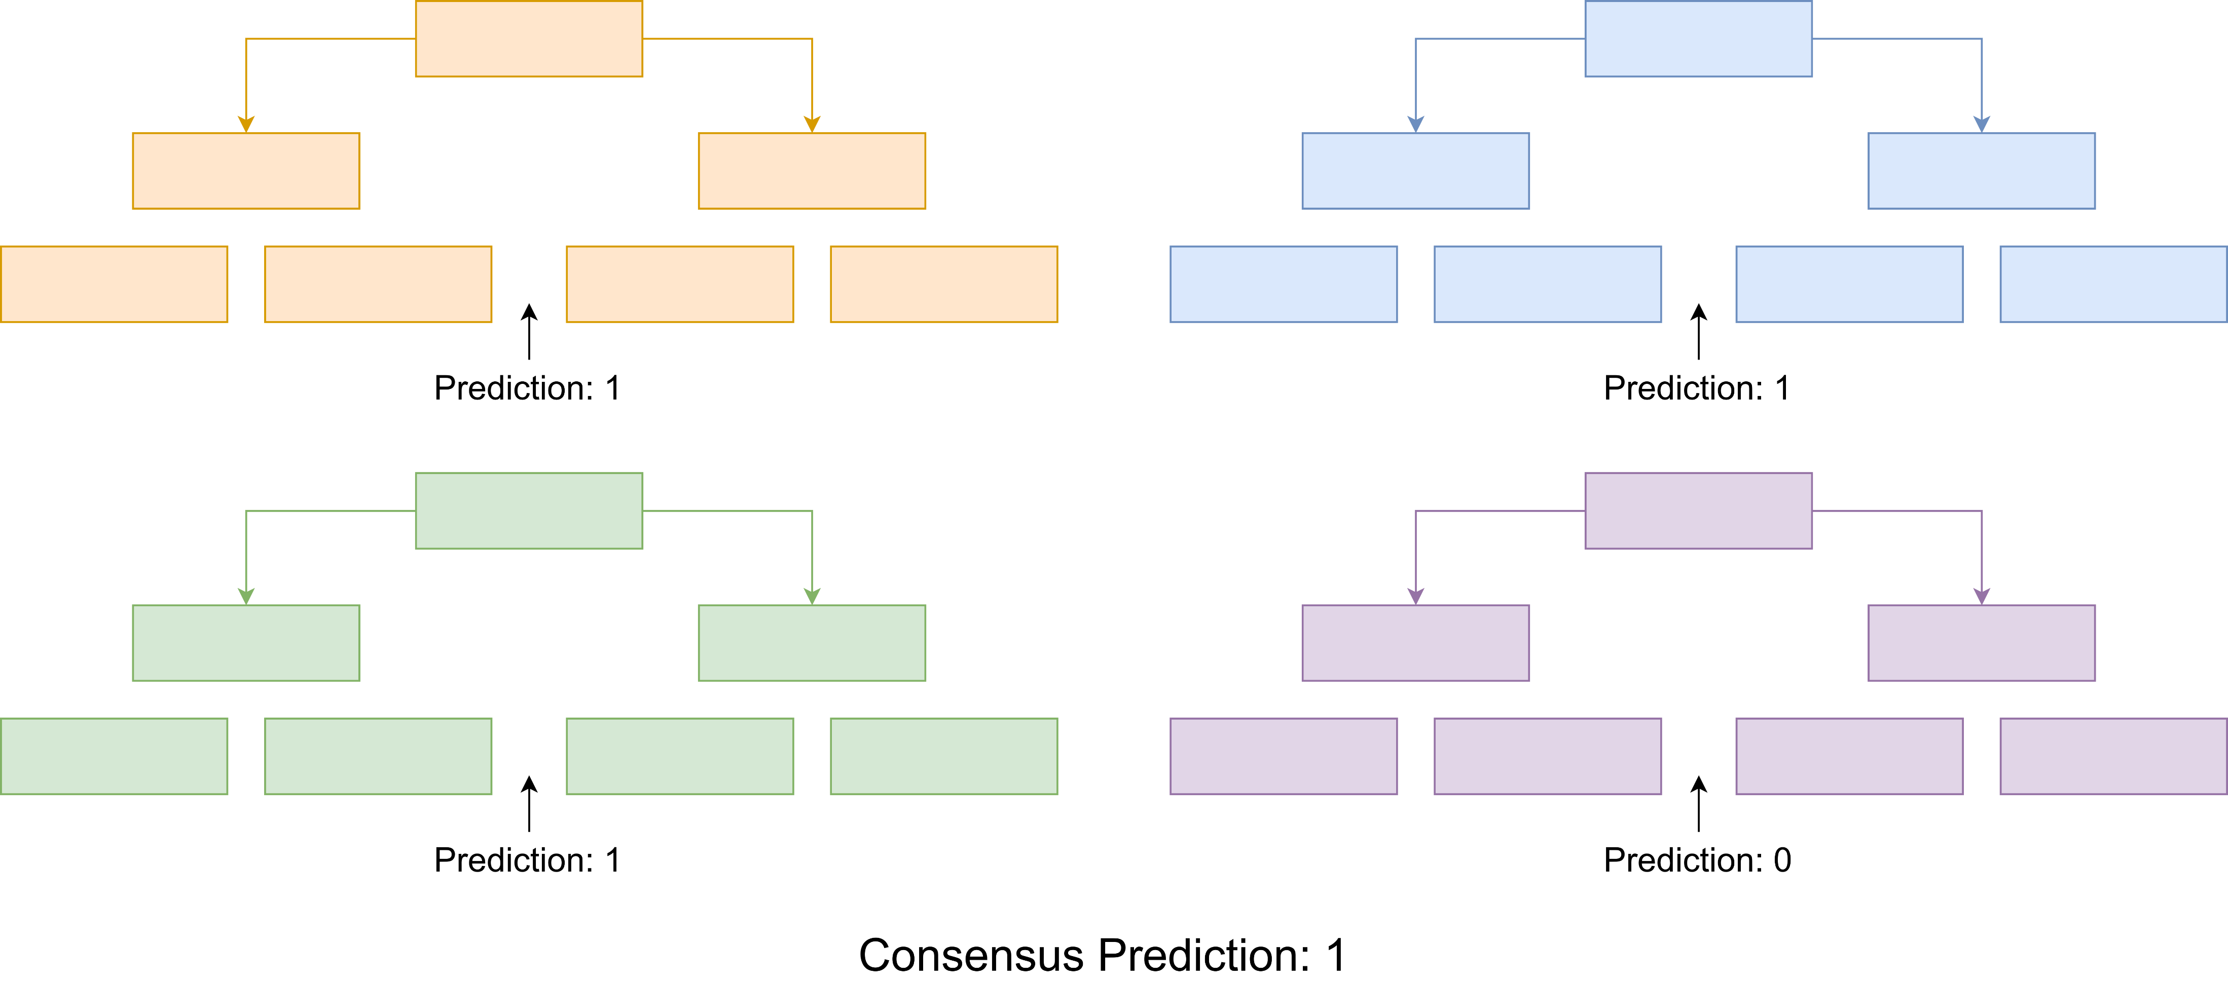
Decision Tree Ensembles
One tree is too sensitive to data
Ensemble of trees that vote:

Slide 14

Overfitting and the Bias-Variance Tradeoff
If we fit a much bigger model:
$$Y=β_{0}+β_{1}x+β_{2}x^{2}+β_{3}x^{3}+β_{4}x^{3}+…+ε$$
Where $ε\sim N(0, σ^{2})$

Slide 15
Overfitting and the Bias-Variance Tradeoff
If we fit a much bigger model:
$$Y=β_{0}+β_{1}x+β_{2}x^{2}+β_{3}x^{3}+β_{4}x^{3}+…+ε$$
Where $ε\sim N(0, σ^{2})$
Fits our data even better, but poor predictive value

Slide 16
Overfitting and the Bias-Variance Tradeoff
In general, as we increase the bias of our estimator, we decrease its variance. This leads to high error in predictions on new data.
If we reduce the variance, we increase bias but also increase robustness. This is referred to as Regularization. In practice it means that we want to prevent a feature (or a particular parameter) from exerting too much influence on the prediction.
This applies to model complexity. In general, more complex machine learning models use more parameters, and so have higher potential for overfitting, but can be more powerful. If you can capture data patterns more efficiently, you can also accidentally capture noise more efficiently.

Slide 17

Decision Tree Ensembles
One tree is too sensitive to data (high variance – low bias)
Ensemble of trees that vote (lower variance – higher bias) :

Slide 18
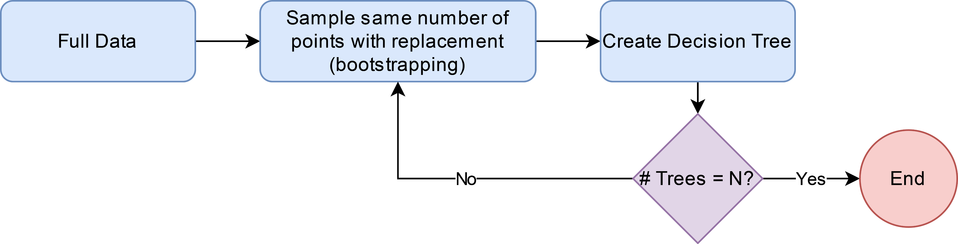
Creating Variety – Random Forest

Slide 19
Random Forests – Pros and Cons
More powerful than linear models
Easy to implement
Fairly interpretable
Versatile
Classification
Regression/Prediction
Clustering
Not as powerful as more complex models
Prone to some overfitting
Hyperparameter tuning may be required

Slide 20
Feature Selection
If we have many features, it can help model performance to select what might be the most important features to use, rather than use all of them.
A variety of feature selection methods are available. We will take a look at 2 different approaches
Correlation: by examining the correlation between features, we can find the ones that are most correlated with other features and get rid of them.
Mutual information: this tells us the amount of information we can get about one variable (the outcome) when another variable (a feature).

Slide 21
Dimensionality Reduction
A dimension is a value needed to represent a data point.
The number of values needed to describe each data point is the dimensionality.
For example, in 3-dimensional physical space, we need 3 values for each point in space.
This is essentially the number of features for each observation.
By reducing dimensionality, we try to describe as much information in the data as we can in a smaller number of features.

Slide 22
Principal Component Analysis – 2D Example
The fitted line minimizes the variance perpendicular to it and maximizes the variance along it.
What if describe the data in relation to that line?
What other line would we need to describe the remainder of the variance in the data?

Slide 23
Principal Component Analysis – 2D Example
The resulting PCs have the properties:
Perpendicular to each other (orthogonal)
Are linear combinations of the original features
The practical effect of PCA is a rotation of the data to a new set of orthogonal coordinates that concentrate the represented variance:

Slide 24
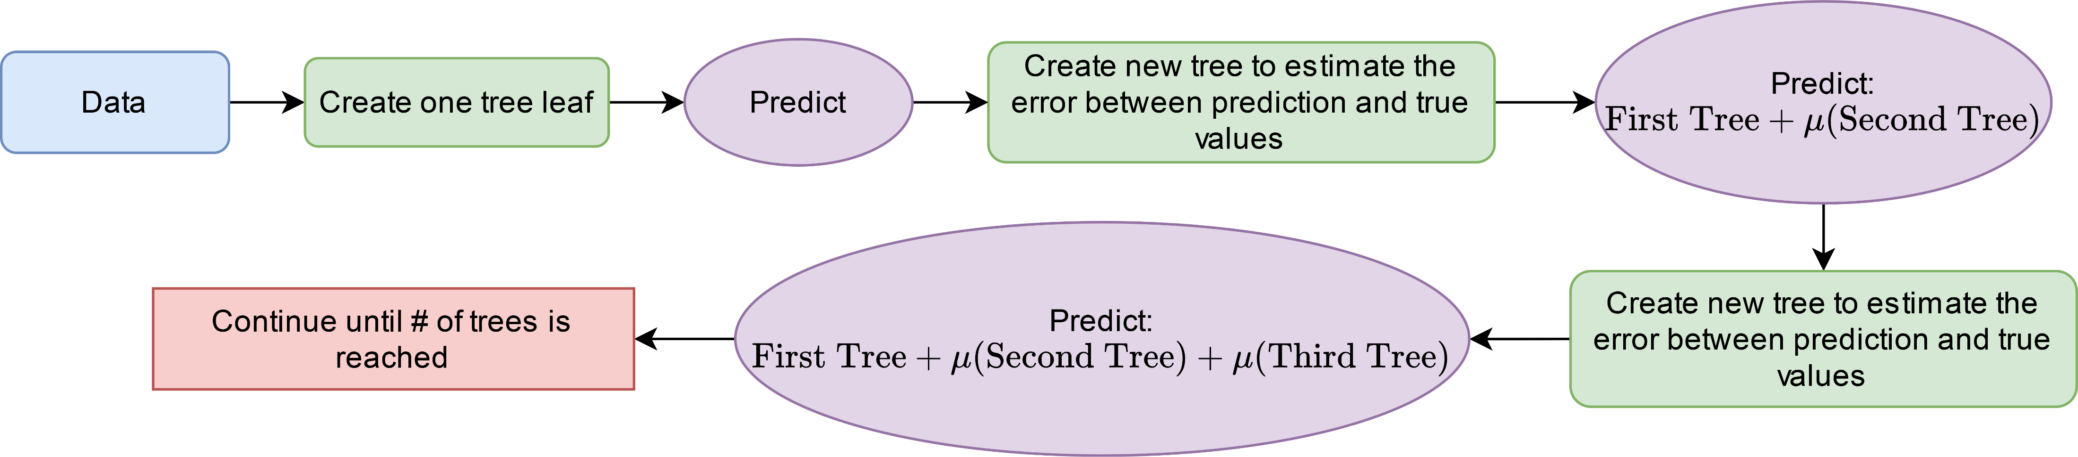
Gradient Boosting Trees – Learning From Your Mistakes
Rather than create a tree ensemble just using sampling tricks, we can iteratively improve on the trees to produce the ensemble (AdaBoost does something similar).
This generally outperforms Random Forest models.

Slide 25
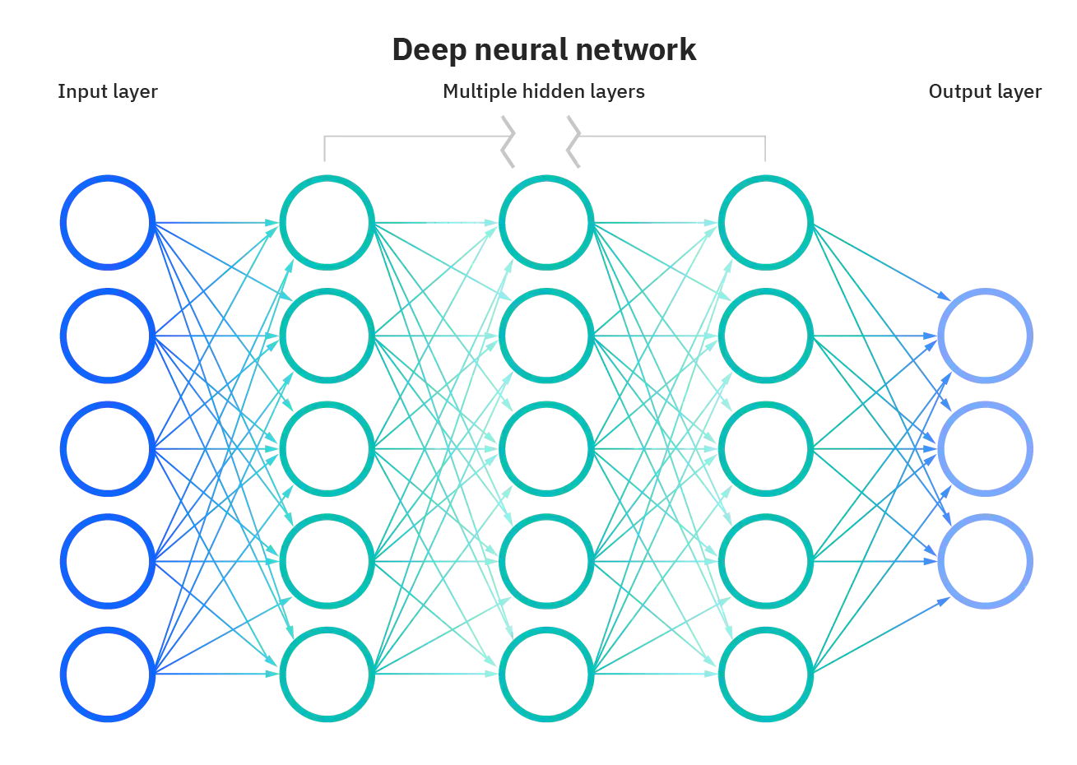
Neural Networks
Courtesy of IBM: https://www.ibm.com/cloud/learn/neural-networks

Slide 26
Neural Networks
Come in a large variety of flavors:
Dense (Multilayer Perceptron)
Convolutional
Recurrent
Long Short-Term Memory
Autoencoders-decoders and their variational relatives
Generative Adversarial Networks
Ensembles
Different Architectures

Slide 27
Neural Networks
One of the most powerful machine learning models available.
Extremely prone to overfitting – millions (and sometimes billions!) of parameters
Many hyperparameters and architectures to tune
Can be computational expensive
Has a distinct advantage in transfer learning

Slide 28
Ethical and Social Considerations
Complex machine learning algorithms are “black boxes”.
Real world biases will inevitably make it into our data and models.
When deployed for social use, models can reinforce their own predictions
A useful predictor is not necessarily a causal predictor

