Slide 1
BMI - associated differences
Preheat Retreat
Caroline Murphy, Amaree Gardner, Tim Smyth

Slide 2
Pre-exposure & Post-exposure
14 genes were statistically significantly associated with BMI at the 0.05 alpha level
302 genes were statistically significantly associated with BMI at the 0.05 alpha level

Slide 3

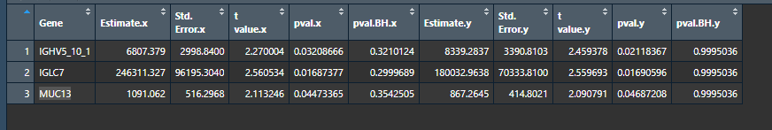
Overlapping Genes
IGLC7 immunoglobulin lambda constant 7
IGHV5-10-1 immunoglobulin heavy variable 5-10-1
MUC13 mucin 13

Slide 4
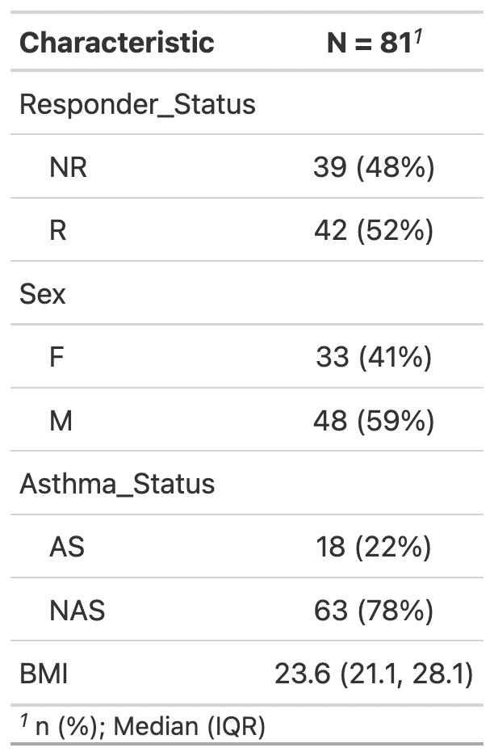
Overlapping Genes
Demographics of the 3 overlapping genes

Slide 5
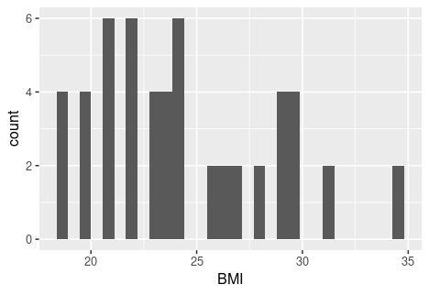

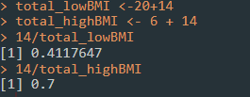
Relate BMI to responder
41% low BMI “Responders”
70% high BMI “Responders”

