Slide 1



PREHEAT
PRESENTATION
Elena McDermott, Oyemwenosa Avenbuan & Keith Rogers

Slide 2

TASK
Our group was asked with evaluating the differences between genes by race and ethnicity

Slide 3
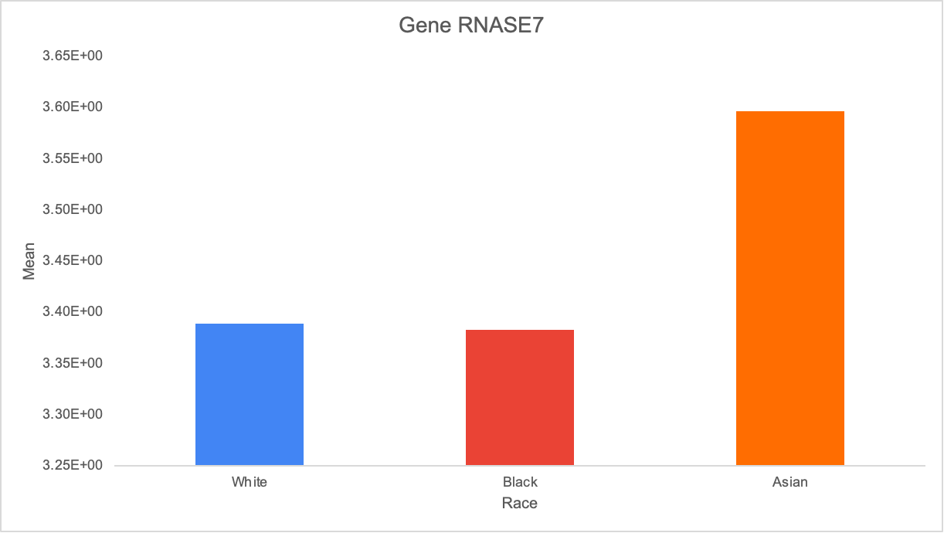
GENE RNASE7
Notes:
Anti-microbrial activity

Slide 4
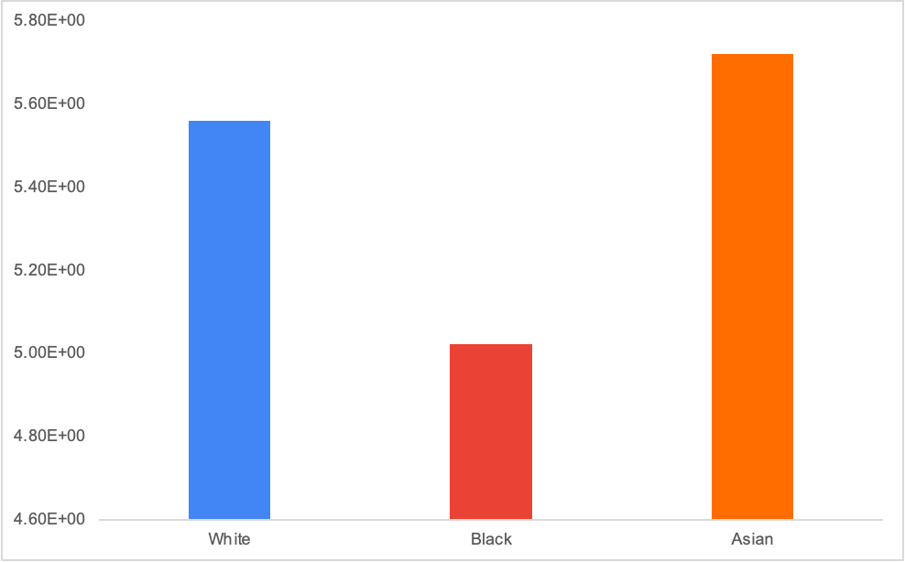
GENE PRB1
Notes:
PRB1
-

Slide 5
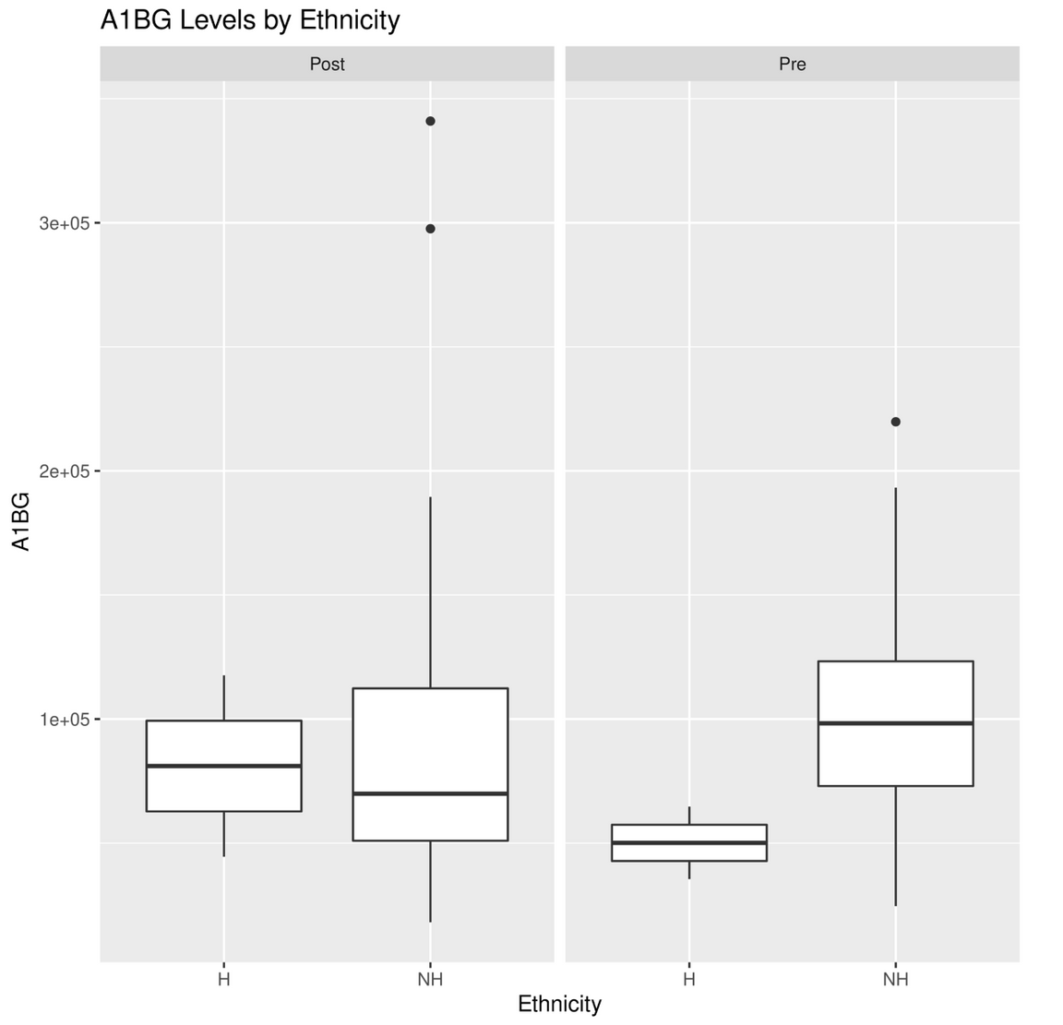
Notes:
used A1BG levels because we saw that the levels pre and post-exposure was significantly difference
- unknown function

Slide 6
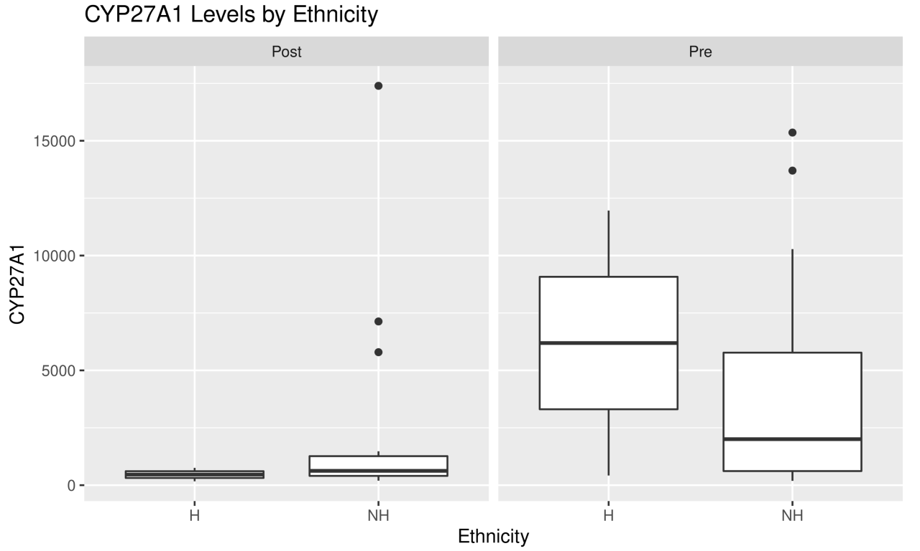
Notes:
used CYP27A1 levels because we saw that the levels pre and post-exposure were significantly difference
- related to the cytochrome P450 family and in the literature, it is known for breaking down cholesterol

