Slide 1
Proteomics Data Pre-Processing and QC PREHEAT Retreat Kyle Roell

Slide 2
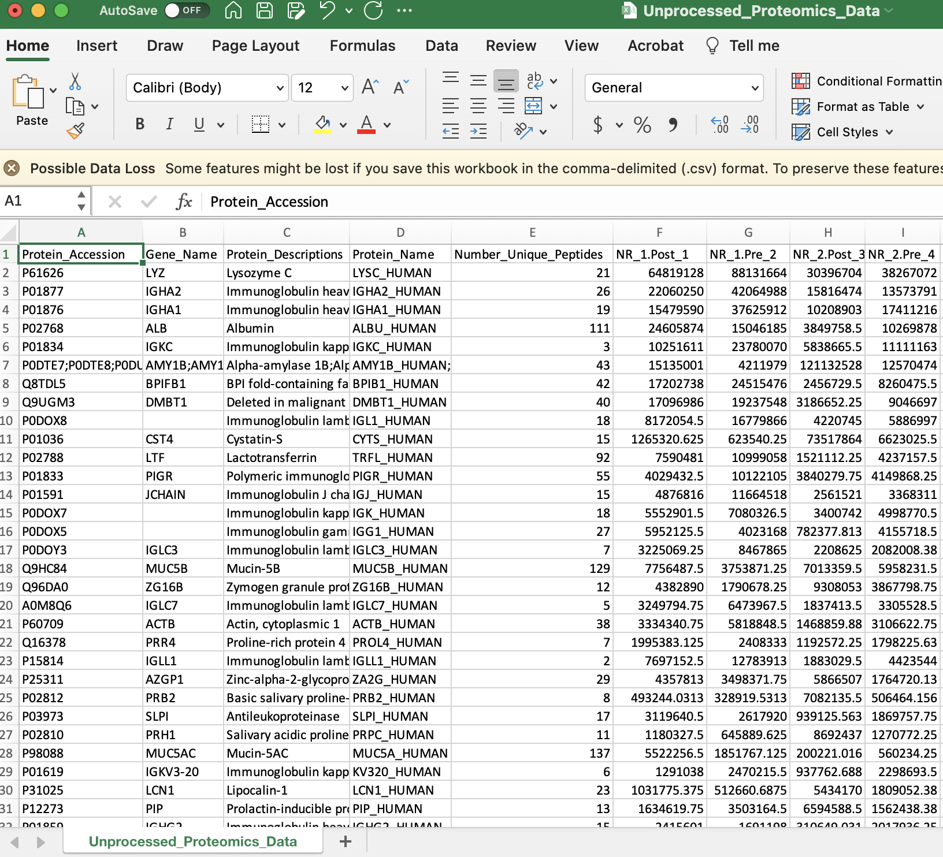
Proteomics Data
Raw proteomics data generally set up with proteins on rows, samples on columns
Each row (protein) contains (may vary by facility):
Protein accession
Gene name
Protein description
Protein name
Number of unique peptides
Columns corresponding to samples contain
raw data for protein intensities

Slide 3
Pre-processing / QC (Quality Control)
What is QC? Why do we need to QC?
QC is just the process of detecting and correcting any systematic or non-biological biases that may have been introduced into the data
These unwanted biases can even exist even with the most careful preparation, precision of instruments, advances in technology, etc.
We do this to ensure that the effects we are seeing are indeed due to what we are investigating (usually things like biological differences, treatment differences, etc.)
QC is done on virtually all datasets, especially high-throughput data such as the data set we are working with

Slide 4
QC Basic Steps
Sample Outliers
Reshaping & Merging Dataframes
Normalization
Imputation of Missing Data
Post-QC QC Analyses
Additional Test for Outliers using PCA

Slide 5
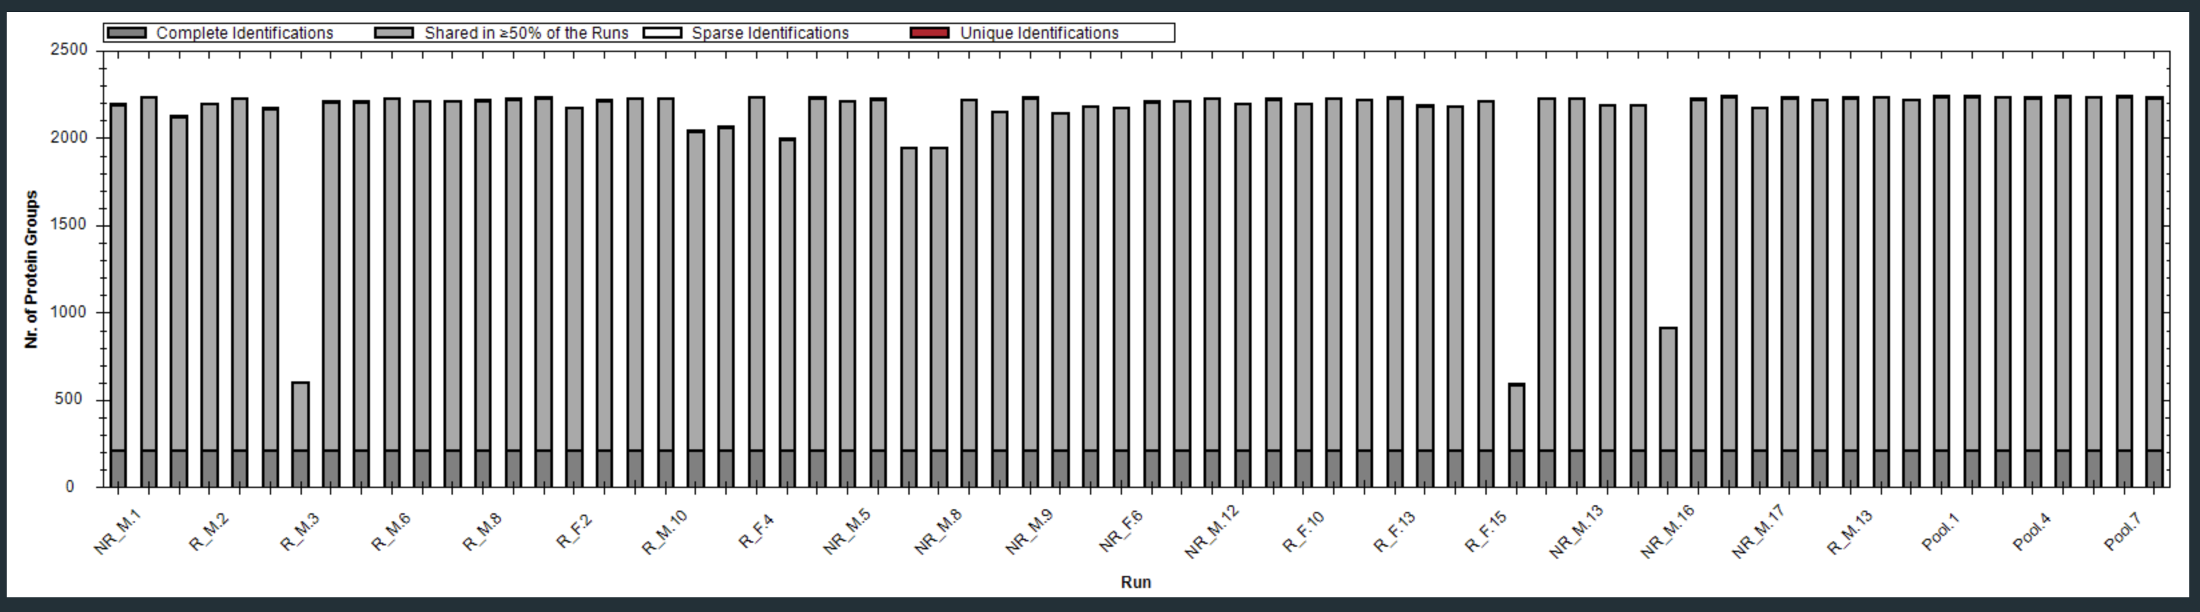
Sample Outliers
It is important to look at overall samples to identify outliers before any further QC
These can affect certain normalization procedures, for example
Below, can be easily seen 3 samples have VERY few proteins identified

Slide 6
Reshaping & Merging Dataframes
While not an actual QC procedure, this step is important (and sometimes the most difficult)
Basically, before being able to do any further analyses or QC, we need to reshape the data so it can be merged
The reason for this, as discussed previously (long vs wide form) is that the demographic data and protein intensity data need to be put into the same, compatible format
This can be easily accomplished with things like:
tidyr::pivot_longer
reshape::melt
(base) merge
dplyr::x_join

Slide 7
Normalization
One of the biggest, or most notorious, steps in QC is normalization
Normalization aims to "correct for variability that is not coming from the biological system itself, but from the experimental process”¹
Normalization is really trying to put all samples on the same scale
1. Summing the abundance values for each sample
2. Calculating the median value across all of the summed abundance values
3. Calculating the ratio for each sample (Sum/Med) --> normalization factor
4. Normalize data by dividing intensities by normalization factor
1 https://help2.biognosys.com/portal/en/kb/articles/how-is-my-data-normalized-in-spectronaut#:~:text=Default%20normalization%20in%20Spectronaut,-Spectronaut%20default%20settings&text=This%20default%20normalization%20is%20based,peptides%20up%20and%20down%20regulated

Slide 8
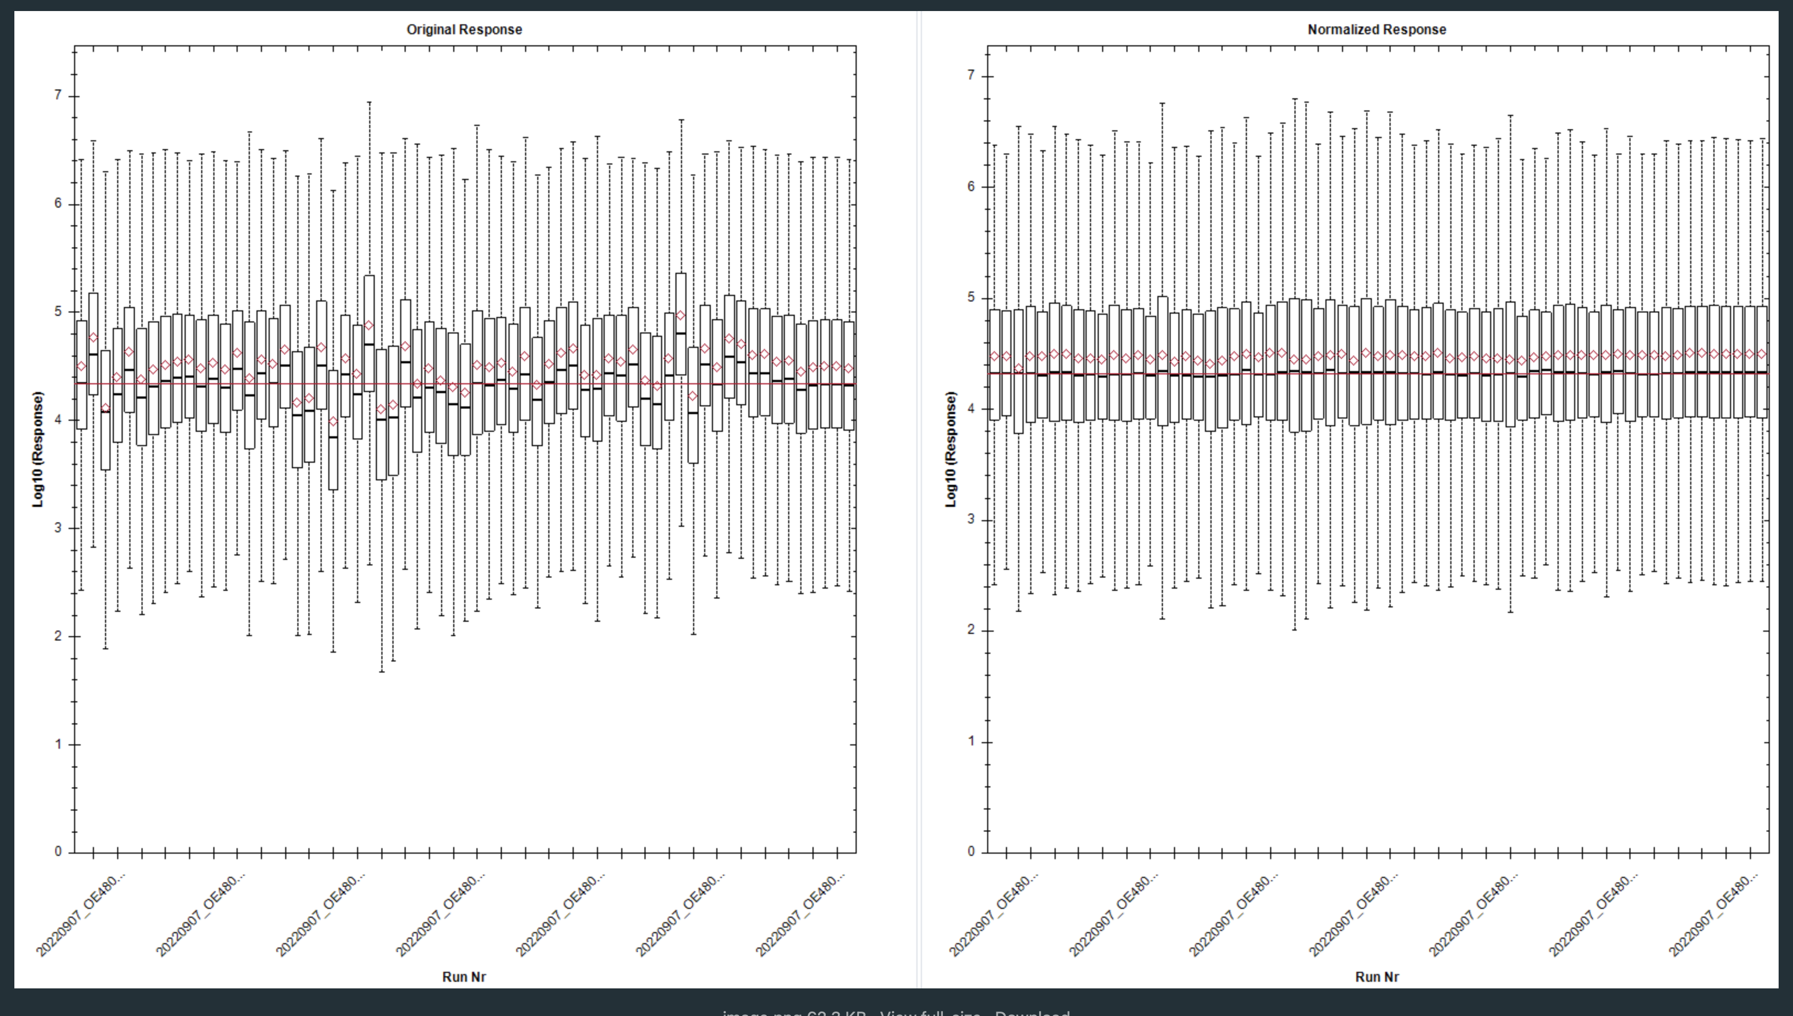
Normalization Plots

Slide 9
Imputation of Missing Data
Quantile Regression Imputation of Left Censored Data (QRILC)
Goal of imputation:
Replace missing values with estimated values based on as much information as possible to generate the best estimate
This allows us to preserve as many samples and data points as we can for our analyses
QRILC replaces data with left-censored data from a Gaussian distribution
Basically, we are assuming that data is missing due to low expression / detection
So we are sampling from a (truncated) normal distribution
This ensures we get small values so we aren’t inaccurately estimating large intensities when we assume they are missing due to low expression

Slide 10
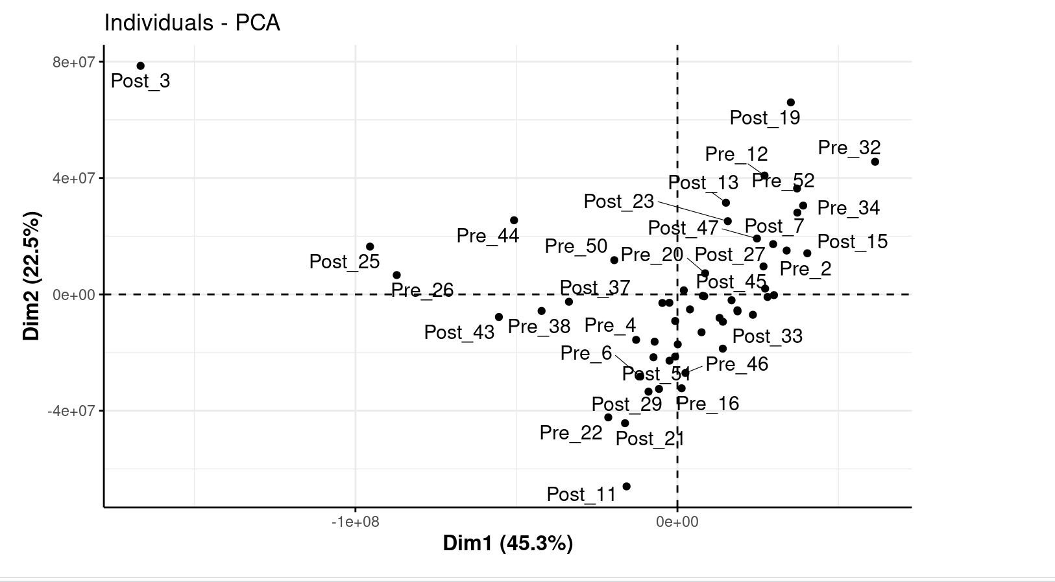
Post-QC QC Analyses
We still want to look at things post normalization and imputation
One approach often used is PCA (principal components analysis)
PCA is a dimensionality reduction method
Here we are using it to help visualize the data and look for outliers
Can see “Post_3” groups alone
Now can follow-up to see if
we need to remove it
Ex: “more than 6 standard deviations
away from the mean” using
PCA data

Slide 11
Export Data
Now we can export the QC’d data and use it in analyses
Questions?

