Slide 1
Introduction to Coding Environment (RStudio Cloud) PREHEAT Retreat Kyle Roell

Slide 2
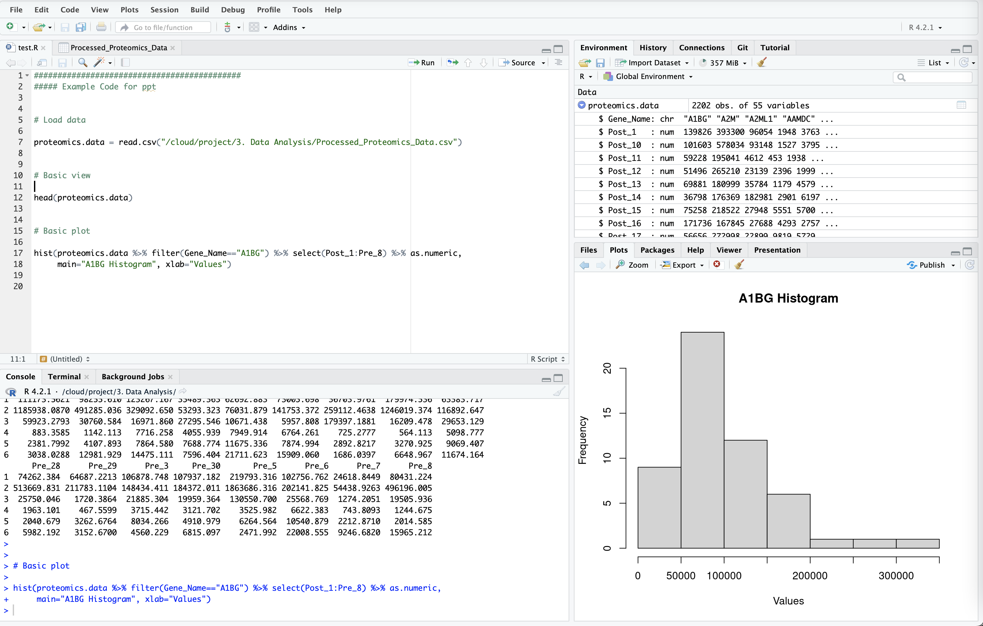
RStudio (Posit)
RStudio is an IDE (integrated development environment) for R
Open source
Runs on most platforms
Allows you to write code, view output, plots, files, etc.
Officially known as Posit (Oct 2022)
RStudio for desktop
RStudio Server
RStudio Cloud
R packages
Tidyverse, Shiny, Markdown, etc.

Slide 3
Parts of RStudio – Text Editor
Text editor is used to view code, text files, etc.
Edit and write code that you can run below in console tab
View datasets

Slide 4
Parts of RStudio – Console
Console is where you run code
This is where you input commands to R
Can directly run commands from here or from code above using “Run” button (or key commands based on system – command enter for Mac)

Slide 5
Parts of RStudio – Environment
Displays your current environment
Datasets
Variables
Can open up datasets to view specifics
Can load or save data here

Slide 6
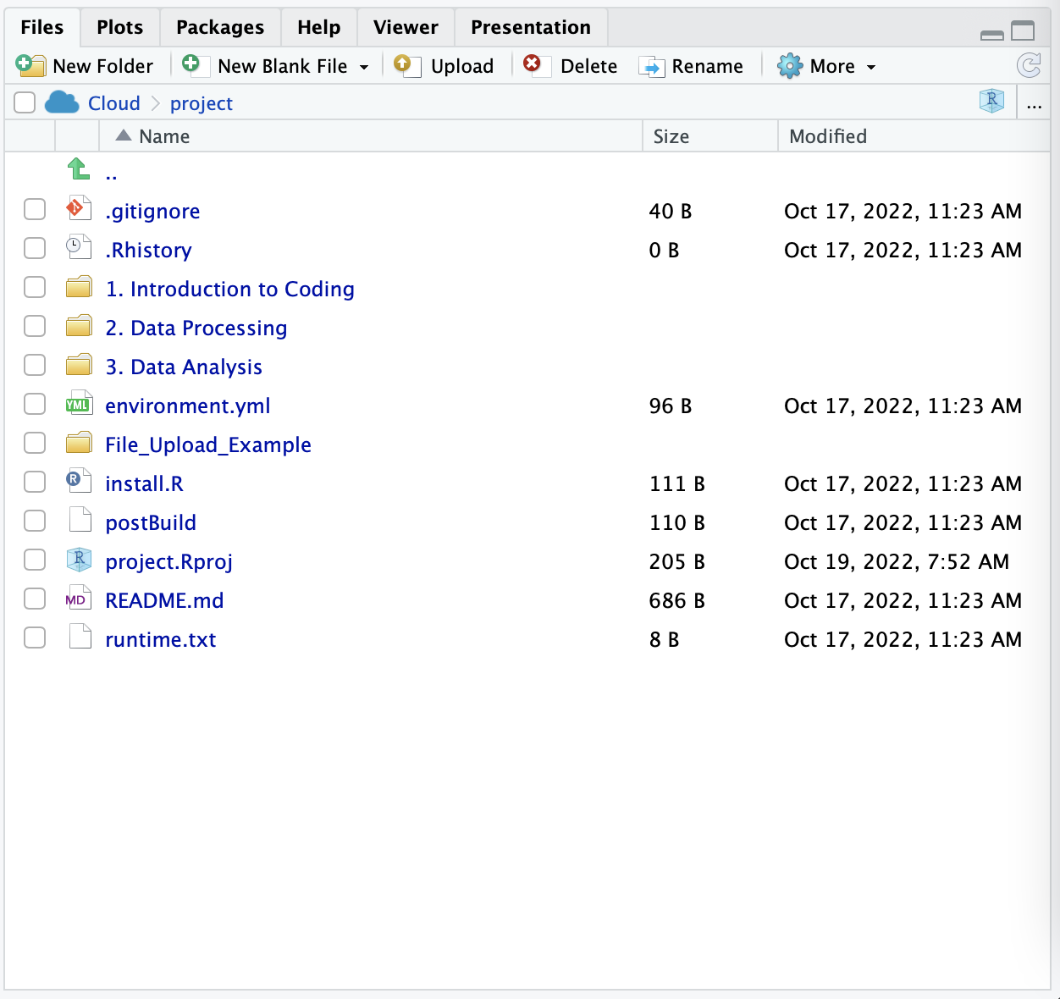
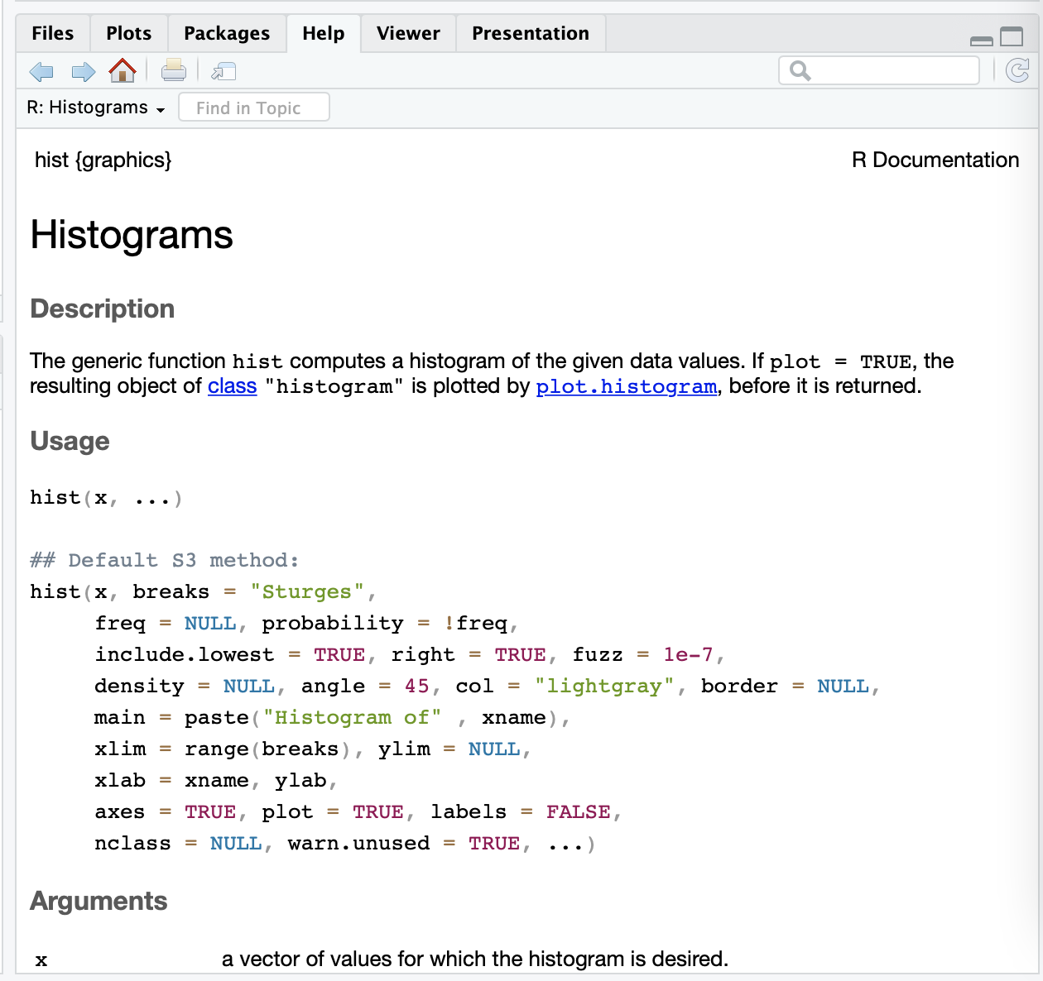
Parts of RStudio – Plots, File Explorer, Help
Bottom right window is used for many things
Plots show up here
File explorer can be opened to look through directories
Help menu also here
Can get information on functions running ?function_name (ex. ?hist to open help info on base histogram function)

Slide 7
RStudio Cloud
RStudio Cloud is like using RStudio but with a cloud-based environment
Don’t have to install R on your local machine
This is nice for purposes like this workshop
Allows instructors to pre-setup R environment, easy access to data, etc.
No configuration or anything
Essentially the same interface as RStudio
Some things are slightly different
File structures
Interacting with local machine
Memory

Slide 8
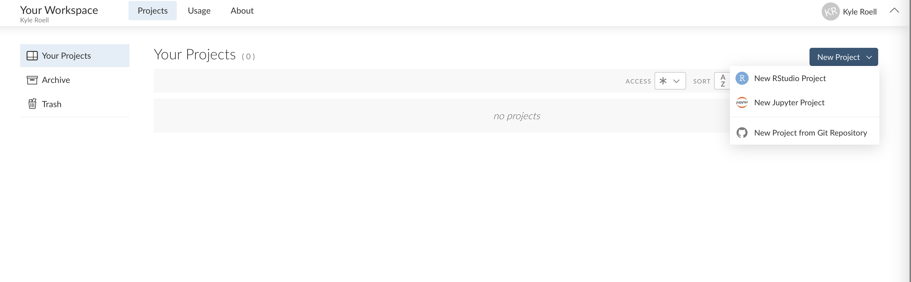
RStudio Cloud – Creating Projects
It’s easy to create a new project in RStudio Cloud
Can choose which type of project
RStudio, Jupyter, connect to GitHub
This deploys a new project and easy to just start working

Slide 9
RStudio Cloud – GitHub
You can create a project based on an existing GitHub repository
This is what I did for our PREHEAT Retreat project
You can then use RStudio Cloud to push, pull, commit, etc.
We won’t be doing this in this workshop
Allows for nice collaboration, storage, etc.

Slide 10
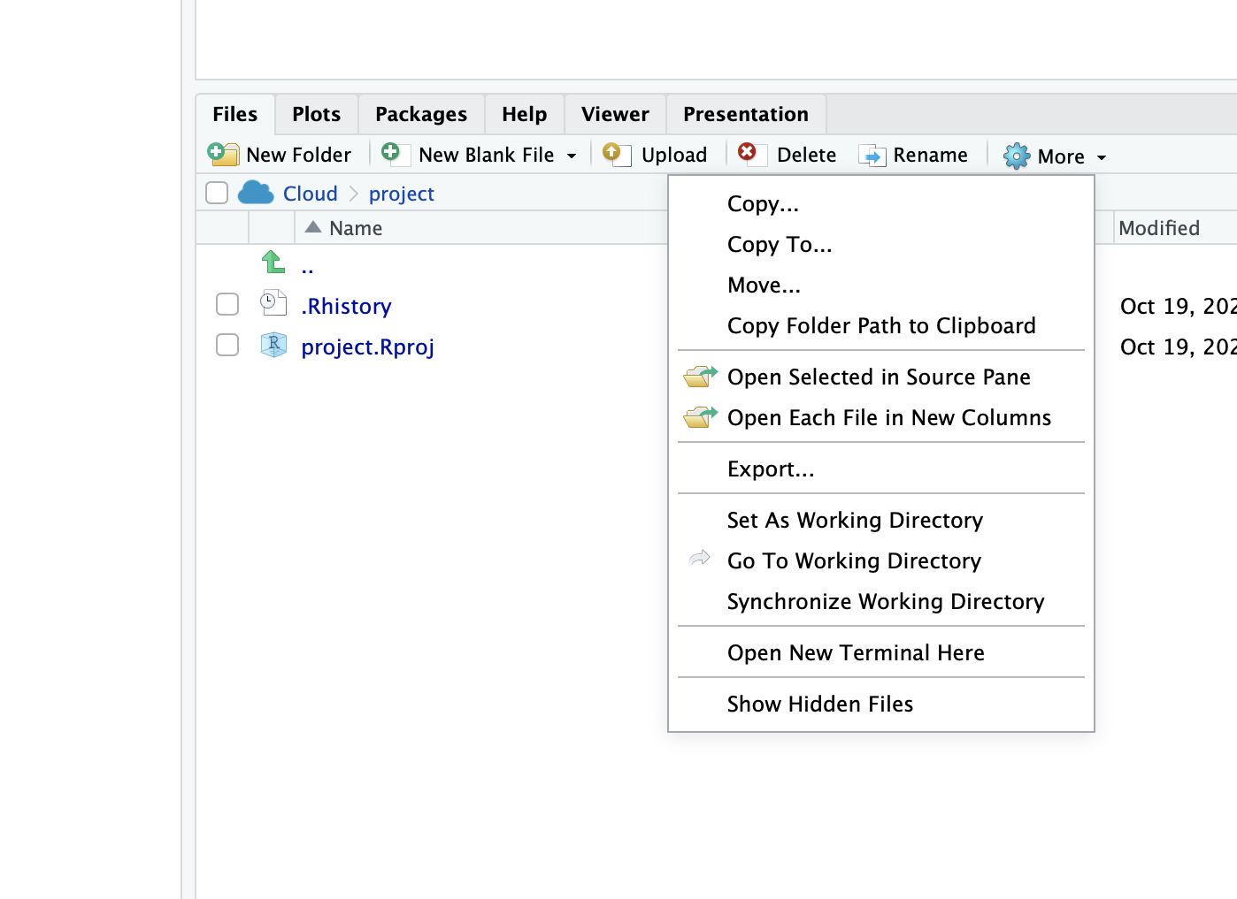
RStudio Cloud – Files, Loading, Saving
When you create a project, you have access to the files in that environment
For example, creating a new project from a GitHub repository will copy all the directories, files, code, etc. and give you access to them
You can also upload files from your local
machine, using “Upload” button
You can download files to your local
machine, using “More” -> “Export” option

Slide 11
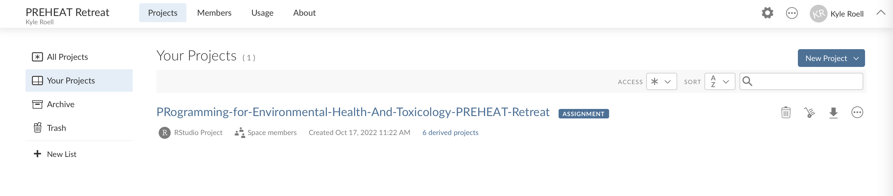
PREHEAT Retreat Project
For this workshop, we created an existing project from the GitHub repo everyone has been added to
You should see this project (listed as an assignment) in your projects space
When you click on this, RStudio Cloud will create your own personal version of this project, so you can edit files, save things, etc.
Because this is linked to GitHub, however, do not push or commit anything
Just use it as an existing environment space to save your personal files and then download them to your machine, explained earlier

Slide 12
Demo / Questions
Questions?

