Slide 1
Intro to Statistical Analyses: Two-Group Analyses PREHEAT Retreat Kyle Roell

Slide 2
Statistical Analyses in R
R makes running basic, and advanced, statistics surprisingly easy
This is both good and bad
Many are included in base R
Lots of packages for more advanced analyses
Basic idea is to explore data and uncover underlying trends, patterns, etc.
Generally, we employ statistical tests or methods to do this
T-tests, Anova, Regression, etc.

Slide 3
Statistical Tests
Statistical tests are used to test a (null) hypothesis (H₀)
Allowing us to make inferences about our data and potentially extrapolate those more generally
Generally, for a given statistical test, we either “reject” or “do not reject” the H₀, based on some test statistic
Thus, a statistical test requires a pair of hypotheses
H₀: a null hypothesis
H_{a}: an alternative hypothesis
Example: " H₀: mean of groupA = mean groupB”, and H_{a}: “mean groupA != mean groupB”
If we reject the null hypothesis, we conclude the means of the two groups are not equal
The significance level of the test, α, is the chance of rejecting H₀ when it is true
This is often sent to .05, and a ”threshold for p-values”, why p-value < .05 considered “significant”
P-value is probability of obtaining test results at least as extreme as those observed, assuming H₀ is true

Slide 4
Common Tests
How do you know which statistical test or method to use?
This depends up your hypothesis, type of data, assumptions of test
(basic, general) Examples:
Difference between 2 group means: T-test*
Difference between >2 group means: Anova*
Relationship between two *categorical* variables: Chi-Square test
Relationship between variables: Correlation, Regression*
* We will be using these in this workshop

Slide 5
T-test
A T-test is used to compare means of two groups
One sample t-test: compare mean of one group to specific value
Two sample t-test: compare means of two independent groups
Paired t-test: compare means of two related groups (ex: before/after treatment)
Consider a two sample t-test, the H₀ is that the two group means are equal
All tests generally have some assumptions that should be met to perform them
Simple random sampling is an assumption common across t-test types
Another shared assumptions of t-tests are that the data are normally distributed
Can generally assume this with large enough sample size
For two sample t-test, sample variances should be equal between groups
This can be overcome by using Welch’s t-test, which is default in R, for example

Slide 6

Two Sample T-Test Example
From our data, we have two groups: Asthmatics and Non-Asthmatics
We want to see if there is a difference in protein expression between these two groups
In R, simply call the function t.test() with appropriate variables
Ex: t.test(Value_Pre ~ Asthma_Status, data=proteomics.data)
What is actually happening:
We calculate a test statistic: t, using our data
We can use this t-value to get a p-value
This allows us to reject the null hypothesis or not
Are the two means equal or not?

Slide 7
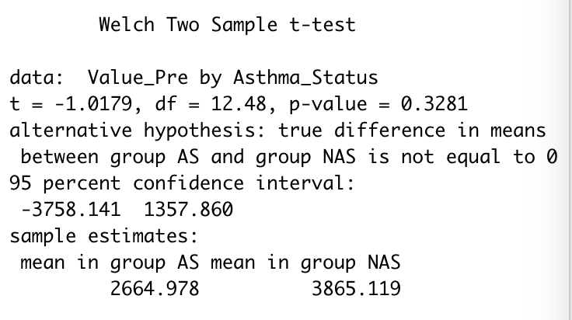
T-Tests in R
As stated before, R makes it very easy to run a t-test
Ex: t.test(Value_Pre ~ Asthma_Status, data=proteomics.data)
How do we interpret the output?
”data” shows the values and group
“t” is the t-value, test statistic
”df” are degrees of freedom
“p-value” is the p-value
”95% Confidence Interval” upper and lower bounds
Sample means from each group
In this case, we do not reject the null hypothesis
as p-value > .05, can’t declare difference in groups

Slide 8
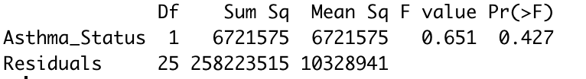
Anova (Analysis of Variance)
Anova is similar to a t-test but can be used when you have more than 2 groups
H₀: no difference in means
Same assumptions as t-test
Again, very simple to run this in R
Ex: aov.results = aov(Value_Pre ~ Asthma_Status, data=proteomics.data),
assume 3 asthma categories
Results interpretation
To get results, use summary(aov.results)
P-value>.05, do not reject null
No difference in group means!

Slide 9
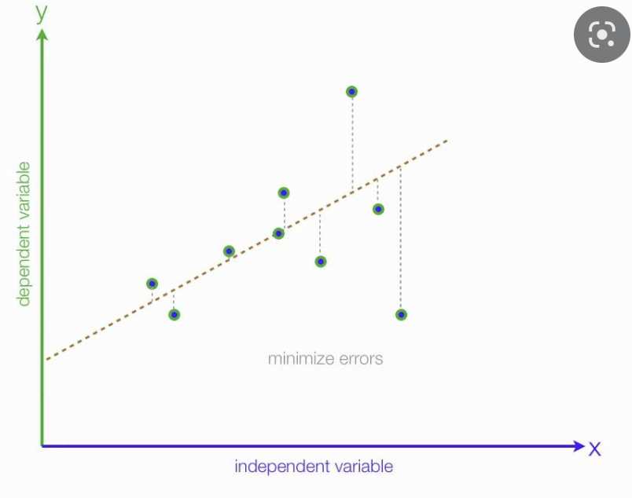
Regression Analysis – Simple Linear Regression
Simple Linear Regression (SLR) is used to understand the relationship between two variables
Dependent variable (Y) and independent variable (X)
Ex: relationship between BMI (X) and Protein Expression (Y)
Generally Ordinary Least Squares (OLS) is used to estimate parameters in a SLR model
A graphical interpretation is fitting a line
to the data points of X plotted against Y,
so that we minimize the squared distance
between the points and that line
Assumptions: linear relationship, independence and
normality, and constant variance of residuals

Slide 10
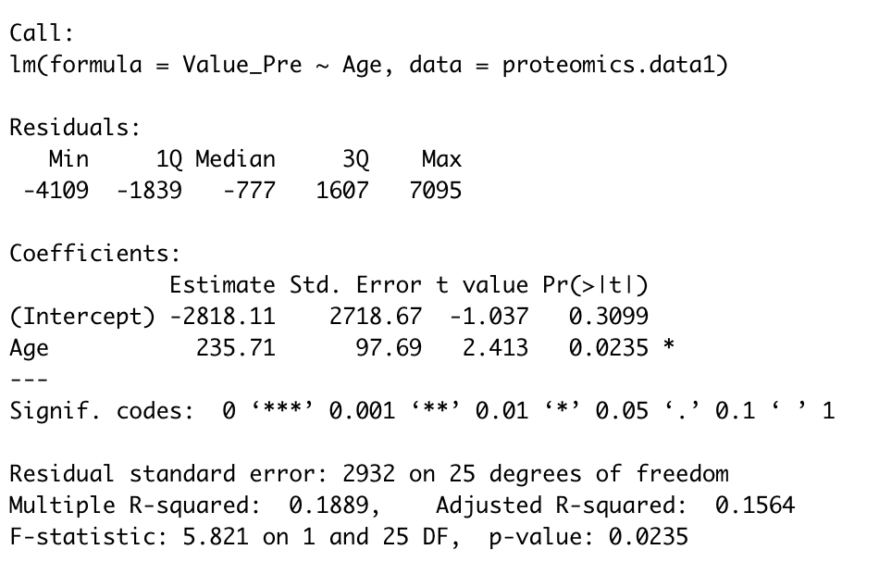
Simple Linear Regression in R
It is ”simple” to run a simple linear regression in R
lm.results = lm(Value_Pre ~ age, data=proteomics.data)
This says run a regression with ”Value_Pre” as the dependent variable and “age” as the independent variable
We want to see if there is a relationship between protein expression (”Value_Pre”) and age
Output using “summary(lm.results)”
“Call” is the function call you made
”Residuals” describe those distances to the best fit line
”Coefficients” describe the model
”Estimate” is the estimate of a specific variable
“Std. Error” is standard error of the estimate
“t value” is the test statistic for that specific variable
“Pr(>|t|)” is the p-value for that specific variable, is there a relationship?
”Multiple R-squared” percentage of variation explained

Slide 11
SLR Output in R
Remember that we can think of this relationship graphically as a line
In that case, the estimates of (Intercept) and Age correspond to values in the equation of that line
Y = mX + b
Here Y is the dependent variable (Value_Pre), m is the slope (estimate for Age), X is the independent variable (Age) and b is the intercept

Slide 12
SLR Output in R – Interpretation
We just said that our slope value (m) is the estimate for Age
This means, as Age increase by 1, our dependent variable increases by the amount estimated for Age
In our example, the estimate for Age is 235.71, this means for every one unit increase in Age (1 year), the value for our dependent variable, protein expression, increases by 235.71.
If we think about this in terms of a line, and 235.71 as our slope, this makes sense
Slope is (change in Y)/(change in X), so 235.71 unit change in Y per 1 unit change in X

Slide 13
Multiple Testing Corrections
Finally, when we are running LOTS of test like this, there is a chance we are rejecting some H₀ when we shouldn’t
Remember, α, is the chance of rejecting H₀ when it is true (Type 1 error)
So if we set this to the standard .05, meaning we reject H₀ when p<.05
5% chance of rejecting H₀, when we shouldn’t (ex. we are saying there is a difference between two groups)
If we are running 2000 tests at a significance level of .05, we expect that, by chance, we are rejecting H₀ 100 times!
To address this, there are numerous procedures that adjust the threshold and/or p-value so that we are controlling these errors

Slide 14
Summary
That was a LOT
T-test is used when we want to test differences between two groups
Anova is used similarly to a t-test but for more than two groups
Simple Linear Regression is used to determine relationship between two variables
Easy to code in R and lots of free resources for these and more advanced analyses

Slide 15
Questions?

