Slide 1
PREHEAT Retreat Summary: Sex-Associated Proteins
Katelyn & Arjun
21 October 2022

Slide 2
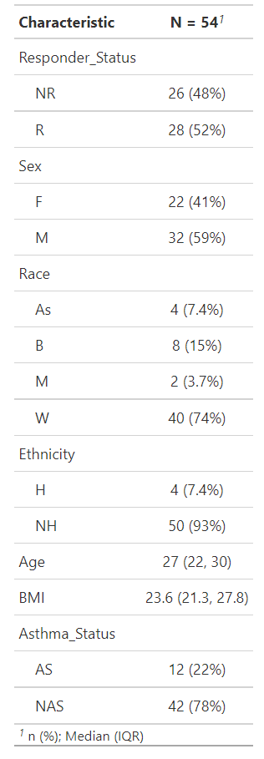
Demographics Summary

Slide 3
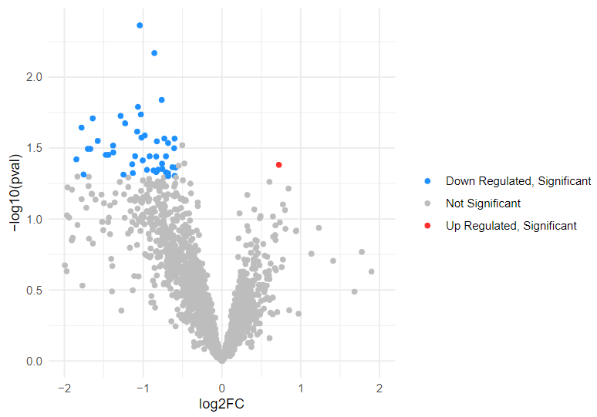
Pre-exposure woodsmoke: Volcano plot display sex-associated genes
TNC

Slide 4
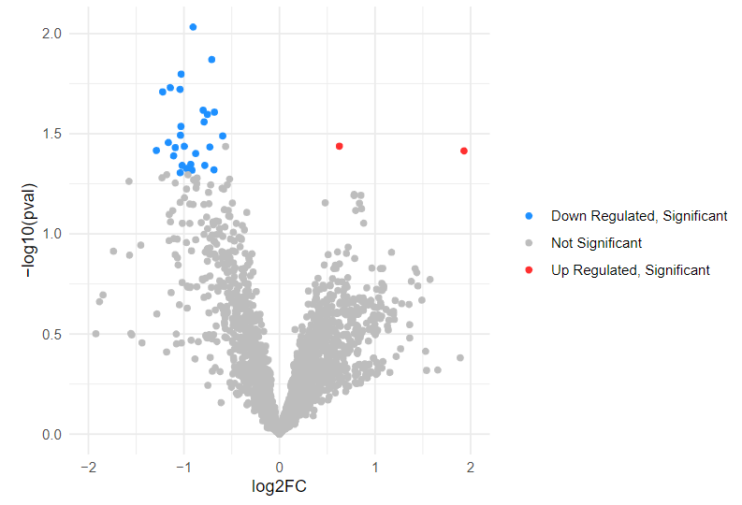
Post-exposure woodsmoke: Volcano plot display sex-associated genes
BPIFA1
ANKFY1

Slide 5
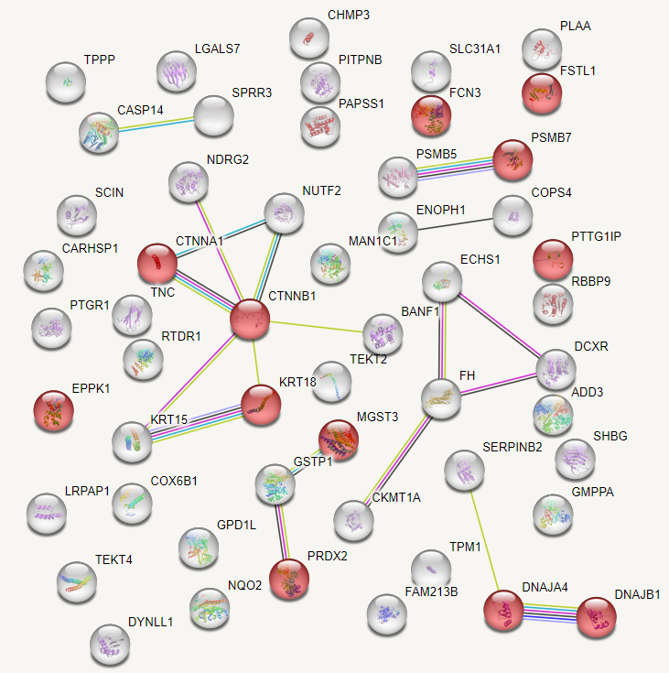
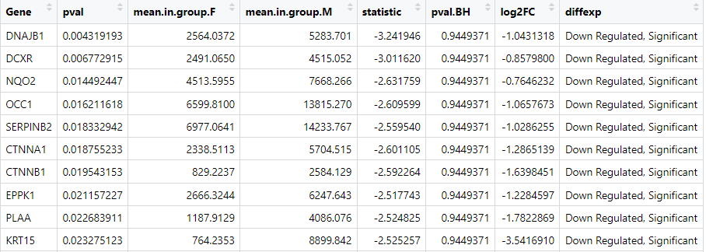
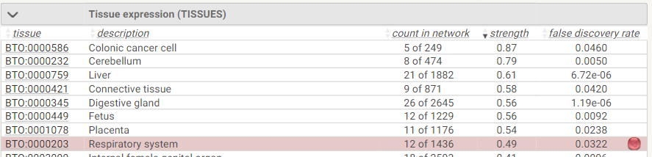
Top 10 Genes Significantly (p<0.05) Associated with Sex in Pre-Exposure Woodsmoke
10 out of 54 total genes significantly (p<0.05) associated with sex in pre-exposure

Slide 6
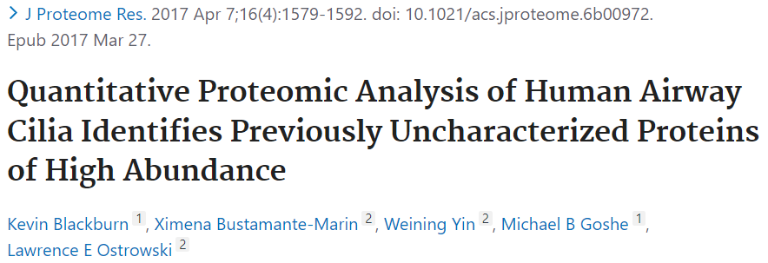
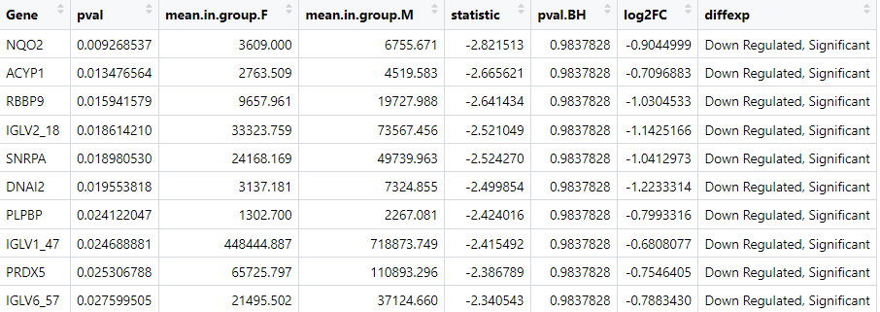
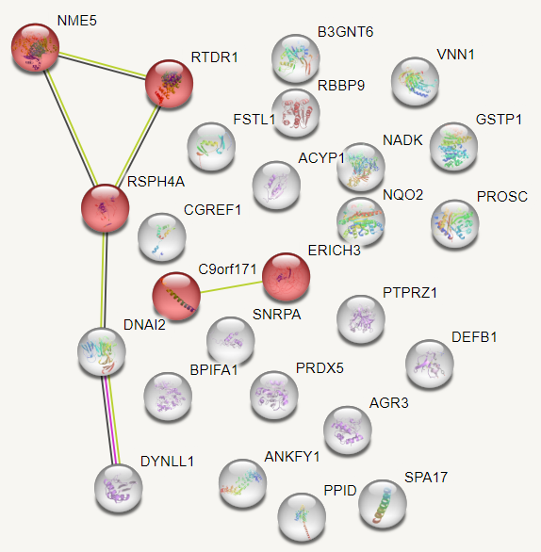
Top 10 Genes Significantly (p<0.05) Associated with Sex in Post-Exposure Woodsmoke
10 out of 30 total genes significantly (p<0.05) associated with sex in post-exposure

Slide 7

Thank You & Acknowledgments
PREHEAT Retreat Organizer
CiTEM: Julia Rager, Ilona Jaspers, and Neil Alexis
UNC SRP Center: Kyle Roell, Lauren Eaves, and Lauren Koval
Computational Biosciences Club: Amjad Dabi and Nyssa Tucker
And per requested by Amjad, an obligatory cat photo☺

