Slide 1
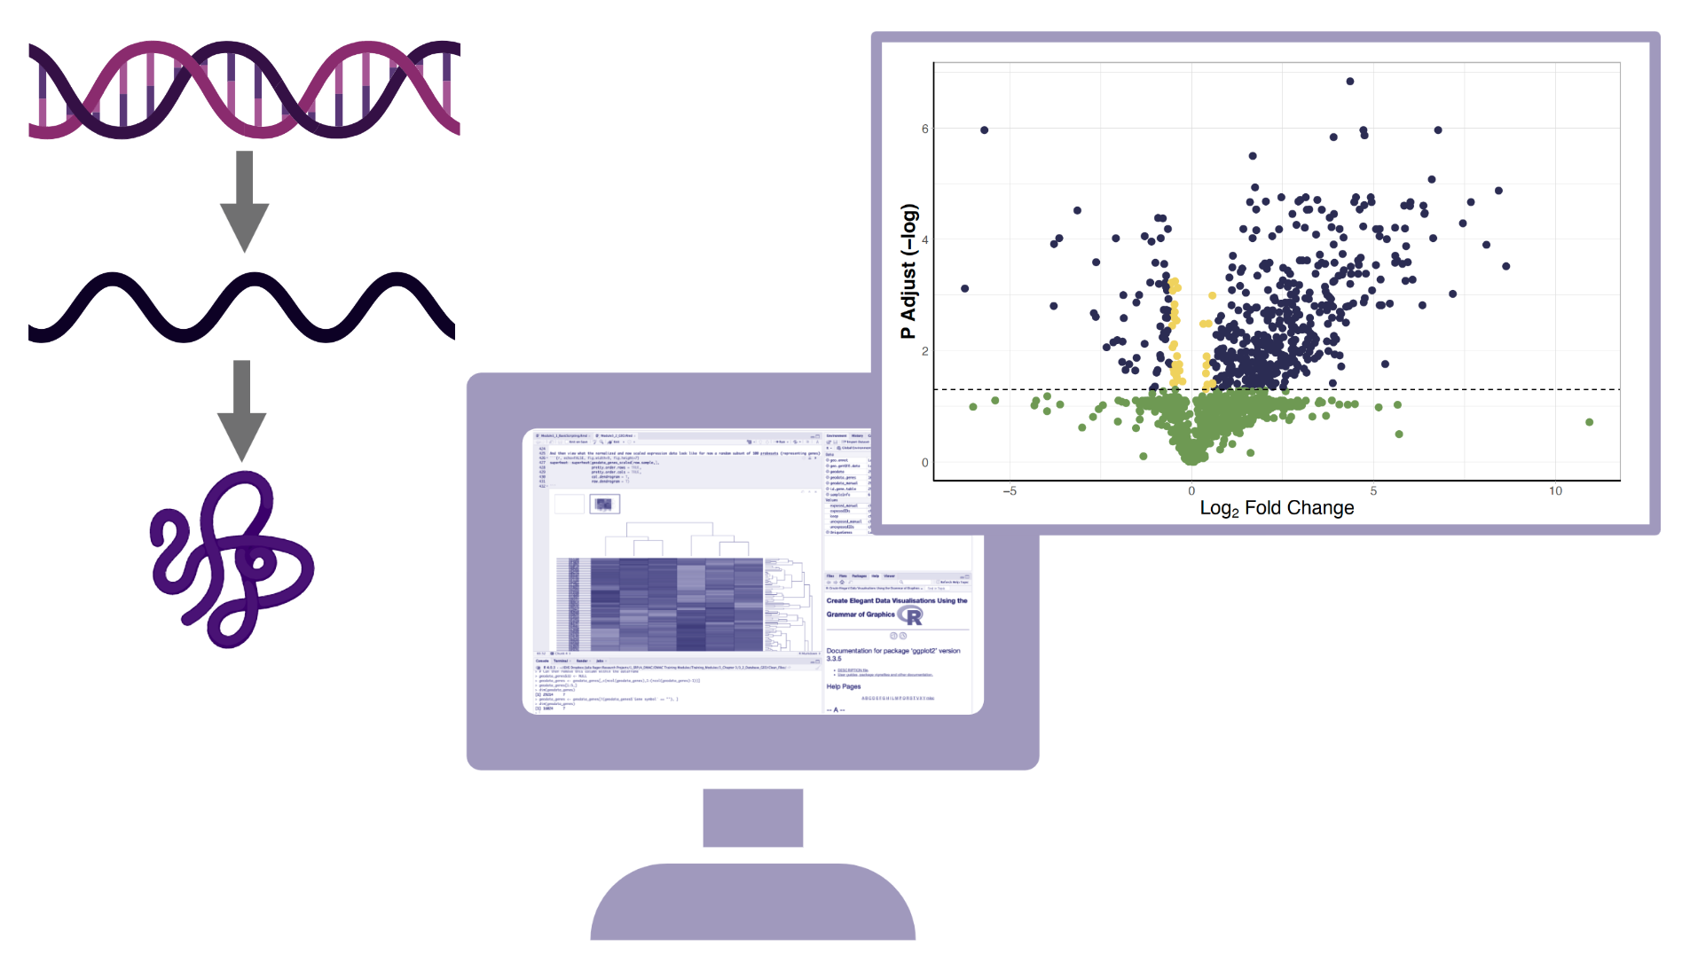
Welcome to the PRogramming for Environmental HEalth And Toxicology (PREHEAT) Retreat

Slide 2


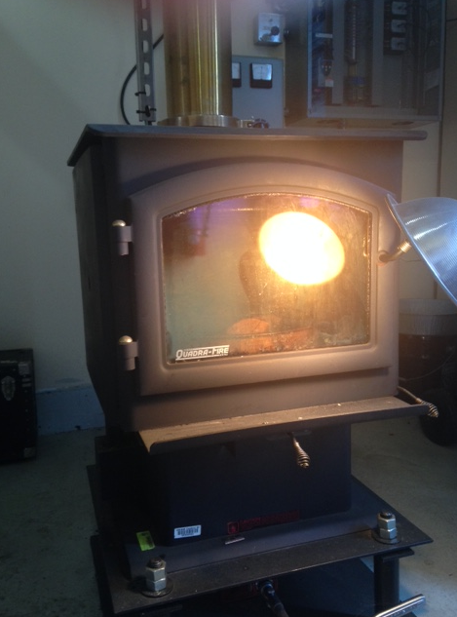
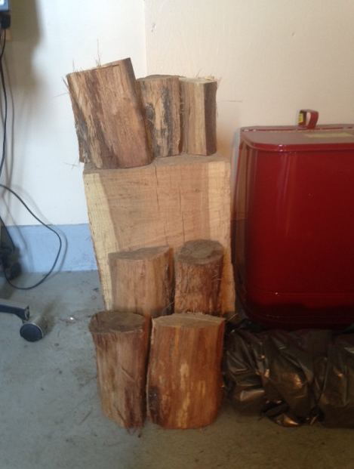
Wood Smoke Exposure: Background
Q: Why are we interested in the health effects of wood smoke exposure?

Slide 3
Wood Smoke Exposure: Background
Q: Why are we interested in the health effects of wood smoke exposure?
A1: Epidemiology Says We Need To Be Interested….
Identifies 3 main sources of exposure:
Indoor exposures due to cooking/biomass in developing countries
Ambient PM exposures from residential wood combustion in developed countries
Wildfires due to global warming
Identifies Associations with Disease:
Exacerbations of asthma and COPD
CVD morbidity
WSP account for a disproportionally high number of hospitalizations compared to PM2.5
from other sources

Slide 4
Wood Smoke Exposure: Background
Q: Why are we interested in the health effects of wood smoke exposure
A2: Controlled Human Exposure Studies Say We Need To Be Interested…
Inhalation of WSP produces an inflammatory response in the airways; increased sputum neutrophils and pro-inflammatory cytokines
Some people have an excessive airway inflammatory response = RESPONDERS
GSTM1null status and asthma help make you a RESPONDER

Slide 5
“SMOKESCREEN” STUDY
We are currently conducting a controlled human exposure study (SMOKESCREEN) to identify Inflammatory RESPONDERS to Wood Smoke - RESPONDERS are then eligible to enroll into subsequent mitigation studies
Subjects are exposed to 500 ug/m³ WSP over 2 hrs with alternating 15-minute periods of rest and exercise
Induced sputum is measured before, 6 and 24 hrs after exposure
Sputum samples are analyzed for their neutrophil content and pro-inflammatory cytokine profile.
Inflammatory RESPONDERS are defined as having a > 10% point increase in sputum neutrophils post vs pre-exposure

Slide 6
SPUTUM SAMPLES
Location: Sputum samples derive from the surfaces of the large/central airways – a site that is proximal to WSP deposition, asthma/COPD pathology
Collection: Subjects inhale hypertonic saline using an ultrasonic nebulizer in increasing concentrations (3-5%) for a total of 21 minutes, then through directed cough, expectorate sputum samples into a specimen cup
Processing: Samples are processed in the lab using DPBS wash buffer and a strong reducing agent (sputolysin) to help separate the mucus from the cell content. The samples are homogenized, centrifuged, filtered and cell-free supernatant samples are captured and stored (-80 deg C), and cytospin slides are generated and stained for differential cell analysis under the microscope - - this process takes ~ 2 hrs

Slide 7
Proteomic Assessment and Other Outcomes
Cell free supernatant samples are used for proteomic assessment
Cytospin slides are used to define Inflammatory RESPONDER status following differential cell analysis for neutrophil content
Remaining cell pellets can be used for RNA/DNA (gene signature) analysis
THANK YOU
QUESTIONS?

