Slide 1
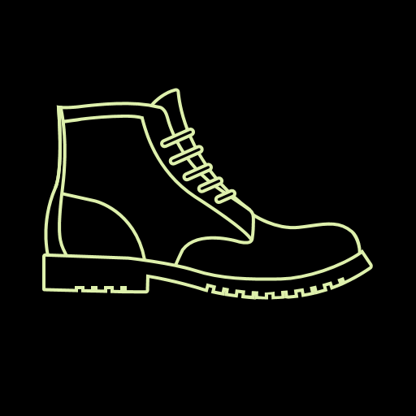
BOOT CAMPING
The app that makes preparing your next outdoor adventure a breeze

Slide 2
Team members
Zach Milosevich – routing, encryption, user authentication
Ian Maynard - database
Nate Pond – front end
Matt Johnson - testing
Kristina Karrass – API calls and mapping

Slide 3
Mission:
Create an app that lets the user search for campsites and trails at a specific location
Give user the tools to prepare for his trip – list of items to pack such as backpacks for day trips or longer trips, meal plans, first aid items, etc.
The user can tick off items already packed and make a list of things still needed
Backpacks, campsites and trails can be saved to the user’s profile

Slide 4




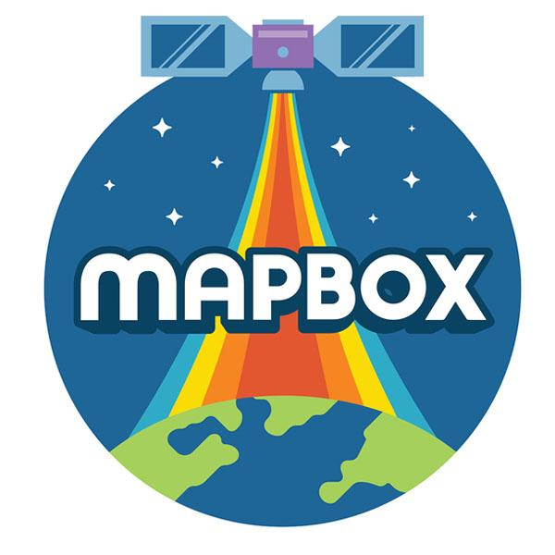
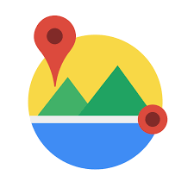


Technologies used
RIDB.RECREATION.GOV

Slide 5
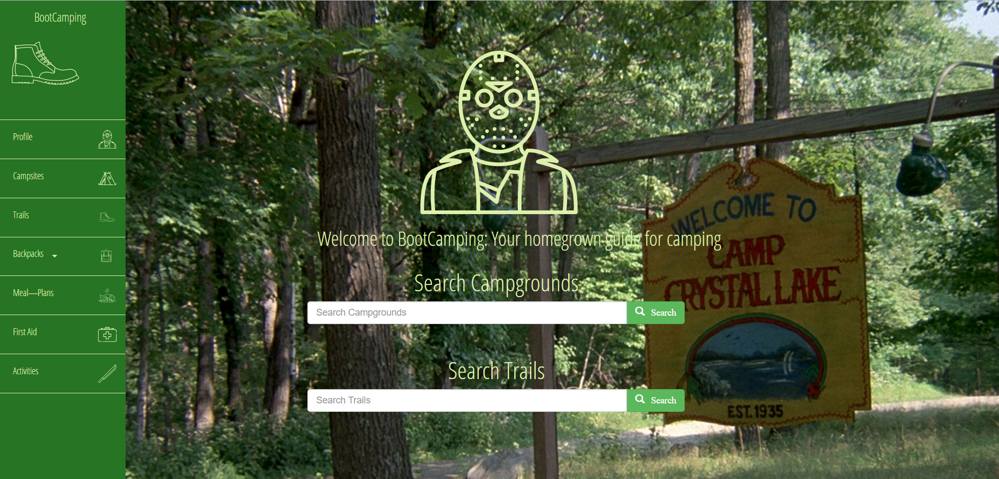

Slide 6
Looking ahead:
Due to the lack of trail APIs, users should be able to add campgrounds and trails and rate them.
Make the app “social” by letting users view each other’s profiles to see backpack information, trails and campgrounds

