Slide 1
three
stages
journey

Slide 2
Describe your journey in 3 stages, one word for each.
Year 1
“Oneword”
Year 2
“Oneword”
Year 3
“Oneword”
Use colors to express the most.

Slide 3
Task 1.
Year 1
“Oneword”
Year 2
“Oneword”
Year 3
“Oneword”
Your journey as a team

Slide 4
Task 2.
Year 1
“Oneword”
Year 2
“Oneword”
Year 3
“Oneword”
Your journey as Mapper/Experimenter/Explorer

Slide 5
Task 1.
DELIVERY
Accelerator Lab ________

Slide 6
Task 2.
My journey as ________

Slide 7
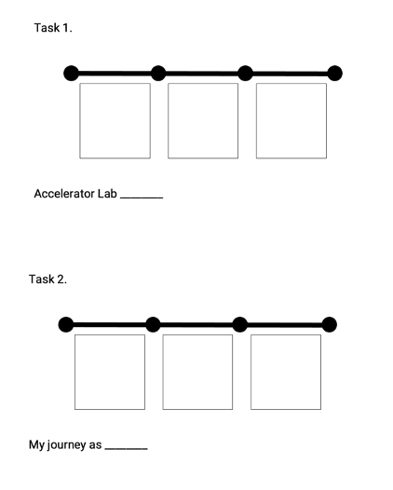
Results:
Name
Print screen and share

Slide 8
Share your results with your team

