Slide 1







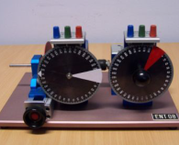

CLIENT
Communications
OL
Expid 1
Expid 2
Expid N
VL
RL
PID
Controller
Simulation
Model
Control
Program
Lab
Equipment

