Slide 1



Страновой офис ЮНИСЕФ в Казахстане
Навыки для девочек:
Программа по разработке наноспутников

Slide 2

Запусти свою мечту: Образовательная программа по разработке наноспутников UniSat для девочек (UNEPG)
UNEPG является совместным проектом ЮНИСЕФ Казахстан и Казахского национального университета имени аль-Фараби

Slide 3
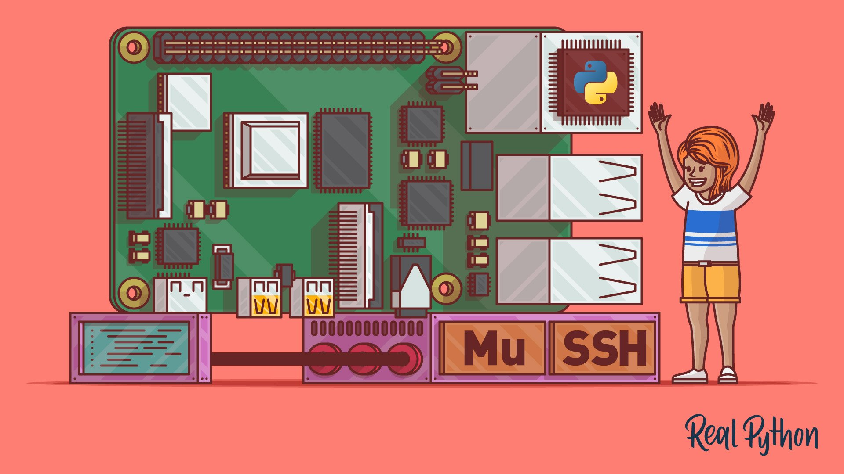


Lecture 3: Software Development on the OBC
Short introduction Trinket.IO Platform
Python Quick Start
Working with Sensors Using Python
© Real Python
Programming the OBC (RPi) Using Python
kaznu.kz
sciencepark.kz
Notes:
In the previous lectures we have learned about OBC, it’s hardware components and main functions and you have also learned to design your first PCB using Fritzing and KiCad. You also learned about I2C. In this lecture, we will use such hardware interfaces to communicate between the raspberry pi and the sensors.

Slide 4

1. Trinket.IO
Introduction
PCB Design
Software Development
English : https://trinket.io/courses/join/efHCLP
Русский : https://trinket.io/courses/join/KSE6Kh
You are here!
kaznu.kz
sciencepark.kz
Notes:
Trinket is an online platform where you can learn and run your programs online instantly. Remaining parts of the lecture 3 will be mainly on the trinket io platform, where you are going to learn programming and communication between hardware devices interactively, this will help you better understand code and gives you opportunity to practice what you learned.
To continue, click on the links above, we have prepared the course in both English and Russian, you can pick whatever language you like. Remember to comeback after finishing your lessons on trinket and submit your test here on this platform, Good luck and enjoy learning!

Slide 5
The following materials are used in this lecture.
Literature:
1. Edwards, T., Phelps, S. and Mains, A., 2017. Drawing Sequences. Ohio Journal of School Mathematics, 74(2).
2. Kurniawati, A., Kusumaningsih, A. and Sophan, M.K., 2018. Visualization code tools for teaching and learning introductory programming. In 2018 2nd International Conference on Informatics for Development (ICID) (pp. 97-100).
3. Holliday, M., Ramirez, A., Settle, C., Tatum, T., Senesky, D. and Manchester, Z., 2019. Pycubed: An open-source, radiation-tested cubesat platform programmable entirely in python.
Internet resources:
https://files.realpython.com/media/Getting-Started-With-Python-on-Raspberry-Pi_Watermarked.be0a53816c48.jpg
https://python.org
https://realpython.com
kaznu.kz
sciencepark.kz

