Slide 1
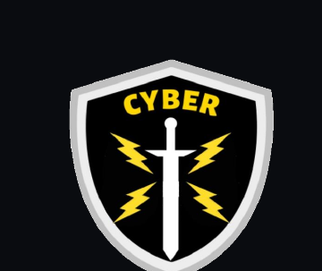
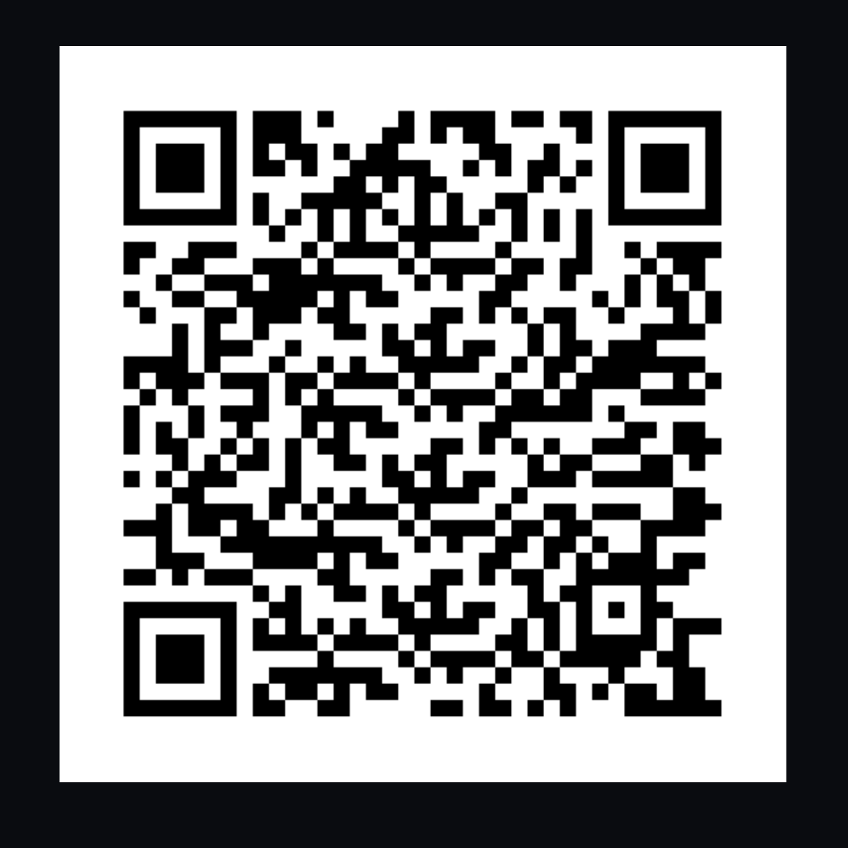
// UNIT ATTENDANCE
Unit Attendance
ALL members, please fill out this attendance form.
....yes, you.
UNG Cyber Unit

Slide 2
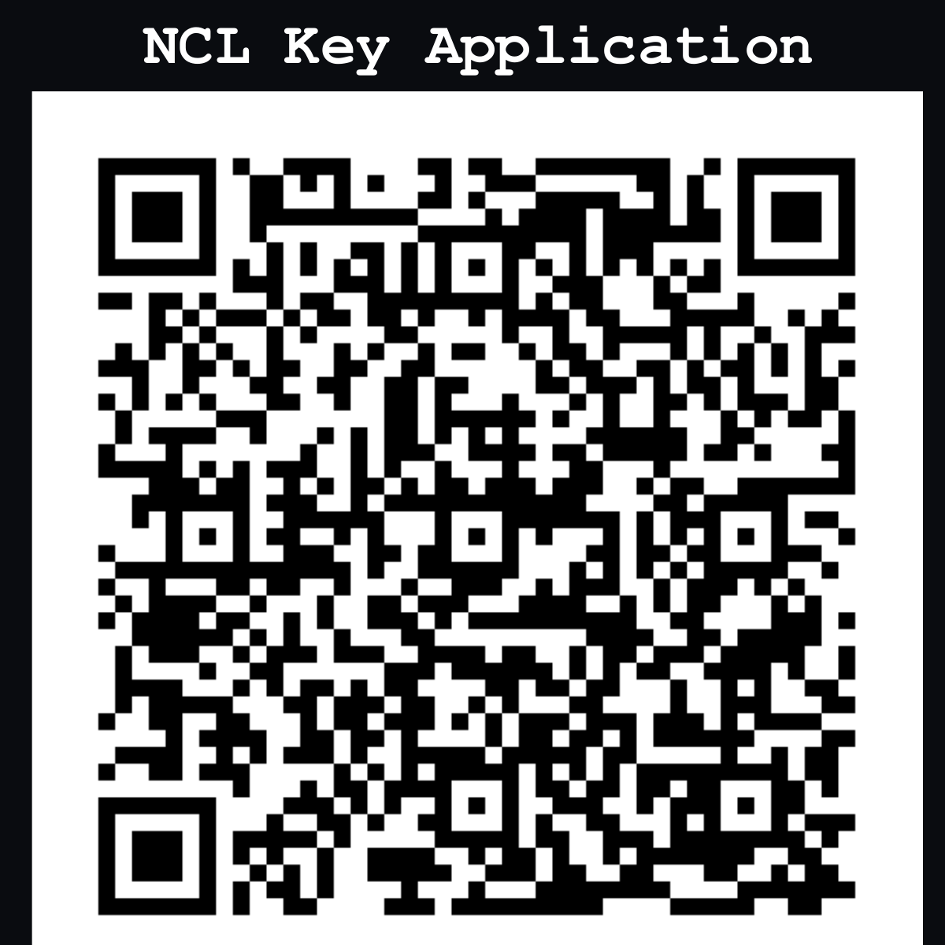
// NCL
National Cyber League (NCL)
https://cyberskyline.com/events/ncl
Beginner Friendly Competition
All members may compete, regardless of skill level
Easy-Hard Difficulty Challenges
Provides Early Experience into CTF-style competitions
Engages team building
Merit-Based Unit Involvement
UNG Cyber Unit

Slide 3
// NCL
Cyber Unit Promotion Path
Junior Member
Tech
Architect
Senior Member
Requirements
Full complete:
Linux Luminarium
HTB Starting Point
HTB Writeup
Promotion Test
410+ on AFT (cadets)
Create a custom tool, training platform, or other program approved by leadership and upload to the UNG Cyber Unit GitHub.
Submit a resume
100+ word essay on why you want to promote
Interview
Promotion Test
UNG Cyber Unit

Slide 4
// NCL
Cyber Unit Promotion Path
Junior Member
Tech
Architect
Senior Member
Requirements
Full complete:
Linux Luminarium
HTB Starting Point
HTB Writeup
Promotion Test
410+ on AFT (cadets)
Create a custom tool, training platform, or other program approved by leadership and upload to the UNG Cyber Unit GitHub.
Submit a resume
100+ word essay on why you want to promote
Interview
Promotion Test
UNG Cyber Unit

Slide 5
UNG CYBER UNIT
Wireshark & Network
Traffic Analysis
Introduction - Joshua Acklen - James Goble - UNG Cyber Unit - 09/22/2026
University of North Georgia | Cyber Unit

Slide 6
// NTA
What is Network Traffic Analysis?
DEFINITION: Network Traffic Analysis (NTA) is the process of capturing, inspecting, and interpreting the data that moves across a network to understand behavior, diagnose problems, and detect malicious activity.
Common Use Cases:
Incident response & threat hunting
Detecting malware command-and-control (C2) traffic
Troubleshooting connectivity & performance issues
Validating firewall / IDS / IPS rules
UNG Cyber Unit

Slide 7
// WHY IT MATTERS
Why NTA Matters for an Analyst
Packets don't lie. Logs can be edited or deleted - raw traffic shows what actually happened on the wire.
Most attacks touch the network. Recon, delivery, command-and-control, and exfiltration all leave traffic behind.
It enables early detection. Spotting anomalies in traffic often catches an attacker before real damage is done.
It's a core analyst skill. Tested in NCL and other CTFs, and part of the Cyber Unit promotion path.
It builds protocol intuition. Knowing how traffic should look makes it obvious when something doesn't.
UNG Cyber Unit

Slide 8
// THE TOOL
Meet Wireshark
DEFINITION: Wireshark is a free, open-source packet analyzer that captures traffic on a network interface and displays it in human-readable detail.
Why We Use It:
Live capture from any interface - Wi-Fi, Ethernet, loopback
Opens .pcap / .pcapng files from other tools (tcpdump, NCL, CTFs)
Deep protocol dissection - HTTP, DNS, TCP, TLS, and more
Free, cross-platform, and the industry-standard packet analyzer
UNG Cyber Unit

Slide 9
// BASICS
The Wireshark Interface
Packet List
Packet Details
Packet Bytes
Top pane - one row per packet: time, source, destination, protocol, and a short summary.
Middle pane - an expandable tree showing every protocol layer of the selected packet.
Bottom pane - the raw hex and ASCII bytes that make up the selected packet.
UNG Cyber Unit

Slide 10
// GETTING STARTED
Capturing Traffic - The Basics
1
Pick an interface (Wi-Fi, Ethernet) from the Wireshark start screen
2
Click the blue shark-fin icon to start capturing
3
Generate some traffic - browse a site, ping something
4
Click the red square to stop the capture
5
File > Save As to keep the capture as a .pcapng for later
UNG Cyber Unit

Slide 11
// FILTERING
Reading & Filtering Traffic
With thousands of packets in a capture, display filters narrow the view down to exactly what you're looking for.
Common Filters:
http show only HTTP traffic
ip.addr == 192.168.1.1 traffic to/from an IP address
tcp.port == 443 traffic on a specific port
dns show only DNS queries & responses
TIP
Right-click any field in the Packet Details pane and choose 'Apply as Filter' to build filters without memorizing syntax.
UNG Cyber Unit

Slide 12
// TELNET
Telnet: A Cleartext Protocol
DEFINITION: Telnet is a remote-login protocol (TCP port 23) that sends everything - including usernames and passwords - as plain, unencrypted text over the network.
Why It's a Risk:
No encryption - anyone capturing the traffic can read it directly
Still found on legacy devices, switches, and older lab equipment
Replaced in modern practice by SSH, which encrypts the session
A textbook example of why NTA matters for a defender
UNG Cyber Unit

Slide 13
// LIVE DEMO
Viewing Cleartext Credentials in Wireshark
1
Open the class capture file (wireshark-101-class-capture.pcapng)
2
Filter on tcp.port == 23 to isolate the Telnet session
3
Right-click any packet in that conversation, then Follow > TCP Stream
4
Read the reconstructed session top to bottom
5
Spot the username and password sitting in plain text
TAKEAWAY: The same visibility that helps you troubleshoot a network also shows you when a system is exposing credentials in the clear.
UNG Cyber Unit

Slide 14
// ETHICS & LEGAL
Capture Responsibly
RULE: Only capture traffic on networks you own, or where you have explicit written authorization to test.
Why It Matters:
Unauthorized packet capture can violate the Computer Fraud and Abuse Act (CFAA) and similar state laws
Club labs, personal home networks, and NCL / CTF ranges are fair game - production or public networks are not
When in doubt, ask leadership before you sniff
The skills in this deck are for defense and authorized testing only
UNG Cyber Unit

Slide 15
// TRY IT YOURSELF
Put It Into Practice
Ready to test what you just learned against the class capture? This week's challenge is posted in two places:
WEBSITE
ONEDRIVE
ungcyberunit.org
Shared Cyber Unit OneDrive
Posted under Announcements
Also posted there for offline access
UNG Cyber Unit

Slide 16
// RECAP
Key Takeaways
NTA turns raw traffic into visibility - the foundation of incident response and troubleshooting
Wireshark captures and dissects that traffic pane by pane: List, Details, Bytes
Display filters (http, tcp.port, dns) narrow a busy capture down fast
Cleartext protocols like Telnet hand credentials to anyone who's listening
Only capture on networks you're authorized to test
UNG Cyber Unit

Slide 17
// RESOURCES
References & Resources
References
Tools & Links
Wireshark User's Guide
Wireshark Wiki - Sample Captures
UNG Cyber Unit - NTA Session Notes
wireshark.org
wiki.wireshark.org/SampleCaptures
wiki.wireshark.org/DisplayFilters
UNG Cyber Unit

