Slide 1
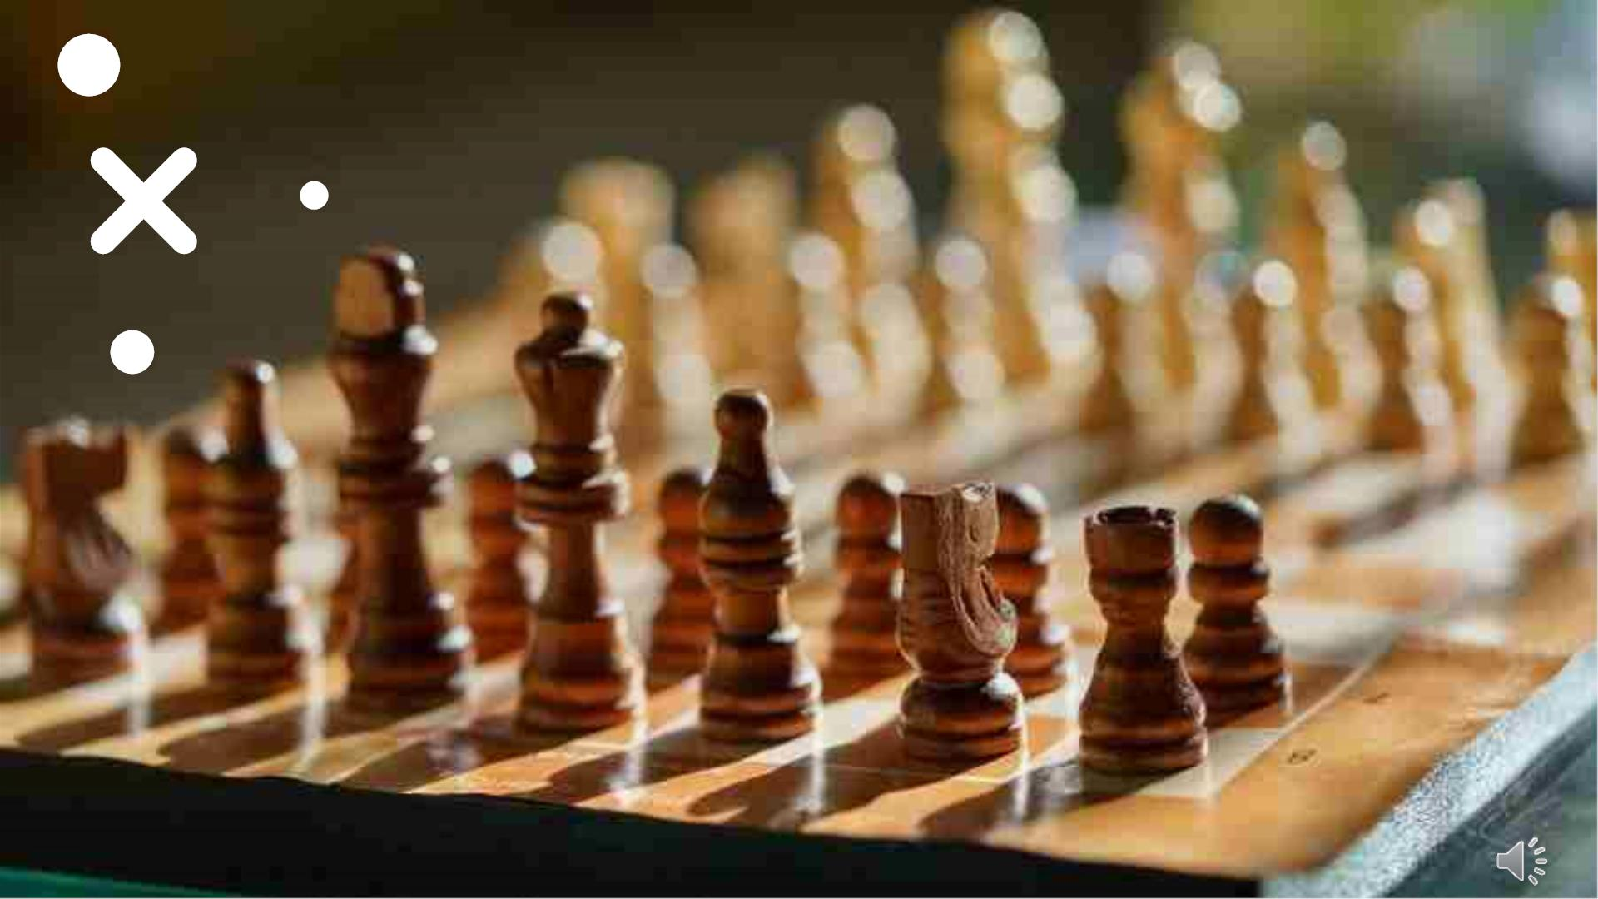
CHESS GAME IN
AI
Barla Medhini
Likhitha Gupta Thallapally
Raghuram Santhoshi Reddy

Slide 2
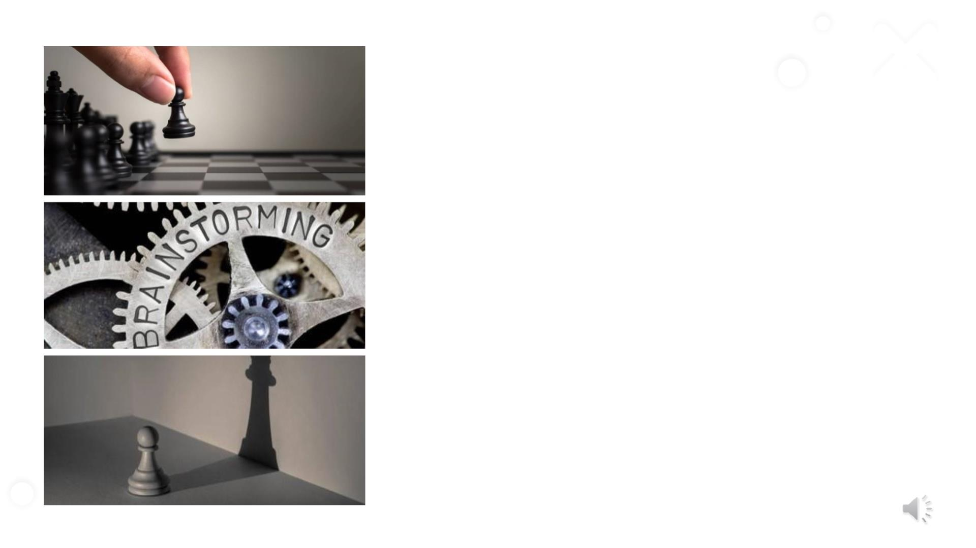
Agenda
• Introduction
• Requirements
• Files to be Included
• Representation of Moves
• Move Selections
• Chess Pieces
• Objective
• Approach
• Methodology
• Algo used
4/30/2023
2

Slide 3
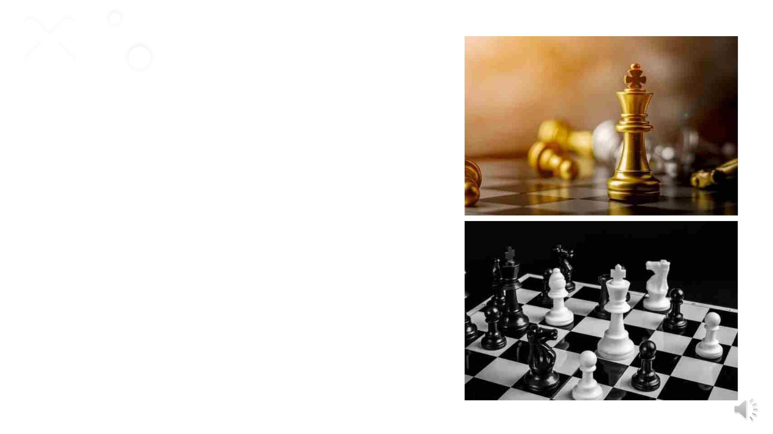
Chess Game
• Chess is a board game for two players. Chess is an abstract strategy
game and involves no hidden information. It is played on
a chessboard with 64 squares arranged in an eight-by-eight grid.
• Artificial intelligence is widely used in everyday situations in the
actual world. Chess is a game where artificial intelligence is used in
a spectacular way.
4/30/2023
PRESENTATION TITLE
3

Slide 4
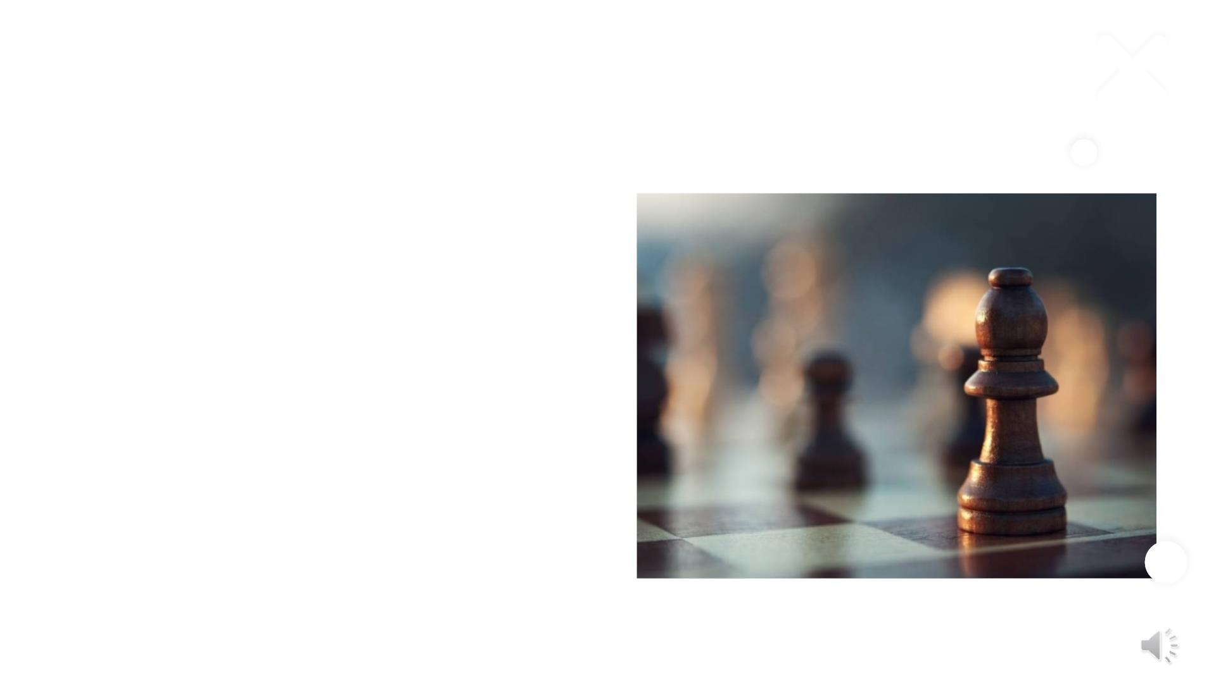
Requirements
• Python 3.10 version
• PIP (performance improvement plan) for libraries
installation.
• PyGame - It is an open-source Python programming
language module created to support the creation of
multimedia apps and games.
• Time - Provides ways to represent time in code,
including objects, numbers, and strings. It not only
represents time, but it also provides functionality such
as waiting during code execution and measuring code
efficiency.
4/30/2023
4

Slide 5
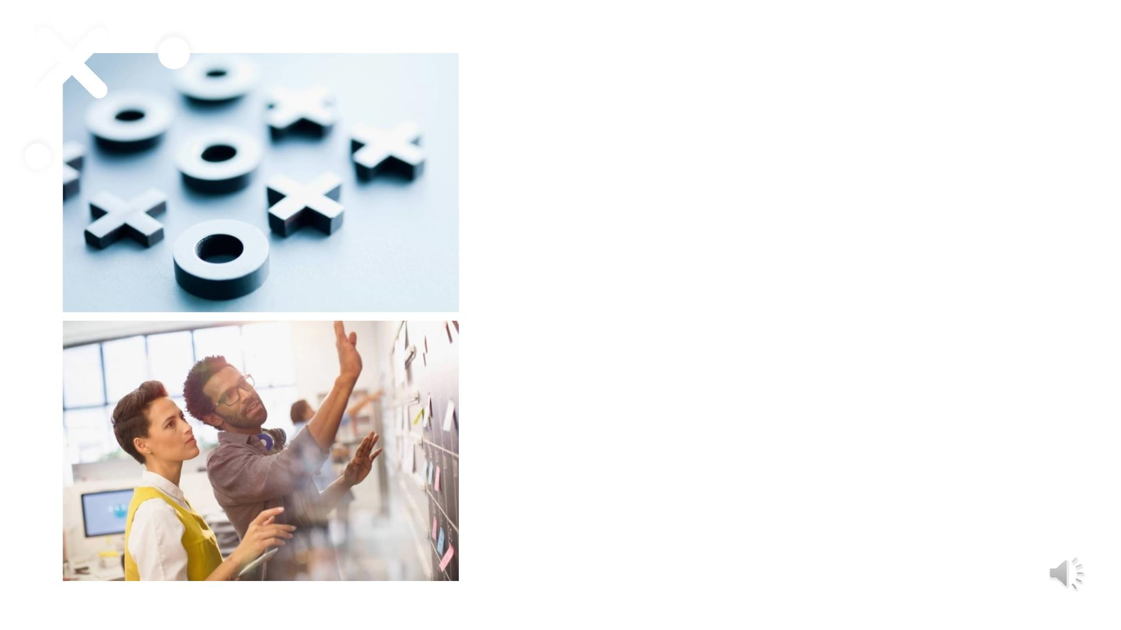
File Uploaded
• assets folder: Contains all the chess piece sprites used for the
game’s graphics.
• chess.py: The main program used to run the interface and game.
Run this program when starting the game
• pieces.py: Contains the master class ‘Pieces’ as well as all
individual piece classes that inherit the main class.
• board.py: This contains the board class and its methods. Also
contains the alpha-beta pruning method that the computer uses
to make moves
• ratings.py: Contains the rating class with methods that evaluate
the rating of a movie.
• userInterface.py: Contains the user-interface class that is used
to play the game and display the game using pygame.
4/30/2023
5

Slide 6

BOARD
REPRESENTATION
4/30/2023

Slide 7
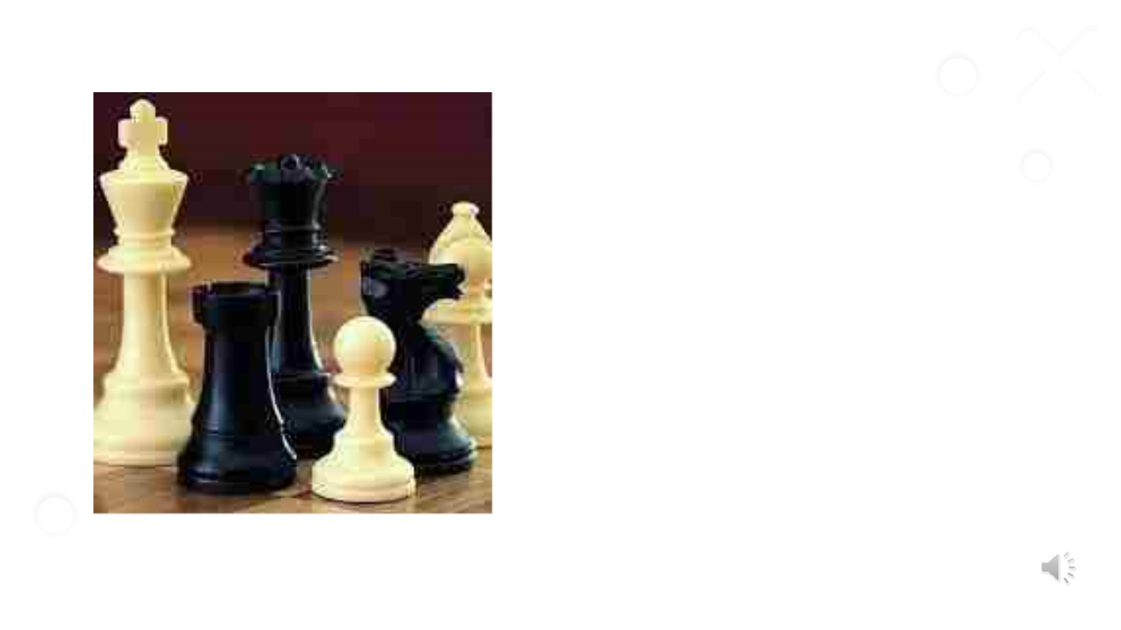
Move Selections
• The player with the white pieces always moves first.
• White players get an opportunity to attack right
away.
4/30/2023
7

Slide 8
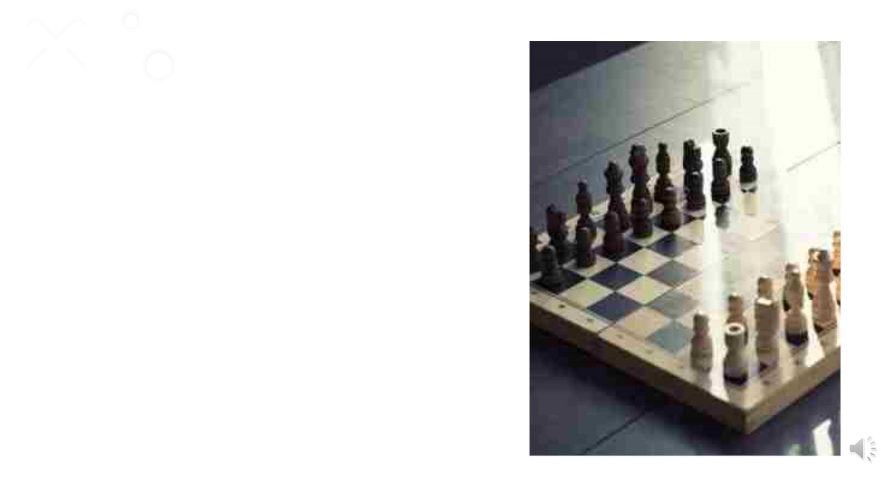
How the Chess Pieces
Move
• King - The king, marked with a cross-bearing crown, can move
in any direction one square. It can move horizontally, vertically,
or diagonally
• Queen- The queen can move any number of squares in any
direction – horizontally, vertically, or diagonally. Considered to
be the most powerful piece.
• Rook -The rook looks like a tower of an ancient building, is
also a powerful piece. It can zoom all over the board,
horizontally or vertically, any number of squares.
• Bishop - The bishop can shoot up and down the diagonals of
the chessboard. The bishop can only move on the diagonals, it
cannot move to different color squares.
4/30/2023
8

Slide 9
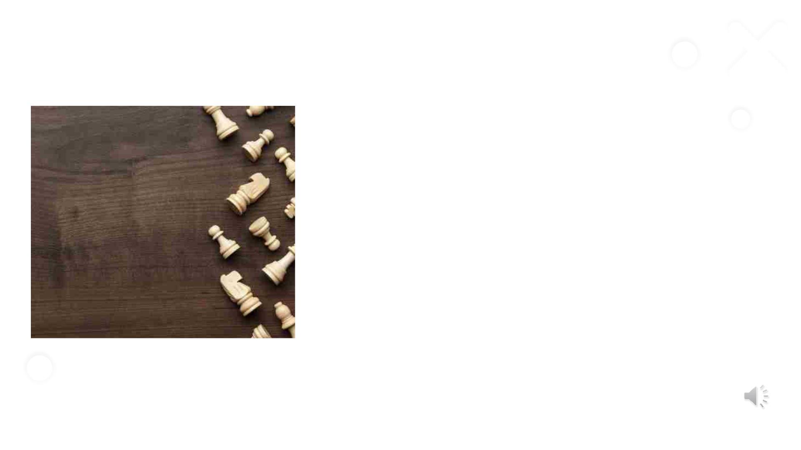
• Knight- The knight moves in an “L” shape, two spaces vertically
and one space horizontally, or the opposite: two spaces horizontally
and one space vertically.
• Pawns -Pawns can move one space forward only unless it’s their
first move: then they can move two squares. It is the only piece which
cannot move backwards.
4/30/2023
9

Slide 10
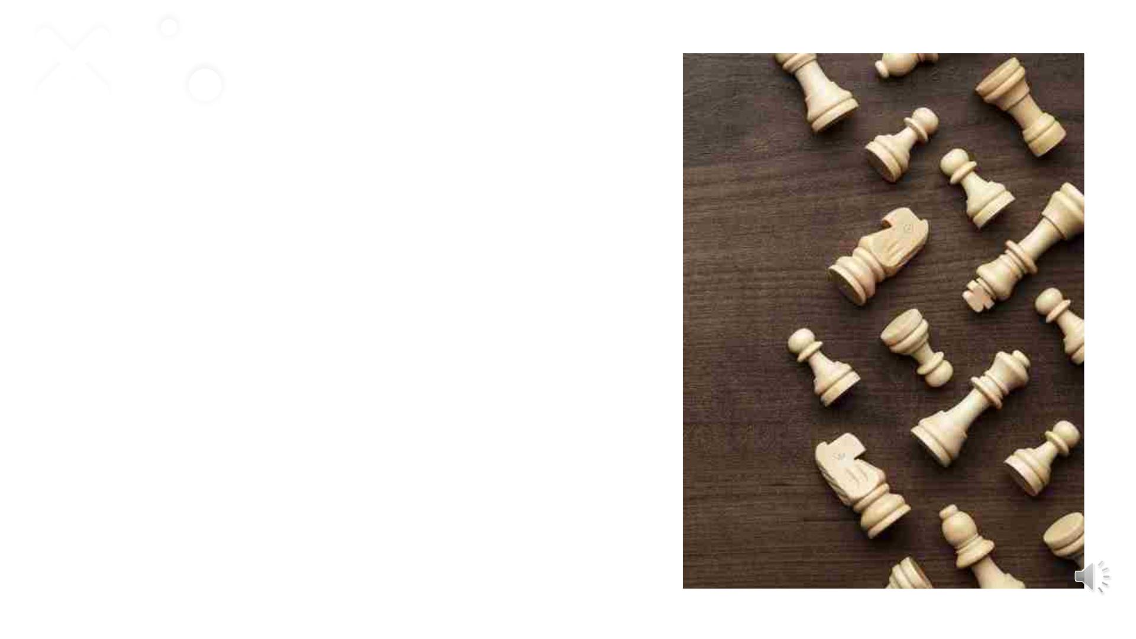
Objective
• For this project, a fully functional chess game featuring player
vs. player and player vs. artificial intelligence modes will be made
using object-oriented programming, the minimax algorithm,
Python, and Pygame.
4/30/2023
PRESENTATION TITLE
10

Slide 11
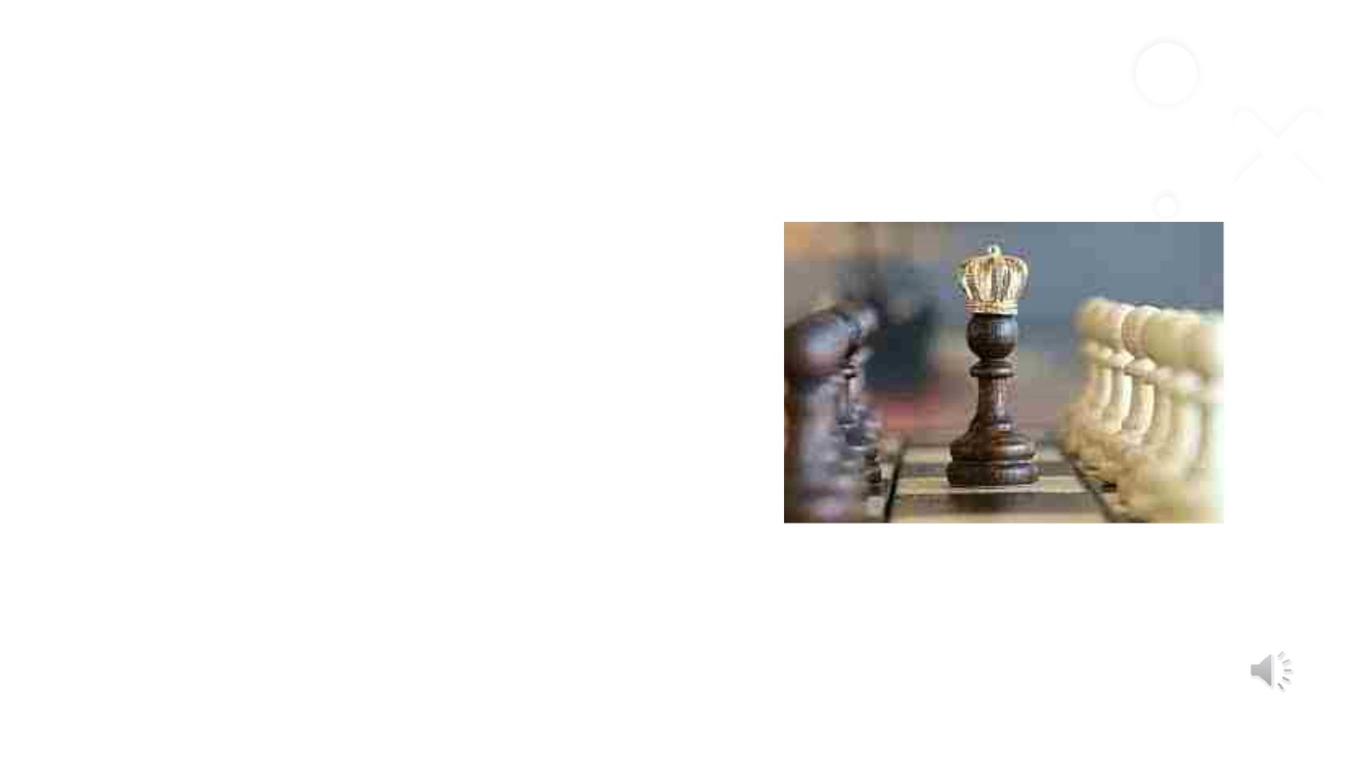
Approach
• Tools - Python Interpreter - Visual Studio
• Libraries - PyGame - Numpy
• Techniques (Concepts and Algorithms)
1. Move generation and board visualization
2. Position Evaluation
3. Search tree using Minimax
4. Alpha beta pruning
4/30/2023
PRESENTATION TITLE
11

Slide 12

Evaluation Methodology & Deliverables
• Ensuring safe and unsafe moves
• Checks
• Contrasting the time complexity with other chess games played online.
• Time taken by the algorithm to make the next move.
• It is an end-to-end project which lets the player play the game against AI algorithm created with the
help of pygame library.
Deliverables :
• The GitHub link
• Chess game video uploaded in YouTube
4/30/2023
PRESENTATION TITLE
12

Slide 13

Alpha Beta Pruning
Alpha–beta pruning is a search algorithm that seeks to decrease the number of nodes that are evaluated by the minimax
algorithm in its search tree. It is an adversarial search algorithm used commonly for machine playing of two-player
games.
The two-parameter can be defined as:
• Alpha: The best (highest-value) choice we have found so far at any point along the path of Maximizer. The
initial value of alpha is -∞.
• Beta: The best (lowest-value) choice we have found so far at any point along the path of Minimizer. The
initial value of beta is +∞.
4/30/2023
PRESENTATION TITLE
13

Slide 14
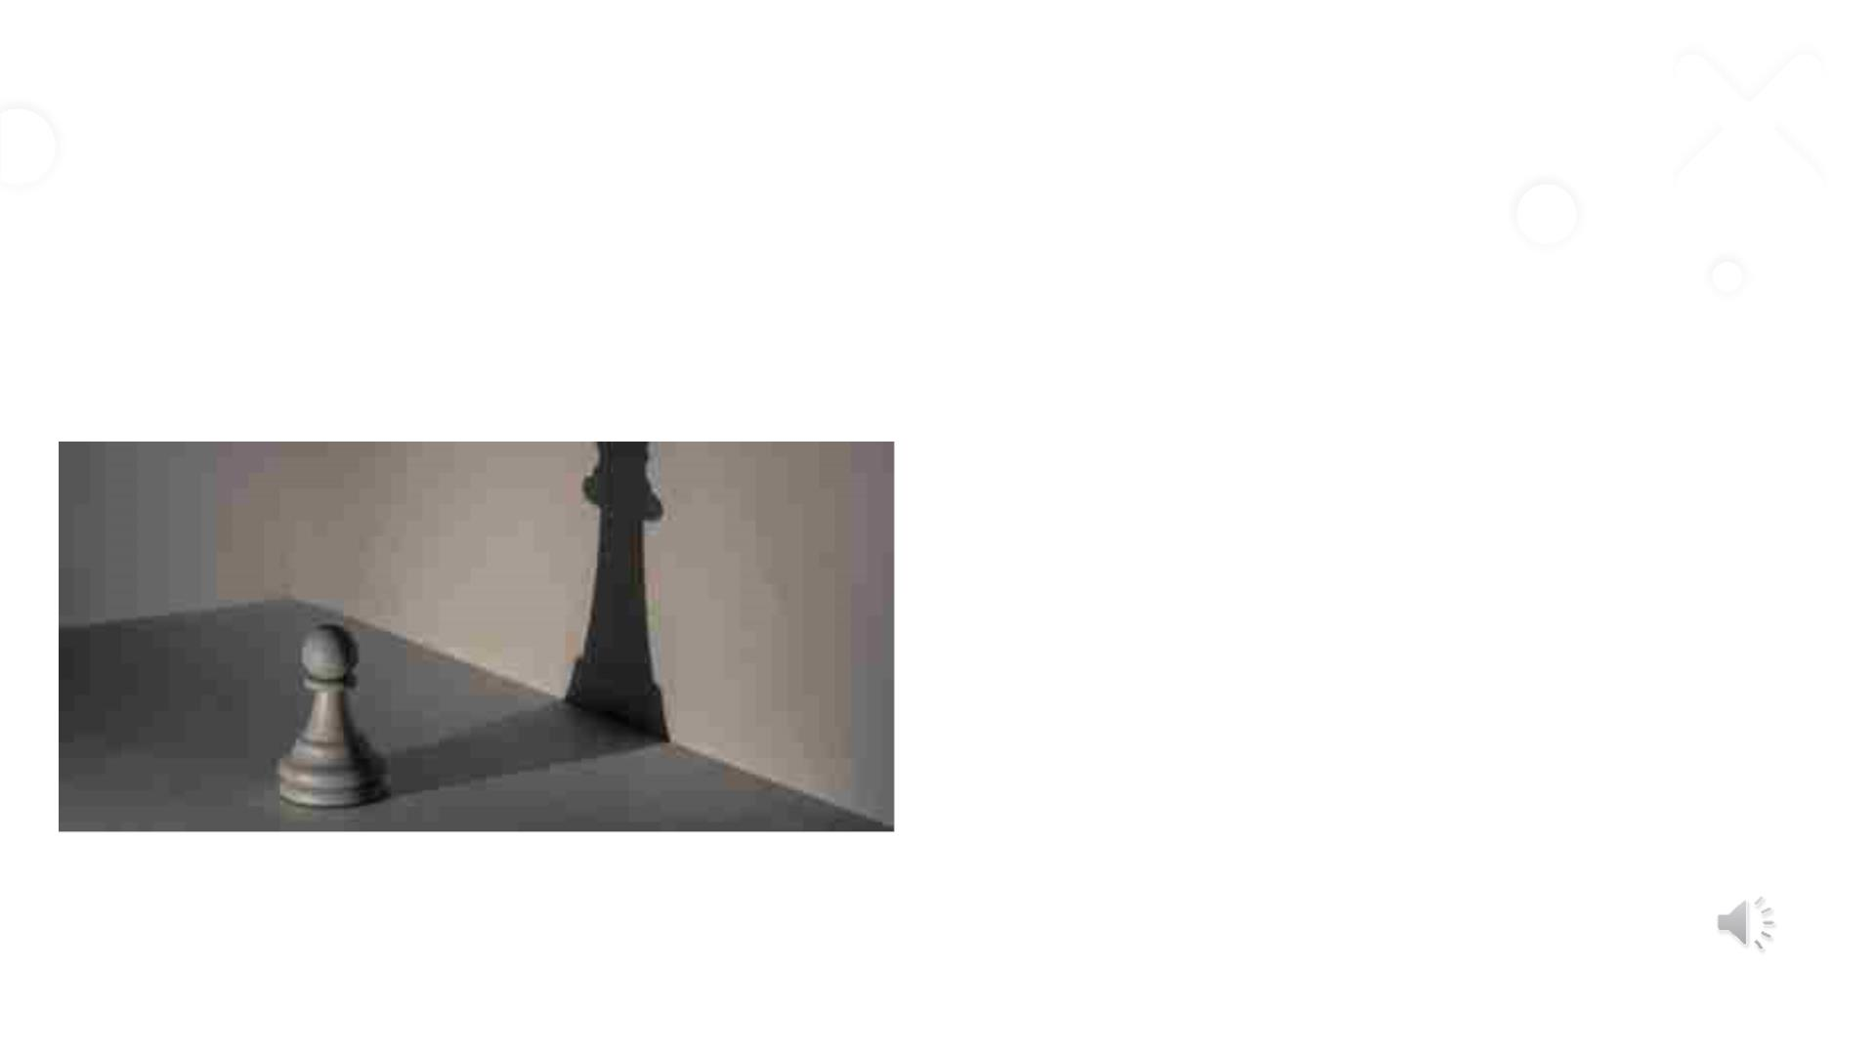
Algorithm Explained
• Alpha beta pruning algorithm will be used for this
chess game.
• The algorithm maintains two values, alpha and beta,
which represent the minimum score that the maximizing
player is assured and the maximum score that the
minimizing player is assured respectively.
• Initially alpha = - infinity and beta = + Infinity
• The current maximum depth evaluates up to 3 players.
4/30/2023
14

Slide 15


Slide 16
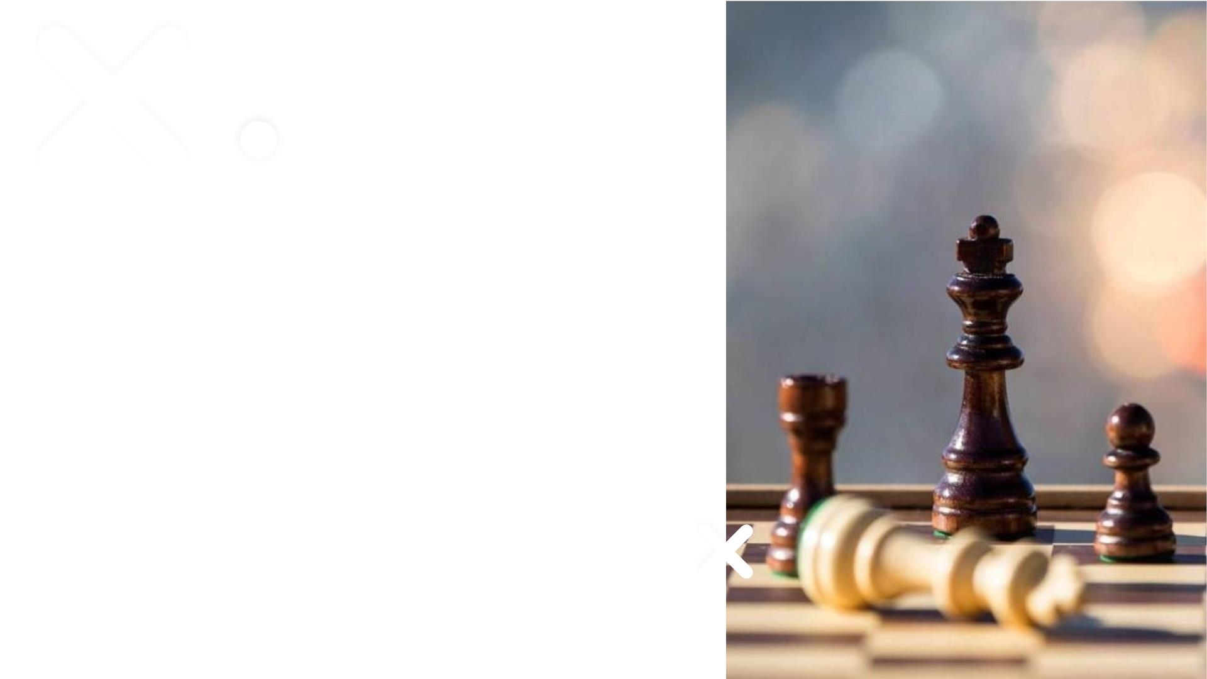
Thank You
4/30/2023
16

