Slide 1
PYTHON

Slide 2
Dictionary
Dictionaries are used to store data values in key:value pairs.
A dictionary is a collection which is ordered, changeable and do not allow duplicates.
Dictionaries are written with curly brackets, and have keys and values.
N.B :- As of Python version 3.7, dictionaries are ordered. In Python 3.6 and earlier, dictionaries are unordered.
When we say that dictionaries are ordered, it means that the items have a defined order, and that order will not change.
Unordered means that the items does not have a defined order, you cannot refer to an item by using an index.
Dictionaries are changeable, meaning that we can change, add or remove items after the dictionary has been created.
The keys() method will return a list of all the keys in the dictionary.
The values() method will return a list of all the values in the dictionary.

Slide 3
Pandas
Pandas is a Python library used for working with data sets.
It has functions for analyzing, cleaning, exploring, and manipulating data.
Pandas allows us to analyze big data and make conclusions based on statistical theories.
Pandas can clean messy data sets, and make them readable and relevant.
Relevant data is very important in data science.
A Pandas DataFrame is a 2 dimensional data structure, like a 2 dimensional array, or a table with rows and columns.

Slide 4
Panda Data Cleaning
Data cleaning means fixing bad data in your data set.
Empty cells
Data in wrong format
Wrong data
Duplicates
Empty cells can potentially give you a wrong result when you analyze data.

Slide 5
Matplotlib
Matplotlib is a low level graph plotting library in python that serves as a visualization utility.
Matplotlib was created by John D. Hunter.
Matplotlib is open source and we can use it freely.
The plot() function is used to draw points (markers) in a diagram.
The xlabel() and ylabel() functions to set a label for the x- and y-axis.
The scatter() function to draw a scatter plot.
The bar() function to draw bar graphs.
A histogram is a graph showing frequency distributions.
The hist() function will read the array and produce a histogram .
The pie() function to draw pie charts.

Slide 6
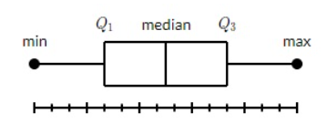
Matplotlib Box Plot
A box plot which is also known as a whisker plot displays a summary of a set of data containing the minimum, first quartile, median, third quartile, and maximum. In a box plot, we draw a box from the first quartile to the third quartile. A vertical line goes through the box at the median. The whiskers go from each quartile to the minimum or maximum.

Slide 7
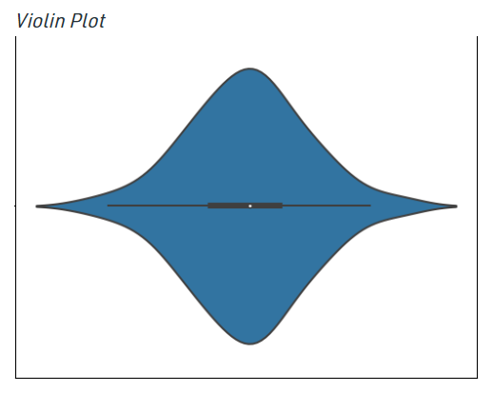
Matplotlib violin Plot
Violin plots are a combination of box plot and histograms. It portrays the distribution, median, interquartile range of data. So we see that iqr and median are the statistical information provided by box plot whereas distribution is being provided by the histogram.

Slide 8
Python File Handling
File handling is an important part of any web application.
Python has several functions for creating, reading, updating, and deleting files.
The key function for working with files in Python is the open() function.
The open() function takes two parameters; filename, and mode.
To open a file for reading it is enough to specify the name of the file.
To delete a file, you must import the OS module, and run its os.remove() function .
To delete an entire folder, use the os.rmdir() method .

Slide 9
There are four different methods (modes) for opening a file:
"r" - Read - Default value. Opens a file for reading, error if the file does not exist.
"a" - Append - Opens a file for appending, creates the file if it does not exist.
"w" - Write - Opens a file for writing, creates the file if it does not exist.
"x" - Create - Creates the specified file, returns an error if the file exists.

Slide 10
Inheritance
Inheritance allows us to define a class that inherits all the methods and properties from another class.
Parent class is the class being inherited from, also called base class.
Child class is the class that inherits from another class, also called derived class.

Slide 11
Types of Inheritance
Single inheritance: When a child class inherits from only one parent class, it is called single inheritance. We saw an example above.
Multiple inheritances: When a child class inherits from multiple parent classes, it is called multiple inheritances.
Multilevel inheritance: When we have a child and grandchild relationship.
Hierarchical inheritance More than one derived class are created from a single base.
Hybrid inheritance: This form combines more than one form of inheritance. Basically, it is a blend of more than one type of inheritance.

