Slide 1
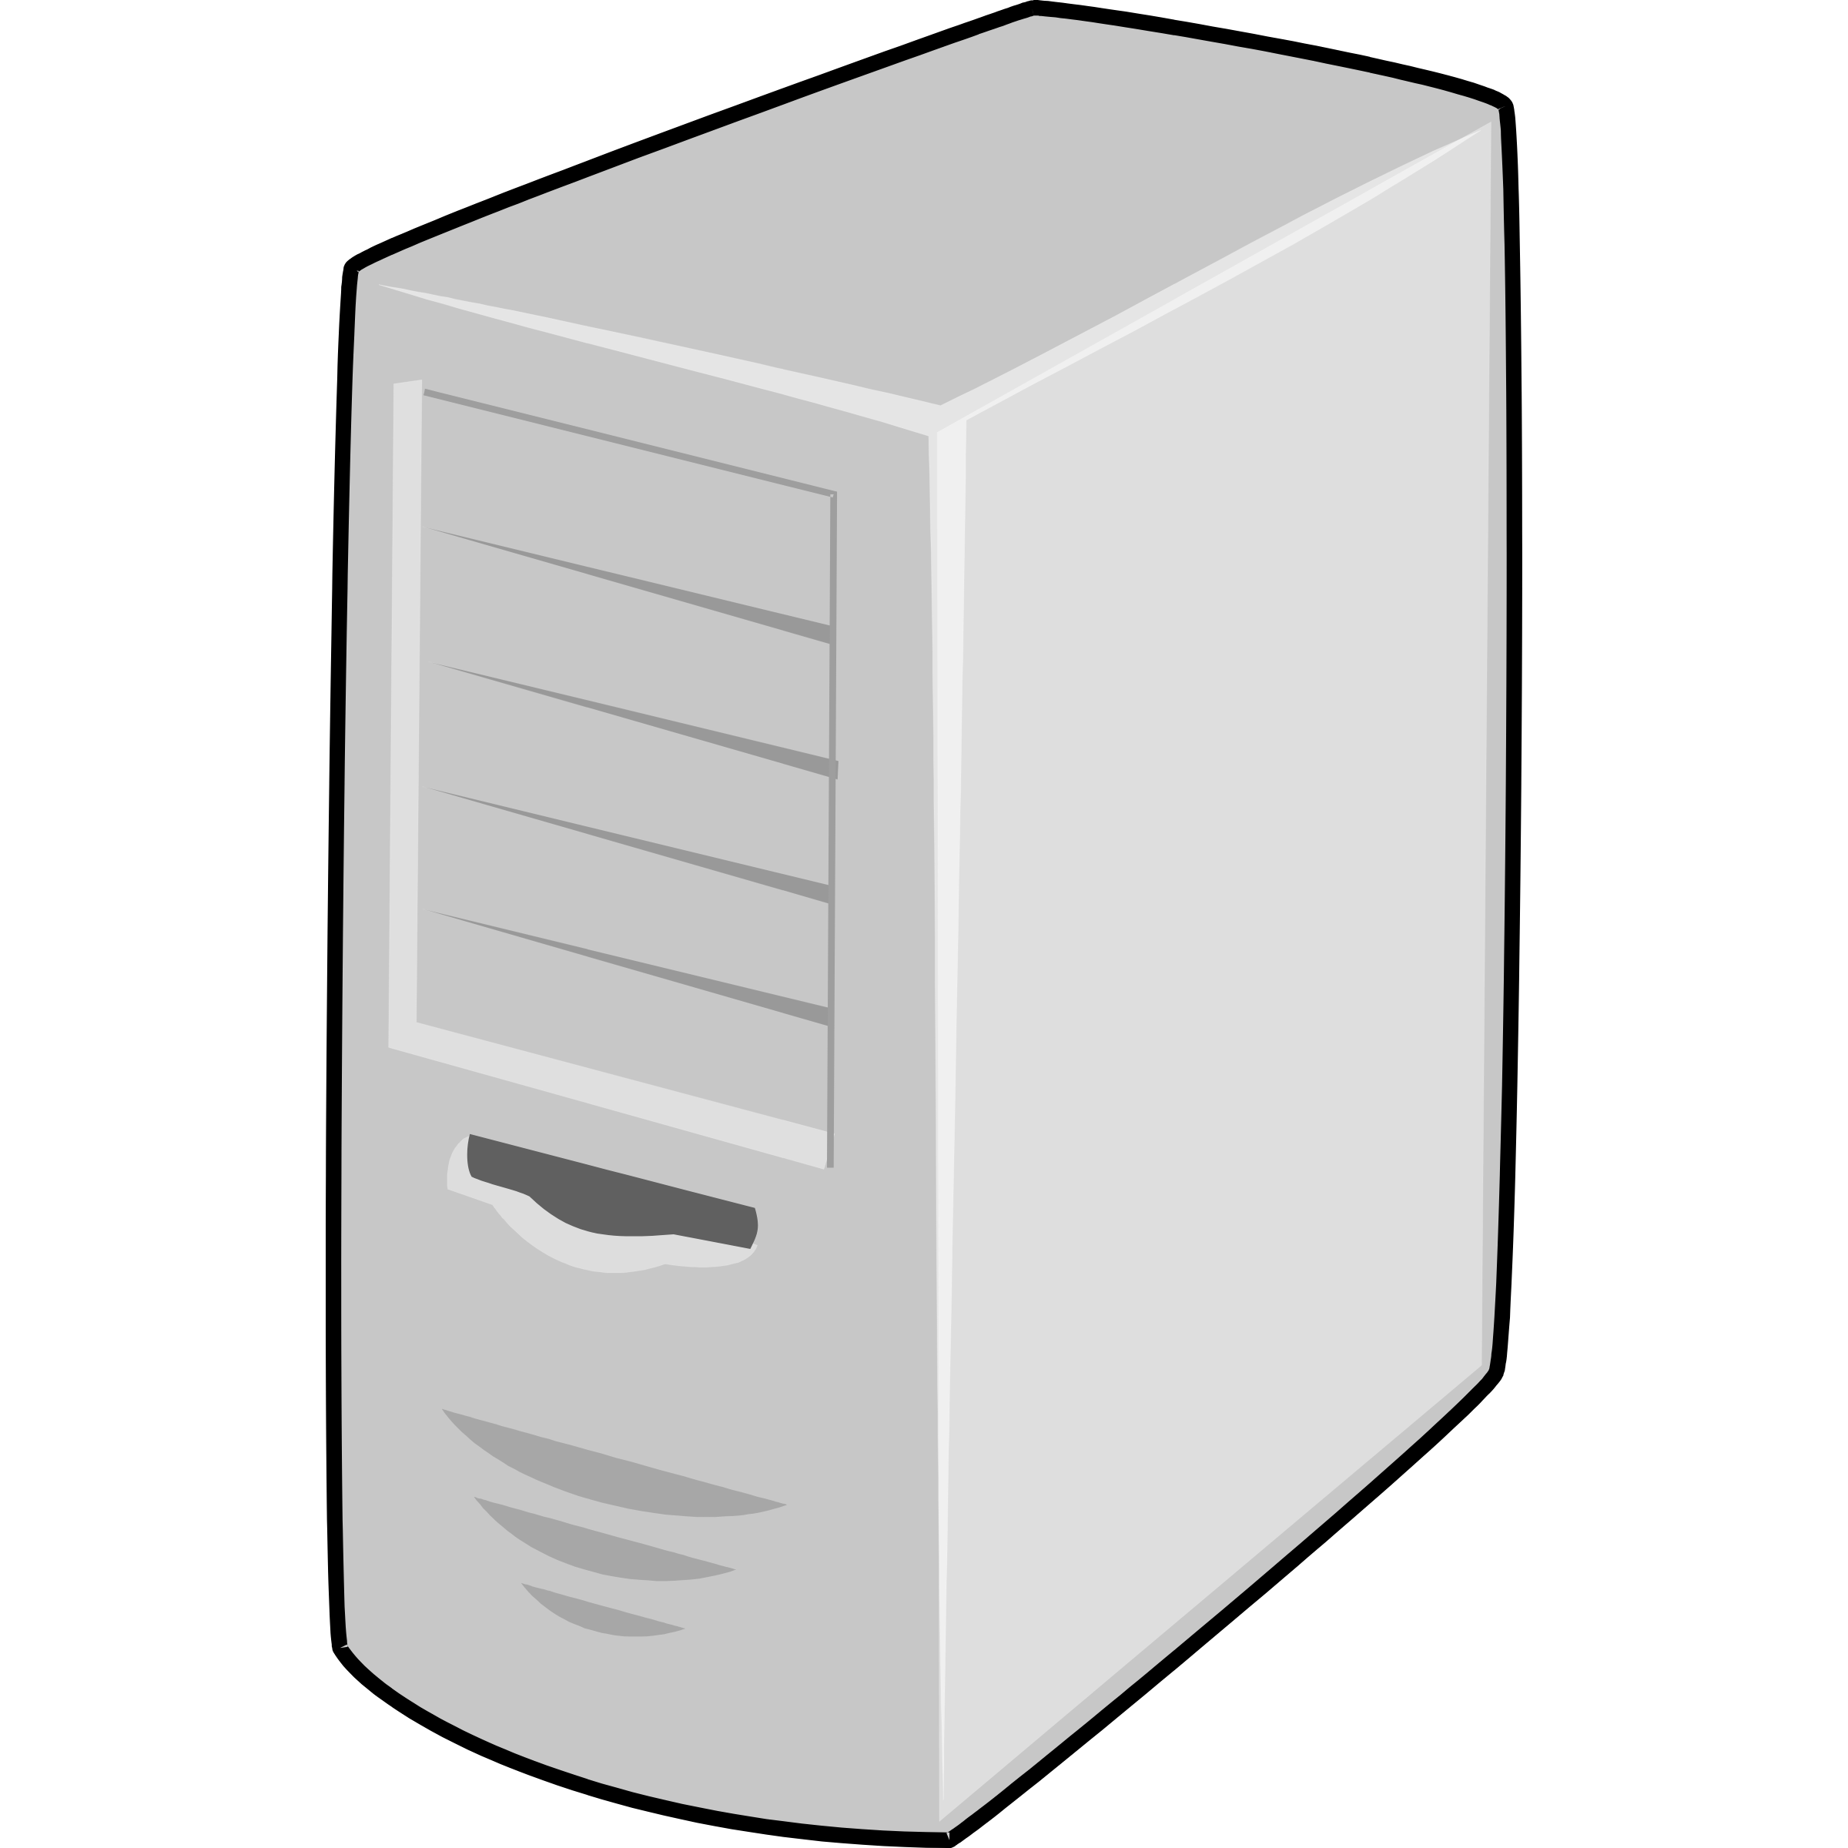

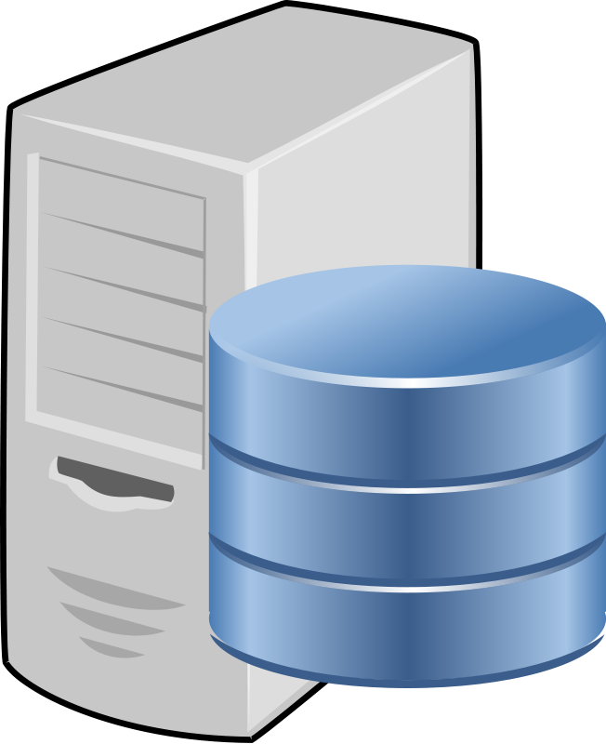

Legend
Auth Server
(or UNICORE/X server)
Control flow
Data flow
Authentication request
1
(username + password)
UFTPD Server
UFTP Cient
(end-user or server)
2
Prepare FTP session
(local username +
one-time password)
Command port
3
FTP Control Connection
(one-time password)
Listen port
4
Passive FTP Data Connections
Data ports
(dynamic or configured range)

