Slide 1


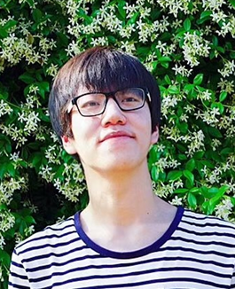
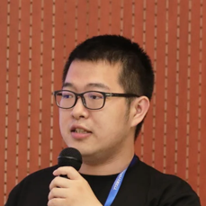
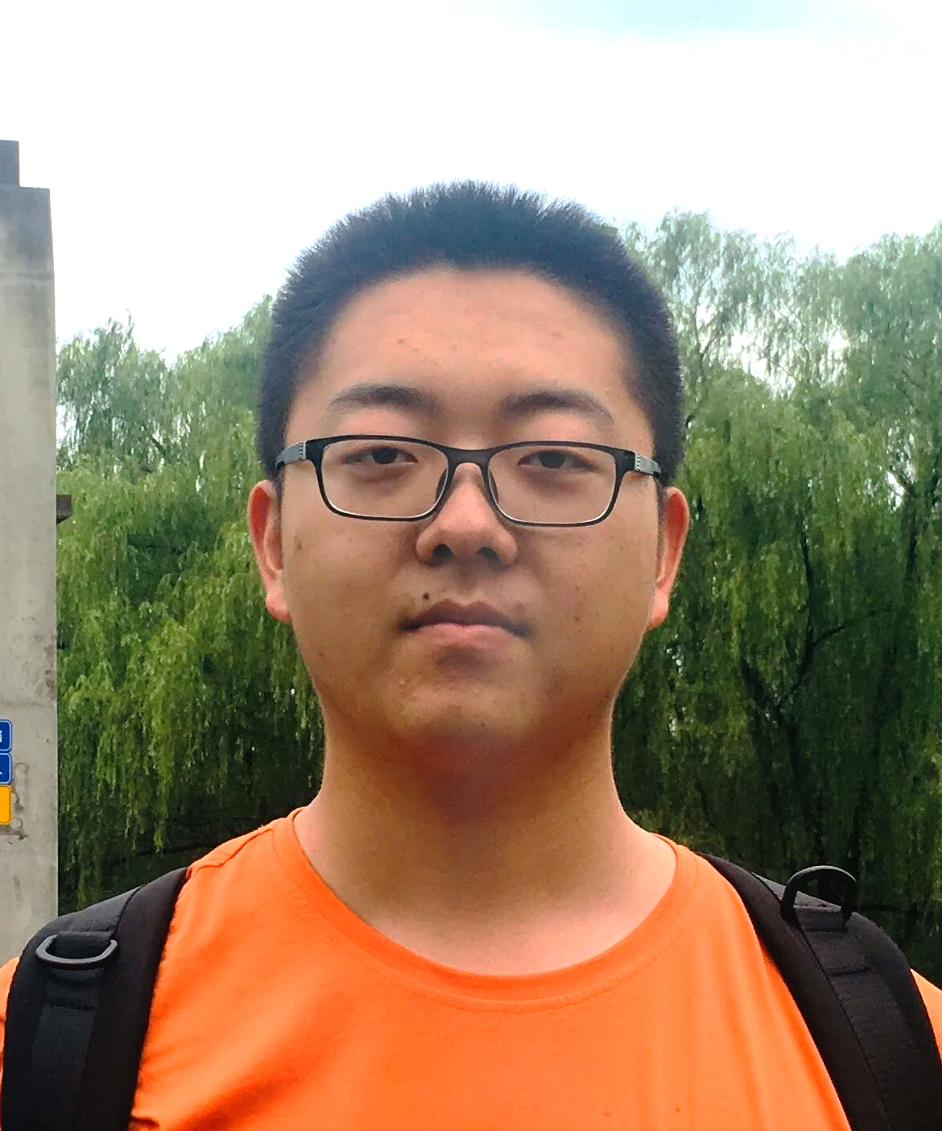
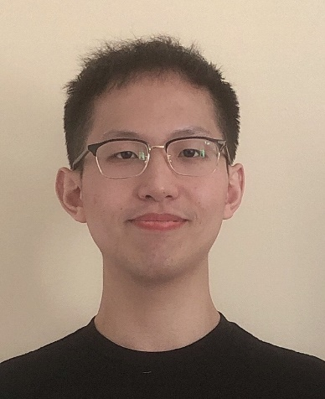
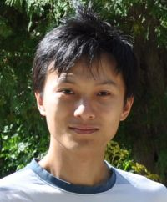
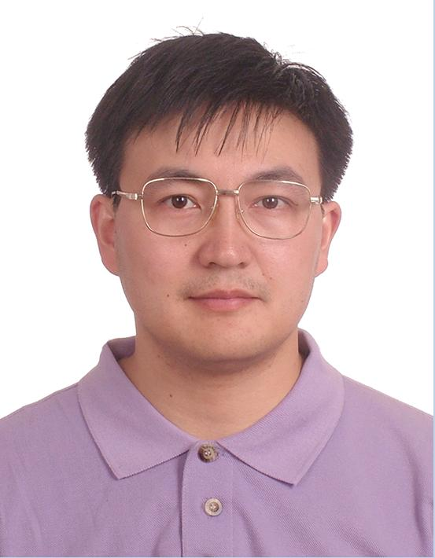
A Syntax-Guided Edit Decoder For Neural Program Repair
Qihao Zhu
Zeyu Sun
Yuan-an Xiao
Wenjie Zhang
Kang Yuan
Yingfei Xiong
Lu Zhang
FSE - 2021
Notes:
Hello everyone.
I am Qihao Zhu from Peking University, Beijing, China.
My talk is about our paper“A Syntax-Guided Edit Decoder For Neural Program Repair”.

Slide 2
Approach
PART ONE

Slide 3




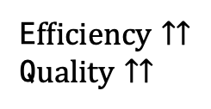
Automated Program Repair （APR）
AutomatedProgram Repair
E$fficiency↑↑$
Q$uality↑↑$
Buggy Code
APR Tool
Patches
62.5% more successfully repaired bugs
25.3% less debugging time in average^{[1]}
[1] Jingjing Liang, Ruyi Ji, Jiajun Jiang, Yiling Lou, Yingfei Xiong, Gang Huang: Interactive Patch Filtering as Debugging Aid. CoRR abs/2004.08746 (2020)

Slide 4






Automated Program Repair
Patch Pattern
Human Prior
Knowledge
Tuning Policy
Training
APR Tools
History Patches
Deep Learning(DL) Models

Slide 5
Limitations of current DL-based APR
1. Including syntactically incorrect programs
Encoder
Decoder
Standard
Sequence
Decoder
2. Inefficient representation of small edits
LSTM AST-based Encoder Context-Aware …
3. Not being able to generate
project-specific identifiers

Slide 6
Recoder: Syntax-Guided Decoder For Limitation 1. Including syntactically incorrect programs
Program Gneration Expand the non-terminals in the AST
The generated programs are syntactically correct.^{[1]}
root
1: root -> Module
Module
Rule Sequence:
1 2 3 10 11 13 64 18 19 8
2: Module -> body
body
3: body -> Assign
Assign
10: Assign ->
targets value
targets
value
11: targets -> Name
18: value -> Num
Name
Num
13: Name -> id
19: Num -> n
id
n
64: id -> length
8: n -> 10
length
10
[1] Zeyu Sun, Qihao Zhu, Yingfei Xiong, Yican Sun, Lili Mou, Lu Zhang. TreeGen: A Tree-Based Transformer Architecture for Code Generation. Proceedings of the AAAI Conference on Artificial Intelligence. Vol. 34. No. 05. 2020.

Slide 7


Recoder：Represent Patch via Edits For Limitation 2. Inefficient representation of small edits
Patches
Cfa
.
createEdge
(
fromNode
,
Branch
.
ON_EX
,
finallyNode
)
;
Sequence of Tokens
Length: 13
cfa.createEdge(fromNode,
Branch.UNCOND, finallyNode);
+ cfa.createEdge(fromNode,
Branch.ON_EX, finallyNode);
≪
Edits
Length: 3
modify
UNCOND
ON_EX

Slide 8
Recoder：Copy Operation For Limitation 2. Inefficient representation of small edits
Recoder also can copy a sub-tree from the buggy code.
+ if((interfaceType.getImplicitPrototype() == null)){
+ return;
+ }
ObjectType implicitProto = interfaceType.getImplicitPrototype();
LocalDeclaration
Edits
Left
right
Edit
End
Insert
Method
Invocation
IfStatement
qualifier
name
left
right
interfaceType
getImplicitPrototype
Method
Invocation
Literal
ID of
Non-Term
null

Slide 9
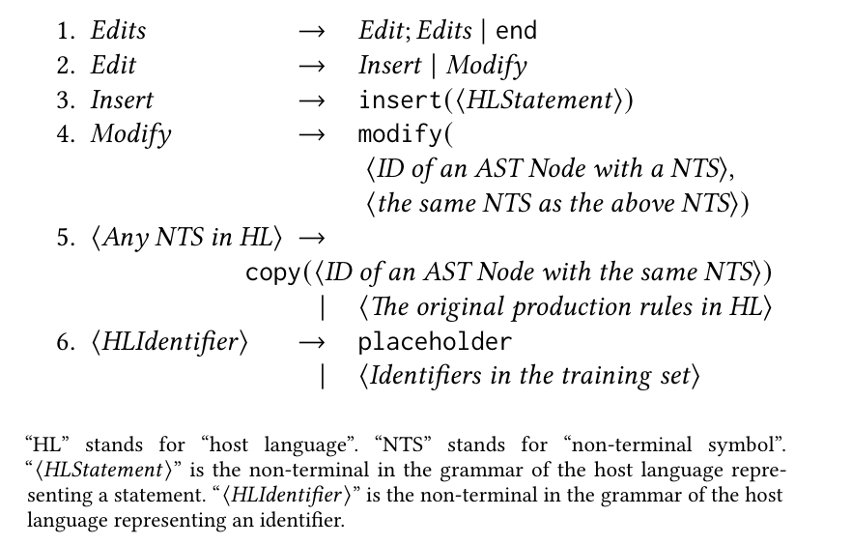
Recoder：Represent Edits via Grammar For Limitation 1 & 2
Decoder
Guide
Patches
Different from code generation, some special rules only can be applied to specific non-terminals.

Slide 10
Recoder：Provider/Decider Architecture
Non-terminals
Original Grammar
Rule
Predictor
Copy
operation
Tree
Copier
Edit
Location
Subtree
Locator
Provider₁
Provider_{N}
…
Choice₁₋₁
p₁₋₁
Choice₁₋₂
p₁₋₂
…
Choice_{1-m}
p_{1-m}
Choice_{N-1}
p_{N-1}
Choice_{N-2}
p_{N-2}
…
Choice_{N-t}
p_{N-t}
Provider₁
q₁
Decider
Provider_{N}
q_{N}
Choice₁₋₁
p₁₋₁*q₁
Choice₁₋₂
p₁₋₂*q₁
…
Choice_{1-m}
p_{1-m}*q₁
Choice_{N-1}
p_{N-1}*q_{N}
Choice_{N-2}
p_{N-2}*q_{N}
…
Choice_{N-t}
p_{N-t}*q_{N}

Slide 11
Recoder: Placeholder Generation For Limitation 3. Not being able to generate project-specific identifiers
Recoder generates placeholders for project-specific identifiers
- return cAvailableLocaleSet.contains(locale);
+ return availableLocaleSet().contains(locale);
MethodInvocation
Edits
Edit
End
qualifier
name
args
Modify
cAailable
contains
member
NodeID
qualifier
locale
Method
Invocation
Placeholder
Placeholder Generation
availableLocaleSet

Slide 12
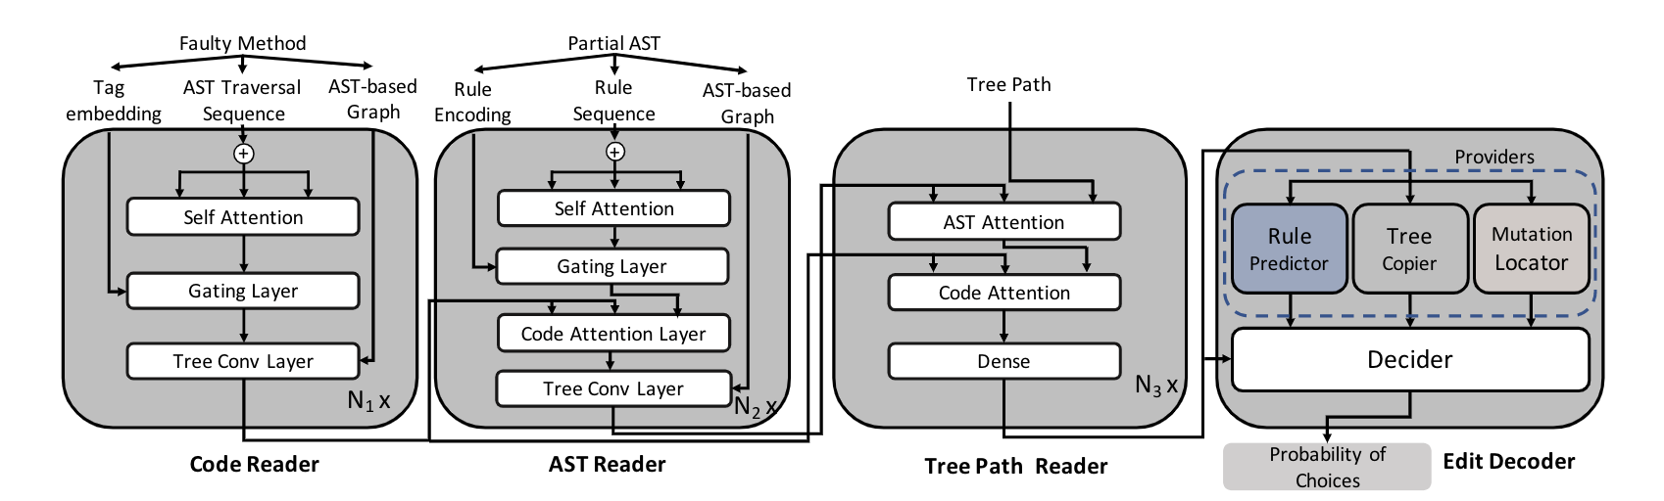
Recoder: Overview

Slide 13
Evaluation
PART TWO

Slide 14
Experiment: Benchmarks
We evaluated our approach on four benchmarks.
Defects4J v1.2 benchmark^{[1]}
Defects4J v2.0 benchmark^{[1]}
QuixBugs benchmark
IntroClassJava benchmark
[1] René Just, Darioush Jalali, and Michael D. Ernst. 2014. Defects4J: A database of existing faults to enable controlled testing studies for Java programs. In
Proceedings of the International Symposium on Software Testing and Analysis (ISSTA). San Jose, CA, USA, 437–440
[2] Derrick Lin, James Koppel, Angela Chen, and Armando Solar-Lezama. 2017.QuixBugs: a multi-lingual program repair benchmark set based on the quixey
challenge. 55–56. https://doi.org/10.1145/3135932.31359
[3]

Slide 15
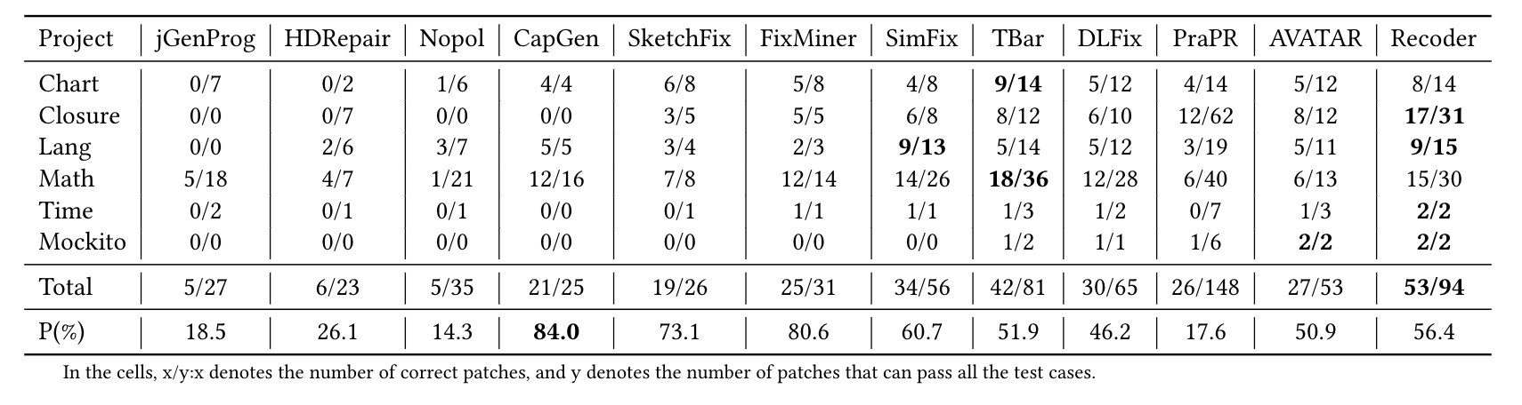
Defects4J v1.2: Comparison without Perfect Fault Localization
Recoder is the first DL-based APR approach that has outperformed the traditional APR approaches

Slide 16
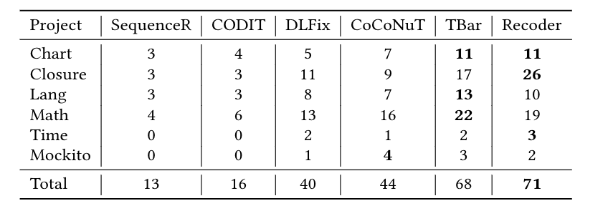
Defects4J v1.2: Comparison with Perfect Fault Localization
Recoder outperforms all of the existing APR approaches, including traditional ones.

Slide 17
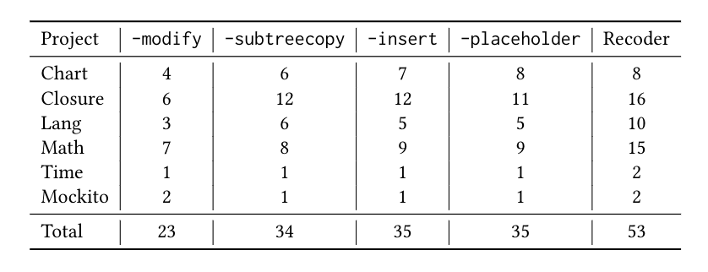
Experiment: Ablation Test
The performance of ablation models on Defects4J v1.2
Each component contributes to the overall performance of Recoder.

Slide 18
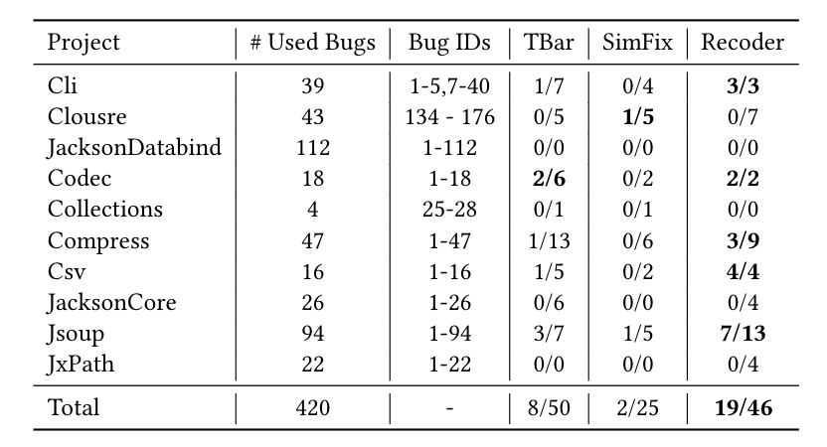
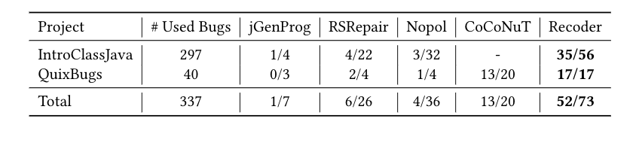
Generalizability
Comparision on Defects4J v2.0 Comparision on QuixBug and IntroClassJava
Recoder still repairs most bugs compared with baselines on three becnmarks.

Slide 19
Conclusion
We propose Recoder for automated program repair.
Syntax-Guided Decoder
Represent patch as a sequence of edits.
Generates placeholders for project-specific identifiers
The experimental results show that Recoder significantly outperforms existing approaches.

Slide 20


Thanks
A Syntax-Guided Edit Decoder For Neural Program Repair
Zhuqh@pku.edu.cn
https://github.com/pkuzqh/Recoder/FSE2021.ppt
https://github.com/pkuzqh/Recoder

