Slide 1



Geo-UAV / SfM (2026 edition):
Teaching multiview stereo
structure-from-motion photogrammetry
acquisition and processing
Geo-SfM: A tutorial on how to plan, acquire and use UAV imagery and SfM processing in the geosciences
(not a lecture series on mathematical and physical principles; neither a photography course)

Slide 2

AG-214: autumn 2026 lecture series
«Learning by doing»
  3 days of lectures and hands-on practicals
  1 days of fieldwork and hands-on acquisition practical
Open, online modules: UNIS eBook portal @ https://unisvalbard.github.io/ebooks/
Geo-UAV: Online course tutorial: https://unisvalbard.github.io/Geo-UAV/
Geo-SfM: Online course tutorial: https://unisvalbard.github.io/Geo-SfM/
Peter Betlem
Course Instructor
NGI: 2024 - ???
(UNIS: 2016-2024)

Slide 3
AG-214: Focus & aims
Motivation:
Plan of approach for acquiring digital data sets
Standardised & structured data processing
Scientific notekeeping and data availability
Learning outcomes:
Fundamental understanding of UAV operations in Svalbard
Fundamental understanding of photogrammetry, and how to acquire and process data
Basic understanding of how to apply georeferencing and spatial alignment
Become familiar with best-practices in data processing, including quality assessment and data validation
Be able to perform basic data analysis and feature interpretation

Slide 4
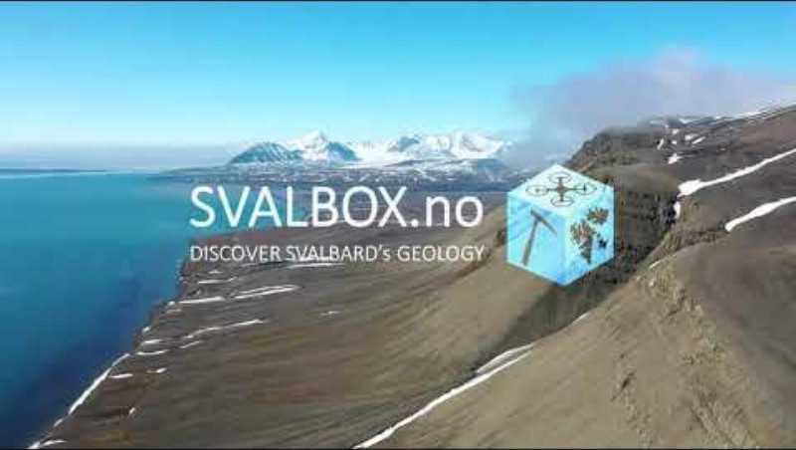
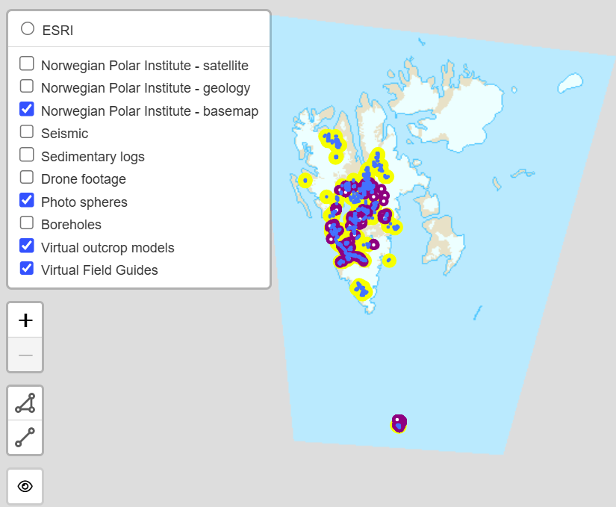
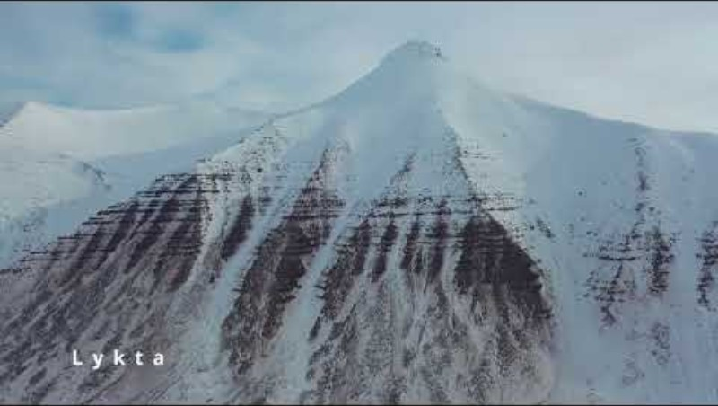
AG-214: Background - Svalbox
Svalbox is UNIS’s open, interactive 3D geoscience database for Svalbard. It places digital outcrop models, photospheres, maps and related datasets within their regional geological context.
• Supports safer and more quantitative fieldwork
• Provides open access to published models and source data
• Uses SfM photogrammetry to create 3D models from overlapping photographs
• Demonstrates the complete AG-214 workflow, from acquisition and processing to documentation and data sharing

Slide 5
AG-214: 2026 timetable
Date | Geo-SfM Session | Deliverable
21.09 (morning) | Welcome to Geo-UAV/Geo-SfM/GitHub Learning the ropes with SvalBox UAV Ses. 1: UAS Operators SfM Ses. 1: SfM photogrammetry | Registered as an operator Experience with accessing Svalbox Introduction to UAS surveying Introduction to 3D modelling
21.09 (afternon) | UAV Ses. 3: Flying a multirotor UAV UAV Ses. 4: Planning and Surveying HSE brief | Trial with flying/drones Field/survey planning (in 4 groups) Survey objectives (4 total)
22.09 | FIELD training & acquisition | FIELD data (4 data sets)
23.09 | SfM Ses. 1: SfM photogrammetry SfM Ses. 3: Geo-referencing | Create a georeferenced, 3D model (own data) Georeferencing knowledge
24.09 | SfM Ses. 1: SfM photogrammetry SfM Ses. 4: Automation SfM Ses. 5: Visualisation Field data presentations | Automated/structured approach to processing/data management Integrated GIS project with field data

Slide 6
Geo-SfM platform: Github
Github:
User-friendly
Commercial platform for version control (keep track of changes)...
... and that facilitates collaboration
Implements Git

Slide 7
Geo-SfM platform: Github
Github:
User-friendly
Commercial platform for version control (keep track of changes)...
... and that facilitates collaboration
Implements Git
Notice something that needs changing?
Sign up to GitHub, correct the resource, and re-submit («PR-request») it for approval/integration

