Slide 1



Artificial Intelligence Lab Assignments Presentation
Sushar Hembram
A2
002311001041
3rd Year 1st Semester

Slide 2
OVERVIEW
Asignment 1
Assignment 2
Assignment 3
Assignment 7
Assignment 4
Assignment 6
Assignment 5

Slide 3
ASSIGNMENT STRUCTURE & ORGANIZATION
Each assignment in this presentation is organized using a consistent format
to clearly demonstrate the problem-solving approach and results:
Overview & Question: Brief description of the assignment and its objective.
Approach/Algorithm Used: Explanation of the AI technique or algorithm applied to solve the problem.
Process Visualization: Flowchart or diagram illustrating the solution steps.
Input & Output: Examples of input data and the corresponding intermediate and final output generated.
Achievements & Conclusion: Summary of results, challenges faced, and key learnings.
This structure ensures that each assignment is presented in a clear, logical, and concise manner, highlighting both the methodology and outcomes.

Slide 4

DAY 1 ASSIGNMENT 1
DATE: 24.07.2025
Question:
"Given a text input, process the data using an AI algorithm to generate a meaningful output. The task involves reading from read.txt, applying a rule-based or search algorithm, and writing the result to write.txt." and “Show an example of the DFS algorithm”
Objective:
To demonstrate basic AI techniques for text data processing and output generation as well as DFS algorithm.

Slide 5
APPROACH & ALGORITHMS USED
Algorithm/Technique:
For this assignment we had to solve two questions where for the first one, a simple rule-based approach was used to process the input text. The algorithm reads each line, applies predefined rules (such as searching for keywords or patterns), and generates the corresponding output.
In the second question, I had to show an example of the DFS algorithm. Depth-First Search (DFS) is a graph traversal technique that explores as far as possible along each branch before backtracking. In this assignment, DFS is used to find all possible paths from a start point to an end point in a matrix (maze).
Why these approaches:
Rule-based methods are effective for structured text processing and provide clear, interpretable results.

Slide 6
PROCESS & METHODS
File Handling (Text Processing)
Open read.txt and read its contents.
Create or open write.txt and write the read content into it.
Use Python’s with open() for safe file operations.
DFS Algorithm (Maze/Matrix Traversal)
Define a matrix representing the maze.
Set start and end positions.
Use Depth-First Search (DFS) to explore all possible paths:
Visit each cell recursively.
Mark visited cells to avoid cycles.
Backtrack when hitting a wall or dead end.
Store all valid paths from start to end.
Print all discovered paths from start to end.
Display visited and backtracked positions for clarity.

Slide 7

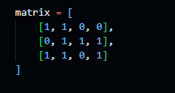

INPUT & OUTPUT
The algorithm read each line from the input file, apply the defined rules, and generated the corresponding output, demonstrating basic AI text processing.
Meanwhile for the DFS algorithm, the output was displayed within the program itself based on the matrix and the best route.

Slide 8
ACHIEVEMENTS & CONCLUSION
Results:
Successfully processed the input text using a rule-based algorithm, producing the expected output in write.txt.
Challenges:
Faced challenges in handling ambiguous text and ensuring all rules were correctly applied. Overcame these by refining the rule set and testing with sample inputs.
Learning:
Gained practical experience in implementing basic AI algorithms for text processing and understood the importance of clear rule definition.

Slide 9
DAY 2 ASSIGNMENT 2
DATE: 07.08.2025
Question:
"Develop a Python program that analyzes and processes categorical data using AI techniques. Convert the data into a transactional format with attribute-value pairs, assign numerical values to each pair, and transform it into a binary dataset where each attribute-value pair is represented as a column. Construct a graph using the binary dataset values, then solve the single pair shortest path problem and visually represent the path on the graph.”
Objective:
To apply AI techniques for data analysis and graph algorithms, demonstrating the ability to process real-world datasets and solve optimization problems such as finding the shortest path.

Slide 10
APPROACH & ALGORITHMS USED
Approach:
In this assignment, I used a stepwise approach to process categorical data and solve a graph problem:
Load and read categorical data from a CSV file.
Convert the data into a transactional format using attribute-value pairs.
Assign numerical values to each attribute-value pair and create a binary dataset.
Construct a graph where each node represents an attribute-value pair, and edges represent co-occurrence in transactions.
Apply a shortest path algorithm to find and visualize the optimal path between two selected nodes.
Algorithms Used:
Data Transformation: Python functions are used here to convert categorical data into transactional and binary formats, enabling further analysis.
Graph Construction: The NetworkX library was used to build an undirected graph from the binary dataset, with nodes and edges based on data relationships.
Shortest Path Algorithm: NetworkX’s shortest path function (based on Breadth-First Search) was used to find the shortest path between two nodes in the graph, which is then highlighted visually.
Techniques:
Attribute-value encoding
Binary matrix creation
Graph theory and visualization
Pathfinding using BFS

Slide 11
PROCESS & METHODS
Step 1: Load Categorical Data
Read the CSV file containing categorical data using Python.
Step 2: Transactional Format Conversion
Transform each record into attribute-value pairs.
Assign a unique numerical value to each attribute-value pair.
Step 3: Binary Dataset Creation
Convert the transactional data into a binary matrix.
Each column represents an attribute-value pair; each row indicates presence (1) or absence (0).
Step 4: Graph Construction
Build a graph where nodes are attribute-value pairs.
Add edges between nodes that co-occur in the same transaction.
Step 5: Shortest Path Computation
Select two nodes (e.g., “Gender=Male” and “Stage=Stage III”).
Use a shortest path algorithm (BFS) to find the optimal path.
Visualize the graph and highlight the shortest path.

Slide 12
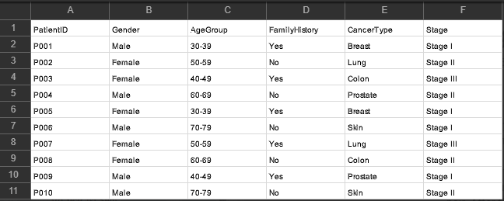
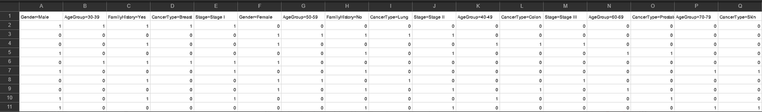
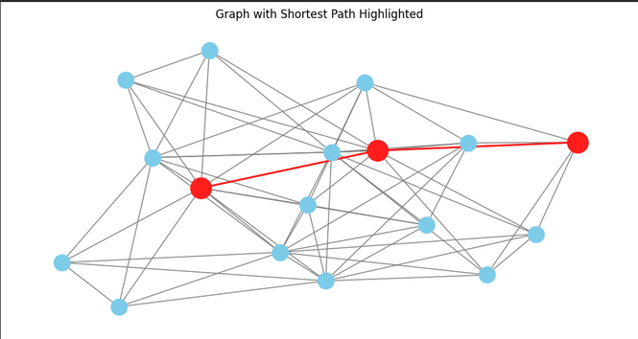
INPUT & OUTPUT
Input:
The original data was a categorical CSV file (cancer_demographics.csv) containing attributes such as Gender, Age, Stage, and Family History.
This data was transformed into a binary dataset, where each attribute-value pair became a column.
The binary dataset enabled graph construction and shortest path analysis between attribute-value pairs, visualized in the output graph.

Slide 13
ACHIEVEMENTS & CONCLUSION
Achievements:
Successfully loaded and processed categorical data from a CSV file.
Converted the data into transactional and binary formats for analysis.
Constructed a graph representing relationships between attribute-value pairs.
Applied a shortest path algorithm to solve a real-world graph problem.
Visualized both the graph and the shortest path, demonstrating practical AI and data analysis skills.
Conclusion:
The assignment showcased the application of AI techniques in data transformation, graph theory, and optimization.
Gained hands-on experience in encoding categorical data, building graphs, and solving pathfinding problems.
These methods are foundational for more advanced AI and data science tasks.

Slide 14
DAY 3 ASSIGNMENT 3
DATE: 14.08.2025
Question:
"Write a Python program to solve the classical Tower of Hanoi problem using the Breadth-First Search (BFS) algorithm. The program should accept inputs for the number of discs, initial and final rod positions, and arrangement order, and display intermediate outputs at each step.”
Objective:
To implement and analyze the Tower of Hanoi solution using BFS, demonstrating state exploration, move tracking, and output generation for each intermediate step, thereby applying AI search techniques to a classic problem.

Slide 15
APPROACH & ALGORITHMS USED
Algorithm/Technique:
Breadth-First Search (BFS) is used to solve the Tower of Hanoi problem. BFS explores all possible states level by level, ensuring the shortest sequence of moves is found from the initial to the goal state.
Approach:
Represent the rods and discs as states, with each state showing the arrangement of discs on the rods.
Start from the initial state and use BFS to explore all valid moves.
For each move, generate a new state and track the sequence of moves.
Continue exploring until the goal state (final arrangement) is reached.
Record and display each intermediate state and move for transparency.
Techniques:
State representation using tuples for rods and discs.
Valid move checking to ensure legal disc transfers.
Queue-based BFS for systematic state exploration.
Output of intermediate steps to a CSV file for analysis.

Slide 16
PROCESS & METHODS
Step 1: Input Collection
Gather user inputs: number of discs, initial and final rod positions, and arrangement order.
Step 2: State Initialization
Represent the initial and goal states as tuples showing disc arrangements on rods.
Step 3: BFS Exploration
Use a queue to explore all possible states level by level.
For each state, check all valid moves and generate new states.
Step 4: Move Validation
Ensure only legal moves are made (smaller disc on larger disc or empty rod).
Step 5: Tracking and Output
Record each intermediate state and move.
Write all steps and moves to a CSV output file for review.
Step 6: Solution Identification
Stop when the goal state is reached.
Display the sequence of moves and total steps taken.

Slide 17
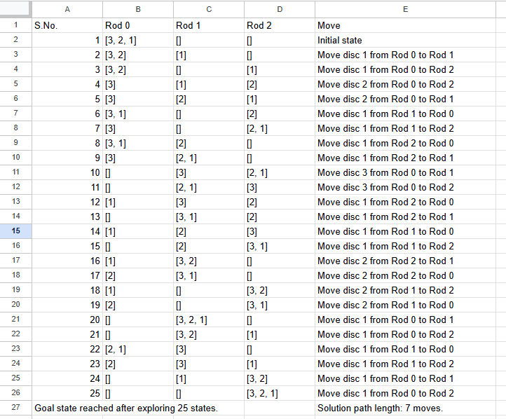
INPUT & OUTPUT
Input:
Number of discs (e.g., 3)
Initial rod position (e.g., Rod 0)
Initial arrangement (e.g., decreasing order)
Final rod position (e.g., Rod 2)
Final arrangement (e.g., decreasing order)
Output:
Intermediate states and moves displayed step-by-step.
All steps and moves written to a CSV file.
Final output shows the sequence of moves to solve the Tower of Hanoi using BFS, including the total number of steps and solution path length.

Slide 18
ACHIEVEMENTS & CONCLUSION
Achievements:
Successfully implemented the Tower of Hanoi solution using the Breadth-First Search (BFS) algorithm.
Explored all possible states and found the shortest sequence of moves.
Generated detailed intermediate outputs and saved them to a CSV file for analysis.
Challenges:
Managing state representation for rods and discs.
Ensuring only valid moves were made during BFS exploration.
Handling large state spaces efficiently for higher disc counts.
Learning:
The assignment demonstrated the effectiveness of BFS in solving classic AI search problems.
Gained practical experience in state space exploration, move validation, and output generation.
The approach can be extended to other combinatorial and optimization problems in AI.

Slide 19
DAY 4 ASSIGNMENT 4
DATE: 21.08.2025
Question:
"Write a Python program to solve the classical 8-puzzle and 15-puzzle problems using Depth-Limited Search (DLS). The program should accept dynamic inputs for puzzle size, start and goal states, and depth limit, and display intermediate outputs at each step.
Objective:
To implement and analyze Depth-Limited Search for n-puzzle problems, demonstrating state exploration, move generation, and output tracking, while handling both 8-puzzle and 15-puzzle cases efficiently.,

Slide 20
APPROACH & ALGORITHMS USED
Algorithm/Technique:
Depth-Limited Search (DLS) is a variant of Depth-First Search (DFS) that explores possible moves up to a specified depth limit. It is used to solve both the 8-puzzle and 15-puzzle problems by searching for a sequence of moves from the start state to the goal state.
Approach:
Represent the puzzle state as a list of numbers, with zero indicating the blank tile.
For each state, generate all possible moves by swapping the blank tile with adjacent tiles.
Recursively explore each move, keeping track of the path and visited states.
Stop searching when the goal state is reached or the depth limit is exceeded.
Record and display each intermediate state and move for analysis.
Techniques:
State representation and manipulation
Move generation based on blank tile position
Recursive search with depth control
Output of solution steps and states to a file

Slide 21
PROCESS & METHODS
Step 1: Input Handling
Read puzzle size, start state, and goal state from an input file.
Accept depth limit as user input.
Step 2: State Representation
Represent the puzzle as a list, with zero for the blank tile.
Step 3: Move Generation
Identify possible moves for the blank tile (up, down, left, right).
Swap tiles to generate new states.
Step 4: Depth-Limited Search
Recursively explore moves up to the specified depth limit.
Track visited states to avoid cycles.
Step 5: Output Generation
Record each intermediate state and move.
Write all steps and the final output state to an output file.

Slide 22
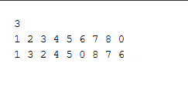
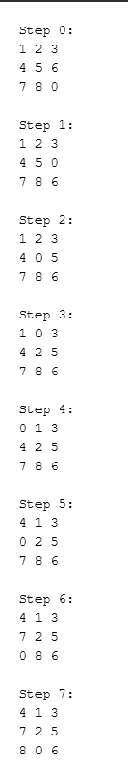
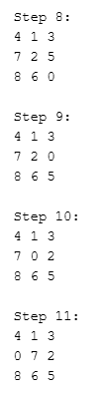
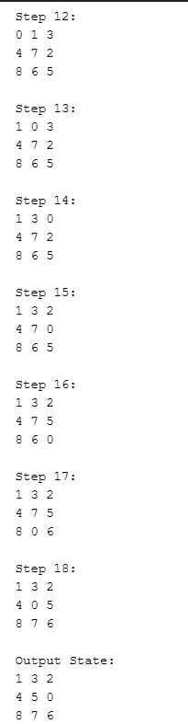
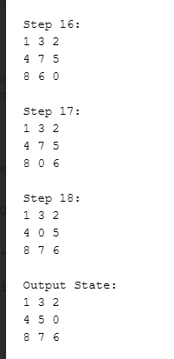
INPUT & OUTPUT
Input:
Puzzle size (3 for 8-puzzle, 4 for 15-puzzle)
Start state and goal state, read from input files in .txt fomat.
Output:
Sequence of steps showing intermediate puzzle states for each move.
Final output state written to an output file in .txt format: (8-puzzle)
Similar output for 15-puzzle
If no solution is found within the depth limit, a message is displayed in the output file.

Slide 23
ACHIEVEMENTS & CONCLUSION
Results:
Successfully implemented Depth-Limited Search to solve both 8-puzzle and 15-puzzle problems.
Handled dynamic inputs for puzzle size, start and goal states, and depth limit.
Generated and recorded all intermediate steps and final output states for each puzzle.
Challenges:
Time Management
Managing large state spaces, especially for the 15-puzzle.
Ensuring efficient move generation and avoiding repeated states.
Handling cases where no solution exists within the given depth limit.
Learning:
The assignment demonstrated the effectiveness of Depth-Limited Search for n-puzzle problems.
Gained practical experience in recursive search, state management, and output tracking.
The approach can be extended to other combinatorial search problems in AI.

Slide 24
DAY 5 ASSIGNMENT 5
DATE: 28.08.2025
Question:
"Use various AI search algorithms—Breadth-First Search (BFS), Depth-First Search (DFS), Depth-Limited Search (DLS), Iterative Deepening Search (IDS), Iterative Local Search (ILS), and Uniform Cost Search (UCS)—to solve the modified Missionaries and Carnivals problem. The task involves finding a safe sequence for a farmer, wolf, goat, and cabbage to cross a river, ensuring no unsafe pairings are left alone.”
Objective:
To implement and compare multiple search algorithms for solving a constraint-based problem, analyze their time and memory requirements, and visualize the results using comparative plots and tables.

Slide 25
APPROACH & ALGORITHMS USED
Algorithm/Technique:
Breadth-First Search (BFS): Explores all possible states level by level to find the shortest solution.
Depth-First Search (DFS): Explores each branch as far as possible before backtracking.
Depth-Limited Search (DLS): DFS with a specified depth limit to control exploration.
Iterative Deepening Search (IDS): Repeatedly applies DLS with increasing depth limits for optimality.
Iterative Local Search (ILS): Uses randomized restarts to escape local optima and find better solutions.
Uniform Cost Search (UCS): Expands the least-cost node first, considering step costs.
Approach:
Represent the problem state as positions of the farmer, wolf, goat, cabbage, and boat.
Define valid moves and constraints to prevent unsafe pairings.
Apply each algorithm to find a safe sequence of crossings.
Record time and memory usage for each run.
Compare algorithm performance using tables and plots.
Technique:
State space representation
Constraint checking
Search tree/graph traversal
Performance measurement and visualization

Slide 26
PROCESS & METHODS
Step 1: Input Preparation
Define initial and goal states for all characters (farmer, wolf, goat, cabbage, boat).
Prepare separate input files for each algorithm with required parameters.
Step 2: State Representation
Model the problem as a tuple of positions for each character and the boat.
Step 3: Valid Move Generation
Generate possible moves, ensuring constraints are not violated (no unsafe pairings).
Step 4: Algorithm Execution
Run BFS, DFS, DLS (with multiple depths), IDS, ILS, and UCS on the problem.
Log intermediate states and actions for each step.
Step 5: Performance Measurement
Record time and memory usage for each algorithm and configuration.
Step 6: Output and Visualization
Save solution steps and performance data to output files.
Create tables and plots to compare algorithm efficiency.

Slide 27
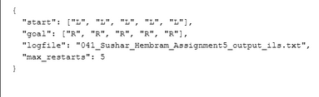
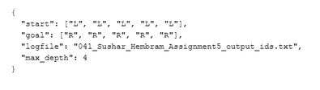
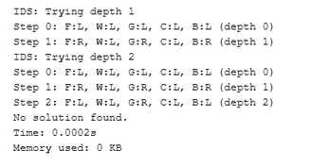
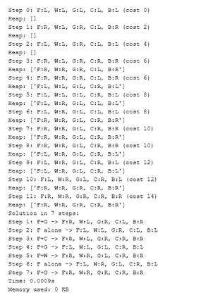
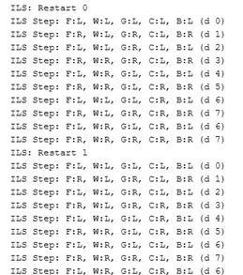
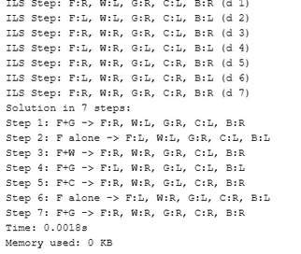
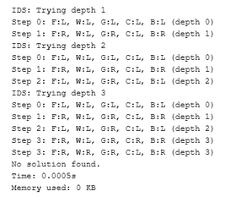
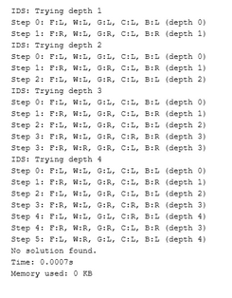
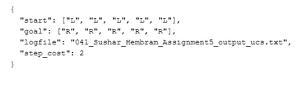
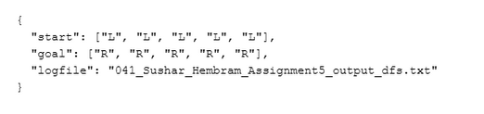
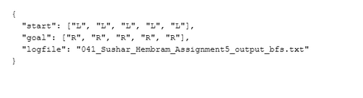
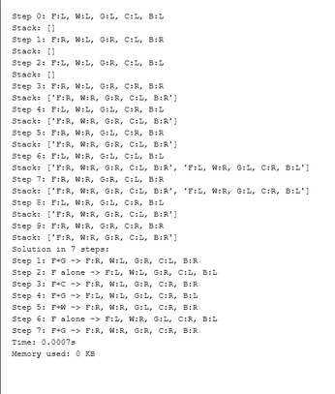
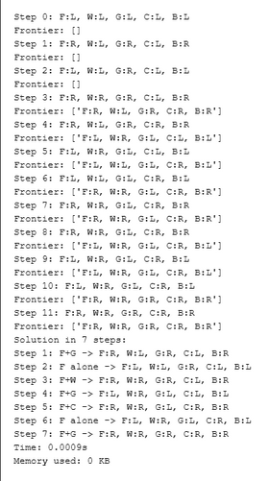
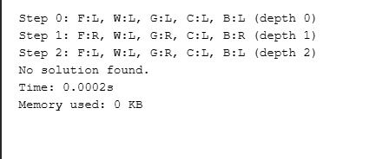
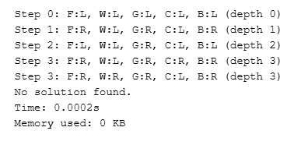
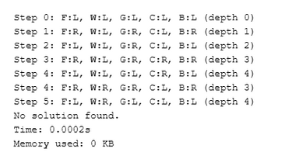
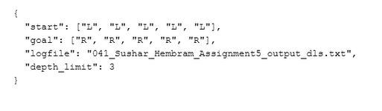
INPUT & OUTPUT
ILS
IDS
UCS
BFS
DFS
Input in .json + their outputs
DLS

Slide 28
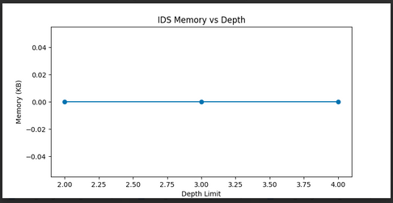
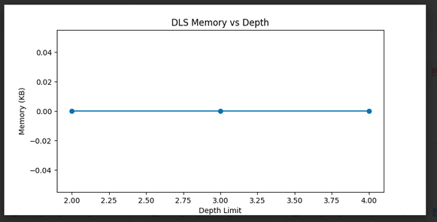
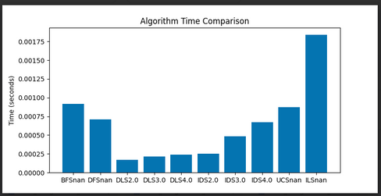
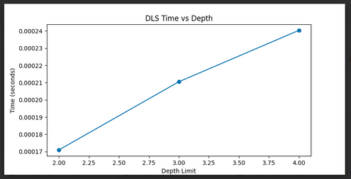
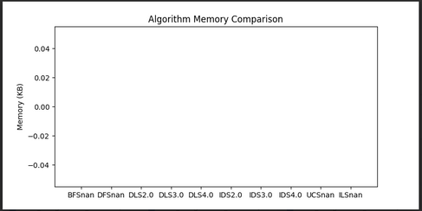
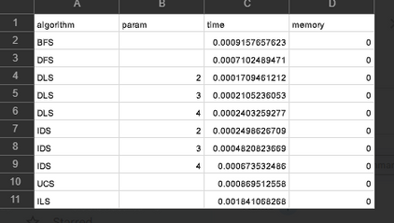
ACHIEVEMENTS & CONCLUSION
Achievements:
Successfully implemented and solved the Missionaries and Carnivals problem using six different AI search algorithms.
Collected and compared time and memory usage for each algorithm and configuration.
Visualized algorithm performance with comparative graphs and summary tables (CSV).
Demonstrated strengths and limitations of each search method in terms of efficiency and resource usage.
Conclusion:
The assignment provided practical insights into the behavior and efficiency of various search algorithms.
Comparative analysis using graphs and tables highlighted which algorithms are optimal for different constraints.
This approach can guide algorithm selection for similar AI problems in the future.

Slide 29
DAY 7 ASSIGNMENT 6
DATE: 11.09.2025
Question:
"Write a Python program to solve the classical Tic-Tac-Toe problem using Best First Search. The program should handle both 3x3 and 4x4 boards, accept dynamic inputs, and use a suitable heuristic function to guide the search for a winning sequence”
Objective:
To implement and analyze Best First Search for Tic-Tac-Toe, demonstrating heuristic-based decision making, dynamic input handling, and output generation for both board sizes, with clear tracking of intermediate and final states.

Slide 30
APPROACH & ALGORITHMS USED
Algorithm/Technique:
Best First Search is used to solve the Tic-Tac-Toe problem. The algorithm explores possible board states by always expanding the most promising node, as determined by a heuristic function.
Approach:
Represent the board as a 3x3 or 4x4 grid, with dynamic input for initial state and player.
Generate all possible moves for the current player, creating new board states.
Use a heuristic function to evaluate each state, prioritizing moves that maximize the player’s chances of winning.
Expand nodes in order of their heuristic value until a winning sequence is found or all possibilities are exhausted.
Record intermediate steps and final solution for analysis.
Techniques:
Heuristic evaluation based on possible winning lines for each player.
Priority queue for node expansion.
Dynamic handling of board size and player input.

Slide 31
PROCESS & METHODS
Step 1: Input Handling
Read board size, initial board state, and starting player from an input file.
Step 2: State Representation
Model the board as a grid (3x3 or 4x4) with cells marked as X, O, or empty.
Step 3: Move Generation
For each empty cell, generate possible moves for the current player.
Step 4: Heuristic Evaluation
Use a heuristic function to score each board state based on potential winning lines.
Step 5: Best First Search Execution
Expand the most promising board state using a priority queue.
Track explored states and avoid revisiting.
Step 6: Output Generation
Record each step and board state in an output file.
Display the winning sequence or report if no solution is found.

Slide 32

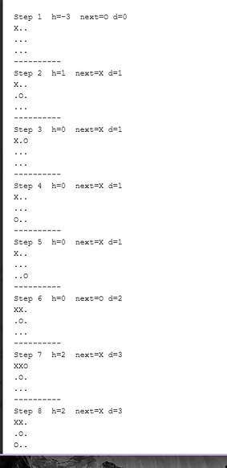
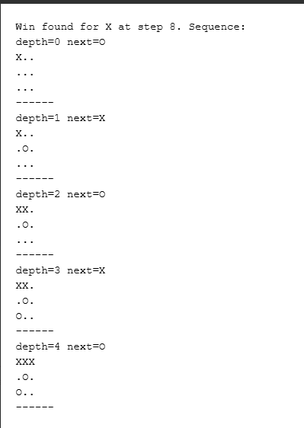
INPUT & OUTPUT
Input:
Board size (3x3 or 4x4), initial board state, and starting player, read from an input file.
Output:
Sequence of board states and moves leading to a win, recorded in the output file.
Intermediate steps and heuristic values displayed in a steps file.

Slide 33
ACHIEVEMENTS & CONCLUSION
Results:
Successfully implemented Best First Search to solve Tic-Tac-Toe for both 3x3 and 4x4 boards.
Designed and applied a heuristic function to guide the search efficiently.
Recorded all intermediate steps and winning sequences in output files.
Challenges:
Designing an effective heuristic to evaluate board states.
Managing the increased complexity and state space for larger boards.
Ensuring dynamic input handling and avoiding repeated states.
Conclusion:
The assignment demonstrated the power of heuristic-based search in game solving.
Gained practical experience in AI search strategies and state evaluation.
The approach can be extended to other board games and decision-making problems.

Slide 34
DAY 8 ASSIGNMENT 7
DATE: 18.09.2025
Question:
"Write a Python program to solve the Travelling Salesman Problem (TSP) using any iterative optimization methods. The program should find the shortest possible route starting from a given city, using a suitable heuristic function and dynamic input parameters.”
Objective:
To implement and analyze the optimization method used by the student for TSP, demonstrating iterative improvement, heuristic-based decision making, and output generation of both intermediate and final solutions, with clear tracking of optimization progress.

Slide 35
APPROACH & ALGORITHMS USED
Algorithm/Technique:
Simulated Annealing, an iterative optimization technique, is used to solve the Travelling Salesman Problem (TSP). The algorithm explores possible tours, accepting both improvements and occasional worse solutions to escape local minima, guided by a temperature parameter that gradually decreases.
Approach:
Represent cities and distances as a matrix, with dynamic input for start city and parameters.
Generate an initial tour using the Nearest Neighbor heuristic.
Iteratively generate neighboring tours by swapping cities.
Use a heuristic function (tour cost) to evaluate each tour.
Accept new tours based on cost and current temperature, allowing probabilistic jumps to avoid local optima.
Gradually reduce temperature to focus the search and converge to an optimal solution.
Record intermediate and final results for analysis.
Techniques:
Iterative improvement and probabilistic acceptance
Heuristic evaluation of tour cost
Dynamic input handling and output tracking

Slide 36
PROCESS & METHODS
Step 1: Input Handling
Read the distance matrix, start city, initial temperature, cooling rate, and number of iterations from the input file..
Step 2: Initial Tour Generation
Create an initial tour using the Nearest Neighbor heuristic.
Step 3: Simulated Annealing Iteration
For each iteration:
Generate a neighboring tour by swapping two cities.
Calculate the cost of the new tour.
Decide whether to accept the new tour based on cost and current temperature (probabilistic acceptance).
Step 4: Temperature Update
Gradually decrease the temperature using the cooling rate.
Step 5: Output Generation
Record intermediate results (tour, cost, temperature) in an output file.
Save the best tour and its cost as the final solution.

Slide 37
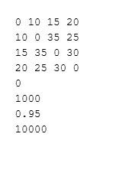
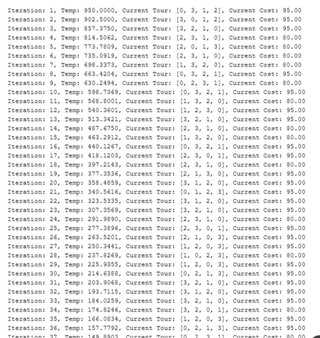
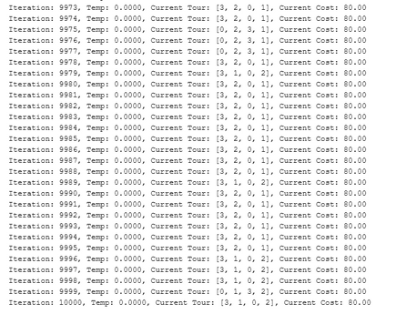
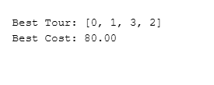
INPUT & OUTPUT
Input:
Distance matrix between cities, start city, initial temperature, cooling rate, and number of iterations, read from an input file.
Output:
Intermediate results for each iteration: current tour, cost, and temperature, recorded in an output file.
Final output: best tour found and its total cost, saved in a separate output file.

Slide 38
ACHIEVEMENTS & CONCLUSION
Results:
Successfully implemented Simulated Annealing to solve the Travelling Salesman Problem.
Found an optimized tour with minimal cost using iterative improvement and probabilistic acceptance.
Recorded and analyzed intermediate and final results for solution quality.
Challenges Faced:
Designing an effective cooling schedule and heuristic for convergence.
Managing randomness and ensuring reproducibility of results.
Handling large iteration counts for better optimization without excessive computation time.
Conclusion:
The assignment demonstrated the power of iterative optimization and heuristic-guided search for complex problems.
Simulated Annealing provided a practical approach to escape local minima and find near-optimal solutions.
The methodology can be extended to other combinatorial optimization tasks in AI.

Slide 39
REFERENCE
Link Name: https://github.com/UNKN0WN006/artificial-intelligence-lab
﻿Brief Description: This Github repository contains all the codes and writeups shared and discussed.

Slide 40
THANK YOU
FOR YOUR ATTENTION

