Slide 1
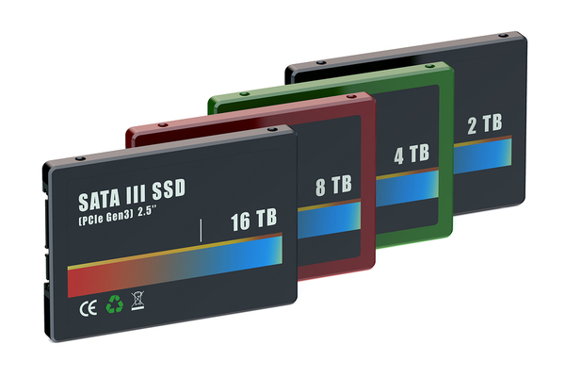
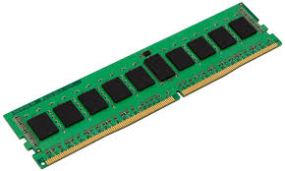
UNIT V
FILE PROCESSING
permanent storage virtual storage

Slide 2


FILES
Text
Binary (0,1)
Text
User Undastand
Slow Processing
Binary
Can not Undastand User
Fast Processing
Opening File
<stdio.h>
typedef struct{
------------;
------------;
}FILE;
FILE *File_Pointer_Name

Slide 3
Ram run effectively
Hard Disk
----------------------
------
Syntax :
EXAMPLE
FILE *fp
fp = fopen(“sample.txt”, “w”);
FILE *pointer_variable;
Pointer_variable = fopen(file_name, file_mod);
Modes :
Binary
“wb” , “rb”, “ab”
“w” → write
“r” → read
“a” → appand
“w+” → write + read
“r+” → read + write (update)
“a+” → append + read
Text
“wt” , “rt”, “at”

Slide 4
Types of file processing:
Sequential access
Random access
Sequential access
Function nume and syntax | Description
fputc(char, fileptr) | Writes a char to a file
fgetc(fileptr) | Reads a char from file
putw(int, fileptr) | Writes a integer to a file
getw(fileptr) | Reads a integer from file
fputs(string, fileptr) | Writes a string to a file
fgets(string, numofchars, fileptr) | Reads a string from file
fprintf(fileptr, formatteddata) | Writes a formatted string to a file
fscanf(fileptr, formatteddata) | Reads a formatted string from file
fwrite(ptr, size, n, fileptr) | Writes a entire block of a file
fread(ptr, size, n, fileptr) | Reads a entire block from file

Slide 5
Random access
Function nume and syntax | Description
fseek(fileptr, displacement, origen) | To set file pointer at specified position in file
ftell(fileptr) | Return the current position at filepointer
rewind(fileptr) | Moves file pointer to beginning of file
File hove any error : it returns NULL
Closing a File
Syntax :
EXAMPLE
fclose(fp);
fclose(pointer_variable);

Slide 6
EXAMPLE : fputc
#include <stdio.h>
int main()
{
FILE *fp;
fp = fopen("fputs_output.txt","w");
if(fp == NULL)
printf("\nError While Opening File");
fputc('b', fp);
fclose(fp);
return 0;
}
fputs_output.txt
b

Slide 7
EXAMPLE : fgetc
#include <stdio.h>
int main()
{
FILE *fp;
fp = fopen("fputs_output.txt",“r");
if(fp == NULL)
printf("\nError While Opening File");
while(1)
{
char c = fgetc(fp);
if(c==EOF)
break;
printf("%c", c);
};
fclose(fp);
return 0;
}
Output : fgetc
b

Slide 8
Sequential access file
#include <stdio.h>
void main()
{
FILE *ptr;
int x, y, z;
ptr = fopen("marks.txt", "r");
if(ptr==NULL)
printf("\nError Opening File!");
while (fscanf(ptr, "%d%d%d",&x,&y,&z)!=EOF)
{
float avg = (x+y+z)/3.0;
printf("\nSum of %d + %d + %d is Total : %f", x,y,z,avg);
}
fclose(ptr);
}
marks.txt
10 10 10
20 20 20
55 66 77
Output
Sum of 10 + 10 + 10 is Total : 10.000000
Sum of 20 + 20 + 20 is Total : 20.000000
Sum of 55 + 66 + 77 is Total : 66.000000

Slide 9
Random access file
Random.txt
I am UNKNOWN
Age 17
Studying in RPSIT
Salam
File positions
1st line 0th position is I
2nd line 13th position is A
3rd lind 29th position is S
4th lind 35th position S
0 → Beginningn of pointer position
1 → Current pointer position
2 → End of pointer position

Slide 10
Random access file
Random.txt
#include<stdio.h>
void main()
{
FILE *ptr;
int c_p, n;
char c;
ptr = fopen("random.txt", "r");
if(ptr==NULL)
printf("\nError Opening File!");
c_p = ftell(ptr);
c = getc(ptr);
printf("Valur at %d is %c\n", c_p,c);
I am UNKNOWN
Age 17
Studying in RPSIT
Salam
Output
Valur at 0 is I
fseek(ptr, 13, 0);
c_p = ftell(ptr);
c = getc(ptr);
printf("Valur at %d is %c\n", c_p,c);
Valur at 13 is A

Slide 11
Random access file
Output
fseek(ptr, -5, 2);
c_p = ftell(ptr);
c = getc(ptr);
printf("Valur at %d is %c\n", c_p,c);
Valur at 38 is S
fseek(ptr, -7, 1);
c_p = ftell(ptr);
c = getc(ptr);
printf("Valur at %d is %c\n", c_p,c);
Valur at 32 is R
rewind(ptr);
c_p = ftell(ptr);
c = getc(ptr);
printf("Valur at %d is %c\n", c_p,c);
Valur at 0 is I

Slide 12
Random access file
Output
printf("Valur at %d is %c\n", c_p,c);
printf("Enter a value to n : ");
scanf("%d", &n);
fseek(ptr, n, 0);
c_p = ftell(ptr);
c = getc(ptr);
while ((c=getc(ptr))!=EOF)
printf("%c", c);
fclose(ptr);
}
Enter a value to n : 0
am UNKNOWN
Age 17
Studying in RPSIT
Salam

Slide 13
Command line arguments.
Run is donated as main()
argc → argument count
*argv → argument vectors
Int main(int argc, char *agrv[])
{
------------------;
------------------;
}

Slide 14
