Slide 1
Objects layout in memory

Slide 2
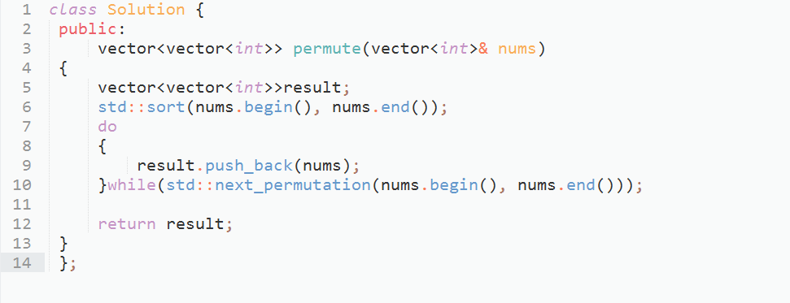
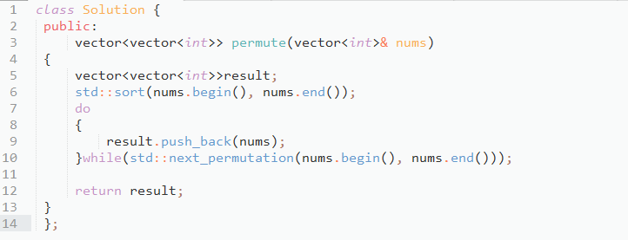
Permutation with using standard function

Slide 3
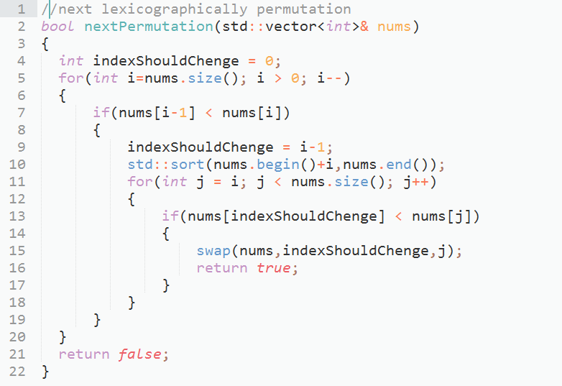
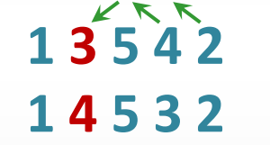

Next Lexicographic permutation

Slide 4
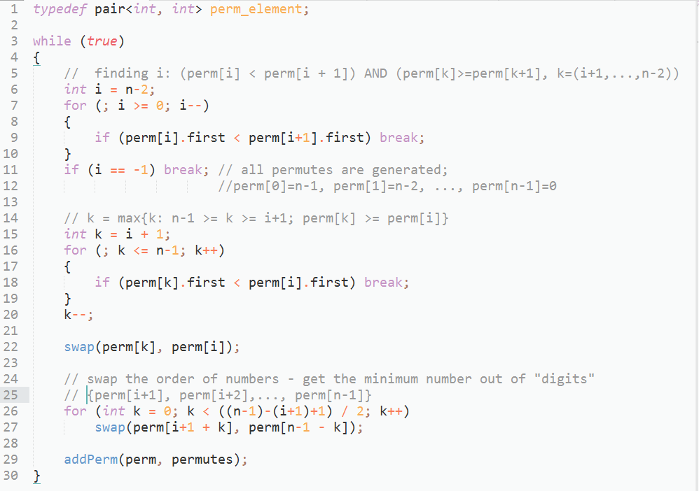
Upgraded solution

Slide 5
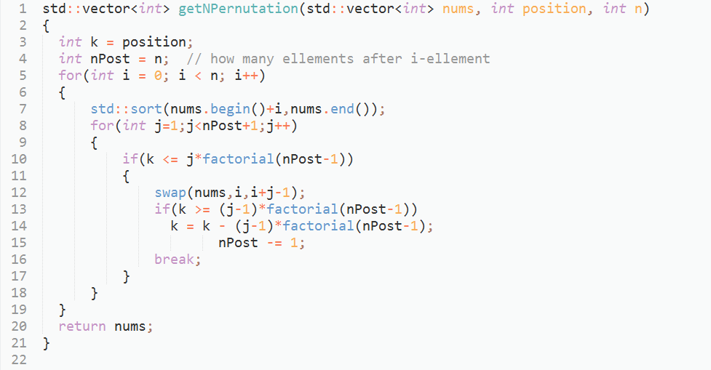
Get permutation by sequence number

Slide 6
Objects layout in memory

Slide 7
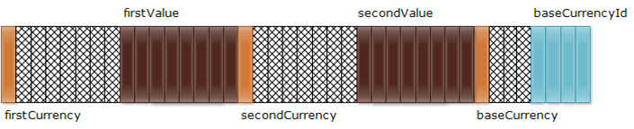
Alignment
struct Currency
{
char firstCurrency;
double firstValue;
char secondCurrency;
double secondValue;
char baseCurrency;
int baseCurrencyId;
};

Slide 8
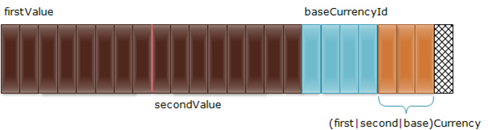
Alignment
struct Currency
{
double firstValue;
double secondValue;
int baseCurrencyId;
char firstCurrency;
char secondCurrency;
char baseCurrency;
};

Slide 9
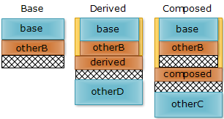
Inheritance
class Base
{
int base;
char otherB;
};
class Derived : public Base
{
char derived;
int otherD;
};
class Composed
{
Base base;
char composed;
int otherC;
};

Slide 10

Multiple Inheritance
class BaseA
{
int fieldA;
};
class BaseB
{
int fieldB;
};
class Derived : public BaseA, public BaseB
{
int fieldD;
};

Slide 11
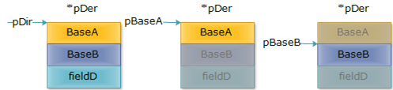
Multiple Inheritance
Derived* pDer = new Derived;
BaseA* pBaseA = pDer;
BaseB* pBaseB = pDer;

Slide 12
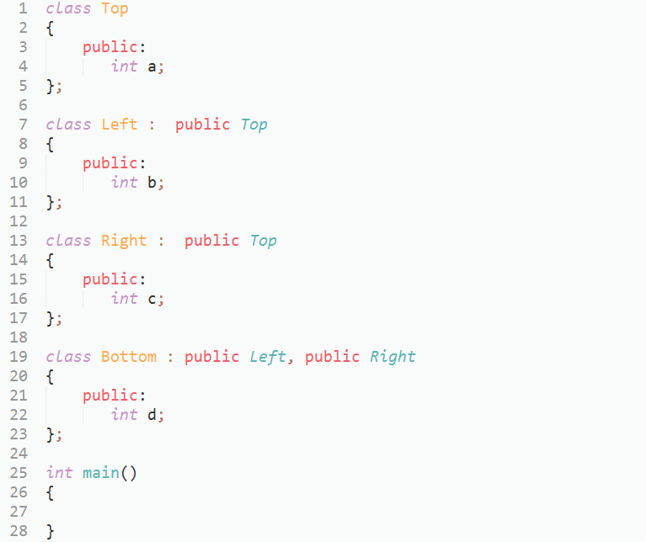
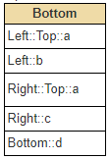
Multiple Inheritance

Slide 13
VIRTUAL TABLE

Slide 14
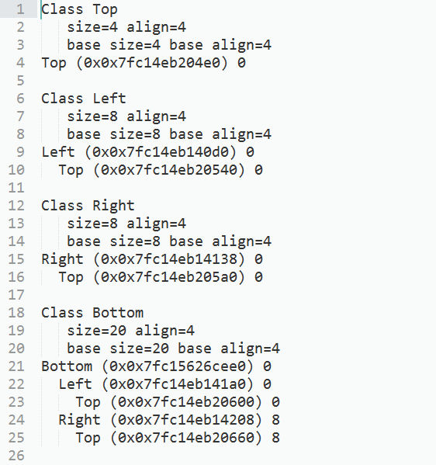
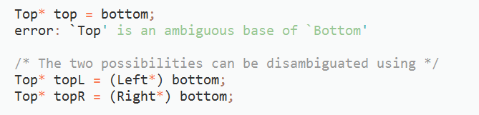
Non-virtual multiple inheritance
-fdump-class-hierarchy

Slide 15
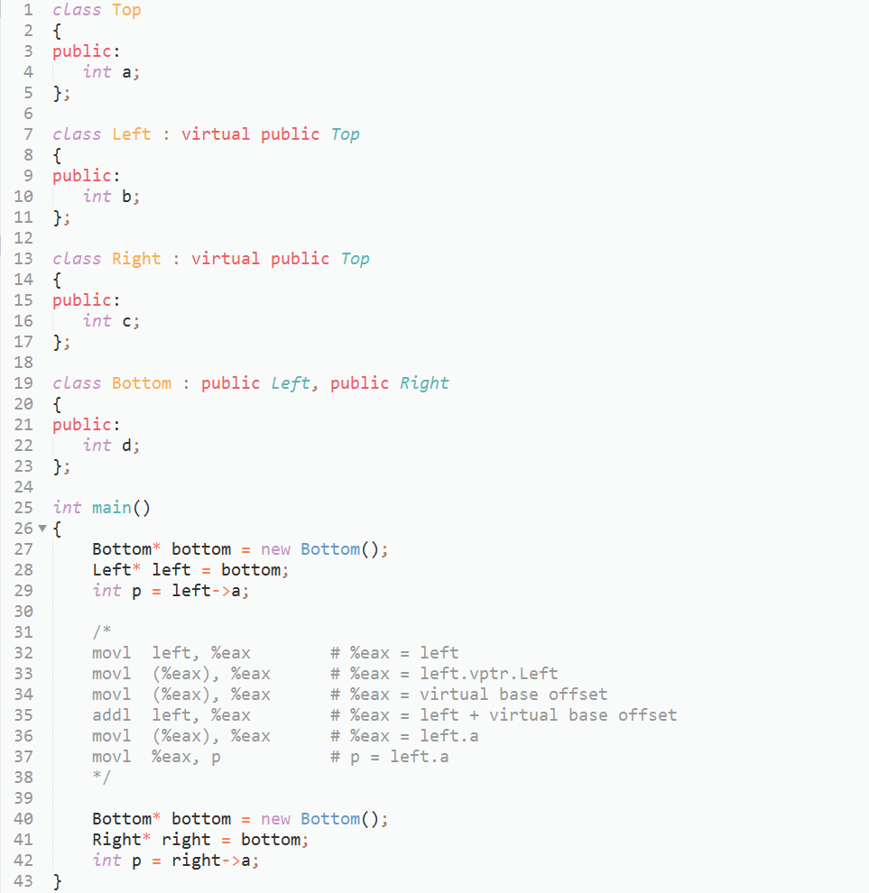
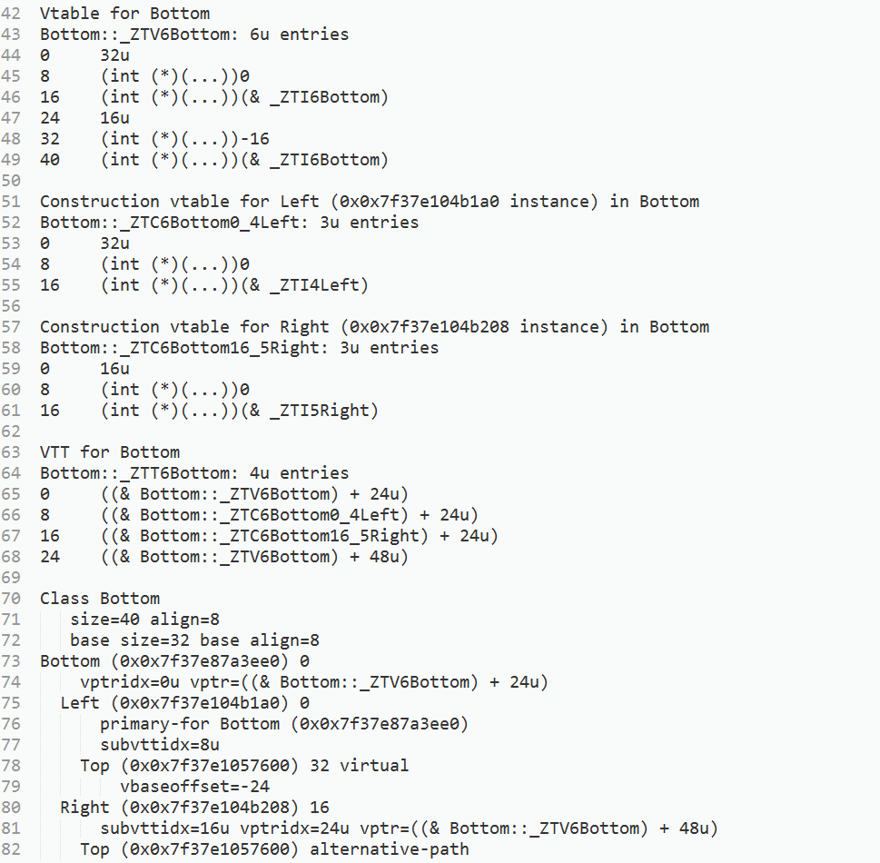
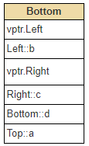
Virtual Inheritance
-fdump-class-hierarchy

Slide 16
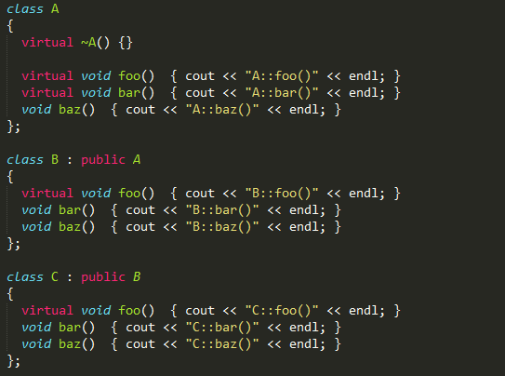
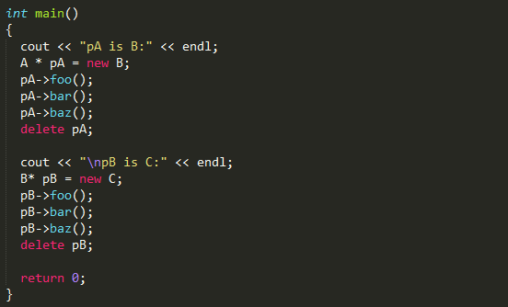
Is it right output?
pA is B:
B::foo()
B::bar()
A::baz()
pA is C:
С::foo()
B::bar()
A::baz()
16

Slide 17
Right output:
pA is B: B::foo() B::bar() A::baz() pB is C: C::foo() C::bar() A::baz()

Slide 18
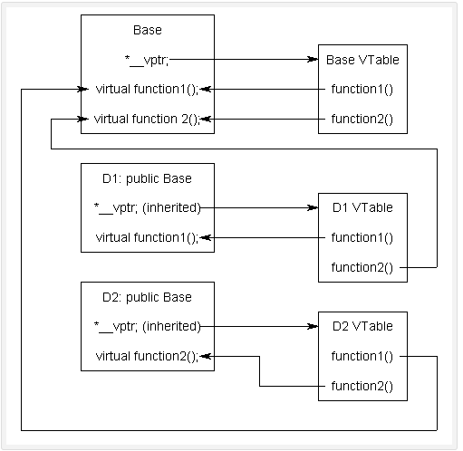
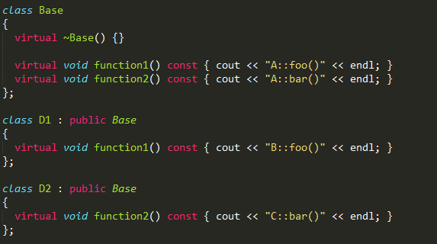
Virtual table
C++ uses a special form of late binding known as the virtual table. The virtual table is a lookup table of functions used to resolve function calls in a dynamic/late binding manner.

Slide 19
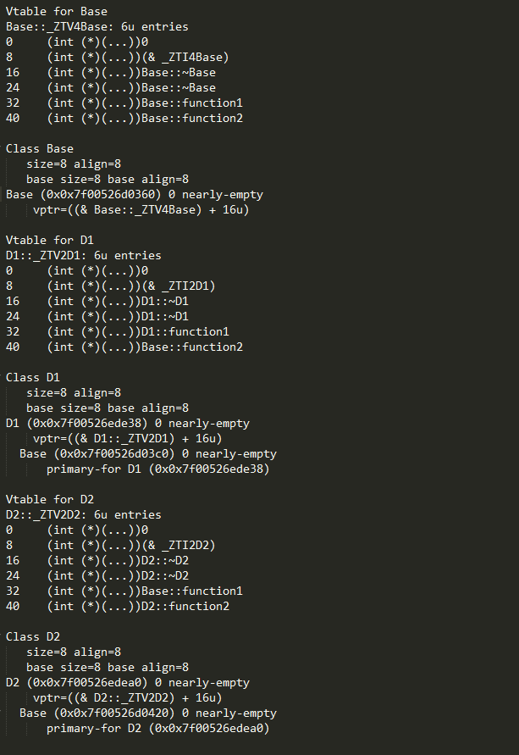
Proof: g ++ -fdump-class-hierarchy option

Slide 20
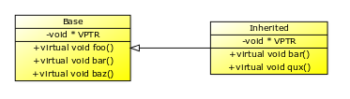
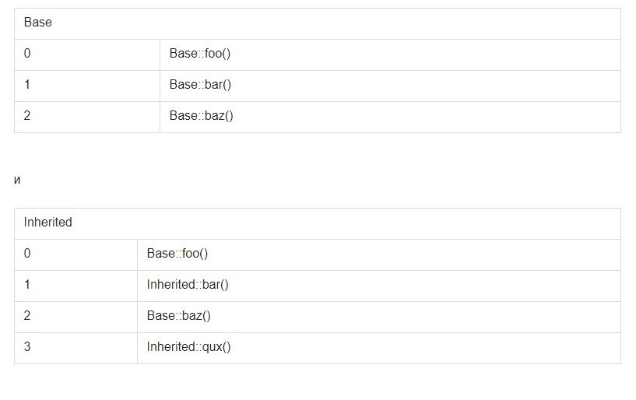
Virtual table

Slide 21
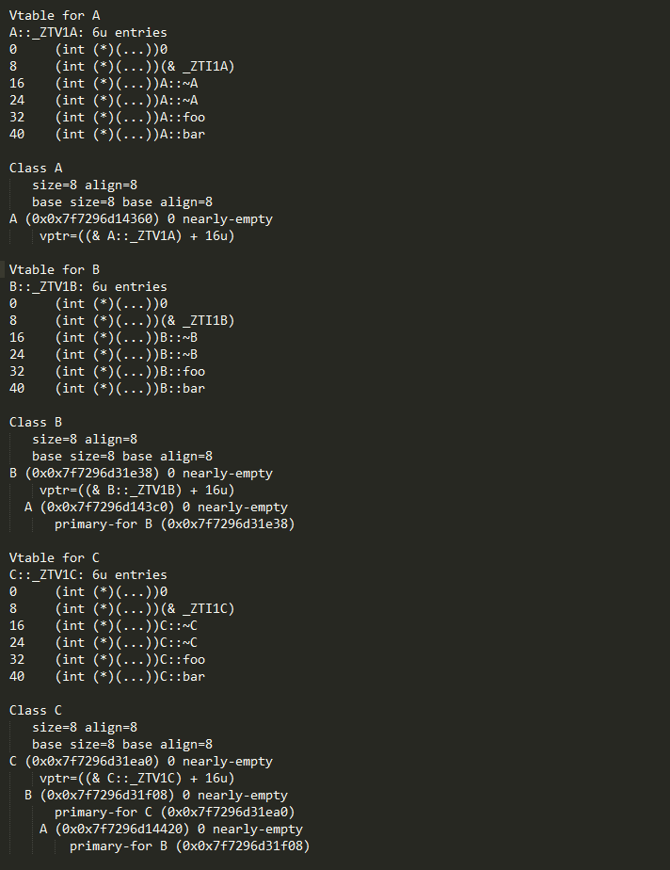

Slide 22
Dynamic_cast

Slide 23
Dynamic_cast
Syntax:
dynamic_cast < new_type > ( expression )
Example:
class Base{
virtual void Print() { cout << "Base::print"; }
void SpecificPrint() { cout << "Specific function of the Base class"; } };
class Derived : Base{
void Print() { cout << "Derived::print"; }
void SpecificPrint() { cout << "Specific function of the Derived class"; } };
//downcast
Base* base = new Derived;
Derived* derived = dynamic_cast<Derived*>(base); or Derived derived = dynamic_cast<Derived&>(*base);
derived->SpecificPrint(); // call Derived::SpecificPrint()
//upcast
Derived* derived = new Derived;
Base* base = static_cast<Base*>(derived);

Slide 24
Thanks for attention

