Slide 1
Prediction of Flight Arrival Delay Time with Machine Learning Approaches on the U.S. Bureau of Transportation Statistics
Group: BD02
First UoN Local Conference on Big Data
Ningbo
May 2023
(COMP4107)

Slide 2

Group Organization
Member Introduction
Chief Executive Officer
Jiarui LI (20216422)
Chief Report Officer
Ran JI (20217337)
Chief Data Officer
Yik Lun Yelan LAU (20217531)

Slide 3
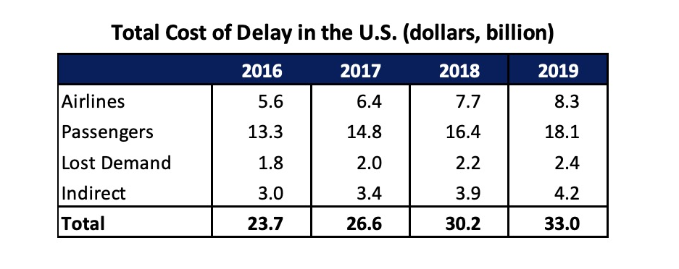
Introduction
Airline Problem: Delay
Common serious problem in the U.S.
Only 70% of flights in the U.S. arrived on time
$30 billion for all parties involved in 2019 in the US alone
Flight delays are caused by many reasons
Samples of cost of Delay in the U.S.

Slide 4
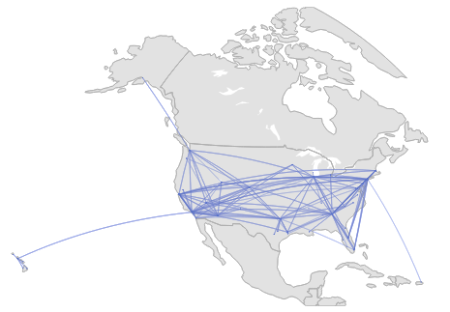



Dataset
Bureau of Transportation Statistics
Years: 2009 – 2019
Region: United States of America
Total Flights: 68,979,001

Slide 5
Dataset
Feature Introduction
Attributes in Dataset | Flight date, Carrier, Carrier number, Original location, Destination location, Scheduled departure time, Actual departure time, Taxi-out time, Taxi-in time, Wheels-off time, Wheels-on time, Delay departure time, Delay arrival time, Actual arrival time, Carrier delay time, Cancelled, Cancelled code, Weather delay time, NAS delay time, Security delay time, Late aircraft delay, Distance
Attributes Setlected | Flight date, Carrier ID, Original location, Scheduled departure time, Departure delay time, Distance, Carrier delay time, Weather delay time, NAS delay time, Security delay time, Late aircraft delay time
Regression (output) | Number of arrival time difference (min)
Table : Features of predictive model

Slide 6

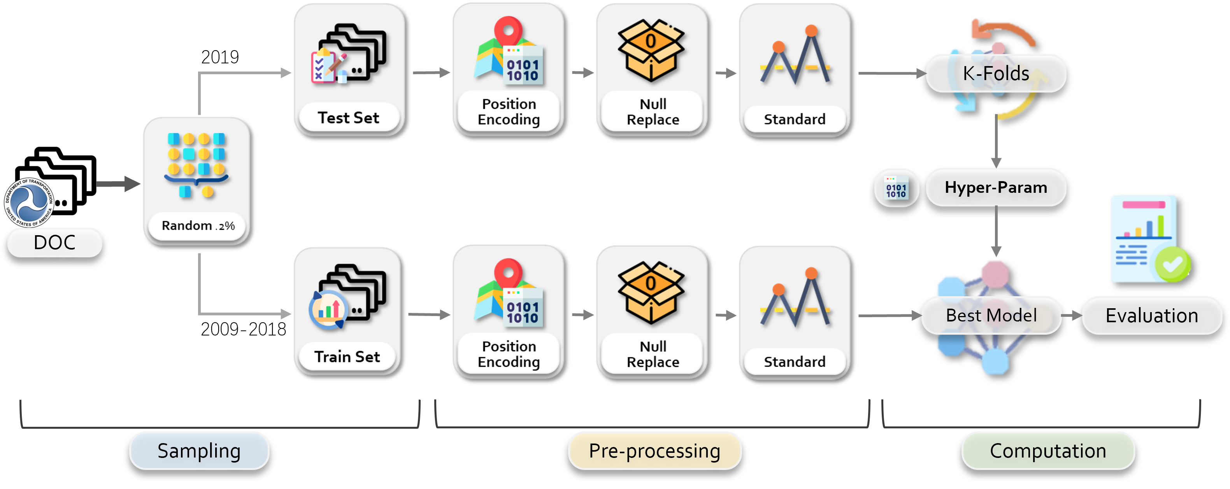
Method
General Workflow

Slide 7
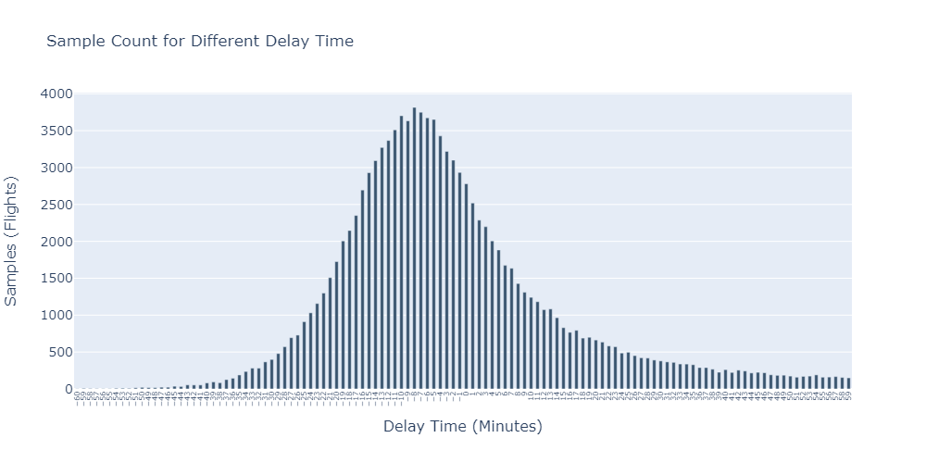



Method
Sampled Dataset
Train Set
121,513 Samples
2009 – 2018 Years
Test Set
14,861 Samples
2019 Year

Slide 8



Method
Methods Detail
Decision Tree
Random Forest
tol=1e-4
Gradient Boost
Gaussian Regression
Linear Regression
3-Folds
Gaussian Regression

Slide 9

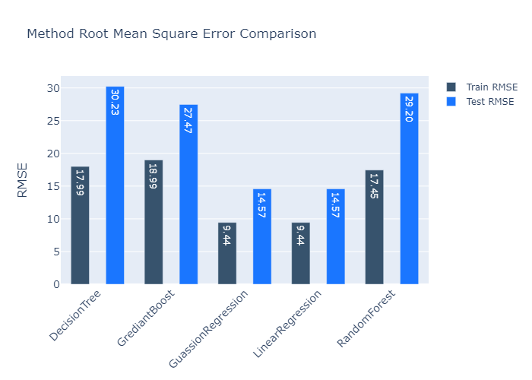
Evaluation
Performance Comparison
Evaluation
Regression | Train |  | Test
Regressor | RMSE | R² | RMSE | R²
Decision Tree | 17.9888 | 0.7935 | 30.2331 | 0.6314
Random Forest | 17.4475 | 0.8058 | 29.1984 | 0.6562
Gradient Boost | 18.9884 | 0.7700 | 27.4730 | 0.6956
Linear Regression | 9.4382 | 0.9432 | 14.5720 | 0.9144
Gaussian Regression | 9.4382 | 0.9432 | 14.5720 | 0.9144

Slide 10
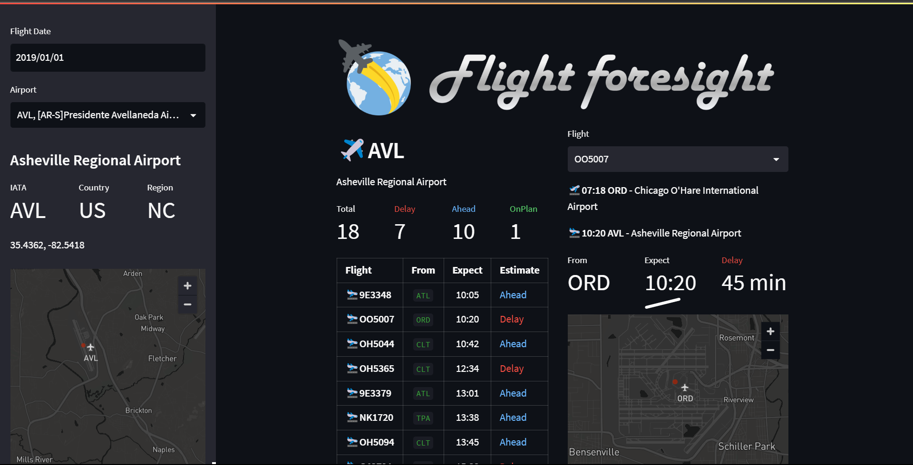
Visualization
Flight Foresight

Slide 11
Conclusion
Airline Delay Predict
Departure information of flights can be used to predict flight delay time.
To handle the large-scale dataset efficiently, Spark for data is applied for processing and distribution among the processing members, thus reducing the overall processing time.
The proposed Linear Regression performs better than other our evaluated methods.
The results can prove that flight delay time can be predicted to reduce loss of airlines and passengers for economy.

