Slide 1
Get started with OpenGL
On Windows

Slide 2
Environment
OpenGL
Microsoft Visual Studio 2017
GLUT - The OpenGL Utility Toolkit
FREEGLUT - An open source alternative to GLUT
GLEW - The OpenGL Extension Wrangler Library

Slide 3


Build a OpenGL Source File
Build a folder named “OpenGL_source”
Build one sub-folder in
“include”
Build two sub-folders in “OpenGL_source”

Slide 4


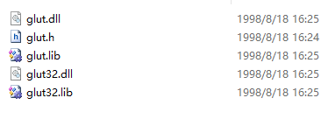
GLUT
http://www.opengl.org/resources/libraries/glut/glutdlls37beta.zip
Extract
Copy “glut.dll” and “glut32.dll” to: “C:\Windows\SysWOW64”
Copy “glut.h” to: “OpenGL_source\include\GL”
Copy “glut.lib” and “glut32.lib” to: “OpenGL_source\lib”

Slide 5


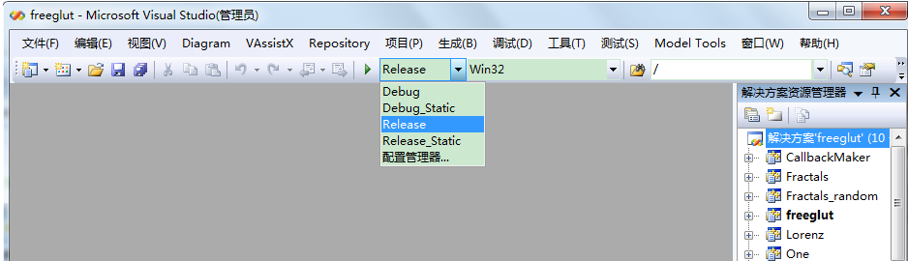
FREEGLUT
http://nchc.dl.sourceforge.net/project/freeglut/freeglut/2.8.0/freeglut-2.8.0.tar.gz
Extract
Run “freeglut.sln” under “freeglut-2.8.0\freeglut-2.8.0\VisualStudio\2010”using Visual Studio 2010
Using “Release” model and build

Slide 6

FREEGLUT
1. Copy “freeglut.h”, “freeglut_ext.h”, “freeglut_std.h” from “freeglut-2.8.0\freeglut-2.8.0\include\GL” → “OpenGL_source\include\GL”
2. Copy “freeglut.lib” from “freeglut-2.8.0\freeglut-2.8.0\lib\x86” to “OpenGL_source\lib”
3. Copy “freeglut.dll” from “freeglut-2.8.0\freeglut-2.8.0\lib\x86” to “C:\Windows\SysWOW64”

Slide 7
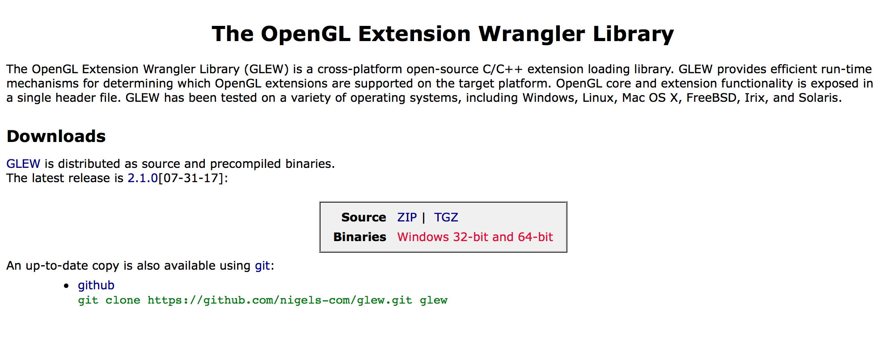
GLEW
glew.sourceforge.net

Slide 8


GLEW
Extract
Copy “glew32.dll” from “glew-2.1.0\bin\Release\Win32” to: “C:\Windows\SysWOW64”
Copy “glew.h”, “glxew.h”, “wglew.h”, “eglew.h” from “glew-2.1.0\include\GL” to: “OpenGL_source\include\GL”
Copy “glew32.lib” and “glew32s.lib” from “glew-2.1.0\lib\Release\Win32” to: “OpenGL_source\lib”

Slide 9

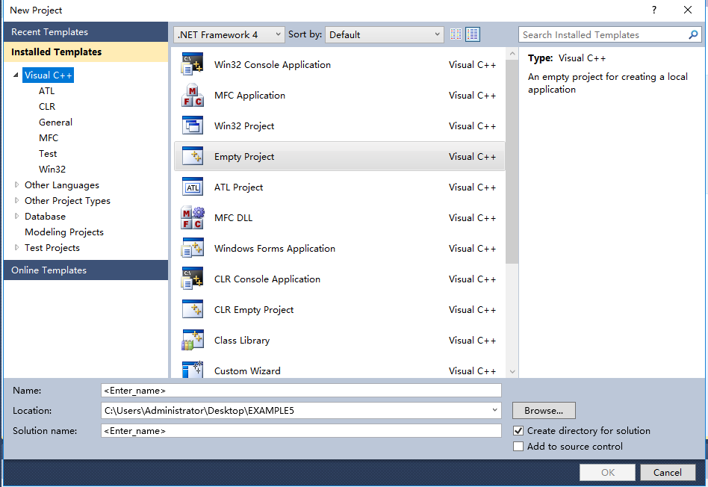
Build the first program
1. New Project
Visual C++ → Empty Project
Browse the Locations of the project
Set the project name

Slide 10
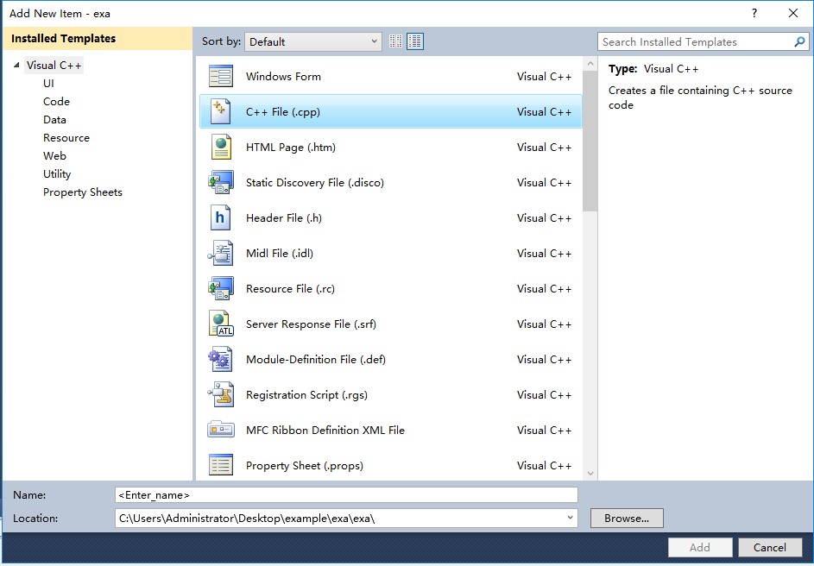
Build the first program
Right click “Source Files” , “Add” “New Item” (Ctrl+Shift+A)

Slide 11
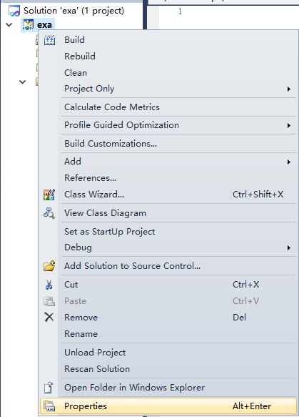
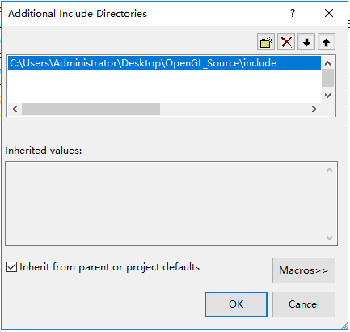
Build the first program
Right click the project and set “Properties”
“C++” → “General” → “Additional Include Directories”
→ link the “include”

Slide 12
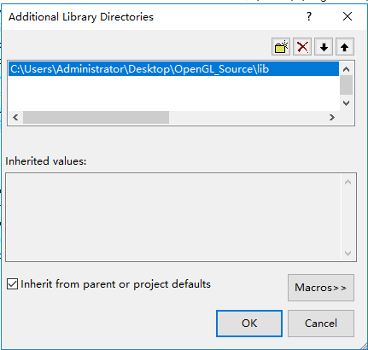
Build the first program
“Linker” → “General”→ “Additional Library Directories”→ link the “lib”

Slide 13
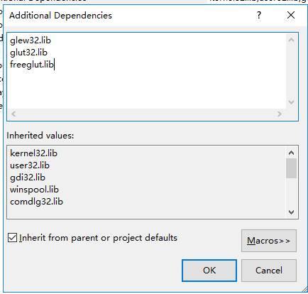
Build the first program
“Linker” → “Additional Dependencies”→add “glew32.lib”, “glut32.lib”, “freeglut.lib”

Slide 14
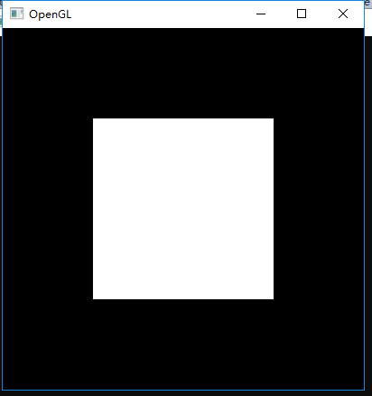
Code1
#include <GL/glew.h>
#include <GL/glut.h>
void display(void){}
int main(int argc, char **argv)
{
glutInit(&argc, argv);
glutInitDisplayMode(GLUT_DOUBLE | GLUT_RGB);
glutInitWindowSize(500, 500);
glutInitWindowPosition(0, 0);
glutCreateWindow("Create Empty Window");
glewInit();
glutDisplayFunc(display);
glutMainLoop();
}

Slide 15
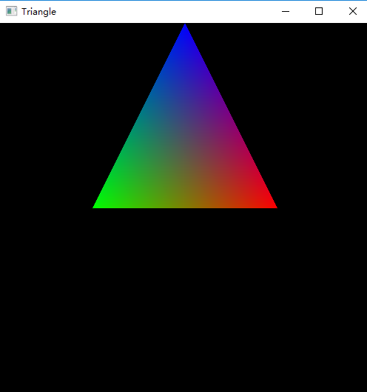
Code2
#include <GL/glew.h>
#include <GL/glut.h>
void display(void)
{
glClear(GL_COLOR_BUFFER_BIT);
glBegin(GL_TRIANGLES);
glColor3f(0.0, 0.0, 1.0);
glVertex3f(0.0, 1.0, 0.0);
glColor3f(0.0, 1.0, 0.0);
glVertex3f(-0.5, 0.0, 0.0);
glColor3f(1.0, 0.0, 0.0);
glVertex3f(0.5, 0.0, 0.0);
glEnd();
glutSwapBuffers();
}
int main(int argc, char **argv)
{
glutInit(&argc, argv);
glutInitDisplayMode(GLUT_DOUBLE | GLUT_RGB);
glutInitWindowSize(500, 500);
glutInitWindowPosition(0, 0);
glutCreateWindow("Triangle");
glewInit();
glutDisplayFunc(display);
glutMainLoop();
}

Slide 16
Exercise
GL_POINTS
GL_LINES
GL_TRIANGLES
GL_TRIANGLE_FAN
GL_TRIANGLE_STRIP
Try it out with these different settings in the example we have done previously.

