Slide 1
Get started with OpenGL
On MAC

Slide 2
Environment
OpenGL
Xcode 8.0
XQuartz
Homebrew
GLUT
FREEGLUT
GLEW

Slide 3
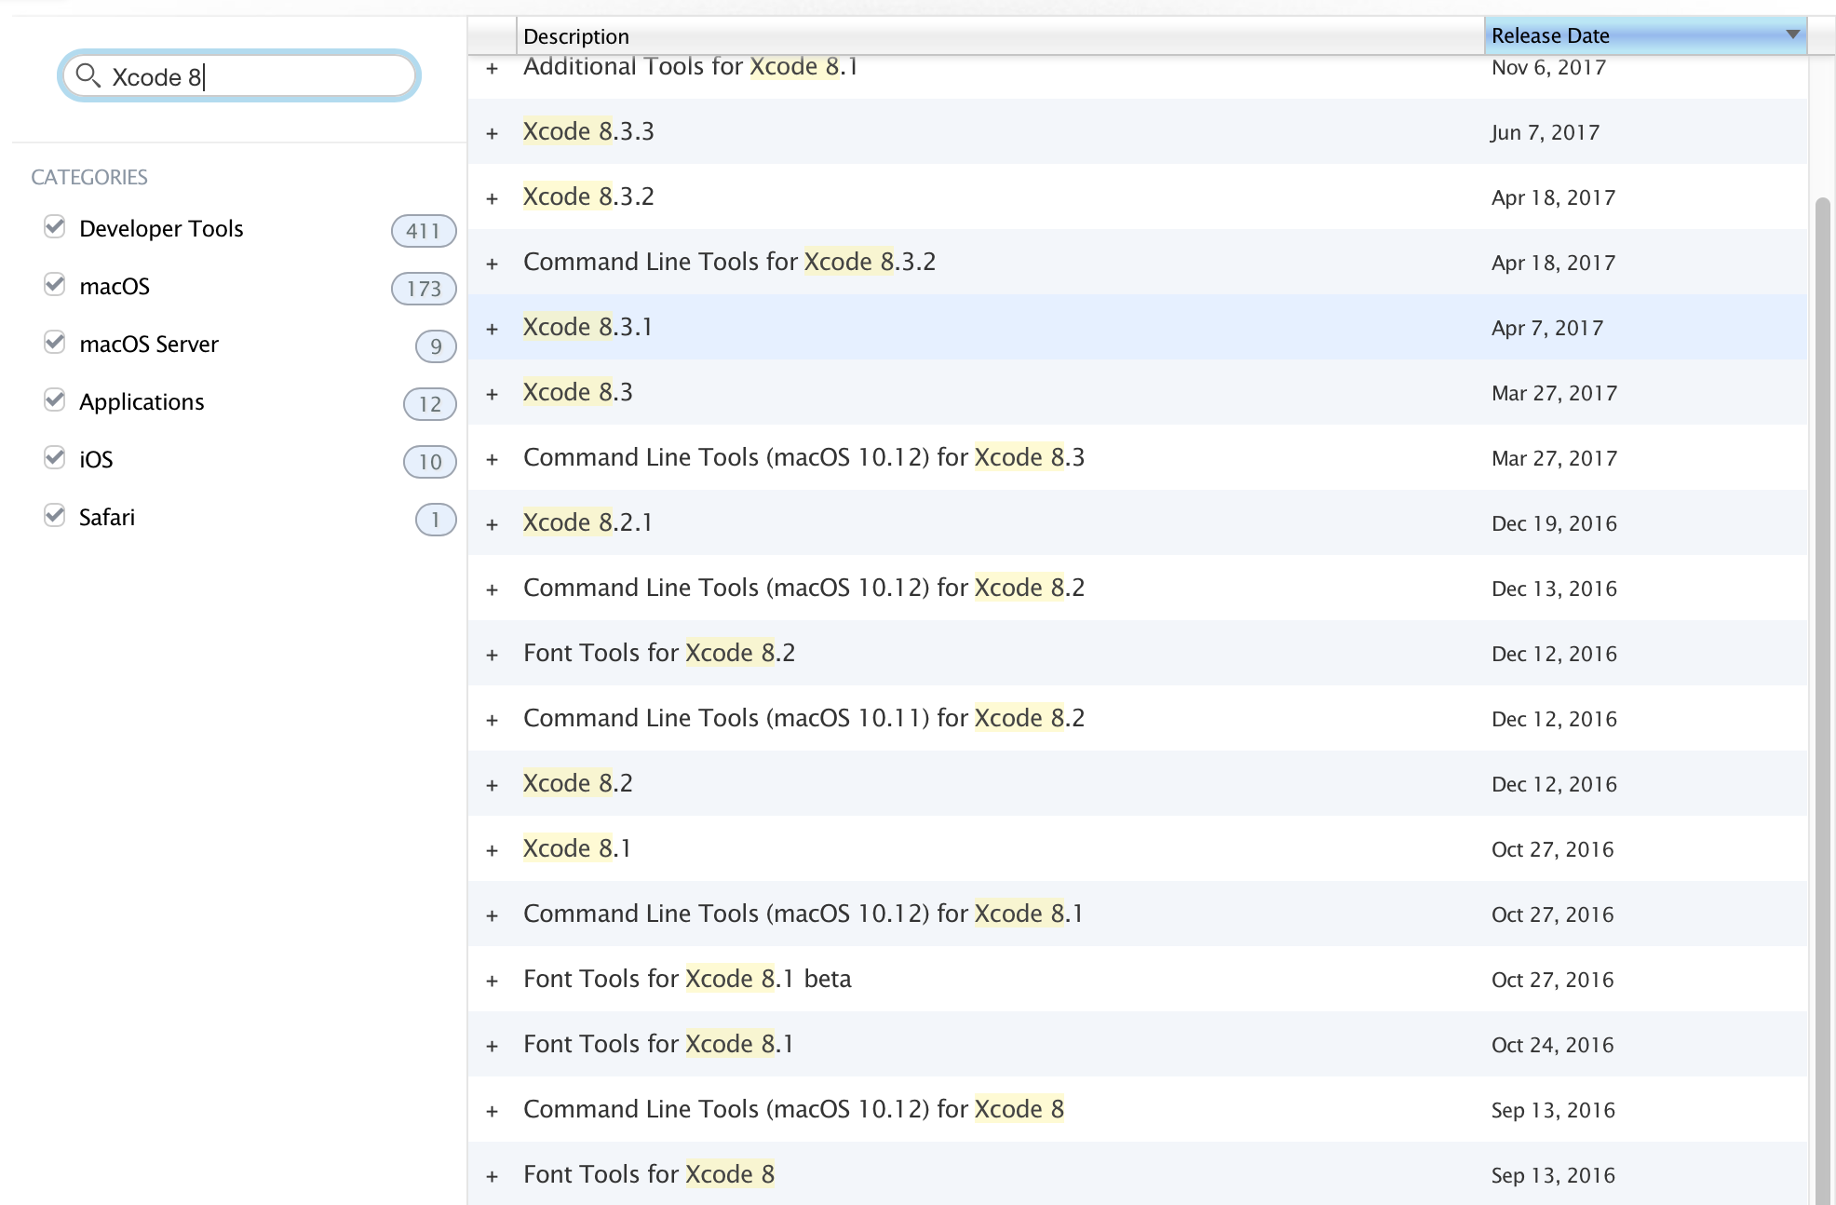

Xcode 8.0
https://developer.apple.com/download/

Slide 4
XQuartz
https://www.xquartz.org

Slide 5
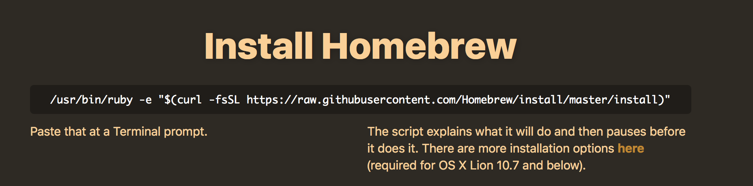
Homebrew
https://brew.sh

Slide 6
GLUT
Already in Mac OS

Slide 7
FREEGLUT
Terminal → type: brew install freeglut
The files are under: /usr/local/Cellar

Slide 8
GLEW
Terminal → type: brew install glew
The files are under: /usr/local/Cellar

Slide 9
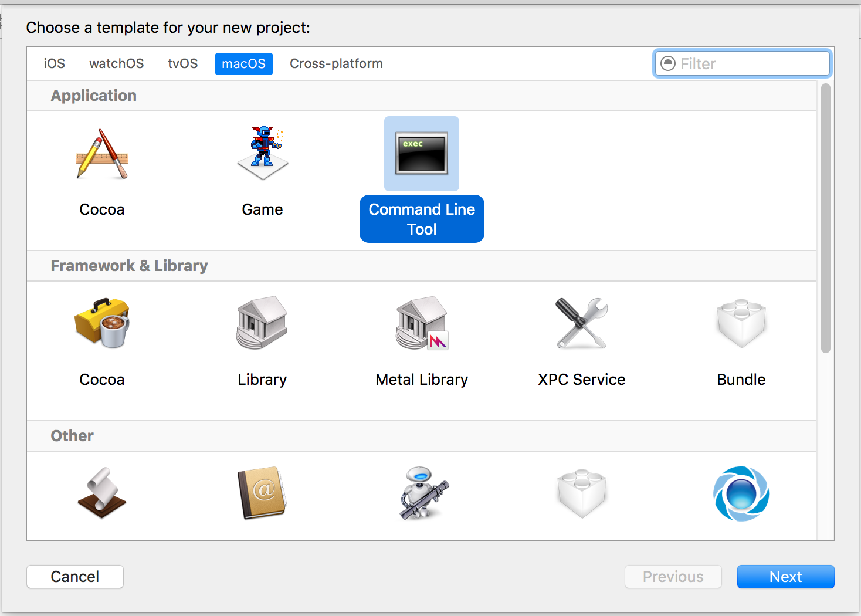
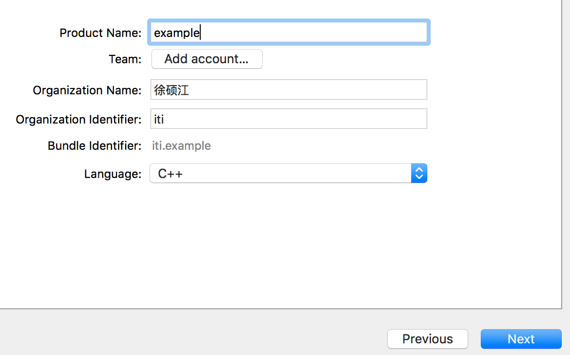
Build the first program
Xcode → File → New → Project
Define the ”Product Name”
Set a location of the project

Slide 10
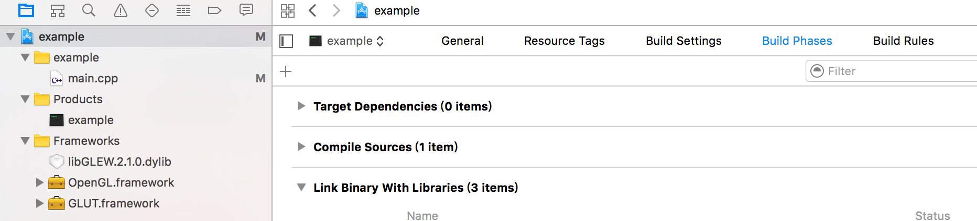
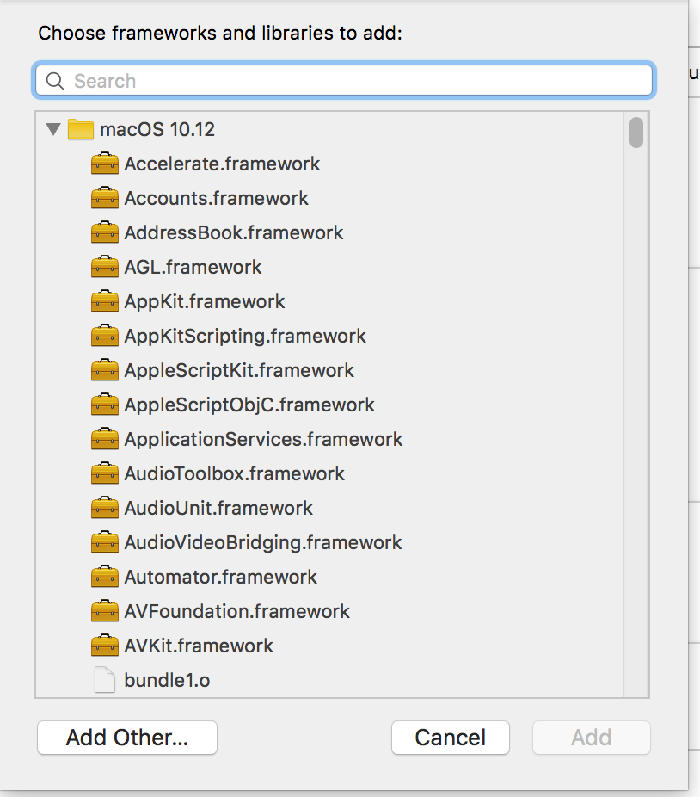
Build phase → Link Binary With Libraries
left click the +
Search and add OpenGL.framework & GLUT.framework

Slide 11
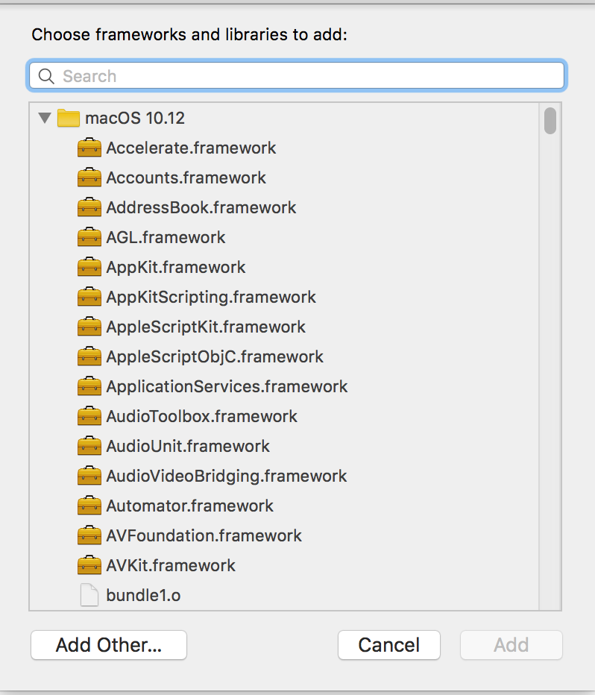
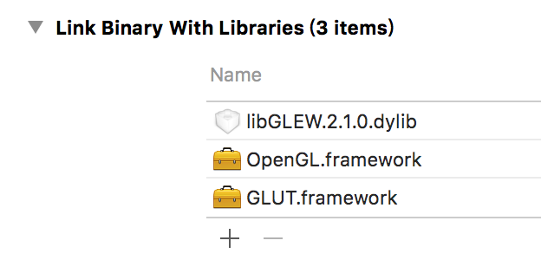
Add Other
Command + Shift + G
Go to the folder: /usr/local/ → Cellar → glew → 2.1.0 → lib → libGLEW.2.1.dylib → Open

Slide 12
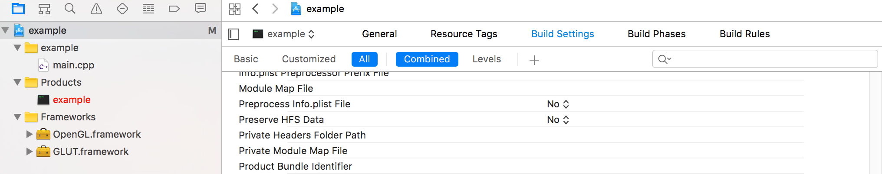
Build the first program
Example → example.exe→Build Settings →ALL
Search Paths

Slide 13
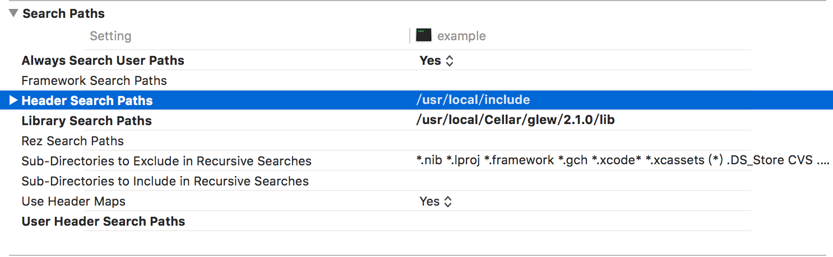
Build the first program
Always Search User Paths → Yes
Link the include and lib

Slide 14
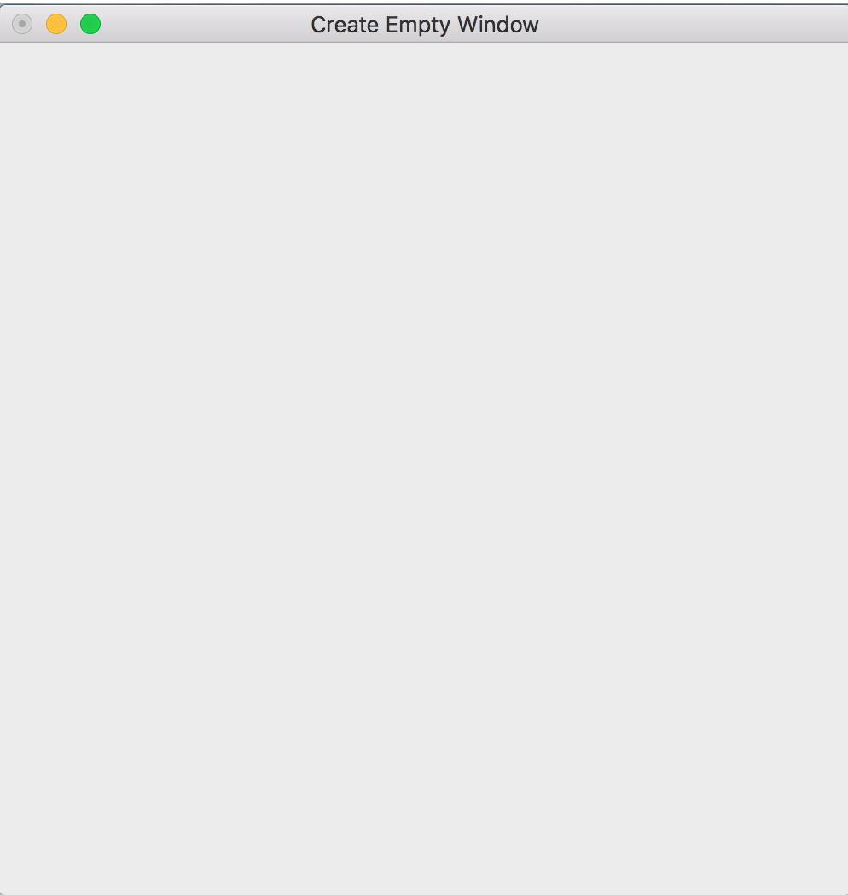
Code1
#include "GL/glew.h"
#include "OpenGL/OpenGL.h"
#include "GL/glut.h"
void
keyboard( unsigned char key, int x, int y )
{
switch ( key ) {
case 033:
exit( EXIT_SUCCESS );
break;
}
}
void display(void){}
int main (int argc,char **argv)
{
glutInit(&argc, argv);
glutInitDisplayMode(GLUT_DOUBLE|GLUT_RGB);
glutInitWindowSize(500,500);
glutInitWindowPosition(0, 0);
glutCreateWindow("Create Empty Window");
glewInit();
glutDisplayFunc(display);
glutKeyboardFunc( keyboard );
glutMainLoop();
return 0;
}

Slide 15
Code2
void display(void){
glClear(GL_COLOR_BUFFER_BIT);
glBegin(GL_TRIANGLES);
glColor3f(0.0, 0.0, 1.0);
glVertex3f(0.0, 1.0, 0.0);
glColor3f(0.0, 1.0, 0.0);
glVertex3f(-0.5, 0.0, 0.0);
glColor3f(1.0, 0.0, 0.0);
glVertex3f(0.5, 0.0, 0.0);
glEnd();
glutSwapBuffers();
}
#include "GL/glew.h"
#include "OpenGL/OpenGL.h"
#include "GL/glut.h”
void
keyboard( unsigned char key, int x, int y )
{
switch ( key ) {
case 033:
exit( EXIT_SUCCESS );
break;
}
}

Slide 16
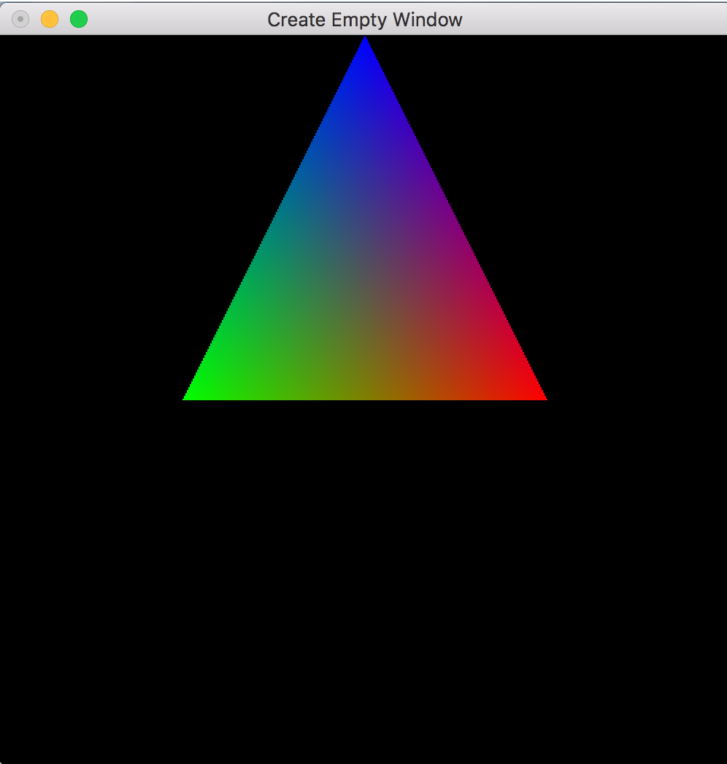
Code2
int main (int argc,char **argv)
{
glutInit(&argc, argv);
glutInitDisplayMode(GLUT_DOUBLE|GLUT_RGB);
glutInitWindowSize(500,500);
glutInitWindowPosition(0, 0);
glutCreateWindow("Create Empty Window");
glewInit();
glutDisplayFunc(display);
glutKeyboardFunc( keyboard );
glutMainLoop();
return 0;
}

Slide 17
Exercise
GL_POINTS
GL_LINES
GL_TRIANGLES
GL_TRIANGLE_FAN
GL_TRIANGLE_STRIP
Try it out with these difference settings in the example we have done previously

