Slide 1
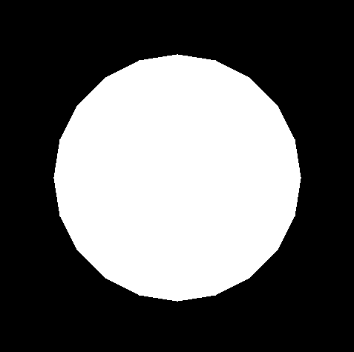
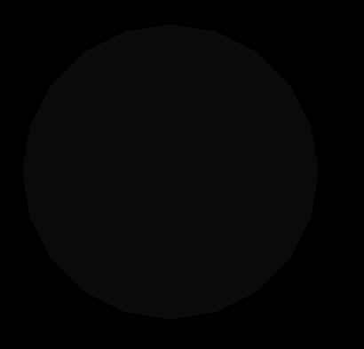
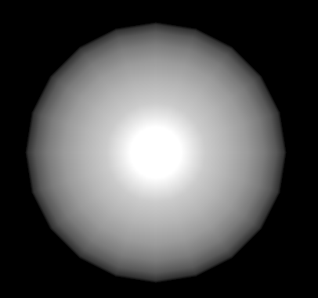
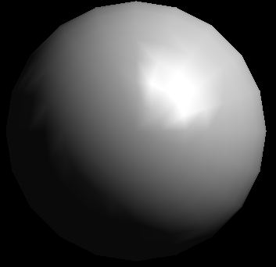
2. Sphere - Directional light
Directional light
File 6.2.1
A white sphere is shown in (a)
Enable:
glEnable(GL_LIGHTING);
Figure (b)
Enable:
glEnable(GL_LIGHTING);
glEnable(GL_LIGHT0);
Figure (c)
Enable:
glLightfv(GL_LIGHT0, GL_POSITION, light_position);
glEnable(GL_LIGHTING);
glEnable(GL_LIGHT0);
Figure (d)
(a): initial
(b): glEnable(GL_LIGHTING);
(c): glEnable(GL_LIGHTING);
glEnable(GL_LIGHT0);
(d): final

Slide 2
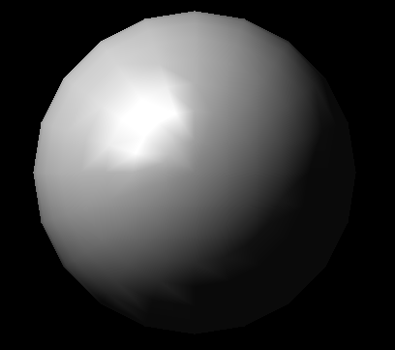
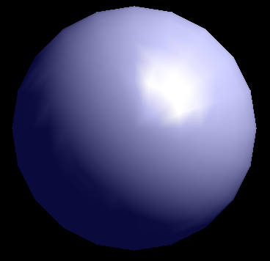
2. Sphere – Light control
File 6.2.2
Add the code:
GLfloat light_ambient[] = { 0.0, 0.0, 0.0, 1.0 };
GLfloat light_diffuse[] = { 1.0, 1.0, 1.0, 1.0 };
GLfloat light_specular[] = { 1.0, 1.0, 1.0, 1.0 };
GLfloat light_position[] = { 1.0, 1.0, 1.0, 0.0 };
glLightfv(GL_LIGHT0, GL_AMBIENT, light_ambient);
glLightfv(GL_LIGHT0, GL_DIFFUSE, light_diffuse);
glLightfv(GL_LIGHT0, GL_SPECULAR, light_specular);
glLightfv(GL_LIGHT0, GL_POSITION, light_position);
You can control the position of the light by:
GLfloat light_position[] = { 1.0, 1.0, 1.0, 0.0 };
Figure (a)
You can control the color of the light by:
GLfloat light_ambient[] = { 0.0, 0.0, 0.0, 1.0 };
Figure (b)
(a)
(b)

Slide 3
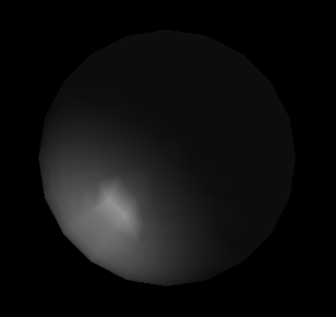
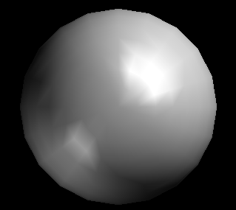
2. Sphere – Spot light
Spot light
File 6.2.3
With one light (directional light)
Figure (a)
With one light (spot light)
Figure (b)
With two light (directional light & spot light)
Figure (c)
(a)
(b)
(c)

Slide 4
2. Sphere – Spot light control
Try to change the value to see the differences:
GLfloat light1_ambient[] = { 0.2, 0.2, 0.2, 1.0 };
GLfloat light1_diffuse[] = { 1.0, 1.0, 1.0, 1.0 };
GLfloat light1_specular[] = { 1.0, 1.0, 1.0, 1.0 };
GLfloat light1_position[] = { -1.0, -1.0, 1.0, 1.0 };
GLfloat spot_direction[] = { 1.0, 1.0, -1.0 };
glLightf(GL_LIGHT1, GL_CONSTANT_ATTENUATION, 1.5);
glLightf(GL_LIGHT1, GL_LINEAR_ATTENUATION, 0.5);
glLightf(GL_LIGHT1, GL_QUADRATIC_ATTENUATION, 0.2);
glLightf(GL_LIGHT1, GL_SPOT_CUTOFF, 45.0);
glLightf(GL_LIGHT1, GL_SPOT_EXPONENT, 2.0);

Slide 5
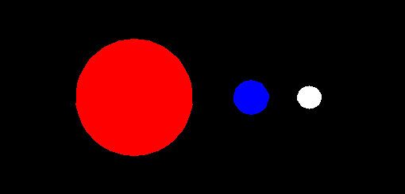
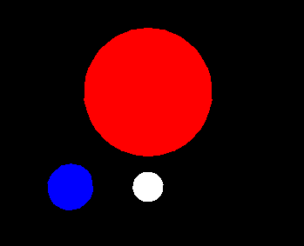
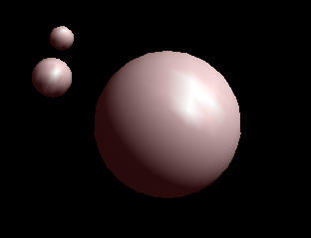
3. Solar system
Use: “Y, y”, “D, d”, “m” to control the system
Try:
glMaterialfv(GL_FRONT, GL_AMBIENT, mat_ambient);
glMaterialfv(GL_FRONT, GL_SPECULAR, mat_specular);
glMaterialfv(GL_FRONT, GL_SHININESS, mat_shininess);
glLightfv(GL_LIGHT0, GL_POSITION, light_position);
glLightfv(GL_LIGHT0, GL_AMBIENT, ambient);
glLightfv(GL_LIGHT0, GL_DIFFUSE, white_light);
glLightfv(GL_LIGHT0, GL_SPECULAR, white_light);

