Slide 1
Cryptography, Steganography, and Hashing
CYBR 1100 – Introduction to Information Security

Slide 2
Agenda
Explain the basics of encryption
Discuss modern cryptography methods
Select appropriate cryptography for your organization
Look at the role of hash functions
Explore steganography

Slide 3
Introduction
Encryption
Scrambling information.
One critical part to the security puzzle.
Without it, all security measures are inadequate.
Cryptography
An art form
Notes:
Encryption
The process to scramble a message or other information so that it cannot be easily read.
One of the most critical parts to the security puzzle.
Without it, all firewalls, IDSs, antivirus and antispyware software, policies, and so forth are inadequate.
Cryptography
The art of writing or deciphering secret code
Basic overview
This is a complex topic.
You get some idea of how it works and how to make intelligent decisions about it.

Slide 4
Cryptography Basics
Encryption
Algorithm scrambles plain
Sender and receiver agree on algorithm
Message difficult to re-create without protocol
Decryption
Reversal of the scrambling protocol
Notes:
Decryption
Reversal of the scrambling protocol to make the message comprehensible.
Encryption
Plain text is scrambled according to a particular algorithm, agreed upon beforehand by sender and receiver.
Without the correct protocol, the message is difficult to re-create.
Plain text – key – cipher text – key – plain text.

Slide 5
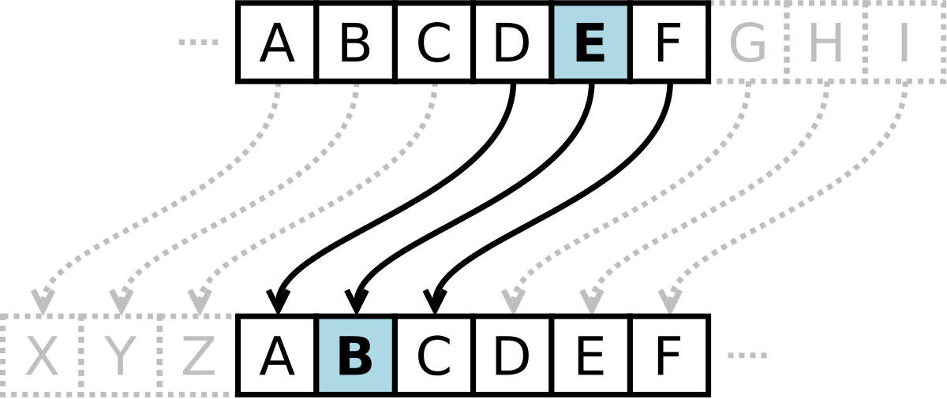
History of Encryption
Old as written communication and war
Caesar Cipher
Shift cipher
A DOG
Shift 1 – B EPH
Shift 2 – C FQI
Shift negative 1 – Z CNF
Frequency distribution cracks this simple cipher.
Substitution alphabet.
Substitutes one letter in the alphabet for another.
Caesar is a mono-alphabetic cipher.
Notes:
As old as written communication and war
Caesar Cipher
Shift cipher – You decide the number of letters you shift over.
A DOG
Shift 1 – B EPH
Shift 2 – C FQI
Shift negative 1 – Z CNF
The history of encryption and code is fascinating to read, but it is beyond the scope of this text. Check out the sites in the text or others on the web.

Slide 6
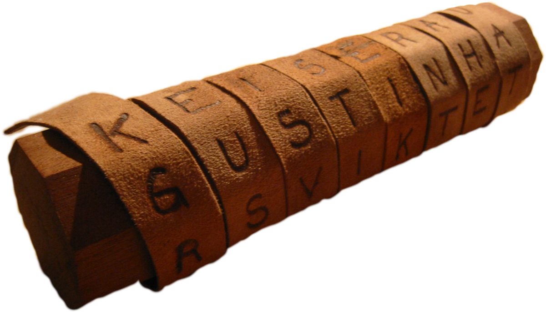
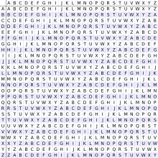
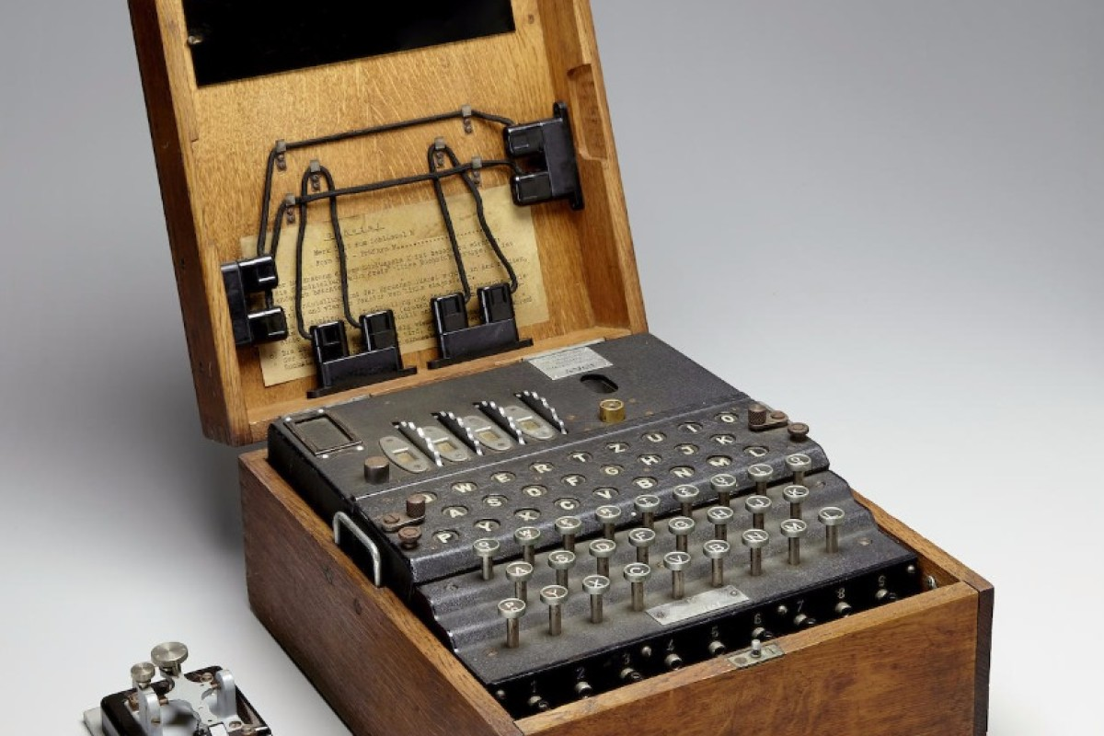
History of Encryption (cont.)
ATBASH
Rail Fence
Vigenere
Enigma
Notes:
Caesar Cipher
Frequency distribution will crack this simple cipher.
Most common letter in English is E and the most common three-letter word is THE.
Substitution alphabet
Substitutes one letter in the alphabet for another.
Caesar is a mono-alphabetic cipher, using only one alphabet.
ASIDE: Caesar needed to send messages to the far-flung posts at the ends of the Roman Empire. He would need security. He would write a message and then encrypt it with the now-famous Caesar 3 cipher. He would send for messengers. They would be extremely well paid, as they did not expect to return alive. Their heads would be shaved and the encrypted message tattooed on their heads. By the time they got to their destination, their hair had grown back and the message hidden. This is the first example we have of stenography. Also, they never saw the message and did not know what it was. After a successful mission and their heads were shaved, the message was decrypted. Because Caesar did not want the enemy to know how he used stenography or if they fell into enemy hands, we have the expression, “Kill the messenger.”

Slide 7

Enigma Explained

Slide 8
Binary Operations
Binary Operations
AND, OR, XOR
Example of AND operation
1 | 1 | 0 | 1
1 | 0 | 0 | 1
1 | 0 | 0 | 1
Notes:
Binary Operations
3 operations not found in decimal or base 10 math
In comparing binary numbers in the AND operation, compare them one place at a time. If both places have a 1 in them, the result is a 1. If one or both of them are a 0, the result is a 0.

Slide 9
Binary Operations
Example of OR operation
1 | 1 | 0 | 1
1 | 0 | 0 | 1
1 | 1 | 0 | 1
Notes:
Binary Operations
OR
In comparing binary numbers in the OR operation, compare them one place at a time. If one or both of them are a 1, the result is a 1. If not, the result is a 0.

Slide 10
Binary Operations
Example of XOR operation
1 | 1 | 0 | 1
1 | 0 | 0 | 1
0 | 1 | 0 | 0
Notes:
Binary Operations
In comparing binary numbers in the XOR operation, compare them one place at a time. If one of them, but NOT both of them, is a 1, the result is a 1. If not, the result is a 0.

Slide 11
Binary Operations
XOR only reversible binary operation
Convert plain text to ASCII
A DOG = 065 032 068 079 071
Then, convert ASCII to binary
0100 0001, 0100 0100, 0100 1111, 0100 0111
Notes:
XOR
The only reversible binary operation
First, convert plain text to ASCII
A DOG = 065 032 068 079 071
Then, convert ASCII to binary
0100 0001, 0100 0100, 0100 1111, 0100 0111

Slide 12
Binary Operations
XOR the ASCII
0100 0001, 0100 0100, 0100 1111, 0100 0111
1111 0111, 1111 0111, 1111 0111, 1111 0111
1011 0110, 1011 0011, 1011 1000, 1011 0000
Result is cipher text.
Notes:
Then, using any random, previously agreed upon string as the key, XOR the ASCII
0100 0001, 0100 0100, 0100 1111, 0100 0111
1111 0111, 1111 0111, 1111 0111, 1111 0111
1011 0110, 1011 0011, 1011 1000, 1011 0000
The result is the cipher text, which can be decrypted using the agreed upon key and the XOR operation, then converted back to ASCII
Uses single-key encryption
Both sender and receiver use the same key – weak
Uses mono-alphabetic substitution
Subject to frequency distribution attack – weak
Excellent introduction to contemporary encryption

Slide 13
Cryptography Terms
Key: The bits that are combined with the plain text to encrypt it. In some cases this is random numbers; in other cases it is the result of some mathematical operation.
Plain text: The unencrypted text.
Cipher text: The encrypted text.
Algorithm: A mathematical process for doing something.
Notes:
Then, using any random, previously agreed upon string as the key, XOR the ASCII
0100 0001, 0100 0100, 0100 1111, 0100 0111
1111 0111, 1111 0111, 1111 0111, 1111 0111
1011 0110, 1011 0011, 1011 1000, 1011 0000
The result is the cipher text, which can be decrypted using the agreed upon key and the XOR operation, then converted back to ASCII.
Uses single-key encryption
Both sender and receiver use the same key – weak
Uses mono-alphabetic substitution
Subject to frequency distribution attack – weak
Excellent introduction to contemporary encryption

Slide 14
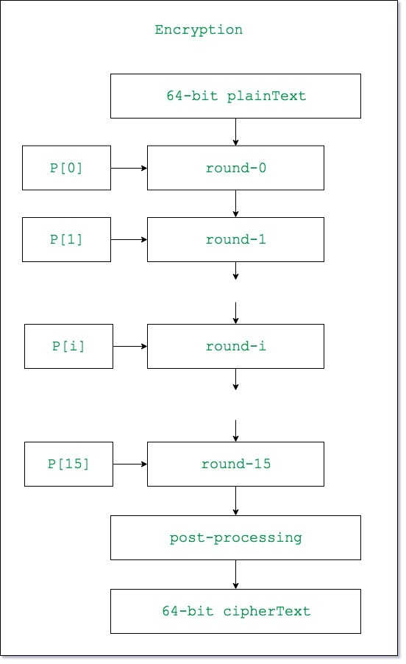
Modern Methods
Single key (symmetric) encryption
Same key to encrypt and decrypt
Blowfish
Symmetric block cipher
Works on “blocks” of letters
Uses variable length key (32–448 bits)
Freeware
Notes:
Single (symmetric) encryption
Uses the same key to encrypt and decrypt
Blowfish
Symmetric block cipher
Works on “blocks” of letters
Uses variable length key (32–448 bits)
Bruce Schneier – 1993
Freeware

Slide 15
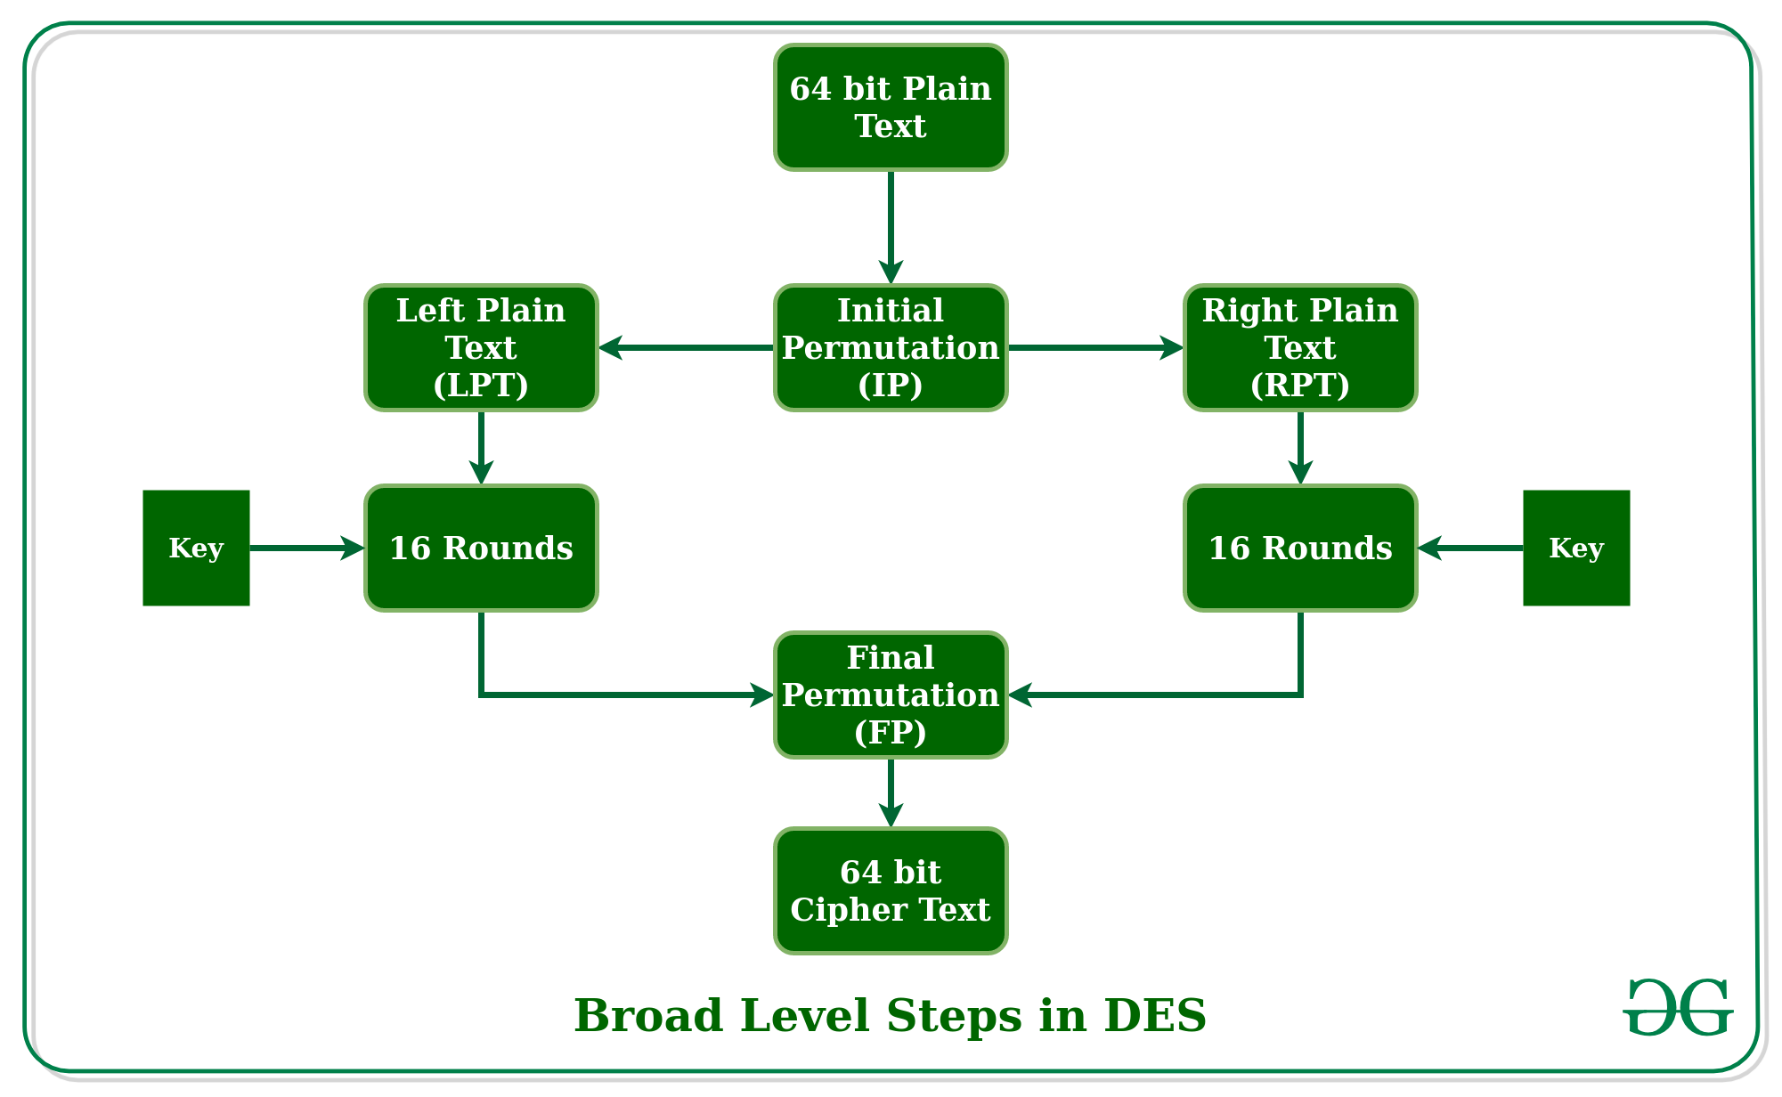
Modern Methods (cont.)
Data Encryption Standard (DES)
Divided into 64-bit blocks; then transposed
2. Manipulated by 16 steps of encryption, using 56-bit key
3. Scrambled by a swapping algorithm
4. Transposed one final time

Slide 16
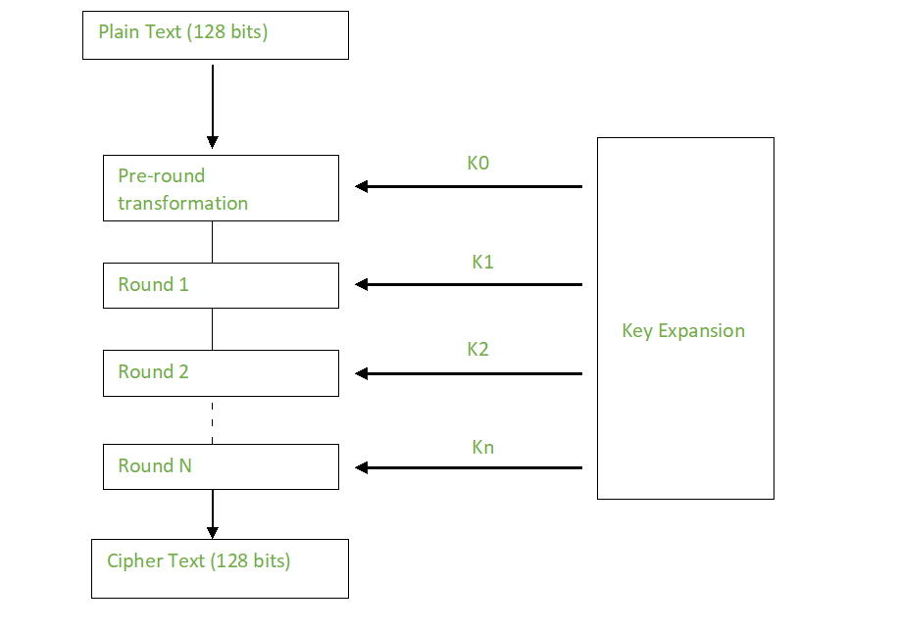
Modern Methods (cont.)
Advanced Encryption Standard (AES).
Advanced Encryption Standard was the algorithm eventually chosen to replace DES. It is a block cipher that works on 128-bit blocks. It can have one of three key sizes of 128, 192, or 256 bits. This was selected by the United States government to be the replacement for DES and is now the most widely used symmetric key algorithm.

Slide 17
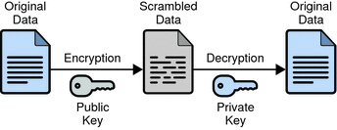
Modern Methods (cont.)
One major problem with symmetric key encryption
How do you transmit the symmetric key?
The answer: public key encryption

Slide 18
Modern Methods (cont.)
Public key (asymmetric) encryption
Opposite of single key encryption.
One key (public key) used to encrypt .
One key (private key) used to decrypt.
Only holder of a private key can decrypt messages.
Notes:
Public key (asymmetric) encryption
The opposite of single-key encryption.
One key (public key) is used to encrypt a message.
One key (private key) is used to decrypt a message.
Distribute public key, but only holder of private key can decrypt those messages.

Slide 19
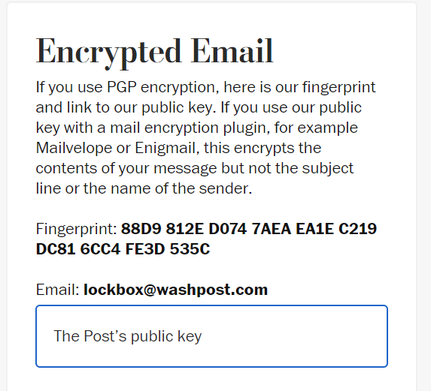
Modern Methods (cont.)
Public key (asymmetric) encryption
Depends on large prime numbers, factoring, and number theory.
Public key encryption is most widely used.
Pretty Good Privacy (PGP):
Freeware
Quite secure
Notes:
Public key (asymmetric) encryption
Public key algorithms depend on large prime numbers, factoring, and number theory.
The major issue with symmetric encryption is the distribution of keys, so public key encryption is the most widely used.
Loss of a key with symmetric encryption is a major problem because someone else could decrypt all the messages.
Not so with asymmetric encryption.

Slide 20

Modern Methods (cont.)
The MIT Distribution Center for PGP home page (http://web.mit.edu/network/pgp.html)

Slide 21
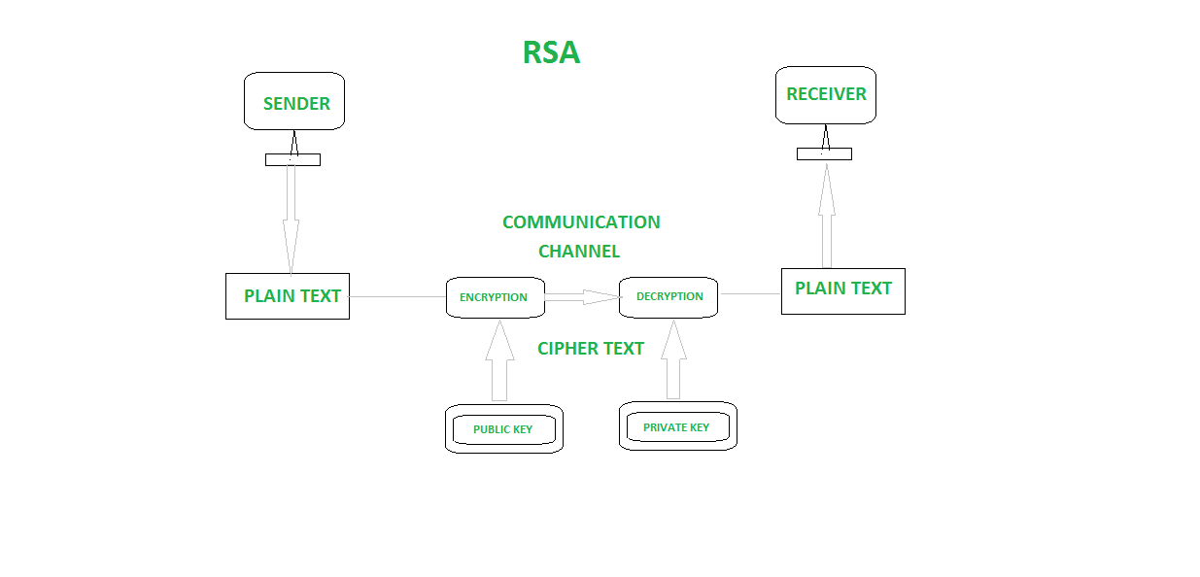
Modern Methods (cont.)

Slide 22
Modern Methods (cont.)
Public key (asymmetric) encryption
RSA
You start by generating two large random primes, p and q, of approximately equal size. Now you need to pick two numbers so that when multiplied together the product will be the size you want (that is, 128 bits, 256 bits, and so on).
Now multiply p and q to get n.
Let n = pq
Let m = (p - 1)(q – 1)
p | q | n | m
3 | 11 | 33 | 20

Slide 23
Modern Methods (cont.)
Public key (asymmetric) encryption
RSA
Now select another number; call this number e. Pick e so that it is co-prime to m.
Choose a small number e, co-prime to m.
You are almost done generating a key. Now you just find a number d that when multiplied by e and modulo m would yield a 1. (Note: Modulo means to divide two numbers and return the remainder. For example 8 modulo 3 would be 2.).
Find d, such that de % m = 1.
Now publish e and n as the public key. Keep d and n as the secret key. To encrypt, simply take your message raised to the e power and modulo n.
p | q | n | m | e | d
3 | 11 | 33 | 20 | 7 | 3

Slide 24
RSA Continued
Public key is (e, n) => (7, 33)
Private key is (d, n) => (3, 33)
The encryption of m = 2 is c = 2⁷ % 33 = 29
The decryption of c = 29 is m = 29³ % 33 = 2
p | q | n | m | e | d
3 | 11 | 33 | 20 | 7 | 3

Slide 25
Avoid ‘bad’ crypto
Unbreakable
Unhackable
Secret algorithm
Kerckhoff’s principle
“It must not require secrecy and must be able to fall into the hands of the enemy without harm.”
Notes:
This can be formally expressed as Kerckhoff’s principle. Auguste Kerckhoff first articulated this in the 1800s, stating that the security of a cipher depends only on the secrecy of the key, not the secrecy of the algorithm. Claude Shannon rephrased this stating that, “One ought to design systems under the assumption that the enemy will ultimately gain full familiarity with them.” This is referred to as Shannon's maxim and states essentially the same thing Kerckhoff’s principle states.

Slide 26
Digital Signatures
A digital signature is not used to ensure the confidentiality of a message, but rather to guarantee who sent the message. This is referred to as nonrepudiation.
Essentially, it proves who the sender is.
Digital signatures are actually rather simple, but clever.
They simply reverse the asymmetric encryption process.
Recall that in asymmetric encryption the public key (which anyone can have access to) is used to encrypt a message to the recipient, and the private key (which is kept secure and private) can decrypt it.
With a digital signature, the sender encrypts something with his private key.
If the recipient can decrypt that with the sender's public key, then it must have been sent by the person purported to have sent the message.

Slide 27
Hash
Hashing is a type of cryptographic algorithm that has some specific characteristics.
First and foremost it is one way.
That means you cannot "unhash" something.
The second characteristic is that you get a fixed-length output no matter what input is given.
Finally, it should have few or no collisions.
A collision is when two different inputs provide the same output.

Slide 28
Hash – cont.
MD5
SHA1
SHA2
SHA3

Slide 29
VERY Simple Illustration of Rainbow Tables
Password | MD5 Hash (in Hex)
aaaa | 74b87337454200d4d33f80c4663dc5e5
aaab | 4c189b020ceb022e0ecc42482802e2b8
aaac | 3963a2ba65ac8eb1c6e2140460031925
aaa1 | 39dc4f1ee693e5adabddd872247e451f
aaa2 | 0ad346c93c16e85e2cb117ff1fcfada3
aaa4 | ee93fca7c150d9c548aff721c87d0986
Password | MD5 Hash (in Hex)
aaaaa | 594f803b380a41396ed63dca39503542
aaabb | 120858a7016efcfab66967b834e9153c
aaacc | ee43671d755ac457cfe6e32d1894788e
aaa1a | 5bbac29650eb36b4de16885c190a9fa3
aaa2a | 597f0ce6d11567cc691b3f5df35594cb
aaa4a | 4305dc076b3ba2bf8d55524cddf5a72d

Slide 30
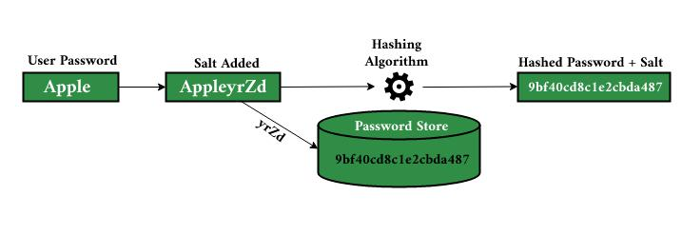
Hash - Salt
Random bits added to further secure encryption or hashing. Most often encountered with hashing, to prevent Rainbow Table attacks.
The ”salt” is added to a password each time
The salt is unique to each user and must be tracked with their hashed password.

Slide 31
Historical Steganography
The ancient Chinese wrapped notes in wax and swallowed them for transport.
In ancient Greece, a messenger’s head might be shaved, a message written on his head, then his hair was allowed to grow back.
In 1518 Johannes Trithmeus wrote a book on cryptography and described a technique where a message was hidden by having each letter taken as a word from a specific column.

Slide 32
Historical Steganography - Continued
During WW II the French Resistance sent messages written on the backs of couriers using invisible ink
Microdots are images/undeveloped film the size of a typewriter period, embedded on an innocuous documents. These were said to be used by spy's during the Cold War.

Slide 33
Steganography Terms
Payload is the data to be covertly communicated.
The carrier is the signal, stream, or data file into which the payload is hidden. This is also sometimes called the cover object.
The channel is the type of medium used.

Slide 34
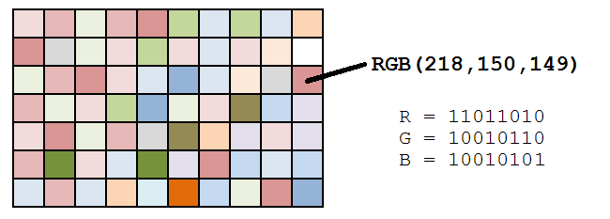
Steganography Example
A message like “attack” can be converted into binary:
01100001 01110100 01110100 01100001 01100011 01101011
An image has pixels with Red, Green, Blue channels
The text can be hidden in the Least Significant Bit (LSB) of the RGB channels of the pixels.
The image will look the same.

Slide 35
Steganalysis
Steganography is not the same as encryption.
The security relies on obscurity of the technique and the image itself.
Hash values of images can leave a clue that to visually similar images are actually different.

Slide 36
Cryptanalysis
Ciphertext Only Attack
Known plain text
Chosen plain text
Related Key

Slide 37
Summary
Encryption is a basic element of security.
Encrypting data when transmitting is an integral part of any security plan.

Slide 38
Announcements and Reminders
We have a final paper as part of the course.
Next week you will propose your topic for this paper
Think about what might be interested in studying further
Lab 7 – Hashing, Encryption, Steganography
Lab uses new Kali VM
Steganography project will give you passwords as you decode each file in order.
Weekly news note
Reading quiz

