Slide 1
Cryptography, Steganography, and Hashing
High School Visit

Slide 2
Introduction
Encryption
  Scrambling information.
  One critical part to the security puzzle.
  Without it, all security measures are inadequate.
Cryptography
  An art form
Notes:
Encryption
The process to scramble a message or other information so that it cannot be easily read.
One of the most critical parts to the security puzzle.
Without it, all firewalls, IDSs, antivirus and antispyware software, policies, and so forth are inadequate.
Cryptography
The art of writing or deciphering secret code
Basic overview
This is a complex topic.
You get some idea of how it works and how to make intelligent decisions about it.

Slide 3
Cryptography Basics
Encryption
  Algorithm scrambles plain
  Sender and receiver agree on algorithm
  Message difficult to re-create without protocol
Decryption
  Reversal of the scrambling protocol
Notes:
Decryption
Reversal of the scrambling protocol to make the message comprehensible.
Encryption
Plain text is scrambled according to a particular algorithm, agreed upon beforehand by sender and receiver.
Without the correct protocol, the message is difficult to re-create.
Plain text – key – cipher text – key – plain text.

Slide 4
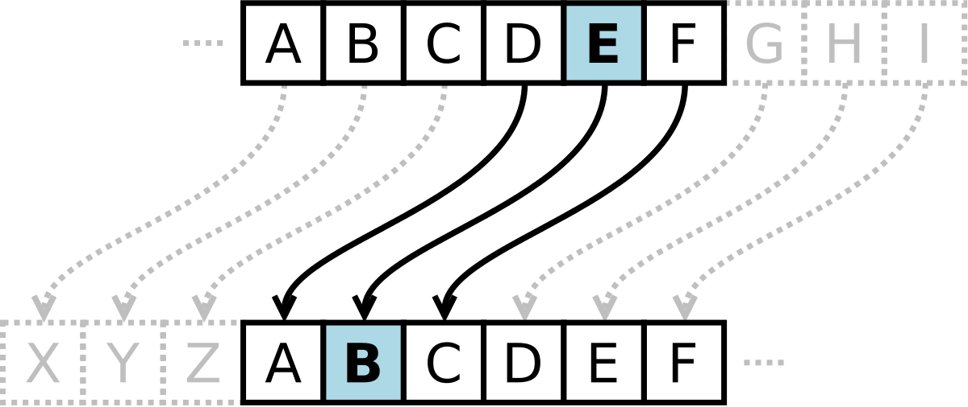
History of Encryption
Old as written communication and war
Caesar Cipher
  Shift cipher
    A DOG
      Shift 1 – B EPH
      Shift 2 – C FQI
      Shift negative 1 – Z CNF
  Frequency distribution cracks this simple cipher.
  Substitution alphabet.
    Substitutes one letter in the alphabet for another.
    Caesar is a mono-alphabetic cipher.
Notes:
As old as written communication and war
Caesar Cipher
Shift cipher – You decide the number of letters you shift over.
A DOG
Shift 1 – B EPH
Shift 2 – C FQI
Shift negative 1 – Z CNF
The history of encryption and code is fascinating to read, but it is beyond the scope of this text. Check out the sites in the text or others on the web.

Slide 5
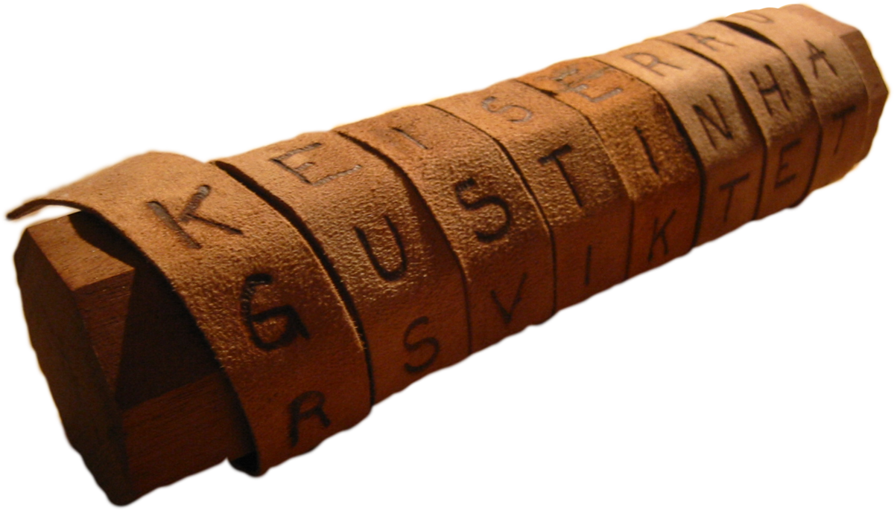
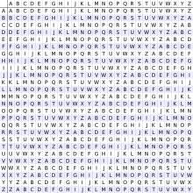
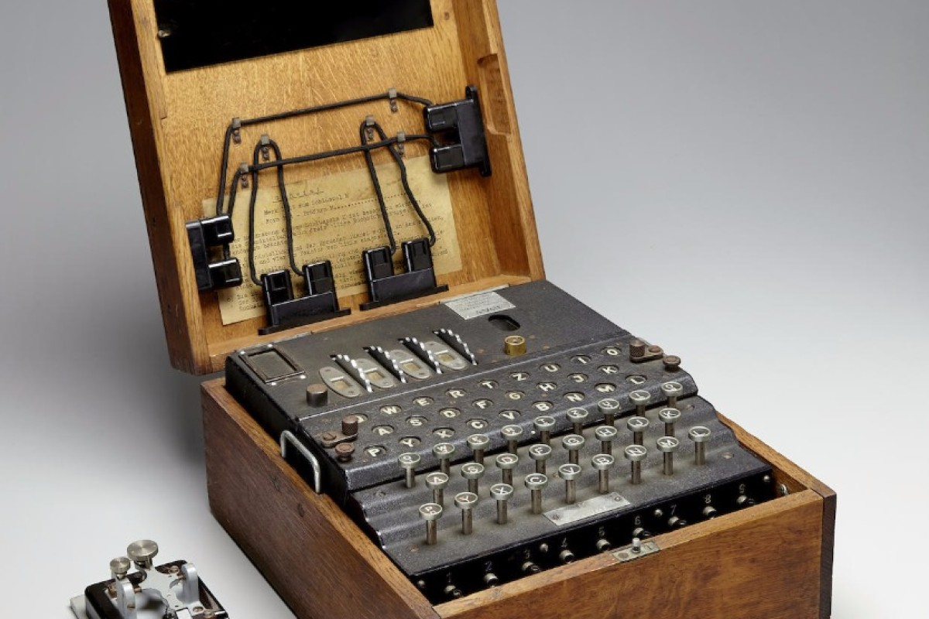
History of Encryption (cont.)
ATBASH
Rail Fence
Vigenere
Enigma
Notes:
Caesar Cipher
Frequency distribution will crack this simple cipher.
Most common letter in English is E and the most common three-letter word is THE.
Substitution alphabet
Substitutes one letter in the alphabet for another.
Caesar is a mono-alphabetic cipher, using only one alphabet.
ASIDE: Caesar needed to send messages to the far-flung posts at the ends of the Roman Empire. He would need security. He would write a message and then encrypt it with the now-famous Caesar 3 cipher. He would send for messengers. They would be extremely well paid, as they did not expect to return alive. Their heads would be shaved and the encrypted message tattooed on their heads. By the time they got to their destination, their hair had grown back and the message hidden. This is the first example we have of stenography. Also, they never saw the message and did not know what it was. After a successful mission and their heads were shaved, the message was decrypted. Because Caesar did not want the enemy to know how he used stenography or if they fell into enemy hands, we have the expression, “Kill the messenger.”

Slide 6
Binary Operations
Binary Operations
  AND, OR, XOR
Example of AND operation
1 | 1 | 0 | 1
1 | 0 | 0 | 1
1 | 0 | 0 | 1
Notes:
Binary Operations
3 operations not found in decimal or base 10 math
In comparing binary numbers in the AND operation, compare them one place at a time. If both places have a 1 in them, the result is a 1. If one or both of them are a 0, the result is a 0.

Slide 7
Binary Operations
Example of OR operation
1 | 1 | 0 | 1
1 | 0 | 0 | 1
1 | 1 | 0 | 1
Notes:
Binary Operations
OR
In comparing binary numbers in the OR operation, compare them one place at a time. If one or both of them are a 1, the result is a 1. If not, the result is a 0.

Slide 8
Binary Operations
Example of XOR operation
1 | 1 | 0 | 1
1 | 0 | 0 | 1
0 | 1 | 0 | 0
Notes:
Binary Operations
In comparing binary numbers in the XOR operation, compare them one place at a time. If one of them, but NOT both of them, is a 1, the result is a 1. If not, the result is a 0.

Slide 9
Binary Operations
XOR only reversible binary operation
  Convert plain text to ASCII
    A DOG = 065 032 068 079 071
  Then, convert ASCII to binary
    0100 0001, 0100 0100, 0100 1111, 0100 0111
Notes:
XOR
The only reversible binary operation
First, convert plain text to ASCII
A DOG = 065 032 068 079 071
Then, convert ASCII to binary
0100 0001, 0100 0100, 0100 1111, 0100 0111

Slide 10
Binary Operations
XOR the ASCII
    0100 0001, 0100 0100, 0100 1111, 0100 0111
    1111 0111, 1111 0111, 1111 0111, 1111 0111
    1011 0110, 1011 0011, 1011 1000, 1011 0000
Result is cipher text.
Notes:
Then, using any random, previously agreed upon string as the key, XOR the ASCII
0100 0001, 0100 0100, 0100 1111, 0100 0111
1111 0111, 1111 0111, 1111 0111, 1111 0111
1011 0110, 1011 0011, 1011 1000, 1011 0000
The result is the cipher text, which can be decrypted using the agreed upon key and the XOR operation, then converted back to ASCII
Uses single-key encryption
Both sender and receiver use the same key – weak
Uses mono-alphabetic substitution
Subject to frequency distribution attack – weak
Excellent introduction to contemporary encryption

Slide 11
Cryptography Terms
Key: The bits that are combined with the plain text to encrypt it. In some cases this is random numbers; in other cases it is the result of some mathematical operation.
Plain text: The unencrypted text.
Cipher text: The encrypted text.
Algorithm: A mathematical process for doing something.
Notes:
Then, using any random, previously agreed upon string as the key, XOR the ASCII
0100 0001, 0100 0100, 0100 1111, 0100 0111
1111 0111, 1111 0111, 1111 0111, 1111 0111
1011 0110, 1011 0011, 1011 1000, 1011 0000
The result is the cipher text, which can be decrypted using the agreed upon key and the XOR operation, then converted back to ASCII.
Uses single-key encryption
Both sender and receiver use the same key – weak
Uses mono-alphabetic substitution
Subject to frequency distribution attack – weak
Excellent introduction to contemporary encryption

Slide 12
Hash
Hashing is a type of cryptographic algorithm that has some specific characteristics.
First and foremost it is one way.
  That means you cannot "unhash" something.
The second characteristic is that you get a fixed-length output no matter what input is given.
Finally, it should have few or no collisions.
  A collision is when two different inputs provide the same output.

Slide 13
Hash – cont.
MD5
SHA1
SHA2
SHA3

Slide 14
VERY Simple Illustration of Rainbow Tables
Password | MD5 Hash (in Hex)
aaaa | 74b87337454200d4d33f80c4663dc5e5
aaab | 4c189b020ceb022e0ecc42482802e2b8
aaac | 3963a2ba65ac8eb1c6e2140460031925
aaa1 | 39dc4f1ee693e5adabddd872247e451f
aaa2 | 0ad346c93c16e85e2cb117ff1fcfada3
aaa4 | ee93fca7c150d9c548aff721c87d0986
Password | MD5 Hash (in Hex)
aaaaa | 594f803b380a41396ed63dca39503542
aaabb | 120858a7016efcfab66967b834e9153c
aaacc | ee43671d755ac457cfe6e32d1894788e
aaa1a | 5bbac29650eb36b4de16885c190a9fa3
aaa2a | 597f0ce6d11567cc691b3f5df35594cb
aaa4a | 4305dc076b3ba2bf8d55524cddf5a72d

Slide 15
Historical Steganography
The ancient Chinese wrapped notes in wax and swallowed them for transport.
In ancient Greece, a messenger’s head might be shaved, a message written on his head, then his hair was allowed to grow back.
In 1518 Johannes Trithmeus wrote a book on cryptography and described a technique where a message was hidden by having each letter taken as a word from a specific column.

Slide 16
Historical Steganography - Continued
During WW II the French Resistance sent messages written on the backs of couriers using invisible ink
Microdots are images/undeveloped film the size of a typewriter period, embedded on an innocuous documents. These were said to be used by spy's during the Cold War.

Slide 17
Steganography Terms
Payload is the data to be covertly communicated.
The carrier is the signal, stream, or data file into which the payload is hidden. This is also sometimes called the cover object.
The channel is the type of medium used.

Slide 18
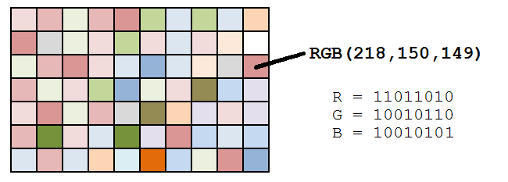
Steganography Example
A message like “attack” can be converted into binary:
  01100001 01110100 01110100 01100001 01100011 01101011
An image has pixels with Red, Green, Blue channels
The text can be hidden in the Least Significant Bit (LSB) of the RGB channels of the pixels.
The image will look the same.

Slide 19
Steganalysis
Steganography is not the same as encryption.
The security relies on obscurity of the technique and the image itself.
Hash values of images can leave a clue that to visually similar images are actually different.

