Slide 1
long flow
Multi-Bottleneck Fairness on RDMA Fabrics:
An Empirical Study
RDMA-RCP — an RCP service mode over INT: one fair-rate field, one scalar per port
Haoyu Wang ¹ · Bo Sheng ¹ · Zerin Shaima Meem ² · Xiaoqian Zhang ²
¹ University of Massachusetts Boston ² University of Nebraska Omaha
45th IEEE IPCCC · Austin, Texas · November 2026
Notes:
Thank you. This talk is about a fairness blind spot in HPCC — the SIGCOMM'19 INT-based congestion control — and a deliberately minimal switch-side alternative: an operating mode that coexists with stock HPCC on the same fabric. The one-line story: a flow crossing several bottlenecks gets half its fair share, no sender-side correction we tried can close the gap, and one fair-rate scalar per switch port — offered as a per-class mode, not a replacement — closes it completely.

Slide 2
BACKGROUND
HPCC in 60 seconds: precision congestion control
1
Switch stamps raw per-hop state into INT
tx bytes, queue length, link rate — stateless per flow
the INT header
hop 1: tx, qlen, rate
2
Sender computes exact utilization U
multiplicative update toward target η = 95%
hop 2: tx, qlen, rate
hop 3: tx, qlen, rate
3
Near-zero queues, top-tier FCT
beats DCQCN / TIMELY / DCTCP on single-bottleneck benchmarks
… up to maxHop = 5
8 bytes per hop — the record grows with path length
The catch: the sender sees load, not its fair share.
Notes:
Quick recap of HPCC for those who haven't seen it: switches stamp raw telemetry into every packet, the sender computes a precise utilization estimate and drives it to 95%. It is excellent on the benchmarks it was designed for. Keep one detail in mind: the INT record is per-hop — 8 bytes per switch, capped at 5 hops — and it carries load, not entitlement.

Slide 3
MOTIVATION
Modern traffic crosses many contended links in series
Cross-pod ML
allreduce spans aggregation + core layers
Disaggregation
memory / storage traffic transits multiple fabrics
Multi-tenancy
shared links at every tier of the DC
Does HPCC still deliver fair service when a flow crosses
multiple bottlenecks — not just one?
Nobody had measured it carefully. We did — deterministically, against a max-min oracle.
Notes:
Why care about multi-bottleneck paths? Three growing traffic classes cross several contended links in series. HPCC's evaluation — like most DC transport work — is single-bottleneck-centric. So the question of this paper is simply: does the fairness survive? Our methodology is deterministic simulation scored against a fluid max-min oracle, so every number you'll see is exactly reproducible.

Slide 4
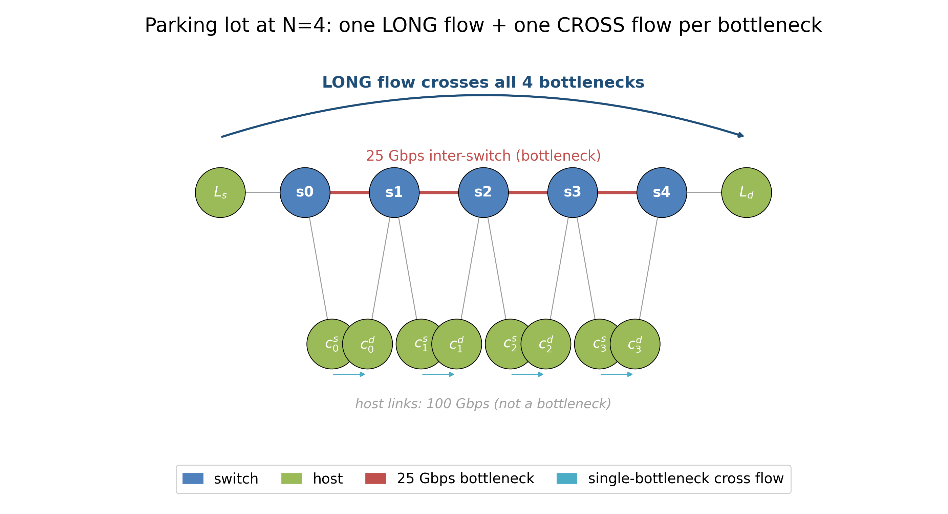
METHODOLOGY
The parking lot, scored against a max-min oracle
Setup
N bottlenecks, 25 Gbps each. One long flow crosses all N; one cross flow per link.
Fair answer
Every flow gets 12.5 Gbps (progressive filling, recomputed as flows finish).
Metric
unfairness = long FCT / mean short FCT. Oracle = 1.0
Deterministic: every configuration reproduces byte-identical artifacts.
Notes:
The classic parking lot: a long flow crosses every bottleneck, one cross flow per link. Because every link is equally contended, max-min says everyone gets the same 12.5 Gbps — so any gap between the long flow and the cross flows is pure multi-bottleneck unfairness. We score against an event-driven progressive-filling oracle, and everything is deterministic.

Slide 5
FINDING 1
The long flow is starved ≈ 2× — and it's structural
1.96×
penalty at N = 4
3.5×
when the long flow is small (RPC-scale)
N ≥ 5
breaks outright: INT maxHop overflow
unfairness ratio — max-min oracle = 1.0
Notes:
The finding: stock HPCC starves the long flow by roughly 2x at N=2 through 4, and the effect grows. HPCC's own multi-rate mode helps but doesn't fix it. It's worse — 3.5x — exactly where it hurts most: small, latency-sensitive flows. And past four bottlenecks the per-hop INT record overflows its hop cap and the control input is corrupted outright. Also robust: asymmetric sizes, staggered starts, and RTT equalization don't move it — this is not RTT unfairness.

Slide 6
FINDING 2
Winner-take-all — and nothing is ‘wrong’
Zero PFC. Zero loss.
No pathology to point at — every link is at target utilization η.
The unfair allocation is the control law's equilibrium.
At each shared link the local single-bottleneck flow wins; the long flow is squeezed at all of them.
stock HPCC, N = 4, first 18 ms — fair share is 12.5 Gbps for everyone
Notes:
Here's what it looks like inside: four cross flows sit at 23 Gbps each while the long flow is pinned at 0.4 — for the entire contention window. The crucial observation: nothing is broken. No PFC, no loss, links at target utilization. The starvation IS the equilibrium of the control law. That reframes the problem: you can't patch a symptom; you have to change what information the control loop has.

Slide 7
NEGATIVE RESULT
Six sender-only designs — none gets close
sender-side variant (mb_mode) | idea | best penalty @ N=4
k-aware additive increase | scale AI by congested-hop count | 1.63×
debiased max/mean blend | soften the max-hop bias | 1.95×
responsibility-weighted MD | MD scaled by own share | 1.89×
k-th-root MD | split the decrease across hops | 1.92×
global share-aware AI | AI boosted by (1 − share) | 1.71×
Each variant is a 1–2 line change in HPCC’s update (mb_mode 0 stays byte-identical to stock) — the target is 1.0×.
Notes:
Our first instinct — and probably yours — was to fix this at the sender, keeping HPCC's stateless-switch story intact. We built five heuristic variants spanning the design space — best case 1.63, target 1.0 — and then the strongest possible sender design: a full mirror of the RCP recursion, run privately per hop from the same INT-visible inputs the switch would use. The mirror still fails: 1.56 even with synchronized starts, 1.65 or 0.81 under staggered arrival — the direction of unfairness set by arrival order — while the identical law at the switch holds 1.0. That is the next slide's story.

Slide 8
WHY
Where the rate state lives: what the RCP mirror proves
1 · The η-hold equilibrium
2 · Private estimates never agree
Links settle at target utilization → HPCC’s multiplicative term ≈ 1.
Every flow holds whatever rate it grabbed at startup. Additive nudges need ~10⁴ RTTs to redistribute.
RCP’s inputs (C, y, q) ARE in INT. A sender-side RCP mirror (mb_mode 6) still fails: 1.56× synced, 1.65×/0.81× staggered — direction set by arrival order.
Private copies of the explicit-rate recursion preserve arrival-history asymmetry; ONE shared per-link register erases it. Per-flow fair queueing: 1.97× windowed, equal-but-idle (13× oracle FCT) windowless.
A shared per-port register carries the history a private copy cannot replicate. That is why it belongs at the switch.
Notes:
Two reasons. First, at eta-hold, HPCC's multiplicative machinery goes idle — everyone holds what they grabbed. Second — and this is the paper's sharpest experiment — the obstacle is NOT information. RCP's inputs are all sender-visible in INT, so we ran the most direct sender design: a private per-hop RCP mirror. Same law, same inputs, same gains. It still fails, and the direction of unfairness flips with arrival order — because independently maintained rate state preserves arrival-history asymmetry forever, while a shared register erases it. Per-flow fair queueing sharpens it: windowed senders leave 1.97 times; remove the window and DRR equalizes — but at thirteen times every flow's oracle completion time, equal but idle. Scheduling enforces equality; the max-min allocation — equal shares at full utilization — also needs a rate signal telling senders how much to offer. That is the corrected placement result, and it is why the rate belongs in the switch.

Slide 9
THE ALTERNATIVE, PART 1
RCP: the link advertises one fair rate to every flow
R ← R · (1 + (α·(C − y) − β·q/d) / C)
α·(C − y)
chases spare capacity — link under-full ⇒ R rises
β·q/d
brakes on backlog — queue forms ⇒ R falls
fixed point
y = C, q = 0 ⇒ N·R = C ⇒ R = C/N
The link converges to the max-min share without ever counting flows — N is implicit in the observed load y.
Notes:
RCP in one equation. Each link keeps a single rate R — the rate every flow crossing it should send at. Alpha chases spare capacity upward, beta brakes on queue. Those balance only when the link is exactly full with no standing queue — which with N flows each sending R means N times R equals C. So R converges to C over N without the switch ever counting flows: N is implicit in the load. This is exactly the missing ingredient from the previous slide, computed exactly where it's observable.

Slide 10
THE ALTERNATIVE, PART 2
Worked example: path-min gives network-wide max-min
long flow ℓ
S1
S2
ℓ dst
L1 (100G): ℓ, a, b → 3 flows
R₁ settles at C/3 = 33.3 G
L2 (100G): ℓ (capped 33.3) + c
R₂ rises until full: 66.7 G
a, b
c
ℓ pkt: fairRate 0 → 33.3 → min(33.3,66.7) = 33.3
ℓ = a = b = 33.3
c = 66.7
Exactly the max-min allocation — both links 100% full, no per-flow state anywhere.
Notes:
A worked example with asymmetric contention. Link 1 carries three flows, so its RCP loop settles at a third of capacity. On link 2, the long flow arrives already capped at 33 — it offers less load, so R2 keeps rising until the link fills at 66.7 for the local cross flow. The packet picks up the minimum along its path. Result: exactly max-min — the long flow equalized where it's tightest, and the slack it can't use is automatically handed to c. No switch counted flows; no switch kept per-flow state.

Slide 11
RDMA-RCP
The whole mechanism: three small pieces
Switch
Wire
Sender
one scalar fair rate per egress port
RCP update once per control interval (≈ RTT)
state: 3 numbers — no per-flow data
new INT mode: one 64-bit fairRate field
8 B / packet, independent of hop count
each hop min-aggregates; receiver echoes
new ACK handler: rate ← path-min fairRate
clamped to [minRate, NIC]
rate-only: per-flow window cap off
stock HPCC (cc_mode 3): byte-for-byte unchanged
an operating mode selected per traffic class — not a replacement
Notes:
The full mechanism fits on one slide, and that's the point. Per egress port: one fair-rate scalar updated by the RCP rule. On the wire: a new INT mode carrying a single 64-bit field, min-aggregated hop by hop — 8 bytes per packet regardless of path length, versus 8 bytes per hop for stock HPCC. At the sender: one new ACK handler that adopts the path minimum. Two honest notes: FS mode runs rate-only — the per-flow window cap is off, and we'll show that's necessary, not incidental — and the stock code path is untouched, byte for byte.

Slide 12
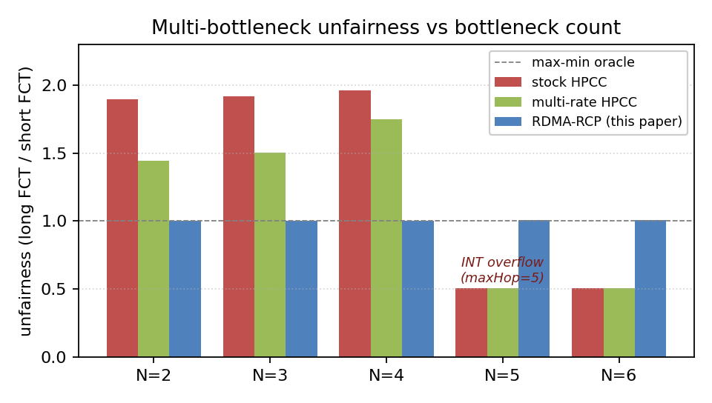
RESULTS
Flat at 1.0 across the whole sweep — zero PFC
1.005×
penalty at N = 4 (was 1.96×)
1.003–1.007×
across N = 2…6, incl. the overflow regime
0 PFC
every workload, every N
HPCC-PINT (compressed INT) still shows 1.77–1.88× — a smaller footprint is not the fix; a fair-share signal is.
Notes:
The headline — and it is not just HPCC: on the same benchmark DCQCN runs 1.7 to 2.3, TIMELY 1.8 to 2.0, DCTCP 1.6 to 1.8, all growing with N. Multi-bottleneck unfairness is endemic to deployable RDMA CC. Blue bars: RDMA-RCP sits at 1.003 to 1.007 across the entire sweep — including N of 5 and 6 where stock HPCC's wire format breaks, because one field doesn't grow with path length. Zero PFC everywhere. And an important control: HPCC-PINT, which also carries a single compressed field but still carries *load*, stays at 1.8x — so it's not about telemetry size, it's about carrying a fair share instead of a load sample.

Slide 13
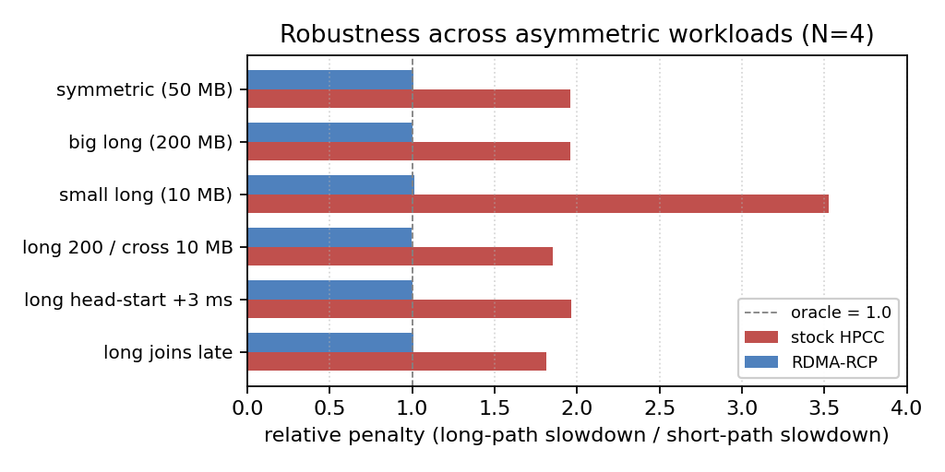
RESULTS
It generalizes — and holds under asymmetry
topology | stock | RDMA-RCP
3-tier tree fabric | 1.36× | 1.003×
k=4 ECMP fat-tree † | 1.34× | 1.001×
parking lot N=5,6 | breaks | 1.006–1.007×
† oracle-normalized (removes ECMP placement luck). Across 5 hash seeds the raw ratio is placement-dominated; RDMA-RCP ≤ stock at 4 of 5 seeds (the 5th is uncontended).
six asymmetric-size / staggered-start variants at N = 4: RDMA-RCP within 1.0 ± 0.012 (worst stock case 3.53× → 1.012×); start-jitter ensembles: stock 1.96–1.99×, RDMA-RCP 1.008–1.017×
Notes:
Robustness and generalization. Left: six perturbations — asymmetric sizes, staggered starts, including the 3.5x small-flow worst case — RDMA-RCP stays within about one percent of the oracle. Right: a 3-tier tree and a k=4 ECMP fat-tree, where the oracle-normalized penalty lands at 1.001; the path-min aggregation is inherently path-invariant, so ECMP needed no design work. Zero PFC across all of it.

Slide 14
RESULTS
The job is gated by its slowest flow: −18–23% JCT
−18–23%
JCT, every seed tested — −18% with the INT header padded to stock size
17.9–18.0 ms
FS JCT is placement-invariant (stock 22.3–23.3)
~3× faster
short background flows in this mix — max-min removes the placement lottery
16-flow ring allreduce, k=4 fat-tree — JCT = slowest flow (ms), 5 ECMP hash seeds
Notes:
So what does fairness buy on a workload operators care about? Collective communication: an allreduce step finishes when its slowest flow finishes, and the slowest flows are exactly the cross-pod multi-bottleneck ones stock HPCC starves. A 16-flow ring coflow — one phase of a ring allreduce — across five ECMP hash seeds: RDMA-RCP cuts completion time 18 to 23 percent at every seed tested, and 18 percent survives padding the INT header to stock size, so the gain is fairness, not header thinness. On a saturating k-equals-6 fabric with 108 inter-pod flows, makespan improves 16 percent. And the short background flows got three times faster — under near-winner-take-all dynamics, a short flow's fate is a placement lottery; max-min removes it.

Slide 15
IS IT A TRICK?
Ablation, sensitivity, and HPCC’s home turf
Rate-only is necessary
Re-enable the per-flow window cap → 1.5–2.5×, worse with path length.
var_win sizes the window from NIC line rate, not the path — the long flow gets window-bound below fair.
Parameters not load-bearing
RCP defaults α = 0.4, β = 0.226 — untuned.
Sweeping α, β, startup fraction, minRate one-at-a-time: penalty stays 1.004–1.008×, PFC = 0 throughout.
Home turf: not a trade-off
Single-bottleneck incast, 8 Gbps startup:
mean FCT 242 vs 259 μs
peak queue 38 vs 143 KB
beats HPCC’s FCT at ¼ the queue — fairness headline unchanged.
Everything regenerates deterministically from the artifact — figures and tables are built from live runs.
Notes:
Three defensibility checks. One: disabling the window is necessary, not a convenience — put it back and the penalty returns, growing with path length, because HPCC's window is sized for the NIC, not the path. Two: we did not tune RCP — the textbook defaults, and one-at-a-time sweeps barely move the result. Three: the cost question — on HPCC's home turf, a single-bottleneck incast, a moderate startup rate makes RDMA-RCP match or beat HPCC's FCT while holding a quarter of the queue. On what we measured, the fairness mode is not a trade-off.

Slide 16
POSITIONING
What this is — and what it isn’t
1
The mechanism is RCP; RDMA-RCP is a mode, not a repair. We claim the measurement and the placement. Coexistence needs sliced telemetry: even a 50/50 DWRR reservation cannot help a class whose controller reads port-global signals.
2
Simulation-only, three topology families. No testbed; no head-to-head with Bolt / PowerTCP (would require re-implementing them). The simulator re-port reproduces the original HPCC baselines end-to-end.
3
Convergence is sub-ms, not one RTT. Within 5% of fair share in ~0.6 ms (~30 RTTs); path-length-independent.
Future: a hybrid overlay — rate = min(rate_HPCC, fairRate) — keep HPCC’s precision and the fairness; needs a path-aware window.
Notes:
We are deliberately explicit about scope. The mechanism is RCP — our contribution is showing where the fix has to live and that placing it there is cheap. The evaluation is simulation-only; we re-ported the HPCC simulator onto modern ns-3 and verified it reproduces the original paper's baselines before building on it. Convergence is milliseconds, not one round trip. And the natural next step is a hybrid that keeps HPCC's per-flow precision under a fair-rate ceiling — the obstacle is HPCC's NIC-sized window, which is its own interesting problem.

Slide 17
CONCLUSION
One field, one scalar — a coexisting fairness mode
Diagnosis
HPCC starves multi-bottleneck flows ~2× (3.5× small flows); breaks past 4 hops. Zero PFC — it’s the equilibrium.
Negative result
Six sender-only designs fail — incl. a full RCP mirror. Per-flow FQ equalizes only what senders offer: 1.97× windowed, equal-but-idle windowless.
RDMA-RCP
A fabric/slice mode alongside HPCC: 1.005×, flows within 5–13% of oracle (hetero cases), zero PFC, −18–23% coflow JCT. Q16 fixed-point verified; high fan-in needs a longer control interval.
Artifact (code · paper · reproduction · data): github.com/UNOCourseDemo/hpcc-fs
Thank you — questions?
Notes:
To close: a real, robust fairness failure in the state of the art; evidence that the endpoint can't fix it because the endpoint can't see the flow count; and a deliberately minimal switch mode — one field, one scalar — that lands within about one percent of the max-min oracle with zero PFC, leaving stock HPCC byte-for-byte intact. One caveat we measured and report: on an unreserved shared queue the two modes do not each get a fair share, and even a weighted-DRR reservation cannot fix it — both controllers still read port-global telemetry. Coexistence needs sliced signals or a separate fabric. Everything is in the artifact, including a full reproduction of the original HPCC baselines. Happy to take questions.

Slide 18
BACKUP
The re-ported simulator reproduces SIGCOMM ’19
short-flow p99 slowdown | HPCC | DCQCN | TIMELY | DCTCP | PINT
WebSearch 50% load | 1.9 | 13.7 | 18.3 | 5.7 | 2.1
FB-Hadoop 70% load | 6.1 | 30.6 | 221.9 | 8.4 | 5.0
PFC events (fb 70%) | 0 | 0 | 1.12 M | 0 | 0
5 schemes × 2 workloads × 3 loads on a 376-node fat-tree (320 servers, 100 G NICs).
All of the paper’s signatures reproduce: HPCC’s short-flow tail far below DCQCN/TIMELY, sub-MB queues, zero PFC; TIMELY’s PFC explosion at load; DCTCP intermediate. Along the way we found and fixed a latent uninitialized-member bug (Node::m_node_type) exposed only at scale.
Notes:
Backup: if asked whether our refactored simulator is faithful — we ran the original paper's full comparison matrix, 30 configurations, and every qualitative signature reproduces. The raw per-run configs and results are publicly archived and linked from the artifact.

Slide 19
BACKUP
Mixed-size workloads · the INT-overflow artifact
Mixed sizes (WebSearch dist.)
Long-flow mean slowdown −15%; short-path mean +45%.
This is correct max-min: stock’s starvation of the long flow was inflating headroom that short flows enjoyed.
Per-class targets (beyond pure max-min) are application policy — future work.
Why stock ‘improves’ at N ≥ 5
The INT header holds maxHop = 5 per-hop records. Longer paths overflow the record; the utilization estimate is computed over the wrong hops.
The 0.51× ‘advantage’ is corrupted control input, not fairness. RDMA-RCP is immune: one field, any path length.
Notes:
Two common questions. Mixed sizes: yes, short flows lose some of the headroom they were borrowing from the starved long flow — that's what fairness means; policy beyond max-min is future work. And the odd N>=5 numbers for stock HPCC are an artifact: the INT record physically overflows at 5 hops, so the controller is reading garbage — that's a bug surface our single-field format simply doesn't have.

