Slide 1
From the Frying Pan to the Fire: Bioinformatics Computing in Two Lectures
Sebastian Smith
Nevada Center for Bioinformatics
stsmith@unr.edu
BCH 709: Intro to Bioinformatics Fall 2015

Slide 2
Overview
Introduction
Linux in a nanosecond nutshell
  Frying pan
Hands-on genome assembly on UNR Grid
  Fire
Today = Computing
Next = Biochem

Slide 3
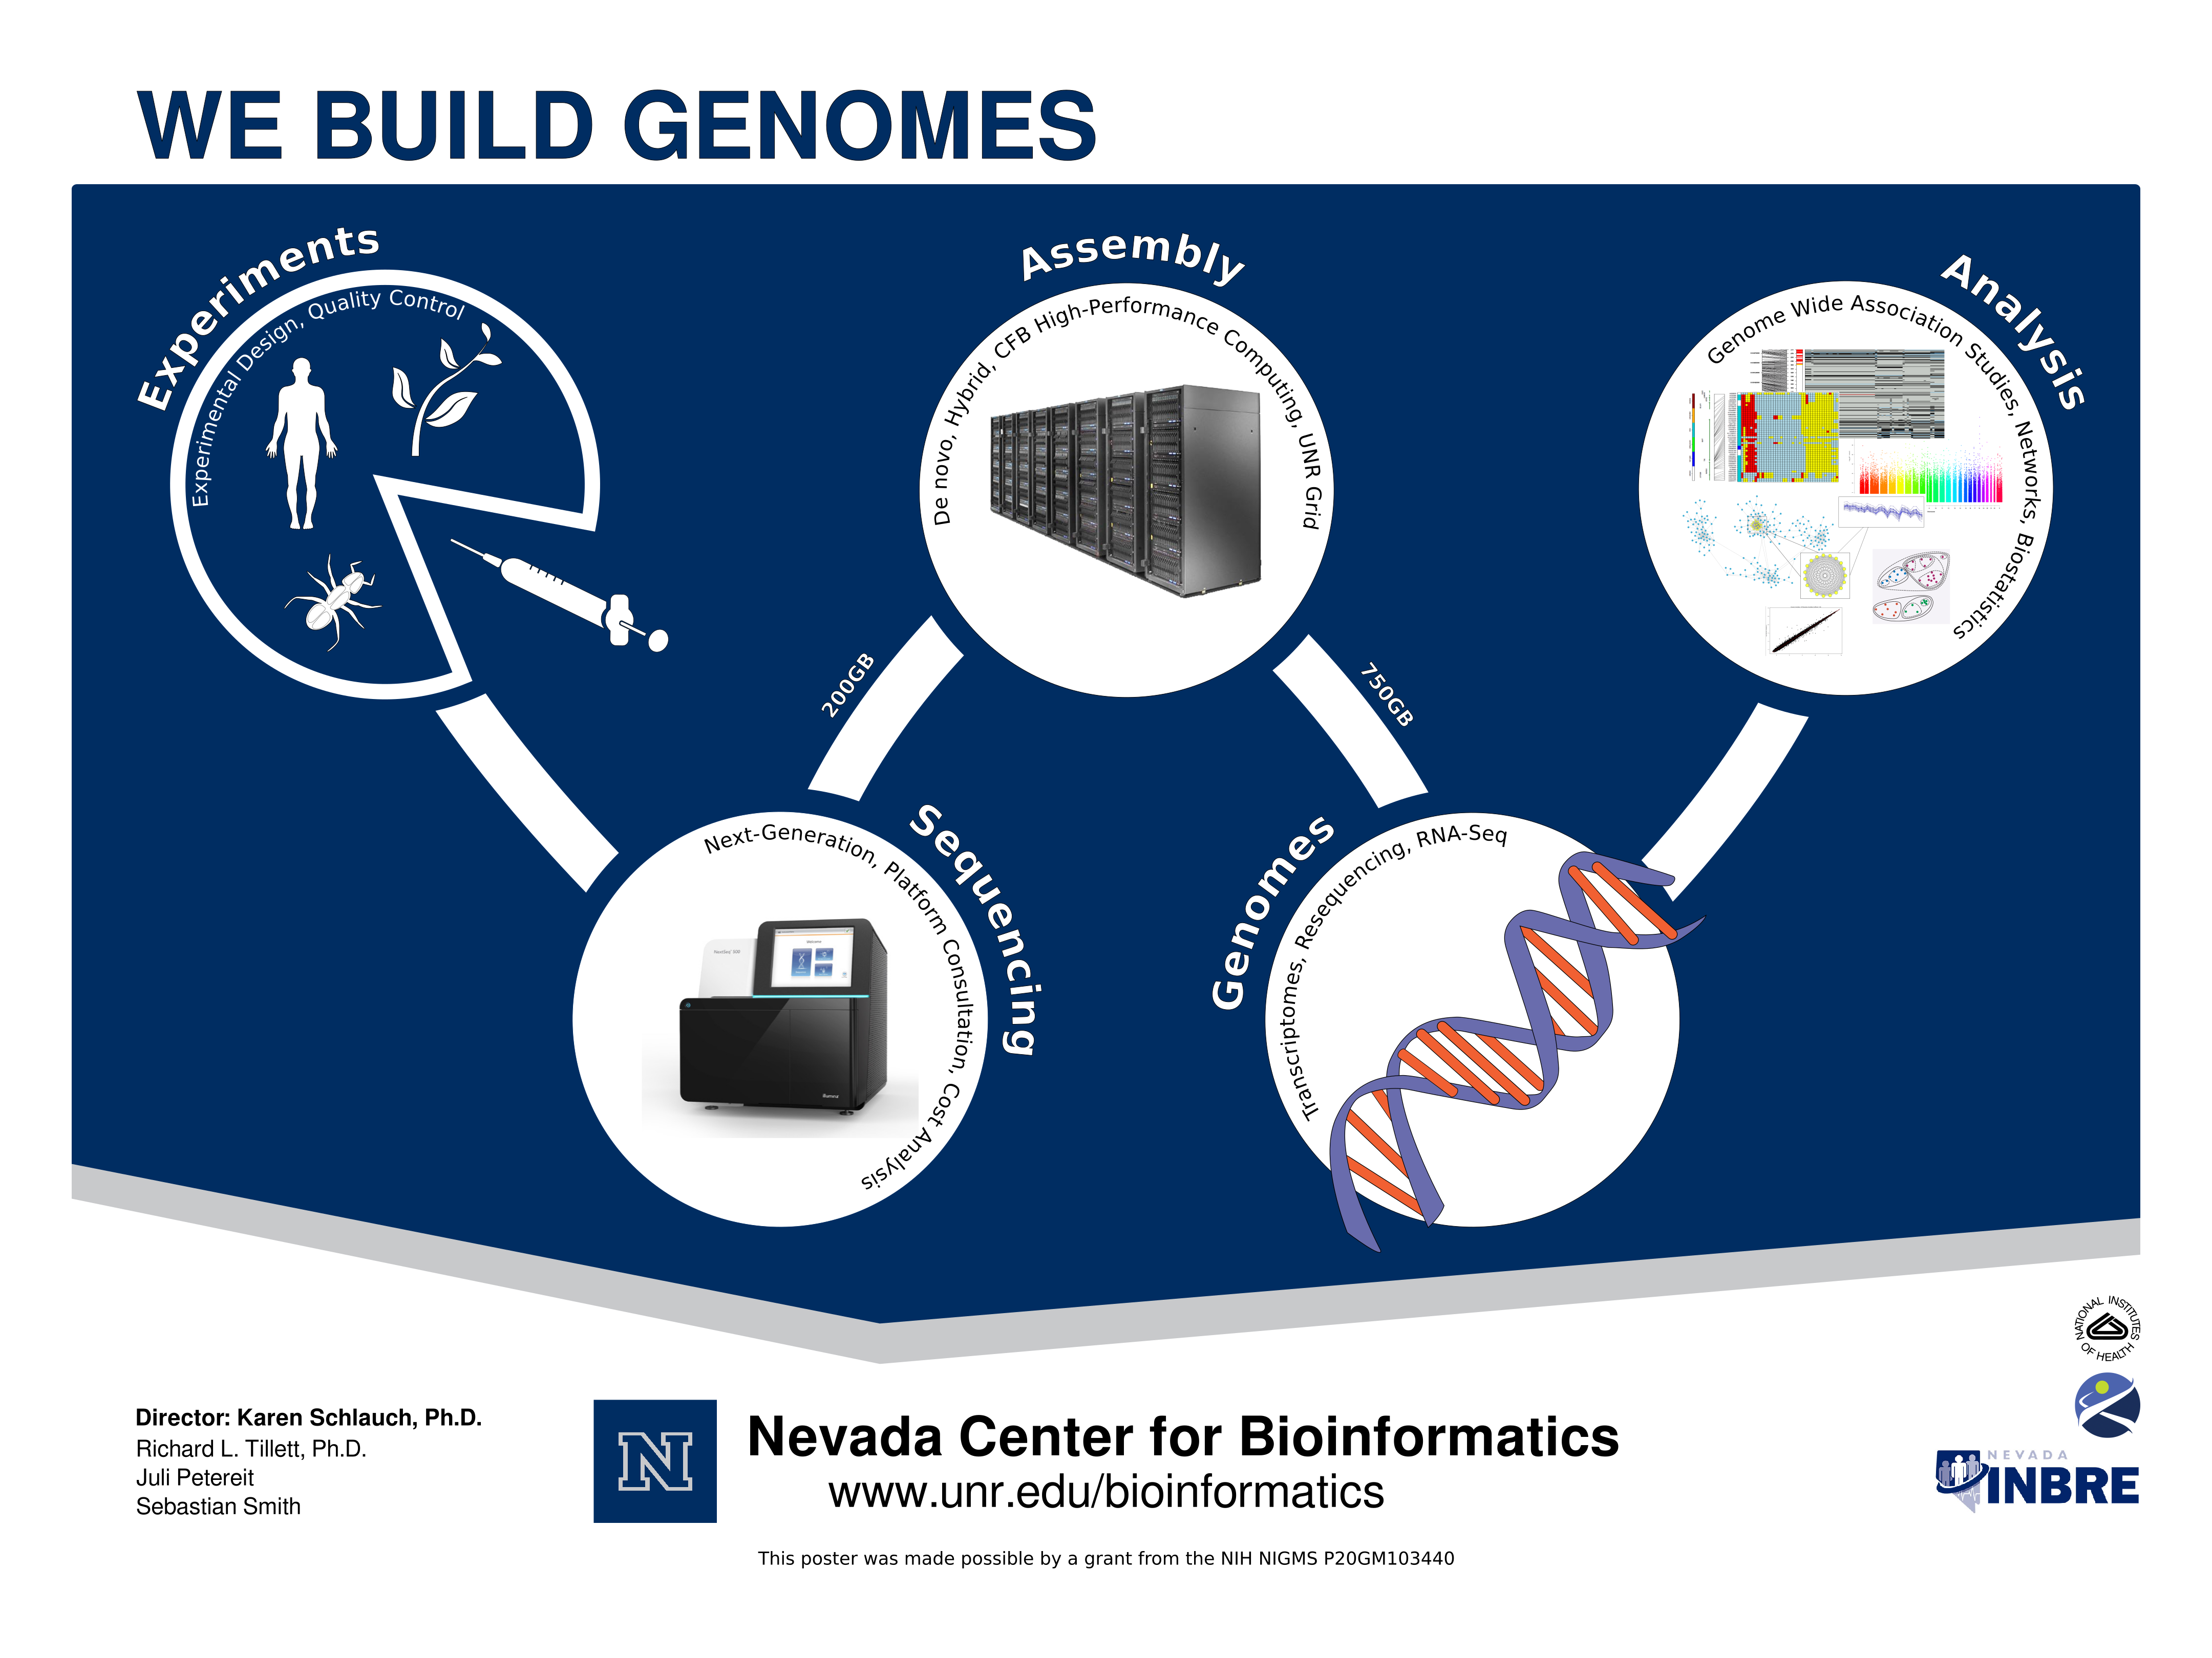

Slide 4
CFB Computing
Example: Assembly of a new genome exceeds 20,000 hrs of computation
  >2.25 years for high-quality results
  Our goal is to complete this computation in 7 days
How?
  High-performance software and systems
    Big computers
    Advanced algorithms
    Parallelism
    Automation

Slide 5
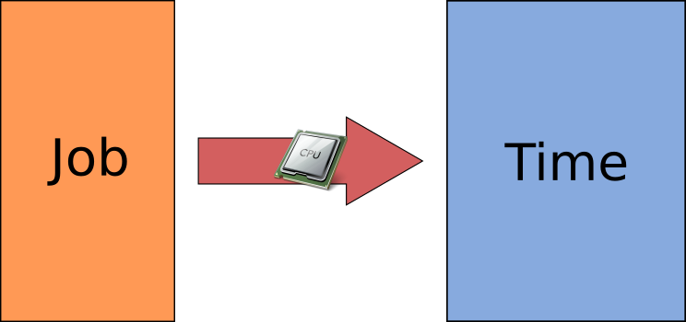
HPC: The Gist

Slide 6
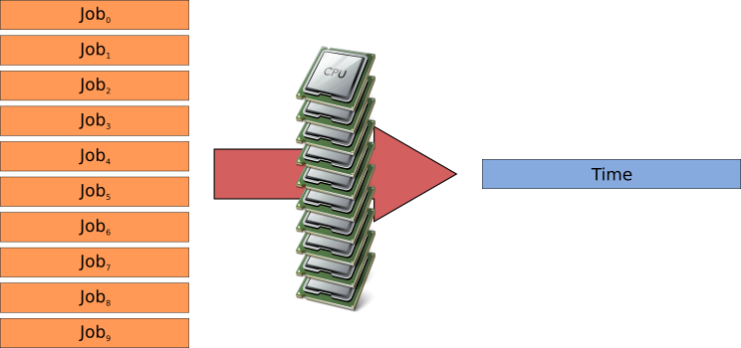
HPC: The Gist

Slide 7
This Class
10,000ft view of HPC at CFB
You will use UNR research computing to:
  Assemble a genome
  Perform an analysis
Goals:
  Provide a HPC “starter kit”
    Use as a template for your own work
  Introduce you to UNR HPC resources

Slide 8
Into the Frying Pan

Slide 9
UNR Grid
Primary research computer
Cluster/Grid
  Collection of computers that work together as one
  27 computers
    16 CPU, 256GB RAM
    432 total CPUs, 4TB RAM
  40+TB disk
Why use it?
  Annihilate work
  ~$200k computer you don't have to buy
Uses Linux
  Centos 6.7

Slide 10
Linux
Monolithic kernel
  Manages applications, computer hardware and their interaction
Operating system
  Highly modular
  Distributions
    Manage collections of software, configuration, security
    Make it easy for end-users
    Ubuntu, Debian, RedHat, CentOS, Fedora, Mint, Arch, Suse

Slide 11
Why Linux?
It's free
  Open source
  Powerful, free development ecosystem
Versatile
  Highly configurable
    Real time systems, desktop computing, supercomputing, specialty
Scalable
  Refrigerators to supercomputers
Performant
Stable
Pervasive
  28% mainframe, 29% embedded, 36% web, 53% mobile, 97% top500 supercomputing
  48% of 2009 businesses use it

Slide 12
CFB Software
Non-interactive
  Automatic, daemon
Shell
  Command Line Interface
    Simple human interface
      Read-Eval-Print Loop (REPL)
    Have to memorize commands, complex to learn
    Fast and powerful
    Powerful programming languages
      Automation
      Control self and other computers
    Low-bandwidth remote-control

Slide 13
Remote Control
You're on Windows... how the heck do we control the UNR super computer?
Secure Shell (ssh)
  Secure, remote CLI
  Windows = Putty
  Linux = ssh
Secure CoPy (scp)
  Securely transfer files
  Windows = WinSCP
  Linux = scp

Slide 14
Connect to the Grid
Execute Putty.exe
Type “login.research.unr.edu” into the “Host Name” box
Type “22” into the “Port” box
Click “Open” button
Input NetID as user name
Input NetID password as password

Slide 15
The Grid Shell
Command interpreter
Bash
  Bourne-again shell
Important features
  Scripting language
    Can read commands from a file
  Tab completion
    Minimize spelling errors

Slide 16
Commands
Software application
  Input from the shell
  Output to the shell
Structure
  command [OPTIONS] <ARGUMENTS>
  Type command name, options, arguments and press enter to execute
$ rsync -avzP stsmith@bioinformatics.unr.edu:~/class/ stsmith@login.research.unr.edu:~/

Slide 17
Files
Everything is a file
Filesystem is a directed graph
  Root = /
  Home = /home
  Your home = /home/<NetID>
Folders = directories
Current Working Directory (CWD)
  Where you are currently located
  Your home directory when you log in
Path
  Specifies a location in the filesystem
  Absolute
    Points to the same location regardless of CWD
    Always starts at root
  Relative
    Points to a different location dependent on CWD
“/” = path delimiter
Shortcuts
  ~/ = home directory
  ./ = current directory
  ../ = parent directory

Slide 18
Manipulating Files
pwd
  List the current working directory
ls [path]
  List directory contents
cd <path>
  Change directory
mkdir <path>
  Make a directory
mv <src path> <dest path>
  Move/rename a file or directory
cp <src path> <dest path>
  Copy a file
  Copy a directory with the -r option
rm <path>
  Remove a file
  Remove a directory with the -r option
file <file path>
  Determine file type
less <file path>
  Read contents of text files

Slide 19
Editing Text Files
nano <file path>
ctrl + x to exit
  Will prompt to save on exit

Slide 20
Processes
Three types
  Interactive, automatic (at, batch, cron), daemon
ps
  Report processes
  Report all processes on system with -ef options
top
  Display tasks in table format
  Updates periodically
Kill [-s signal] <process id>
  Sends a signal to processes
  Kill a process with -s 9 option

Slide 21
Cluster Computing
All users share a common resource
Resource starvation/software failure if we all run at the same time
Take turns using the resource
Batch-queuing system
  Job queue
  Job scheduler
  Program that manages background program execution
UNR Grid uses Sun/Oracle Grid Engine (SGE)

Slide 22
Cluster Management
qsub <script>
  Submit a job to SGE queue
qstat
  Show status of SGE jobs
qdel <job id>
  Delete SGE job from queue

Slide 23
Into the Fire

Slide 24
We Know Enough To Be Dangerous
Run a genome assembly on The Grid
We've packaged a small, simplified assembly task
  Explore the package on your own time to learn how it works
  ~5 hour runtime on 16 CPUs
    80 CPU hours

Slide 25
1
Log in to the grid head node
  SSH to login.research.unr.edu
  Username = NetID
  Password = NetID password

Slide 26
2
$ cd ~/scratch

Slide 27
3
Get class files from Github
  https://github.com/UNR-CFB/bch-709-intro-bioinformatics-2015f
$ git clone https://github.com/UNR-CFB/bch-709-intro-bioinformatics-2015f.git
Makes a bch-709-intro-bioinfomratics-2015f directory

Slide 28
4
$ cd bch-709-intro-bioinformatics-2015f

Slide 29
5
Execute the setup script
$ ./setup.sh
This links a directory containing large Illumina sequencer reads that already exists on the grid
  Faster than copying the files to everyone

Slide 30
6
$ cd day-1/sge

Slide 31
7
Submit the assemble_geno.sge job to the queue
$ qsub assemble_geno.sge

Slide 32
8
Watch the status of your job change
$ watch qstat

Slide 33
9
Let it bake
4.5..5 hours

Slide 34
What Did We Just Do?
$ less assemble_geno.sge
We told the SGE queue to find a computer that has 16 free CPUs and run the assemble_geno.sge script on it
assemble_geno.sge runs an assembler called Spades on the Illumina sequencer reads to produce a genome
We will use the genome to answer questions tomorrow

Slide 35
Questions?

Slide 36
Getting Help
Nevada Center for Bioinformatics
  We help with all stages of research
  Training, systems administration
  Sebastian Smith (systems and software)
    stsmith@unr.edu
  Richard Tillett (biochem)
    rltillett@unr.edu
UNR Grid
  John Anderson
    jra@unr.edu
  http://www.unr.edu/it/research-resources/the-grid

