Slide 1
Blue5 PDR

Slide 2
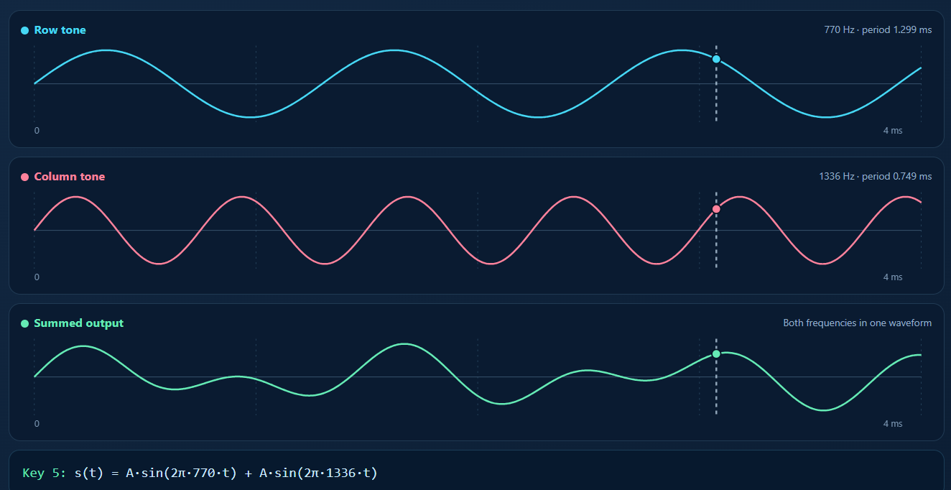
DAC and Timer Implementation
Purpose: Generate a continuous analog DTMF signal by combining two sinusoidal frequencies.
DAC (PA4): Converts digital waveform samples into an analog voltage.
TIM6 Timer: Generates an interrupt at a fixed sampling rate of 16 kHz.
Sine Lookup Table: Stores 32 precomputed samples representing one sine-wave cycle.
Phase Accumulators: Track the positions of the two frequencies within the lookup table.
Signal Combination: The two sine-wave samples are added and written to the 12-bit DAC.
TIM6 controls when the DAC updates, while the phase accumulators determine which samples are output.

Slide 3
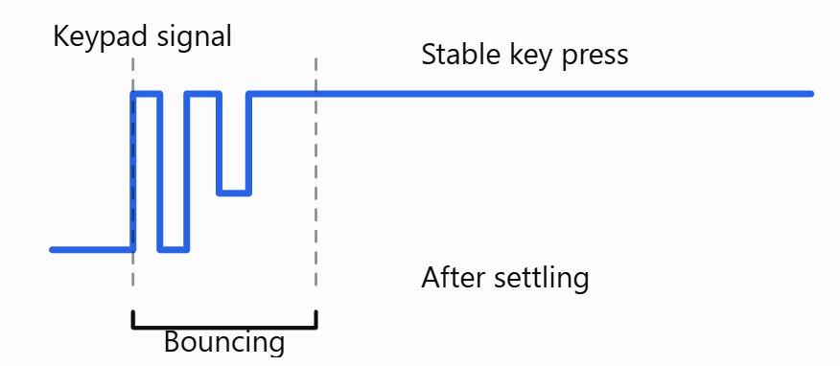

Keypad Debouncing
Why do we need it?
Mechanical keypad switches don't produce a perfectly clean transition. When pressed, their contacts can rapidly connect and disconnect several times over a few milliseconds. Without debouncing, a single press could be interpreted as multiple key events, potentially causing unwanted DTMF tone changes.
Our solution
Detect a change in the keypad state.
Wait 15 ms for the contacts to settle.

Slide 4
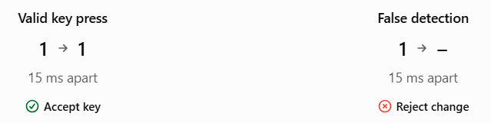
False Key Detection
Why do we check the keypad twice?
A 15 ms delay gives the switch time to stabilize, but the first reading might have been a false detection.
Key Validation Process
First reading: Detect a possible change in the keypad state.
Wait 15 ms: Allow mechanical contact bouncing to settle.
Second reading: Check whether the detected key is still present.
Compare readings:
  Same key → Accept the new state and update the DTMF output.
  Different key → Reject the change and continue scanning.

Slide 5
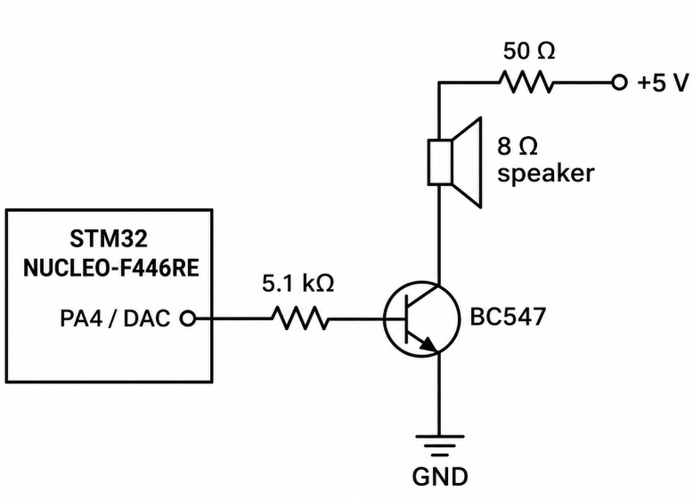
DAC Output and Speaker Driver Circuit
Purpose: Amplify the DAC output current to drive an 8 Ω speaker and produce audible DTMF tones.
DAC (PA4): Generates the analog DTMF waveform by combining two sinusoidal frequencies.
5.1 kΩ resistor: Limits the current flowing from the DAC into the transistor base.
BC547 NPN transistor: Controls the larger current flowing through the speaker using the smaller DAC-driven base current.
50 Ω resistor: Limits the current through the speaker and transistor.
8 Ω speaker: Converts the electrical DTMF signal into audible sound.
The transistor provides current amplification, allowing the low-current DAC output to control a higher-current speaker circuit.

Slide 6
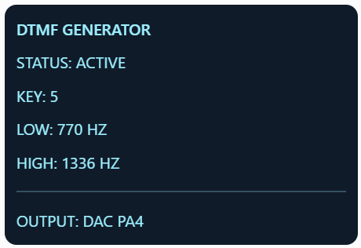
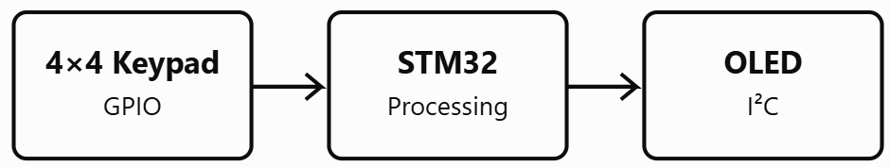
OLED Display Implementation
Purpose: Provide real-time visual feedback of the pressed key, corresponding DTMF frequencies, and system status.
SSD1306 OLED: 128 × 64 pixel display controlled by the STM32.
I²C Communication: Uses PB8 (SCL) and PB9 (SDA) to transmit display commands and data.
Keypad Input: Keypad_GetKey() identifies the pressed key after software debouncing.
Frequency Mapping: DTMF_SetKey() determines the corresponding low and high DTMF frequencies.
Display Update: oled_show() refreshes the key, frequencies, and ACTIVE/IDLE status.
The OLED provides visual feedback of the DTMF output without requiring an external computer.

