Slide 1
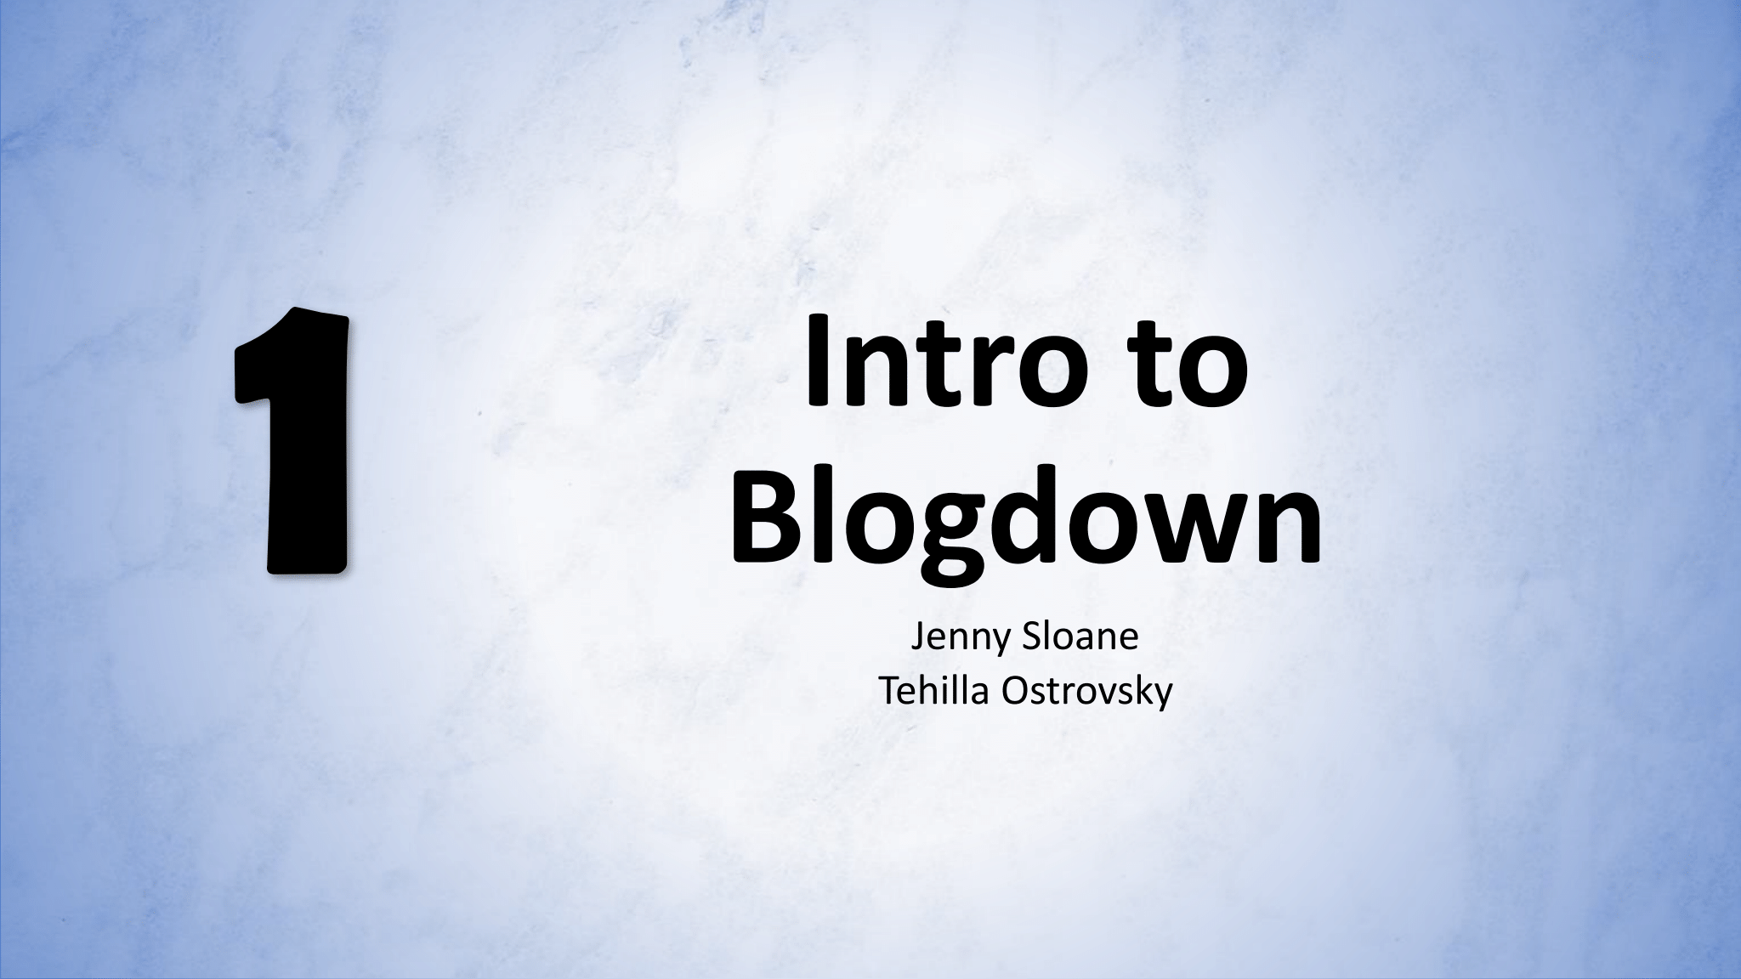

Slide 2




Development Environment
Version Control
Website Host
Website Builder
Website Builder
Notes:
In this series of tutorials we will be using the blogdown package in R to build a persomal-acadmic website. We will with talking about the different platforms that are involved in building your website. The next tutorial will build on how to build the websoite and will dedicate a few tutorials to editing the content changes in your website

Slide 3
Development
Environment
Development Environment – Environment used to build your web application
Set up on your local computer

Slide 4

Website Builder
Open-source static website generator
Wowchemy - Hugo-based open-source website builder that includes an academic theme for static websites

Slide 5

Version Control
Version Control – System responsible for managing computer programs
Repositories - Data structure that stores a set of files

Slide 6
Website Host
Company that hosts websites (static) whose source files are stored in Github
Files are generated into web content files
Notes:
Continuous deployment – updating from one environment and another. Github and netlify

Slide 7


Additional Resources
Hugo - gohugo.io
Wowchemy - wowchemy.com
Netlify - netlify.com
Markdown File – jennysloane.netlify.app/project/blogdown/
Alison Hill’s Blog - alison.rbind.io/blog/2020-12-new-year-new-blogdown/
Dr. Maria Tackett RLadies on building a website with distill - www.youtube.com/watch?v=RYf5HqU1pI4

Slide 8
Make sure….
R installed
Windows - https://cran.r-project.org/bin/windows/base/
Mac - https://cran.r-project.org/bin/macosx/
R Studio installed https://www.rstudio.com/products/rstudio/download/
Git installed - https://git-scm.com/downloads
Github – sign up - https://github.com
Notes:
In the next video we will get Netlify all set up m

Slide 9


Slide 10
Additional Resources
Hugo - gohugo.io
Wowchemy - wowchemy.com
Netlify - netlify.com
Markdown File – jennysloane.netlify.app/project/blogdown/
Alison Hill’s Blog - alison.rbind.io/blog/2020-12-new-year-new-blogdown/
Dr. Maria Tackett RLadies on building a website with distill - www.youtube.com/watch?v=RYf5HqU1pI4

Slide 11
Additional Resources
Hugo - gohugo.io
Wowchemy - wowchemy.com
Netlify - netlify.com
Jenny’s Blog - jennysloane.netlify.app/project/blogdown/
Alison Hill’s Blog - alison.rbind.io/blog/2020-12-new-year-new-blogdown/
Dr. Maria Tackett RLadies on building a website with distill - www.youtube.com/watch?v=RYf5HqU1pI4

