Slide 1

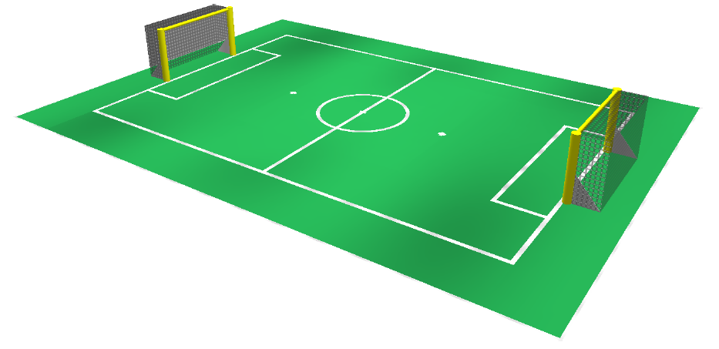
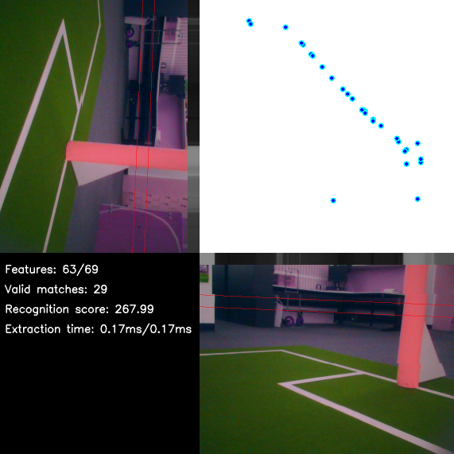
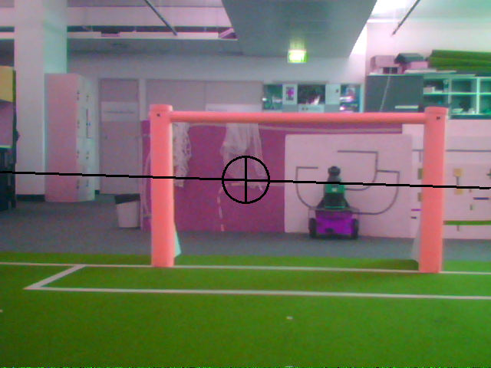
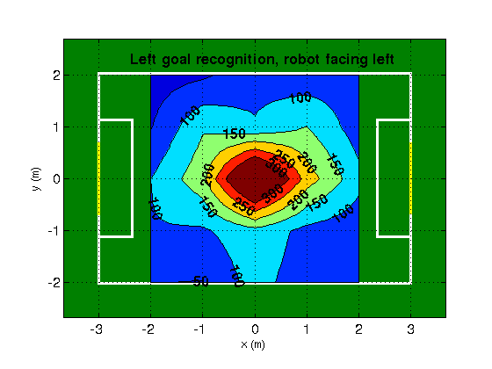
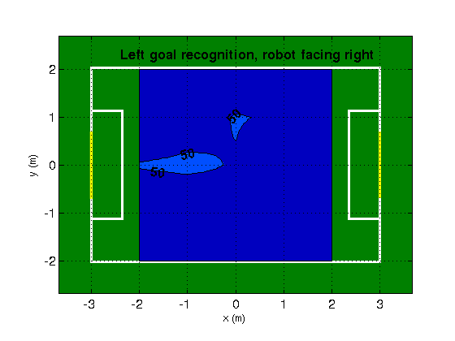
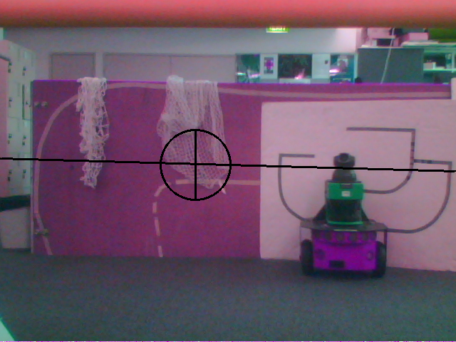
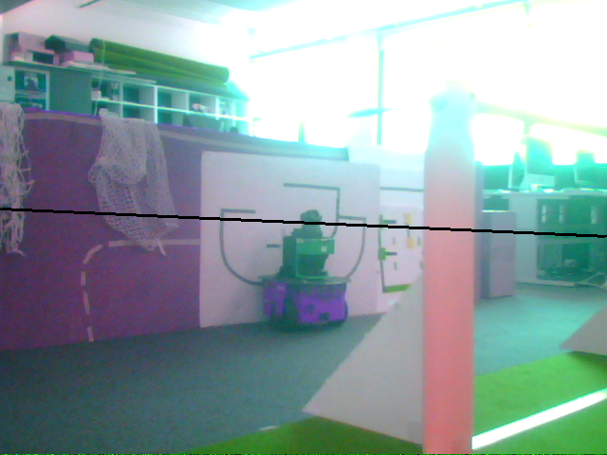
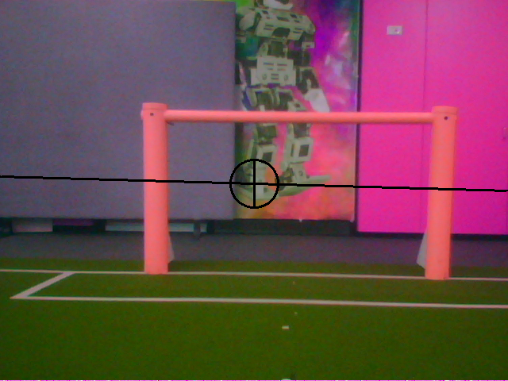
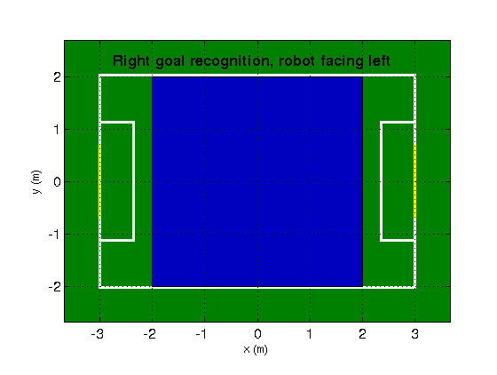
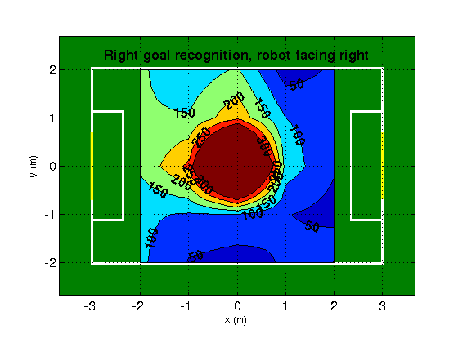
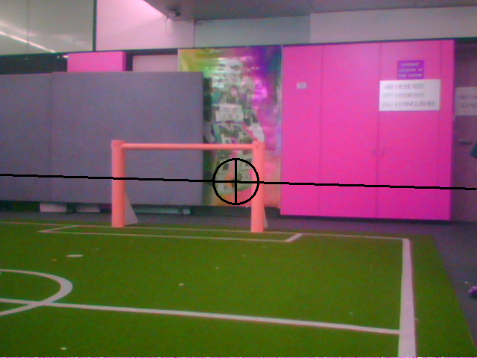
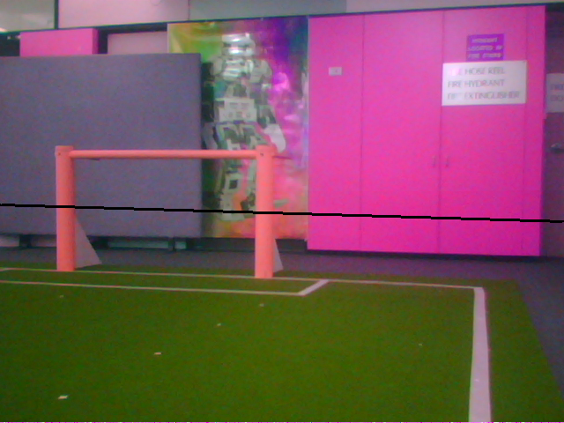
Robot Localisation Using Natural Landmarks
Peter Anderson, Yongki Yusmanthia, Bernhard Hengst, and Arcot Sowmya
Computer Science and Engineering
Motivation and Background
In the 2012 SPL competition, for the first time both goals are yellow. Kidnapped robots need to resolve this field-end ambiguity. Team-wide ball filters require localised, functioning team-mates and a ball. Natural landmark localisation might be a better method. This paper contributes a fast 1 dimensional variant of the SURF [1] algorithm (1D SURF) suitable for mobile robot navigation.
Classification Experiment
88 images captured at 4 degree increments from a single location using the Nao robot camera. No changes in scale or viewing angle. SURF and 1D SURF features extracted from images. Pairs of images classified as overlapping or non-overlapping, based on the sum over matching features of the inverse distance between feature descriptors.
1D SURF
Exploits the robot's planar movement by sub-sampling the horizon to extract one row of grey pixels. Searches for blob response extrema in a 2D scale-space, using the integral image and box filters. Applies a weaker neighbourhood test than SURF, and discards the orientation assignment and 3D quadratic curve fitting steps. Reduces the SURF 64 dimension feature descriptor to 6 dimensions. Dramatically reduces the computational expense of SURF, while still providing repeatable features.
Feature extraction technique | Feature matching technique | Mean number of features | Mean extraction time (ms) | Mean matching time (ms) | Area under ROC curve
SURF | Nearest Neighbours | 429 | 222.3 | 19.1 | 98.8%
1D SURF | Nearest Neighbours | 59.2 | 0.158 | 0.069 | 88.0%
1D SURF | Nearest Neighbours with RANSAC | 59.2 | 0.158 | 0.076 | 89.6%
Execution times evaluated on a 2.4GHz laptop
Application to Robot Localisation
A single image of each goal area captured from the centre of the SPL field. Recognition measured over a 4m x 4m area (including scale and viewing angle changes). Mean feature extraction time: 12ms (Nao V3), 2ms (Nao V4).
Landmark Matching
Discarded in RANSAC geometric verification of feature matches
Left Goal Recognition
Stored image
Right Goal Recognition
Stored image
Application to Visual Odometry
Bipedal robots slip and get pushed while playing soccer. By matching 1D SURF features in subsequent frames, we can accurately measure heading changes, to improve robot localisation and behaviour.
Robot is restricted and slips
References
[1] H. Bay, T. Tuytelaars, and L. Van Gool. Surf: Speeded up robust features. Computer Vision-ECCV 2006, pages 404-417, 2006.

