Slide 1
Stock Price Prediction
CSCE – 5214 – Software Development for Artificial Intelligence
Project -2
Yash Zauwar – 11439929
Goutham Pallapothu – 11519845
Veeranjaneyulu Muppalla – 11532514
Yashwanth Gajula - 11524980

Slide 2
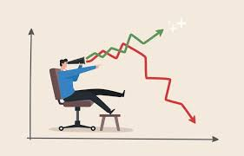
Stock Price Prediction using ML
It is difficult to predict stock values with great accuracy because of the many elements that are involved, which is why machine learning is so important.

Slide 3
Aim of the project
The stock price is a randomly generated number they can be analyzed as a sequence of discrete-time data.
To train a machine learning model for predicting stock prices.
Because of the sequential nature of time-series data, we need a way to aggregate this sequence of information.
Hence, we have opted for LSTM Sequential model.

Slide 4

Dataset
The Dataset we are using is from the finance website : yahoo finance.
We are using the datareader module in python.

Slide 5
Machine Learning Model
We will be developing a ML model using LSTM.
We are dividing the data into training data and testing data to train the model.
Data will be divided as 80% training and 20% testing.
LSTMs are an improved version of recurrent neural networks (RNNs).
Accuracy of various models like SVC, XGBClassifier, LogisticRegression is calculated and model with best accuracy is used for web application.

Slide 6
Workflow
User access the web application
User enters the Stock Name
The data is pulled from yfinance and displayed on the user's screen.
Hosted on AWS using streamlit in python
The data is then modified to feed to the model generated
Based on the model, the values for the stock are predicted
User will be able to find the prediction for the stock name entered in various visualizations.

Slide 7
Milestones
Milestone 1 : Working on the dataset, missing values, column rename etc.,
Milestone 2 : Develop a Machine Learning Model
Milestone 3 : Train the model developed.
Milestone 4 : Integrate the UI with the model.
Milestone 5 : Predict the price of stock with actual price using model.

Slide 8
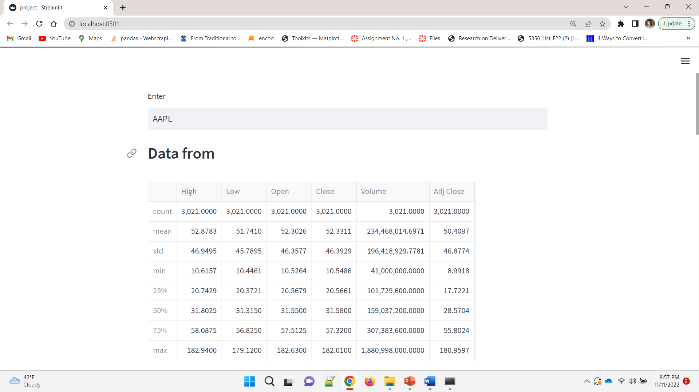
User Interface
The User Interface for the application will be developed in python programming language, which will enable the user to enter the stock name and the prediction for the stock will be shown using various visualizations.
Shown in the image is the sample UI which is still in development phase.

Slide 9
Resources for the Project
Cloud Platform : AWS Server
Dataset : Yahoo Finance Website
Deployment : streamlit Application
Development Language : Python
Stretch Goal : To Deploy a web app to predict the stock price

Slide 10
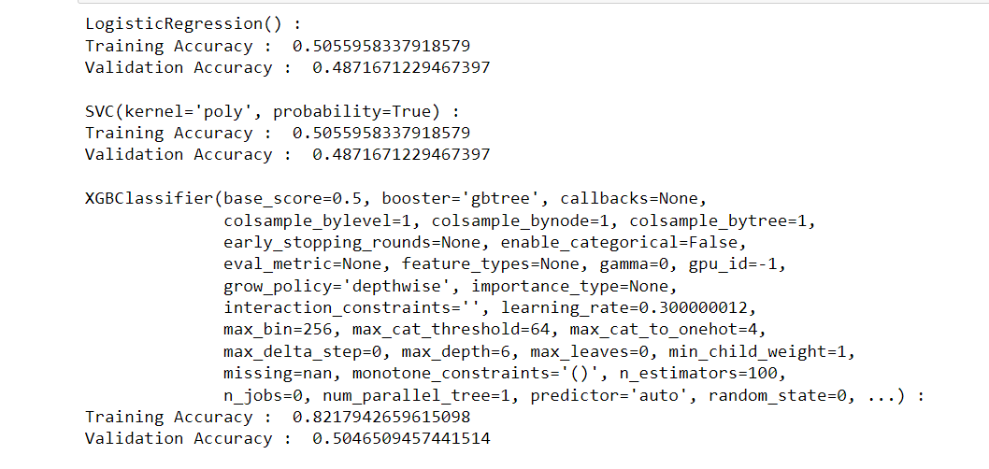
Accuracy :

Slide 11
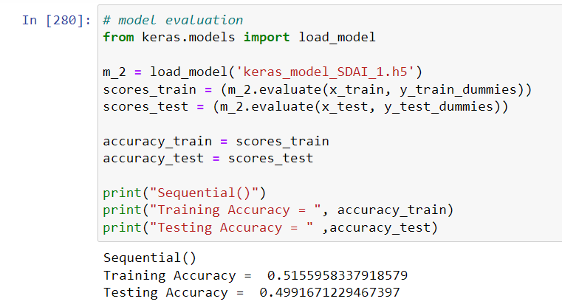
Accuracy :

Slide 12
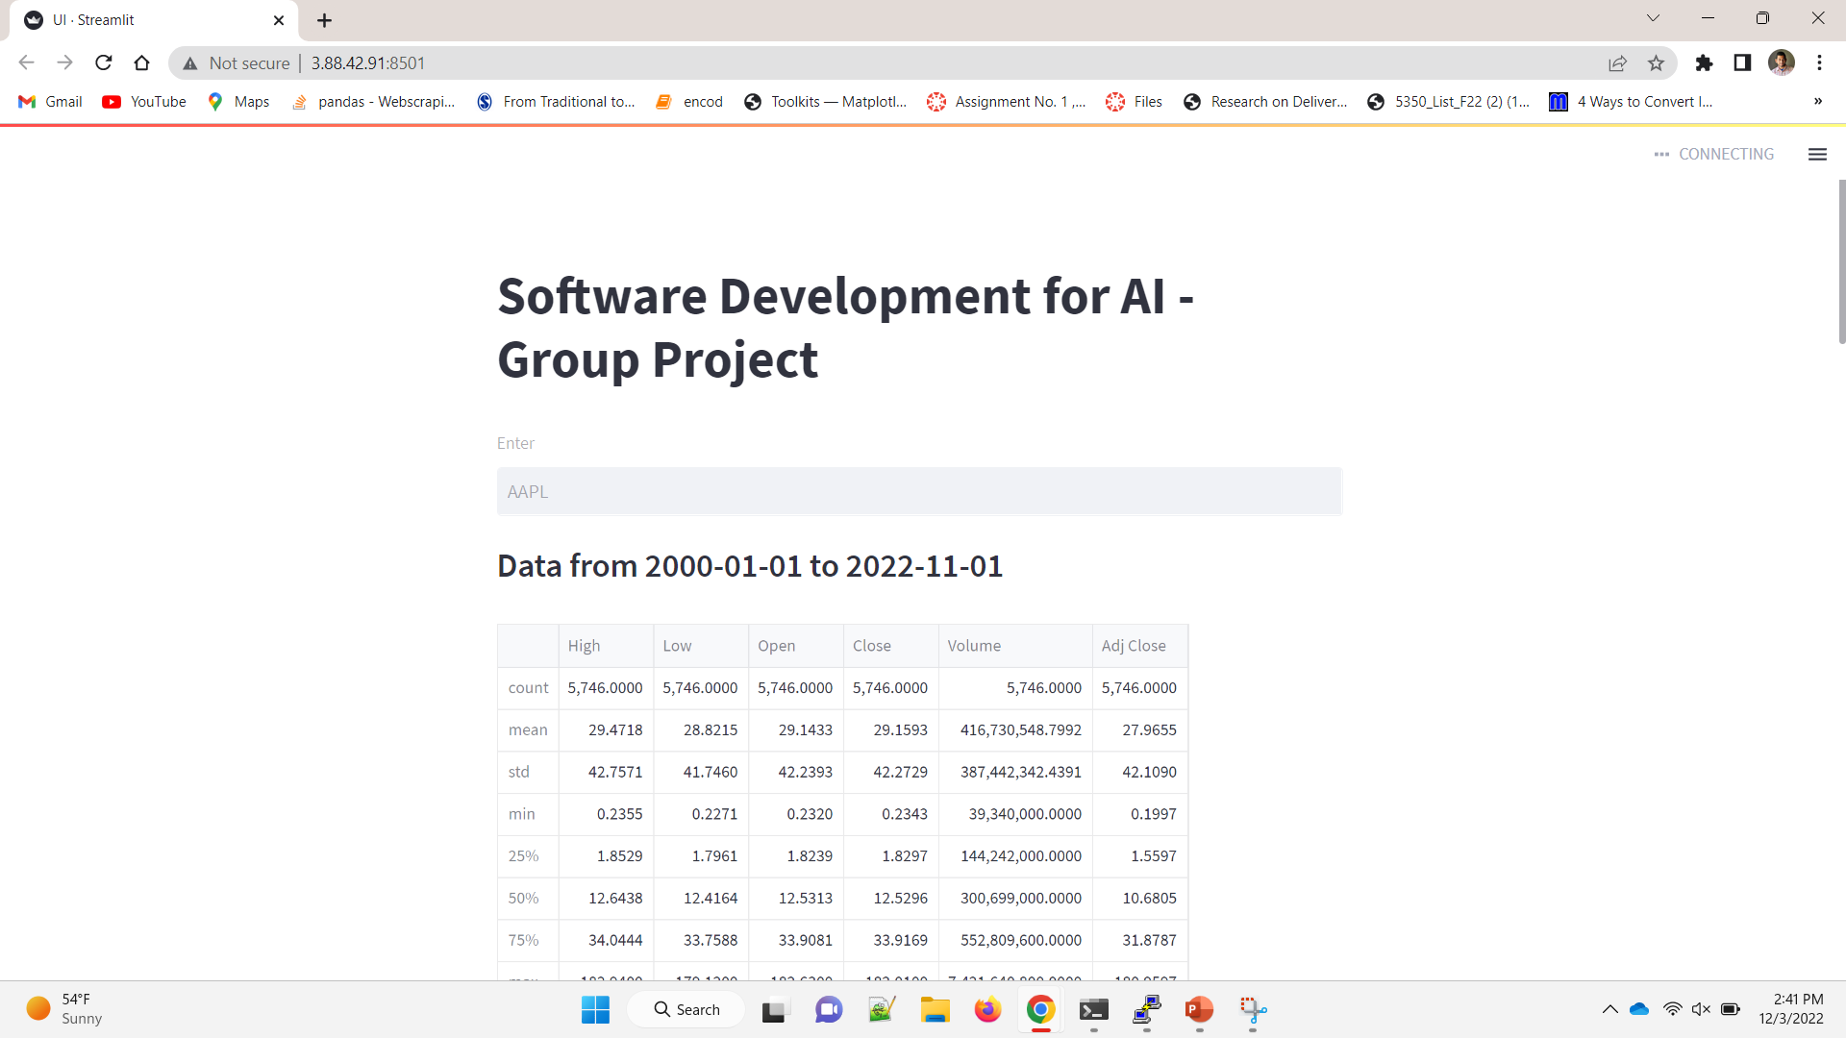
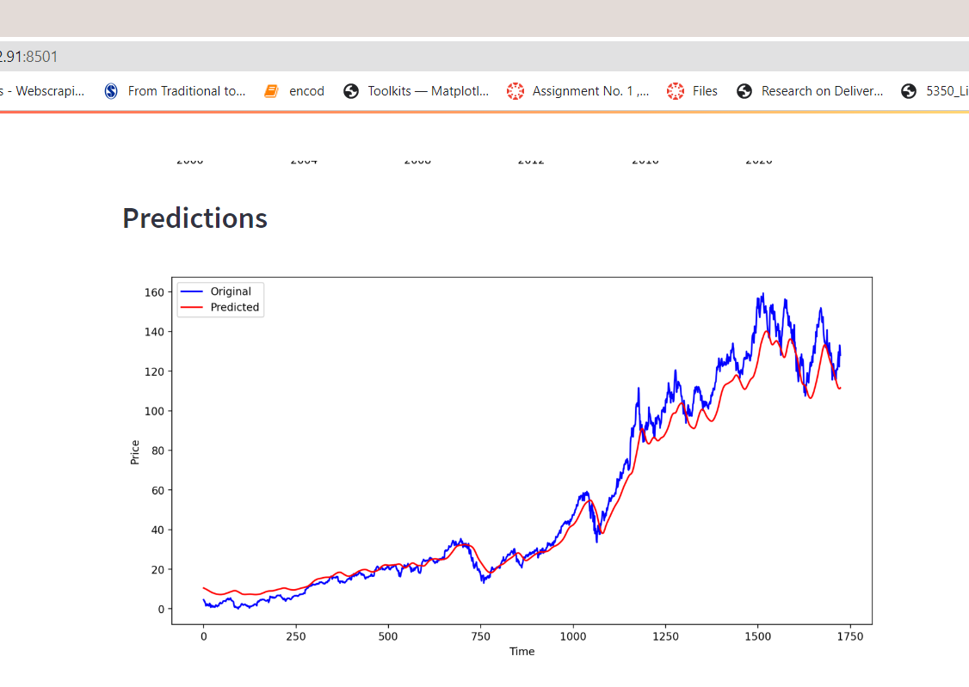

Slide 13
Link to the project
Link : http://3.88.42.91:8501/

Slide 14
Research Work :
The experimental result shows that the sample accuracy rate of the single layer LSTM Model is between 0.60 to 0.70
It is also observed that the more stack layers of LSTM model, the higher the accuracy of prediction results.
References:
https://ieeexplore.ieee.org/abstract/document/8398183/metrics#metrics
https://ieeexplore.ieee.org/abstract/document/9257950
https://link.springer.com/chapter/10.1007/978-981-16-0419-5_8

Slide 15


Slide 16


