Slide 1


Created a additional categorical column which classifies the ships’ operating mode based on the conditions given to us
Identified some ships who do not fall in any of these operating mode, so we removed them
Created a column called “event duration” which calculates the time between consecutive timestamps of each ship
Removed the ships whose intervals are more than 10000 secs as stated in the instructions
We then move on to the calculations and got the necessary calculations by following the formulas given to us in the instructions
To smoothen the calculations process, we checked for null values for the p, vref, ael, abl, sfc_me, sfc_ab, sfc_ae columns
Using the model year of the ship, we created a new column called emission tier which categorize the ships emission tier based on their engine models derived from the supplementary tables
Team :
Organisers :

Slide 2
CO2 Emissions (In Tonnes)
17,462,880
69,913
38,166
155
Transit Mode
Anchorage Mode
Manoeuvring Mode
Alongside Mode
Electrical Load (In kW)
156,986
744,722
Day
night

Slide 3
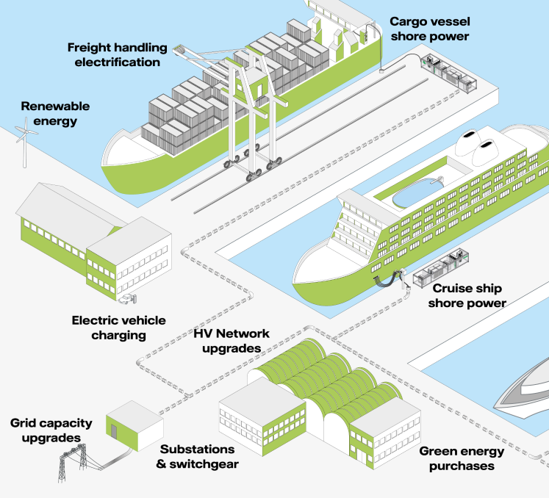
Our solution is to implement port chargers at every port to power the vessels, storage for cargo, and machinery.
There have already been plans to build port chargers in Singapore, one such example being the Jurong Port. But they did not plan to allow the storage of cargo and powering of machinery to undergo electrification as well.
As seen from this report from the INTERNATIONAL COUNCIL ON CLEAN TRANSPORTATION (ICCT), the United States have implemented our idea, and collected data for a paper showing that CO2, PM10, and NOx, would be reduced by 64%, 70%, and 66% in the full electrification scenario. In absolute terms, this represents over 130,000 tonnes of CO2, 57 tonnes of PM10, and 2,000 tonnes of NOx reduced by port electrification in a year, based on the results for 2019.
This further bolsters my idea of implementing this in every port within every port in the country. The image on the left shows a graphical example on how our solution would look like.
To further tackle this issue, we can also reduce carbon emission by scheduling more trips in the day than in the night, and ships can have portable solar panels to collect energy to use in the night. However this might be costly as it requires more capacity in our port and solar energy can be very expensive when implemented full scale

