Slide 1
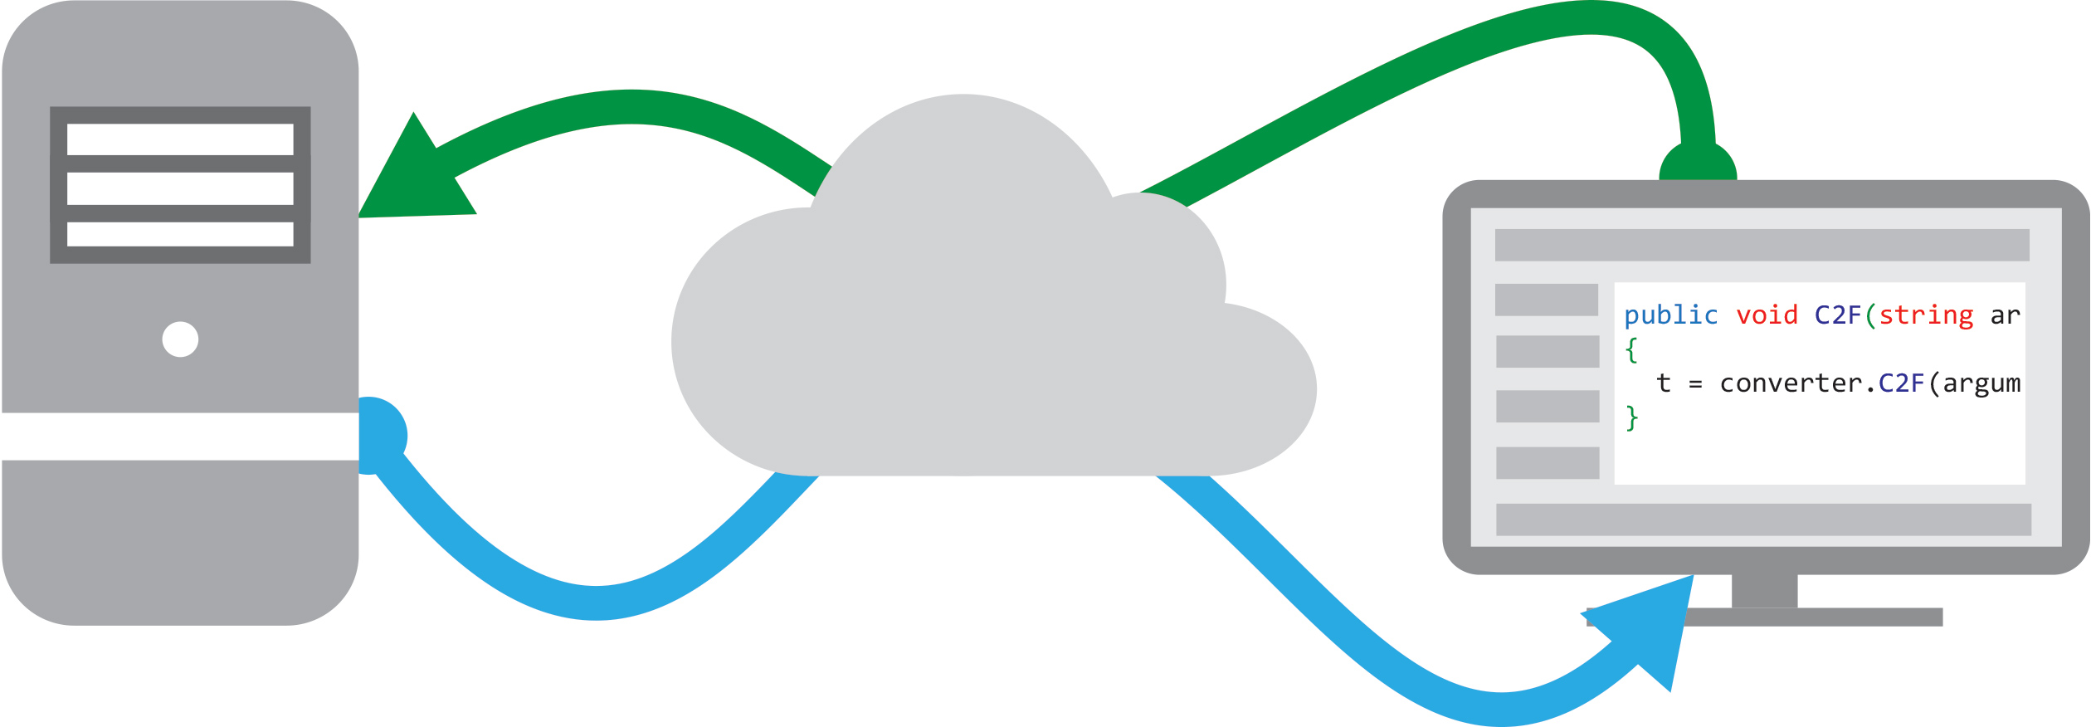
Consuming Web Services
CIS 399

Slide 2
Course Overview
Wk | Topic
1 | Intro, single-screen apps
1 | Activity Lifecycle, saving activity state
2 | Layouts + widgets, Event Handlers
2 | Themes + styles, Menu + settings
2 | Multi-screen apps
Wk | Topic
3 | Fragments
3 | Reading XML files, Asynch Tasks
3 | List Views
3 | SQLite Databases
4 | Consuming web services
4 | Geolocation

Slide 3

Intro to Web Services
Notes:
http://sqlite.org

Slide 4
How Web Services are Used
A Web Service provides information or computing services to other computers over a network
Client 1
consuming the service
Client 2 consuming the service
Client 3 consuming the service
A server
Provides a
Web Service

Slide 5
Advantages of Web Services (Aka Web APIs)
Allows computing services to be distributed across:
Multiple machines
Any distance
Provides a service that is:
OS independent
Language independent

Slide 6
Types of Web Services
Two Main Standards:
REST: Representational State Transfer
Newer, simpler, client code easier to write
An architecture, not a protocol
SOAP: Simple Object Access Protocol
Older, more complex, client harder to write
Lots of legacy SOAP services out there

Slide 7
RESTful Web Services
Architectural principles used in most REST web service implementations:
Use HTTP as it’s protocol
Are stateless (each request is autonomous)
URIs are organized like directories
Transfer data using:
XML (eXtensible Markup Language)
JSON (JavaScript Object Notation)
Or both
Notes:
https://www.ibm.com/developerworks/library/ws-restful/index.html
URI vs. URL: A URL refers specifically to the address of a web page, while URI refers to the address of any resource

Slide 8
HTTP Protocol
HTTP (Hypertext Transfer Protocol) was designed to be used by web servers to deliver web pages in response to requests from web browsers
It is a request-response protocol:
Client Computer
Web Server
Request
Web Browser
Response
Notes:
https://en.wikipedia.org/wiki/Hypertext_Transfer_Protocol#Request_methods

Slide 9
HTTP Request Verbs
The most common HTTP Requests:
GET – Requests a representation of the specified resource
POST – Requests that the server accept the data stored in the body of the request
PUT – Requests that the enclosed entity be stored under the supplied URI.
DELETE – Deletes the specified resource.

Slide 10
HTTP REST Requests
GET – Retrieve a resource from the service
Query parameters are appended to the URI
POST – Create a resource on the server
Parameters are embedded in the body of the request
PUT – Change the state of a resource or update it
DELETE – Remove a resource
Notes:
https://www.ibm.com/developerworks/library/ws-restful/index.html
A resource can be a picture, video file, Web page, business information, etc.
A representation of a resource could be a file name, a URI, or some other abstraction or reference

Slide 11
Example URIs
api.openweathermap.org/data/2.5/forecast?q=London,us&mode=xml
api.openweathermap.org/data/2.5/weather?q=London&mode=xml
http://api.openweathermap.org/pollution/v1/co/0.0,10.0/2016-03-01Z.json
Notes:
https://openweathermap.org/api
These are documentation examples and do not return actual data, just sample data

Slide 12
Code Tour
Using the Weather Underground REST API
Notes:
http://api.wunderground.com/weather/api/d/docs

Slide 13
Code Tour
Look at the code for the completed weather app:
https://github.com/UO-CIS/CIS399AndroidDemos/tree/master/WeatherForecast-SAX+SQLite+REST+ListView
Notes:
http://api.wunderground.com/weather/api/d/docs

Slide 14
Java REST Client Code
Import the Java.io and java.net packages
import java.io.InputStream;
import java.net.HttpURLConnection;
import java.net.URL;
Java.io and Java.net are part of the standard Java library
https://docs.oracle.com/javase/8/docs/api/java/io/package-summary.html

Slide 15
Set up a URL
Build the string used for the REST query:
String apiKey = "0e3e69302fba4e56";
String baseUrl = "http://api.wunderground.com/api/";
String query = "/forecast/q/OR/Eugene.xml";
Create a URL object:
URL url = new URL(baseUrl + apiKey + query);
Notes:
http://api.wunderground.com/weather/api/d/docs

Slide 16
Request and Receive a Response
HttpURLConnection connection = (HttpURLConnection)url.openConnection();
connection.setRequestProperty("User-Agent", "weatherdemo-app"); // key-value pair identifying us
connection.setRequestMethod("GET");
connection.connect();
InputStream in = connection.getInputStream();
Notes:
http://api.wunderground.com/weather/api/d/docs

Slide 17
Further RESTful Reading
RESTful Web Services: A Tutorial http://www.drdobbs.com/web-development/restful-web-services-a-tutorial/240169069
Learn REST, a RESTful Tutorial: https://restapitutorial.com
RESTful Web Services: The Basics https://www.ibm.com/developerworks/library/ws-restful/index.html

