Slide 1
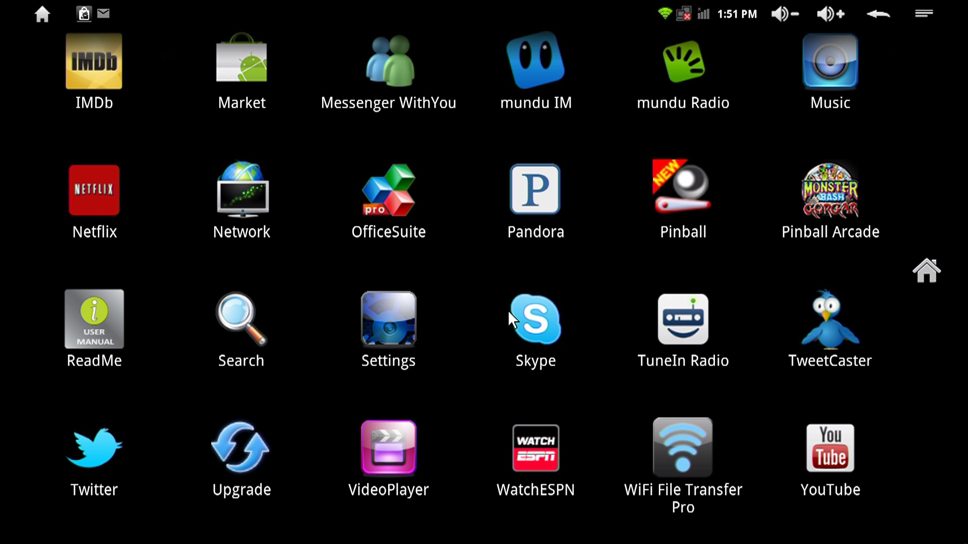
Your First App: Creating the UI
CIS 399

Slide 2
Course Overview
Wk | Topic
1 | Intro + single-screen apps
1 | Activity Lifecycle + saving activity state
2 | Menus + Themes
2 | Multi-screen apps + Fragments
Wk | Topic
3 | Reading XML files + Asynch Tasks
3 | List Views
3 | SQLite Database
4 | Consuming a web service
4 | Geolocation

Slide 3
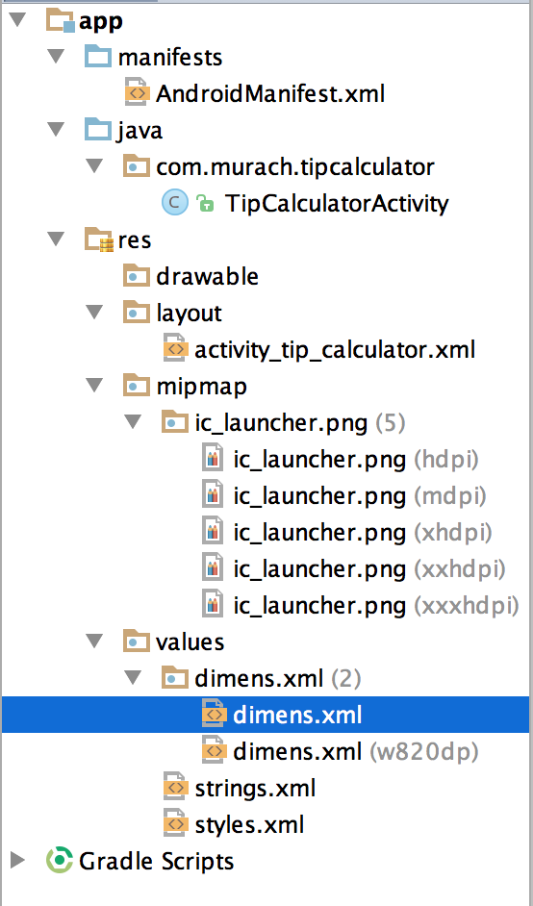
Parts of an App Project
Manifest – Info about the app
Java –Java source code for Activities and other classes
res – Resources
Drawable: Images
Layout: UI layouts in XML
Mipmap: Multi-resolution icon images
Values: named constants
Dimens: dimensions (sizes)
Strings: text strings
Styles: Theme selection
Notes:
Explain that we’re just doing an overview and that we’ll come back and look at everything in detail next week.

Slide 4
Activities
Each App will contain at least one activity. Every activity derives from the Android Activity class
Each activity will load a UI layout and display one screen in an app

Slide 5
Tip Calculator Activity
package com.murach.tipcalculator;
import java.text.NumberFormat;
import . . .
public class TipCalculatorActivity
extends Activity
implements OnEditorActionListener,
OnClickListener {
Notes:
Look at the rest of it in Android Studio
Mainly look at the base class, the callback methods, and SetContentView
NumberFormat is the abstract base class for all number formats. This class provides the interface for formatting and parsing numbers.
import . . . is a collapsed set of import statements

Slide 6
An Empty Activity
package edu.uoregon.bbird.myemptyapplication;
import android.os.Bundle;
public class MainActivity extends AppCompatActivity {
@Override
protected void onCreate(Bundle savedInstanceState) {
super.onCreate(savedInstanceState);
setContentView(R.layout.activity_main);
}
}
Notes:
Explain that this is the minimum required for an activity. focus on inheriting from Activity and overriding onCreate

Slide 7
Activity Class
java.lang.Object
↳ android.content.Context
↳ android.content.ContextWrapper
↳ android.view.ContextThemeWrapper
↳ android.app.Activity
The Activity class takes care of creating a window in which you can load your UI by calling setContentView(View).
https://developer.android.com/reference/android/app/Activity.html

Slide 8
AppCompatActivity Class
java.lang.Object
↳ android.content.Context
↳ android.content.ContextWrapper
↳ android.view.ContextThemeWrapper
↳ android.app.Activity
↳ android.support.v4.app.FragmentActivity
↳ android.support.v7.app.AppCompatActivity
Base class for activities that use the support library action bar or app bar features in API 7 or higher. (The action bar was introduced in API 11)
Notes:
https://developer.android.com/reference/android/support/v7/app/AppCompatActivity.html

Slide 9
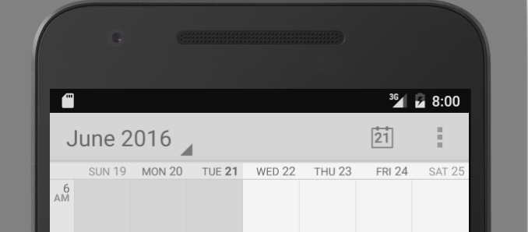
Action Bar
Action bar in the default calendar app
Notes:
https://developer.android.com/design/patterns/actionbar.html
We’ll learn more about these later. I’m just showing this so you know what the AppCompatActivity Class is enabling in older Android versions.
Note: The ActionBar is being replaced by the AppBar: https://developer.android.com/training/appbar/index.html

Slide 10
UI Layout Files
Each screen (Activity) will have at least one layout file
Layout files contain UI definitions using AXML (Android XML)
Layout definitions will contain:
Layout containers, called layouts (confusing?)
UI controls, called widgets.

Slide 11
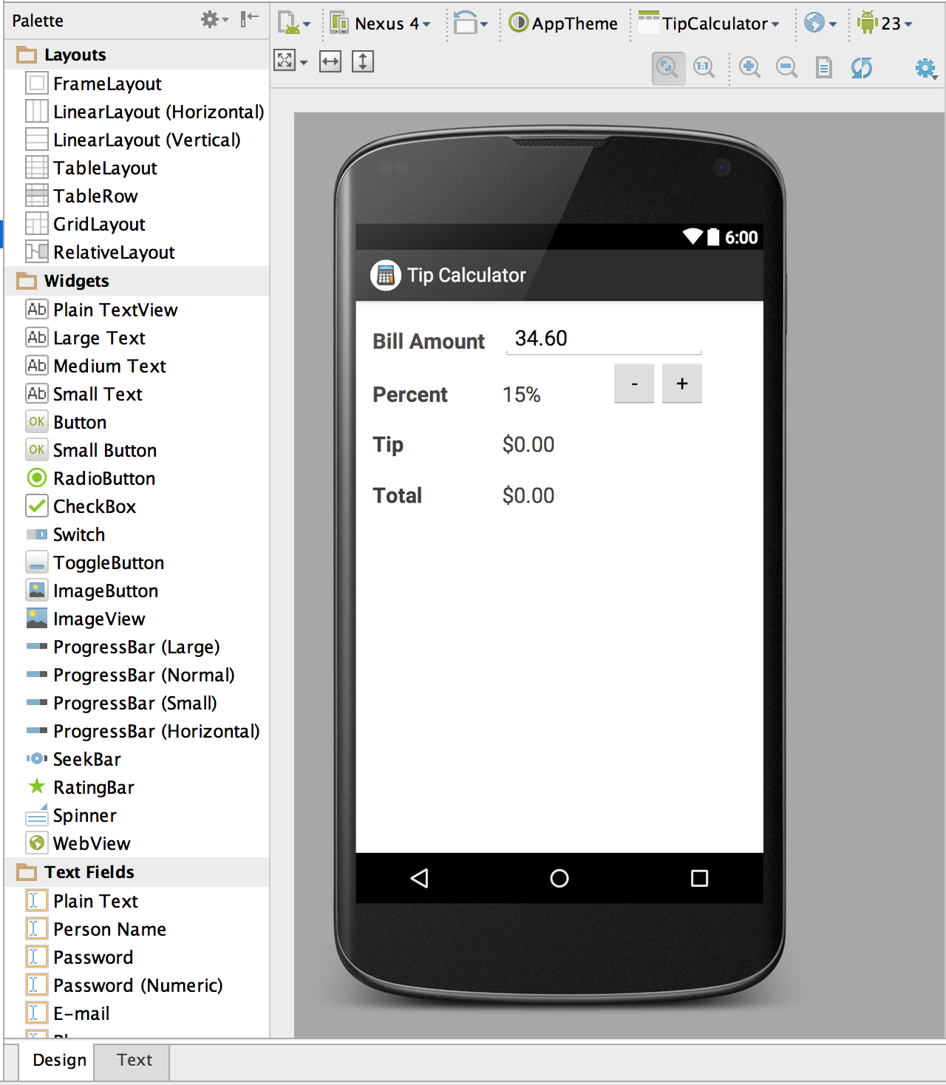
Layout Editor in Design Mode
Select a device (screen size and density) for rendering the UI
Select an orientation
Select an API level

Slide 12
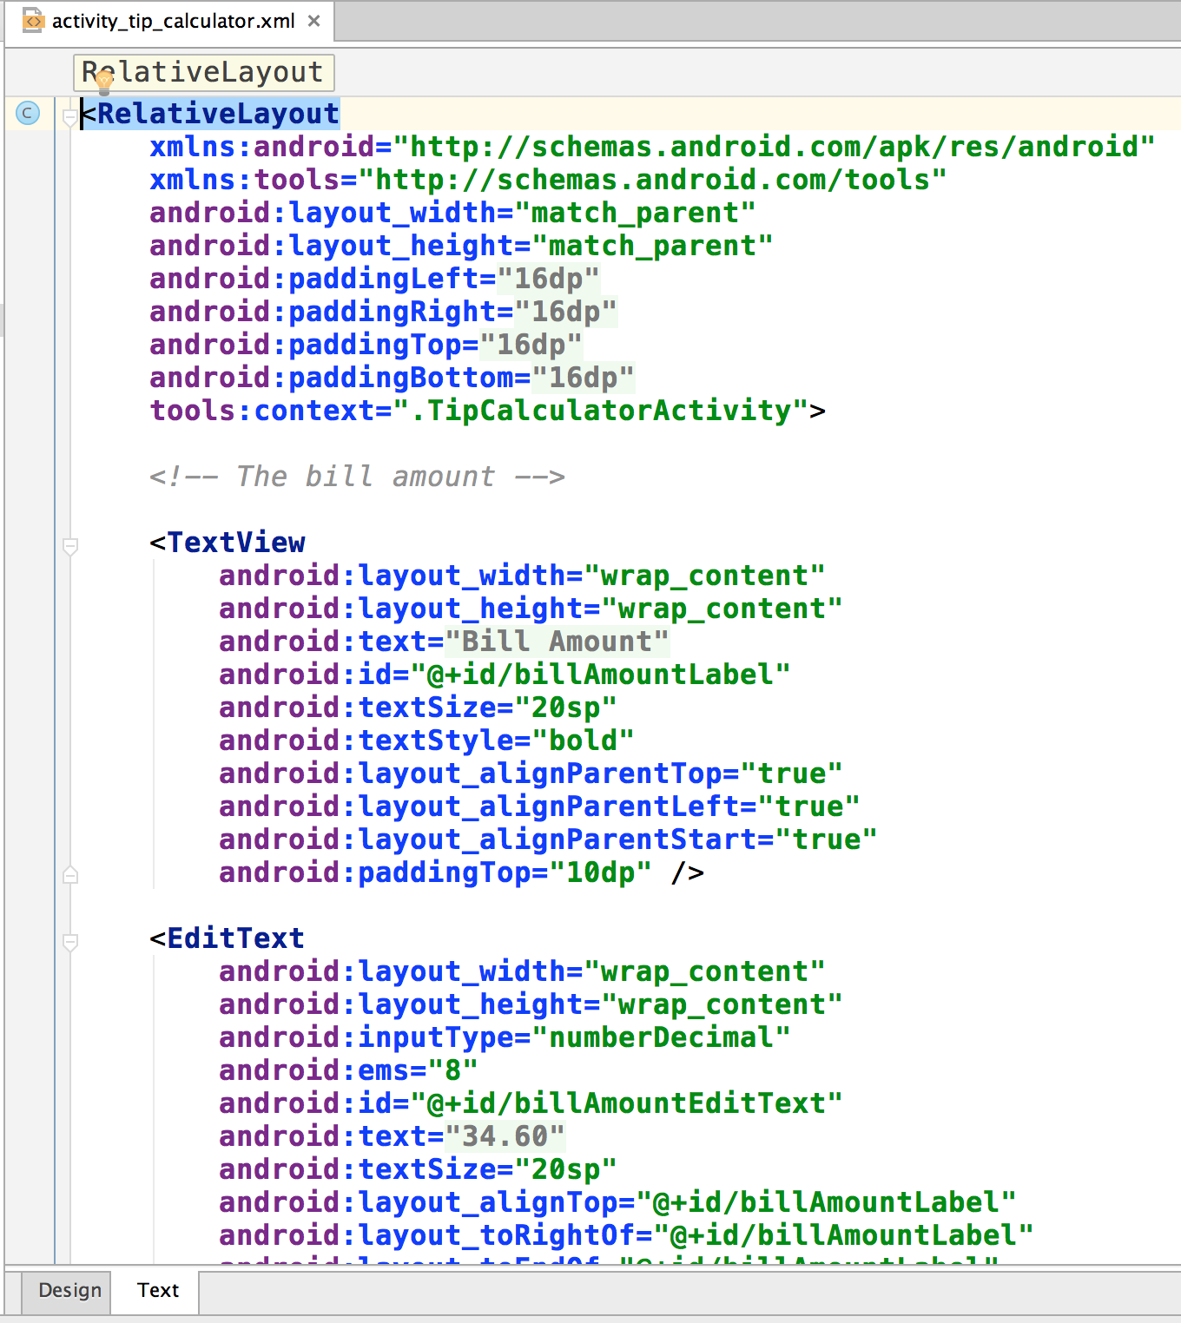
Layout Editor in Text Mode

Slide 13
An (Almost) Empty AXML Layout
<?xml version="1.0" encoding="utf-8"?>
<RelativeLayout xmlns:android="http://schemas.android.com/apk/res/android"
xmlns:tools="http://schemas.android.com/tools"
android:layout_width="match_parent"
android:layout_height="match_parent"
android:paddingBottom="@dimen/activity_vertical_margin"
android:paddingLeft="@dimen/activity_horizontal_margin"
android:paddingRight="@dimen/activity_horizontal_margin"
android:paddingTop="@dimen/activity_vertical_margin"
tools:context="edu.uoregon.bbird.myemptyapplication.MainActivity">
<TextView
android:layout_width="wrap_content"
android:layout_height="wrap_content"
android:text="Hello World!" />
</RelativeLayout>

Slide 14
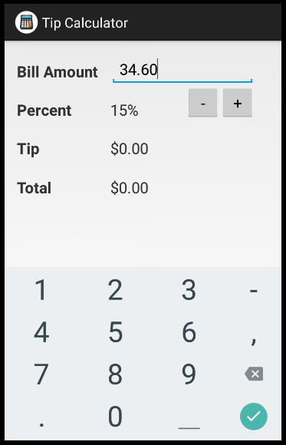
Types of Widgets
EditText widget (editable text view)
Button widget (button)
TextView widget (text view)

Slide 15
Common Widget Properties

Slide 16
Density Independent Pixels
Screens can have different pixel densities (DPI). If you define layout dimensions using pixels, screens with the same size, but different pixel densities, will have different sized layouts.
Therefore, when specifying dimensions, always use either dp or sp units.
A dp (density-independent pixel) corresponds to the physical size of a pixel at 160 dpi.
An sp (scale-independent pixel) is a dp that is scaled by the user's preferred text size.
Notes:
DPI – Dots Per Inch

Slide 17




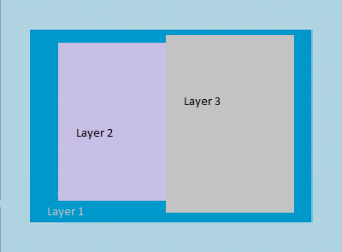
Types of Layouts (Widget Containers)
Linear Layout
Relative and Constraint Layouts
Table
Grid
Frame
Notes:
Build a Responsive UI with ConstraintLayout
https://developer.android.com/training/constraint-layout/index.html

Slide 18
Common Layout Properties
© 2015, Mike Murach & Associates, Inc.

Slide 19
Strings Resource
Define named text strings
Useful when the same text string is used in multiple places.
Useful for localization, different files can be used for different languages

Slide 20
Strings File for the Tip Calculator
<resources>
<string name="app_name">Tip Calculator</string>
<string name="action_settings">Settings</string>
<string name="bill_amount_label">Bill Amount</string>
<string name="bill_amount">34.60</string>
<string name="tip_percent_label">Percent</string>
<string name="tip_percent">15%</string>
<string name="increase">+</string>
<string name="decrease">-</string>
<string name="tip_amount_label">Tip</string>
<string name="tip_amount">$0.00</string>
<string name="total_amount_label">Total</string>
<string name="total_amount">$0.00</string>
</resources>
Notes:
In Android studio, look at the XML layout to see how these are used.

Slide 21
Exercises
Do Exercise 2 - 1 in the textbook
In this exercise you will modify an app based on the Blank Activity template.
Do Exercise 2 - 2 in the textbook.
Make the UI for an Invoice app that is very similar to the Tip Calculator app.
Notes:
In Android studio, look at the XML layout to see how these are used.

Slide 22
Lab 1
Review the instructions for the first lab assignment. Start making the lab 1 app today.
Notes:
In Android studio, look at the XML layout to see how these are used.

